Slide 1
Service environment
© Leonard Walletzký, 2024
Introduction to Service Science

Slide 2
The elements of service system
Provider
Individual
Organization
Any of previous combined with the technology and/or piece of environment
Technology that provider is responsible for
Client
Individual
Organization
Any of previous combined with the technology and/or piece of environment
Portion of reality owned by Client
Target
The reality to be transformed or operated on by Provider for sake of Client
People, dimensions of business
Dimensions of products, technology artefacts & environment
Information, codified knowledge

Slide 3



Value proposition
Forms of relationship
value co-creation
value proposition
information sharing
Provider
Client
Forms of ownership
C is owner of T or
C needs an added
value on T
C must use the target
to get the value
Forms of responsibility
P is responsible for
the actions with T
P transforms target to
bring the value
Target

Slide 4
Mention - Use
Forms of relationship
value co-creation
value proposition
information sharing
Provider
Mention
Client
Mention/Use
Forms of ownership
C is owner of T or
C needs an added
value on T
Forms of responsibility
P is responsible for
the actions with T
Use
Target

Slide 5
Mention - Use
Provider plans the actions
on target based on
the communication
with client
Provider
Mention
Client
Client gets the value
through usage of target
(value in use)
Mention/Use
Use
Target

Slide 6
Value
Value proposition is hidden
is hidden by the hill
Hierarchy of barriers hiding the target
have to be overcame step by step
leads to process of value estimation
Value can not be proposed
It can be only estimated
is used to find value proposition
there is not a target, only target area
target area is the space of all sub-targets, corresponding with particular value estimation

Slide 7
Value estimation
modified by the value co-creation process
motivated by the decreasing of the level of information asymmetry of both parties
the process is about particularize of value estimations
till the moment of founding the value proposition

Slide 8
Value proposition
can be found in the moment client and provider can see the target
share the same point of view
both can see the utility level
and share as well
both partners agree with concrete mutual criteria of success
variables to test
no of customers
profitability
target values
number of customers rise of 30%
profitability rises more than 10%

Slide 9
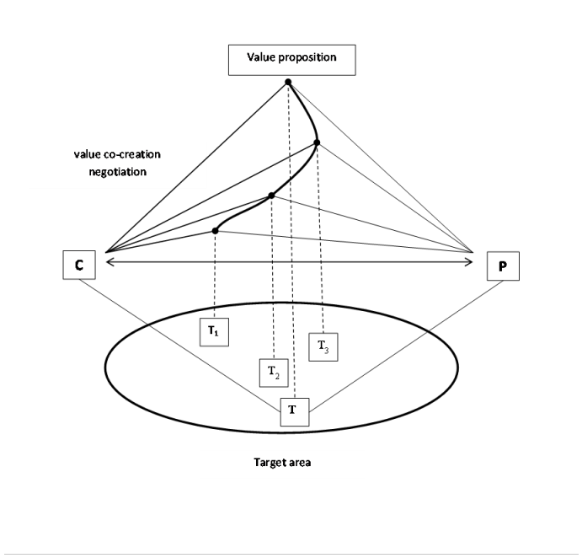
Value proposition

Slide 10
Costs of value estimation
must be shared and paid
problem is complex
must be understood and explored
provider must be paid for using his sources to do it
Client is paying for the analysis of the target area

Slide 11
System complexity
Provider, Client or Target may contain one or more service systems
Those service systems need to cooperate in some way
The cooperation between those service systems is also service system
If they are not a simple person or technology
They can be organization, more complex entity etc.
Technology with the community of developers
It must be organized in synergy
Some services must be finish first, some in the specific order etc.

Slide 12
Service system
Forms of relationship
P
C
P
C
T
T
Provider
Client
Forms of ownership
Forms of responsibility
P
C
T
Target

Slide 13
The time dimension
Selling a service means a lot of preliminary work
Sold product means success
Selling a service is the beginning
Start of the service execution
Preliminary work is about
Value proposition
Service modelling
Providing services means continual development
To stabilize the service system is necessary to continue with the cooperation

Slide 14
Service system
Provider
Client
Target
Time

Slide 15
Role of time
The roles of all elements are not changing during whole life cycle of the service system
Time period of existence of a service system is not a trivial one compared to actions performed within a service provision systems
The dividing of the time and planning of the life cycle are important for the relationship client - provider

Slide 16
Example
Two companies
Software developer EasySoft
Telecommunication company Telecoco
Problem
Telecoco want to have outsourced information system, developed by EasySoft
The service system is easily created
Is there any possibility (or need) to create other service system?
And if yes, are they related?

Slide 17
Service system
Provider – EasySoft
Client – Telecoco
Target – Information system
Benefits are focused to the client
Easysoft uses its competencies to act for the sake of Telecoco
There is one more special relationship
The payment is also service system

Slide 18
Service system
Provider Telecoco
Client
EasySoft
Target
The bank account of EasySoft
The provider (Telecoco) acts on Target (send the payment) for the sake of EasySoft
This service system can not exists without the first service system

Slide 19
Service system
Secondary service system
EasySoft
Telecoco
Action based on value
in prime SeS
Telecoco
EasySoft
Inf. system
Prime service system
Bank account

Slide 20
Prime service system
Primary created service system
The roles are distributed and do not change
Creation of this service system causes the creation of next service systems
We need to analyze
The relationships between them
The possibility of influence
The causes of synergy

Slide 21
Cooperation of service systems
Lets have some service system (S1) with provider, client and target defined
We say the system S1 cooperates with system S2 if
Agent who plays the role of client in S1, plays role of provider in S2
Agent who plays the role of provider in S1, plays role of client in S2
Benefits for the client in S2 depends on benefits for the client in S1 (or vice-versa)
The target is not same

Slide 22
Service system
P1=C2
C1=P2
P2=C1
C2=P1
Action based on value
T1
T2

Slide 23
Example of cooperation – internships on FI
Client
Wants to have properly educated students
Provider
Has abilities to educate the students
Target – study programs with internships
Provides the students
A business partner
Faculty of informatics

Slide 24
Cooperating service system
Internships projects
For the successful study program faculty needs
Practice – an internships with quality emphasis
Mandatory for every student enrolled in the program
Client
Demand the internships positions for the students
Provider
The company
Offers the positions for the students
Faculty of informatics

Slide 25
Cooperating service system
The target
The study programs
Students are „only“ the products of the study program
Faculty wants to improve the study program
Through the internships
Using the feedback from the partners
In this case the target is the same in both cooperating service systems

Slide 26
Dual service system
Let's have the prime service system S1
Let's have a second service system S2, where
Agent who plays the role of client in S1, plays role of provider in S2
Agent who plays the role of provider in S1, plays role of client in S2
Benefits for the client in S2 depends on benefits for the client in S1 (or vice versa)
Target is the same in S1 and S2 with the bidirectional value proposition

Slide 27
Dual service system
P1=C2
C1=P2
P2=C1
C2=P1
Action based on value
T1
T2

Slide 28
Service system environment
Are there any other possibilities of the cooperation?
What to do if
Client or Provider in one service system plays the role of of the Client, Provider or Target in other service systems?
If the value proposition or the benefits depends on other related service system?
Company is able to pay only if its customers will pay
Value proposition can be set properly only if we know all related inputs

Slide 29
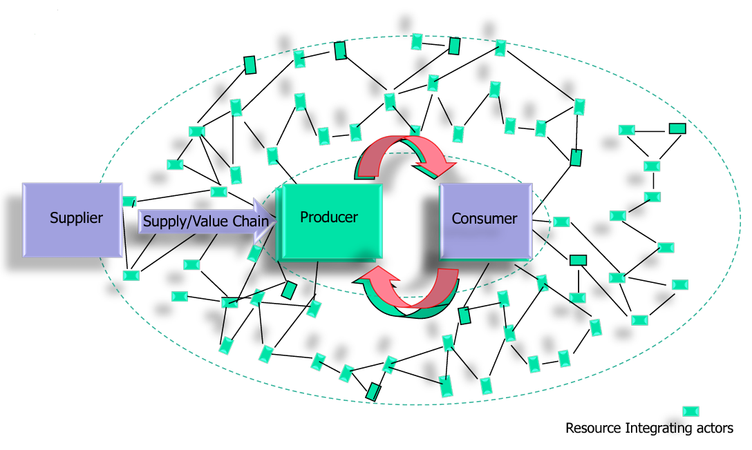
Micro exchange

Slide 30
Exchange within service ecosystems
S. Vargo: Service-Dominant Logic: Foundations and futures, 2018, presentation on Research seminar at Karlstad University

Slide 31
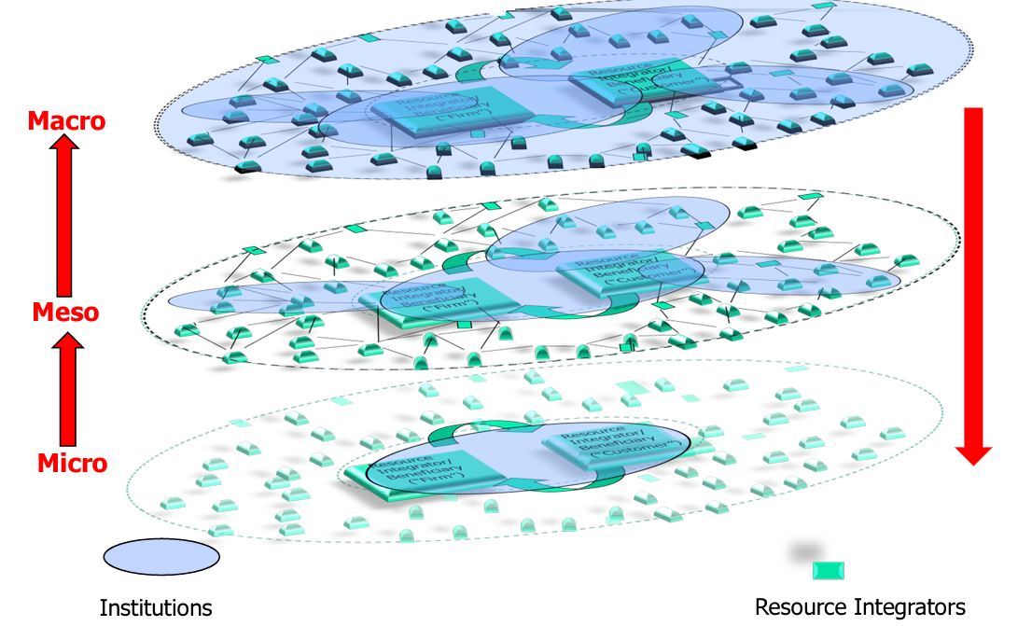
Structuration of service ecosystems
S. Vargo: Service-Dominant Logic: Foundations and futures, 2018, presentation on Research seminar at Karlstad University

Slide 32
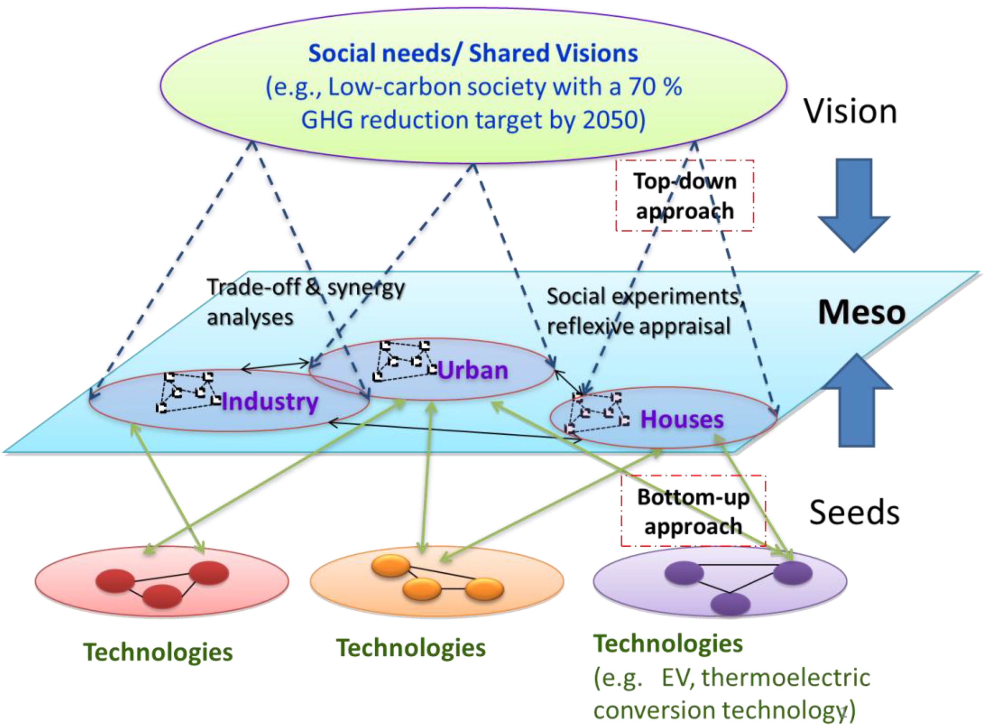
Service system environment
Hara, K.; Uwasu, M.; Kobayashi, H.; Kurimoto, S.; Yamanaka, S.; Shimoda, Y.; Umeda, Y. Enhancing Meso Level Research in Sustainability Science—Challenges and Research Needs. Sustainability 2012, 4, 1833-1847. https://doi.org/10.3390/su4081833

Slide 33
Service system environment
During negotiations must be explored not only the target, but also all important relation
Cooperating service system
Dual service system
Service environment

