Slide 1
Smart City and complexity
Leonard Walletzký

Slide 2
When we want to speak about smart city
Definition of Smart City
Role and design of Services within the Smart City
Modeling the services
Notes:
Napsal bych "úloha a návrh služeb". Ty dva poslední body jsou jasné, ale proč ten první? Zdůvodnit.

Slide 3
Definition of Smart City
Why do we need „correct“ definition of Smart City?
Many cities claim to be smart
Obviously, the implementation of ICT plays key role in city „smartness“
Smart City Council definition:
A smart city is one that has digital technology embedded across all city functions
But is it just usage of ICT that does the city smart?
Notes:
Tady zase jsme u toho, co nám má přinést správná definice. Abycom měli z čeho vycházet v daším přístupu k práci na SC? Podle toho co je tady a na dalším slajdu uvedené, tak jde o roli IT v SC. Ta první definice je sice pro IT jasná ale ignruje vše ostatní, co hraje roli v SC, což ty vlastně říkáš. A tedy ty další definice jsou lepší

Slide 4
Possible definitions
Smart City is a concept that encompasses a set of advanced services, utilizing ICT in innovative ways to enable efficient city management and improve habitation, resilience, and sustainability. It aims to deliver the highest value possible to citizens and other stakeholders through an interconnected network of services. The value proposition of a Smart City (and its services) should be formulated in a clear and understandable manner for the final recipients of the service
A smart city is a place where traditional networks and services are made more efficient with the use of digital solutions for the benefit of its inhabitants and business.
European Commission definition - https://ec.europa.eu/info/eu-regional-and-urban-development/topics/cities-and-urban-development/city-initiatives/smart-cities_en
Definition, developed in SeSLab, reformulated by AI
Notes:
V slovním doprovodu bych zdůraznil, že SC je služba ICT je nástroj té služby a že, definice určuje cíle té služby

Slide 5
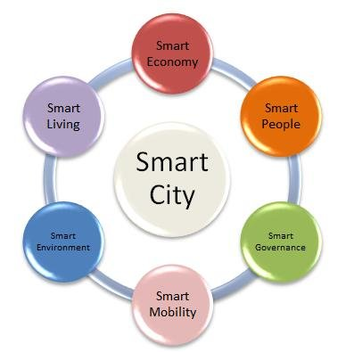
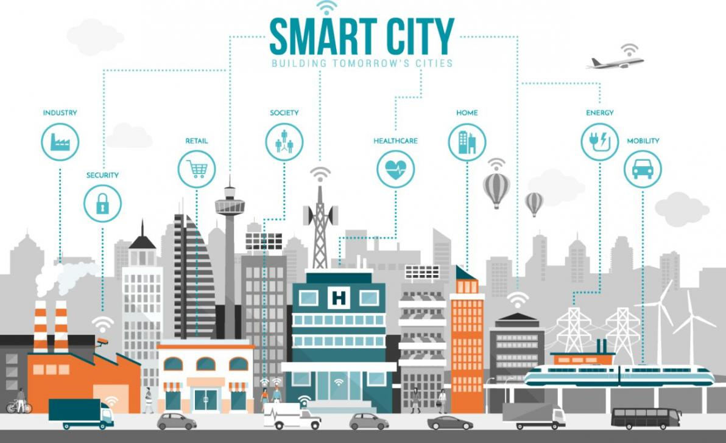
Main research questions
Do the Smart City Services have any structure?
How to design and realize Smart City services in the most efficient and complex way?
What competencies and knowledge are necessary to understand complexity of services?
What are necessary inputs, implementation processes, limits, forms of financing and other constrains to create valuable structure of services within Smart City?
How to formulate the rules to create effective, flexible and complex Smart City, fulfilling the requests of administration, citizens and other related stakeholders?
Notes:
Tady bych to úplně přeoral.Unás v moha konkrétních dílčich ípřípadech SC docela funguj. Research je jak navrhovat a realizovat maximálně efektivní a komplexní SC!!!. Ty struktury nechápu. Aby se splnil ten můj požadavek, tak je třeba znat všechny charakteristické atributy SC, vstupní požadavky, jejich zadavatele, omezující podmínnky, implementační postupy, formy financování a já nevím co ještě. Jestli toto nazýváš strukturou, tak budiš, ale posluchačům by bylo lepší to neservírovat detailně, taky to má hlubší dopad. Pak bych teprve uvedl otázku kompetencí a znalostí. I když nevím, , co jsou ty kompetence. Já bych řekl znalpsti a donednosti.A jako poslední bod bych uvedl na základě získaných a vyhodnoceých informací vytvořit pravidla pro realizaci efektivního , modifikovatelého a kompexního SC, splňujícího požadavky samospravy a vyvarujícího se možným omezením nedostatkům.

Slide 6
Smart City Services
There are many different services, used in Smart City, with different role and customers
Traffic control
Route optimization
Waste services
How are they related or connected? What tasks do they really fulfill?
We are solving a problem of complex environment
Energy grid
Camera systems
Monitoring systems
Notes:
Těch služeb je fůra , tak bych řekl, Např... Místo triviálního HW a SW bych uvedl otázky k řešení: jakou funkci plní ICT služby při realizaci SC služeb, jak jsou využívány ICT komponenty, jaké jsou impomentační postupy, je jejich využití (nasazení) optimální, nedají se lépe využít, jaké již existující postupy by se daly využít přizískání odpovědí na tyto otázky?

Slide 7

What is the complexity?
Complexity characterizes the behavior of a system or model whose components interact in multiple ways and follow local rules, meaning there is no reasonable higher instruction to define the various possible interactions
Johnson, Steven (2001). Emergence: The Connected Lives of Ants, Brains, Cities. New York: Scribner. p. 19. ISBN 978-3411040742.
https://www.intercom.com/blog/the-hidden-cost-of-design-complexity/

Slide 8
What are complex services?
Services acting in complex environment
There is not clear way how to define the process of service provision
The final value depends on
Response of customer
The resources currently used
Interaction with other entities in the environment
All services became more complex

Slide 9

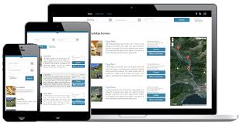
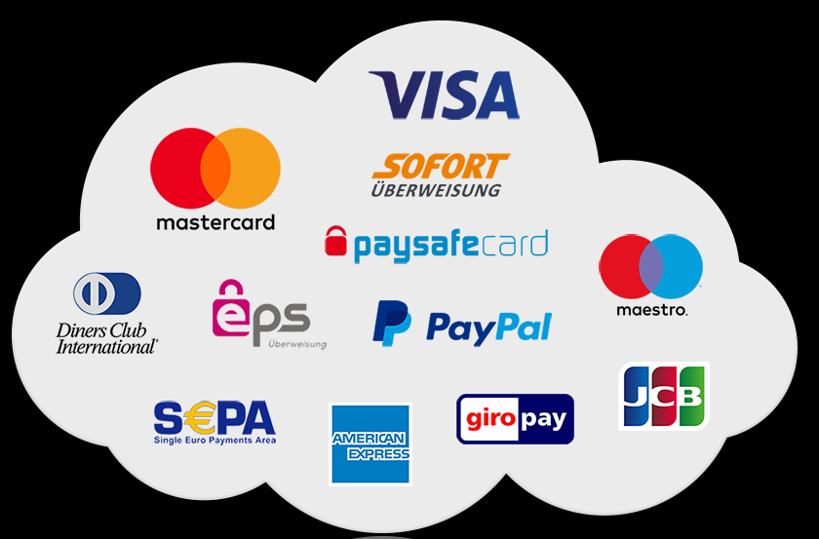
Example: Hairdresser
1960
How to use scissors and other cutting staff
2024
he basic trends in haircutting
Know the basic of marketing (how to impress the new customers and keep the present ones)
Know the basic of taxation and bookkeeping
How to get online actual data of newest trends
How to work with sophisticated software to simulate examples of the hair cutting
How to work with on-line banking to pay the bills and get the payment for services

Slide 10
Help of Service approach
IT services
Supporting services
Smart services
Smart features
The key element of all services is:
Value – usefulness or utility for the receiver of the service
Value proposition – description of the value in the language of receiver
Based on this we divided the Smart City services to the layers depending on their value proposition.
Do they serve for final user (citizen, administration) or are they just „inputs“ for other services?
Notes:
Můj první dotaz by byl – jak se odvodilo těch 5 vrstev value a value proposition

Slide 11
Value and its features
Value is considered to be an improvement in a system, as perceived by the system itself or by the ability of the system to be integrated in its environment.
Value creation takes place as a potential resource has become an effective specific benefit.
Value co-creation has a win-win logic that considers the interaction among different entities represented by various service systems and by the desire to reach collective mutual satisfaction, in which the active contribution is multiple, the integration is maximum, and complementarity is fundamental.
The contributions of knowledge, the application of skills, the ability to configure and reconfigure, and the desire to maintain relationships with long-terms subjects considered strategic all represent the elements of a systemic way of being adaptive.
Value is perceived and determined by the customer on the basis of value in use (through the previously defined consumption process);

Slide 12
Smart features
On top of the Smart Services Structure
Their value proposition is formulated for the city citizen
They are about to define the perception of Smart City
Smart Energy, Smart Mobility, Smart Environment

Slide 13
Smart Services
They support Smart Features
Value proposition is formulated in the way to be understood by Smart Features Providers
But they can be used also directly by city citizens
Than they have also the second (or more) value proposition
Smart Buildings, E-mobility, Traffic control

Slide 14
Supportive services
They are design to support Smart Services
They serve for more than one Smart Service
They have specific value proposition
Can't be understood by citizens
The formulation is more on expert level
There can be one, general value proposition for more Smart Services
Smart Grid, Smart Charging, Smart Monitoring
They are still very complex

Slide 15
Supportive IT services
Implementation of the services rely on the ICT infrastructure
In many cases the services are sharing the infrastructure
From the IT architecture perspective, we can identify two sub-categories
Hardware
Software
We need to avoid possible turbulences (overloading of the infrastructure)

Slide 16
Hardware
It represents all „tangible“ parts of Smart City infrastructure - it contains
Sensors – to measure and collect information about different devices.
Actuators – to command devices when urged by control mechanisms.
Servers – to store data and run computation and processing.
Network – to mediate communication among other elements of the infrastructure.

Slide 17
Software
OPEN DATA – they are to the development of the innovative applications, based on the datasets the city currently has.
Referred to Software IT Services
Data collection – the service of gathering different types of data from different sources (devices, sensors, etc.).
Storage – the service enabling to store the selected data for their later use and processing.
Event processing – online and offline processing of events necessary for later decision support.
Control – commanding of devices in the infrastructure (for instance to switch on/off or to update their software).

Slide 18
Layered model of Smart City
Smart Citizen
Energy
Energy
Mobility
Mobility
E-government
E-government
Environment
Environment
Emergency
Smart
Energy
E-mobility
Traffic Control
Public Transport
Features
Smart Buildings
Smart
Services
Smart Grid Monitoring
Smart Grid Maintenance
Energy2Grid
Smart Charging
Traffic
Monitoring
Route
Optimization
Management of transport
Supporting
services
Data
collection
Storage
Event
Processing
Control
software
IT services
Sensors
Activators
Servers
Networks
hardware
Walletzky L., Buhnova B., Carrubbo L. (2018) Value-Driven Conceptualization of Services in the Smart City: A Layered Approach. In: Barile S., Pellicano M., Polese F. (eds) Social Dynamics in a Systems Perspective. New Economic Windows. Springer, Cham
Notes:
Předpolkádám, že je nějaký oslí můstek s předchozím slajdem.

Slide 19
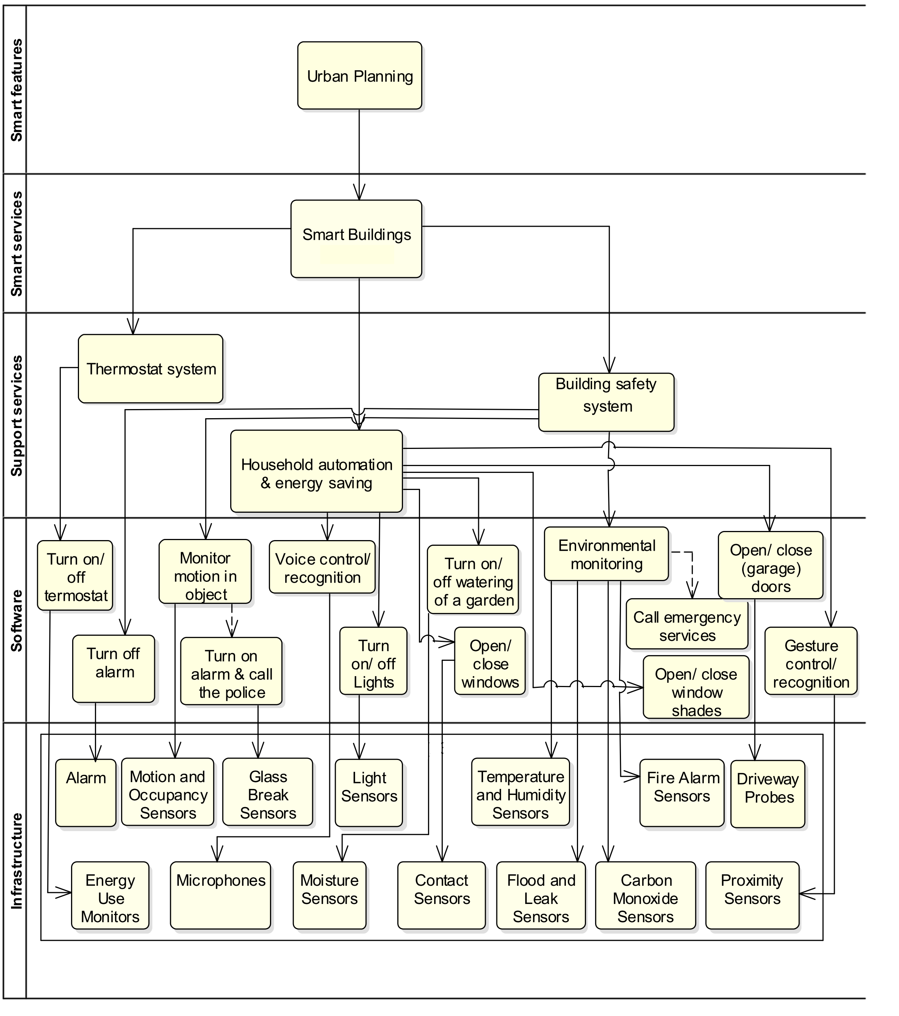
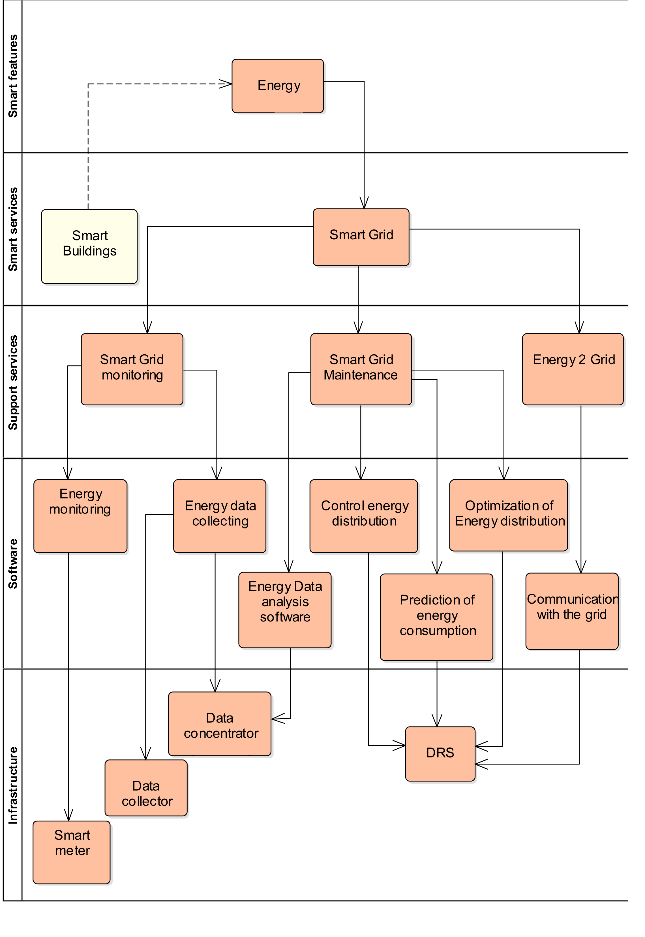
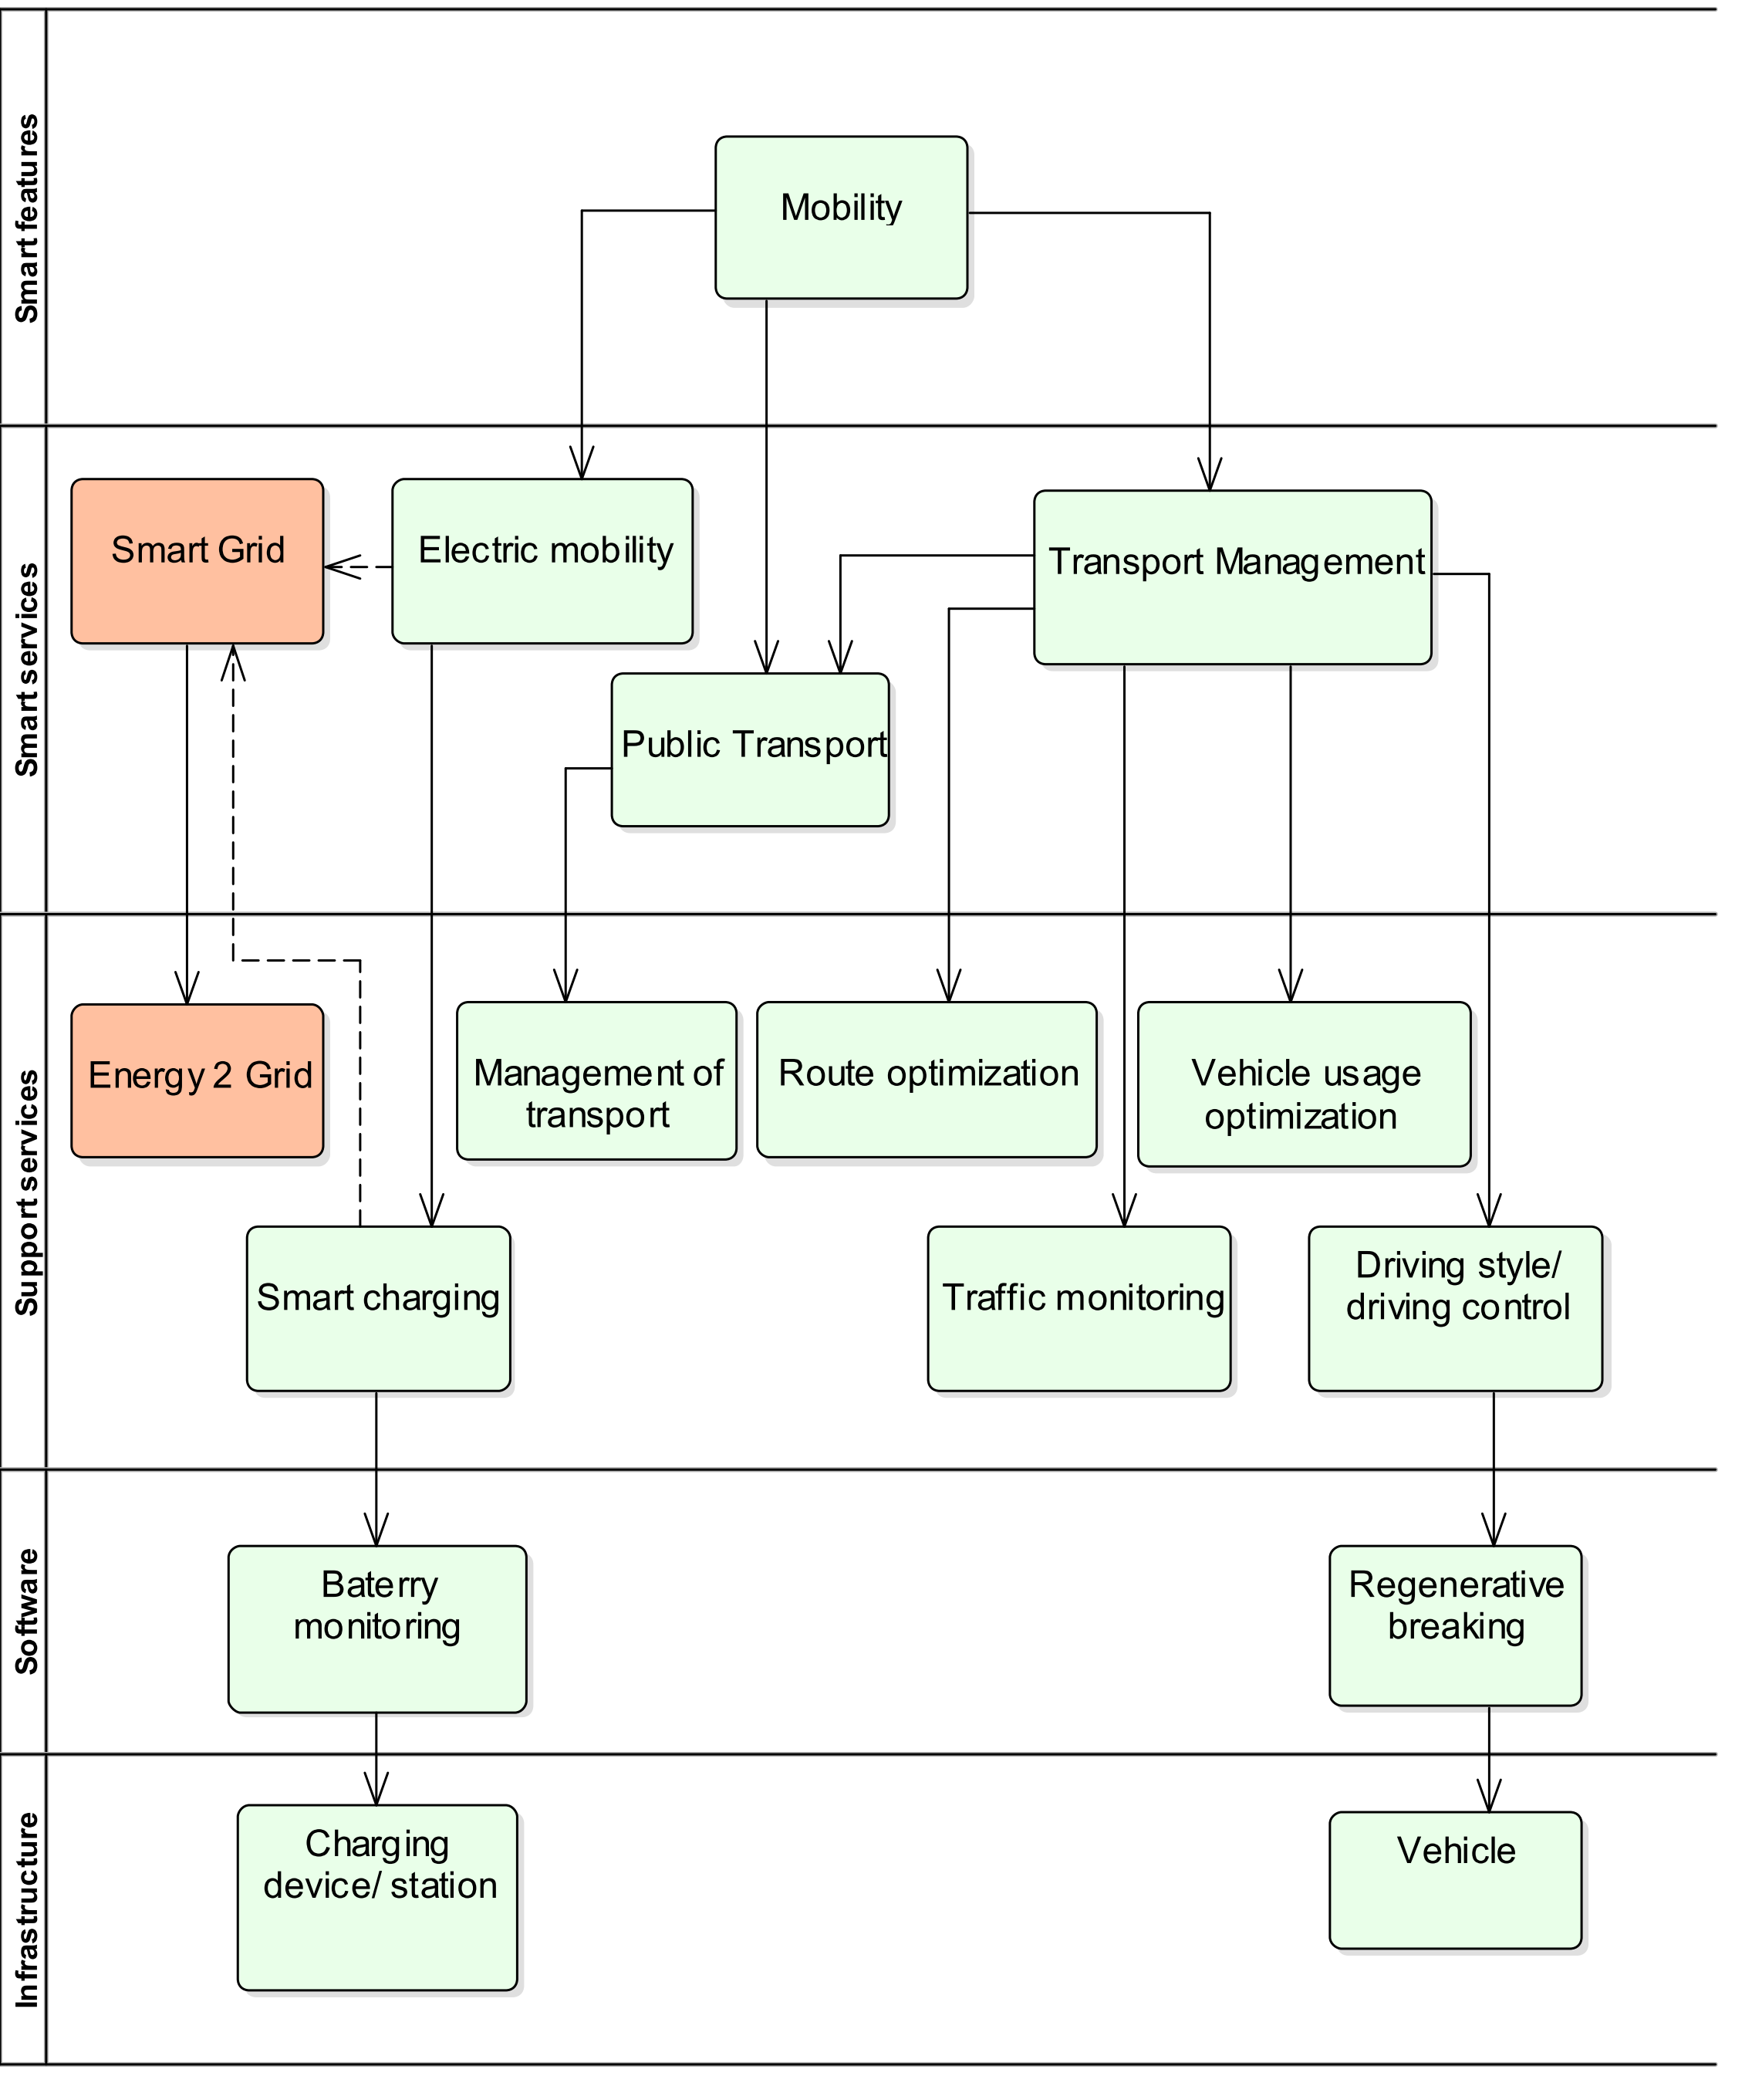
Detailed Layers‘ analysis
Urban planning
Smart Energy
Mobility
Walletzky L., Buhnova B., Carrubbo L., Kazickova, T., Ge, M. (2020) Layered Landscape of ICT and Citizen Services in the Smart City

Slide 20
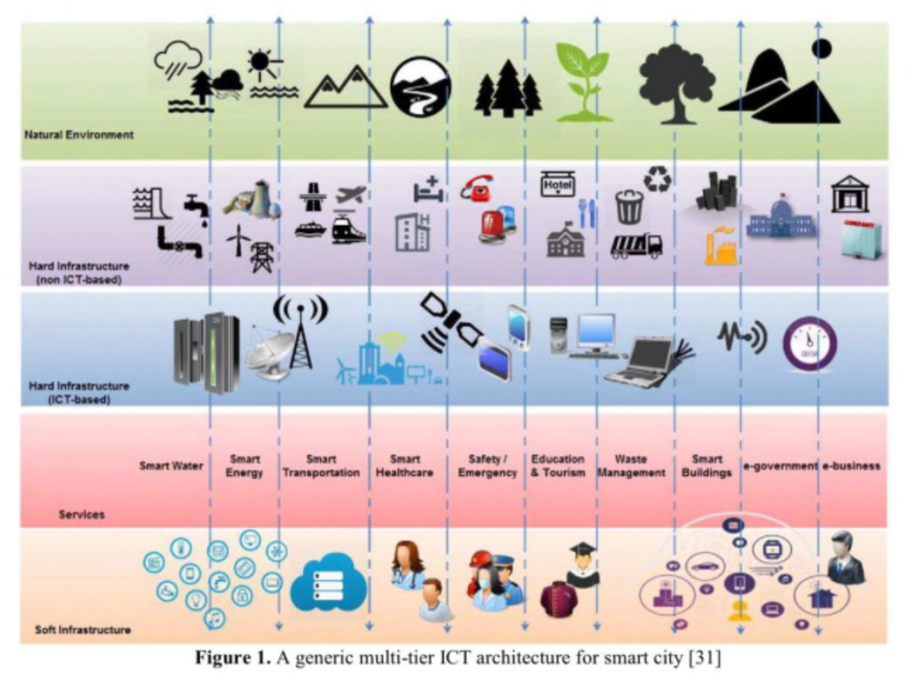
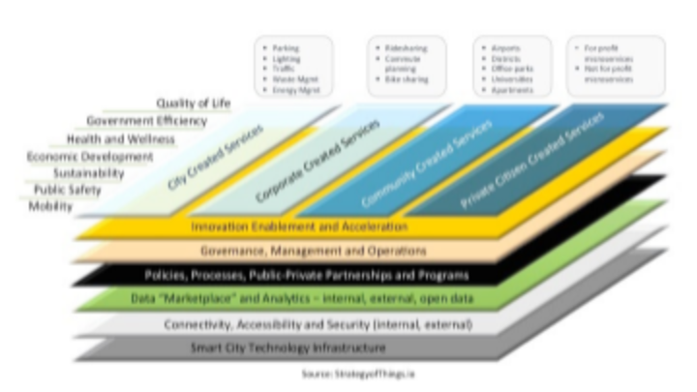
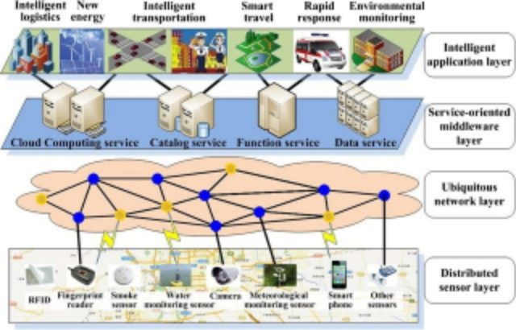
The journey continued…..
The concept of layers was not alone
The same idea was presented by multiple authors
And we have investigated a lot of models…

Slide 21
The main requests to the model
Understandable to the most of actors (common language)
Reflecting the structure and dependencies of the services
Enabling the value analysis
Multicontextual
None of the studied models (including ours) does not fit to all points

Slide 22
New developed model
Smart Features
Smart Services
Supporting Services
Infrastructure
Customer facing services
Background services

Slide 23
Why do we need such complicated structure?
To understand the relations, consequences and links is the key to avoid the risks
The source of the risk can be hidden „somewhere“ in the structure of services
The correction can have unexpected consequences

Slide 24
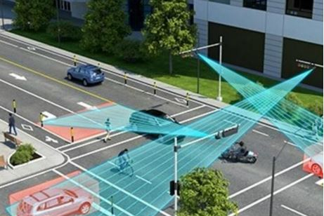
Example I. - cameras
Every city want to prevent accidets, criminality and other negative events
A lot of the cities are equipeed with the cameras (simple or with AI)
BUT
Are the cities also familiar with the risks?
Cybersecurity risks – admin password: http://www.insecam.org/en/bytype/Foscam/
The cameras can be hacked and used for penetration of the system

Slide 25
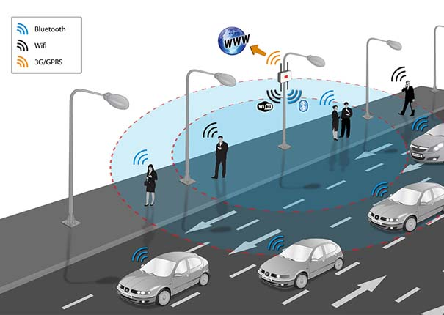
Example – Smart lightning

Slide 26
The positives are obvious
Energy saving
More installed features
Wi-Fi connection
Mobile charging
Many additional sensors for monitoring
Light is adapted to current situation
Sunrise and sunset
Nobody and nothing on the street
Self check to prevent mis functionality

Slide 27
Can we find any negative experiences?
Example I – Install when you are ready
One Czech city decided to use the government support to change really old equipment of public lightning to the completely new devices. They select the company and ordered smart lightning, equipped also with sensors, monitoring the air pollution, noise, and other aspects of city life. All devices were already support for Wi-Fi and there were no needs for additional investment to the infrastructure.
After installation they found they are not getting any data during a day. Why it was possible?

Slide 28
Explanation
The new public lightning was connected to the old infrastructure and it was automatically turned on only during a night. During a day it was automatically turned off with no power.
The city had to invest more money into new infrastructure – it was necessary to change everything including wires.
The official start of a new technology was postponed for 2 years.

Slide 29
Ok, but if we have a good infrastructure….?
Example 2 – Sometimes Smart is not enough….
In another Czech city the smart lightning was installed, including completely new infrastructure. Everybody was exited. The lights were lowering and increasing the intensity of light according of pedestrian or car presence on the street.
After some time a several accidents happened on the streets. The car drivers could not see the pedestrians and bikers on time.
All participants and witnesses reported a very slow or delayed response of lamps
After a year the city changed smart laps back to „silly“ lamps

Slide 30
Explanation
The lamps were equipped with movement sensors to increase the light intensity when the car was coming
The problem was that they assumed the car speed will be not higher than 50 km/h. But, especially during the night, it was.
The lamps were not able to react on time for higher speed and turned on after the car was gone
Nobody analyzed the situation before and there were no will correct it after

Slide 31
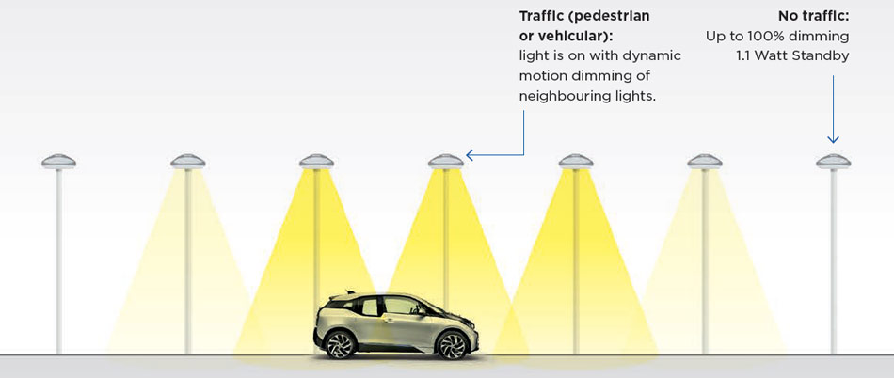
Possible sollution
In other Czech city they solved situation in different way
They cooperate with innovative statup to create software to enable the lamps to communicate with each other
They created solution when the lamp can inform the others the car is coming, can measure its speed and if it is over the limit, inform the police
The effect was that the accidents simply disappeared.

Slide 32
Conclusion
Smart City is more complex and complicated environment than we expected
Design of the services within the Smart City is complicated and hard to manage, there are many stakeholders with different goals and interests
Some consequences are hard to find
They would appear in other context
Improvement in one context leads to the failure in another (f.e. overload of infrastructure)
The competencies and knowledge needed for the Smart City Service design needs to investigated
The main goal is to ensure easier and more efficient way of the Smart Services design and realization

Slide 33
Sources
STANÍČEK, Zdenko. SSME* - Service Systems, Modelling, Execution, Education, Evaluation [online]. Brno, 2009. available at: https://seslab.fi.muni.cz/media/3277865/ssmestar_manuscript.pdf. Manuscript. Masaryk University, Faculty of informatics.
Walletzky, L., Carrubbo, L., Mouzhi, G. - "Exploring complex service design: Understanding the Diamonds of Context„, Naples Forum on Service, 2019
Walletzky, L., Carrubbo, L., Mouzhi, G.: Modelling Service Design and Complexity for Multi-contextual Applications in Smart Cities, ICSTCC konference proseedings, 2019
Caputo, F., Walletzky, L., Ge, M., Carrubbo, L.:Combining the pillars of the Naples forum on Service: a multi-dimensional constructive tool, Naples Forum on Service, 2017

