Slide 1
Asymetric information
Introduction to Service Science
© Leonard Walletzký, 2024

Slide 2
What is the information?
In common language
Knowledge to be presented, content of the message, answer to a question
In science
Data on the properties, setting and arrangement of the object
In informatics
Coded data that can be sent, received, saved and processed by technical equipment

Slide 3
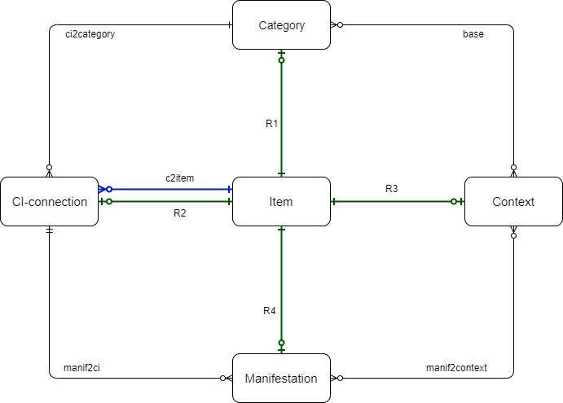

Examples of manifestation of DATA
IT
is any sequence of one or more symbols given meaning by specific act(s) of interpretation
Common understanding
individual units of information.
Star Trek
A character

Slide 4
Economics view to information
Till 60s of 20th century
Information are „perfect“
All parties have same access to the information
Information are public goods
Some authors mentioned marginal problem to access information (Smith, Marshall, Keynes)
1961 – George Stigler – Economics of information
Information is valuable source
First try to set the price mechanism

Slide 5
Economics of information
Perfect information
All participants of the game can see the cards of others as well as the undistributed cards in the package
Incomplete information
All participants have the same information, but no-one has information advantage
All participants can see cards of the others, but undistributed cards are hidden
Asymmetric information
All participants can see only their cards
Some information is private

Slide 6
Economics of information
The game theory – one of the sources of analysis
Imperfect information
One player does not know the behavior of the others
Incomplete information
One or more players do not know one or more aspects of the game rules, necessary for their decisions

Slide 7

Stigler's model
Seniors game
Where to buy a particular good for the cheapest price
Assumptions
The buyer knows all shops, where he can buy this product
The buyer does not know the prices in the shops
The buyer is willing to invest some costs to find the information about the cheapest price
The amounts of those costs are limited
What do we do now to solve this problem?

Slide 8
The searching costs
The valuation of the time, needed for the finding of the information
The costs for the searching must be same or less than expected profit
Conclusions
The costs for the searching are individual
The reduction of the problem to the price difference is wrong
The value is also important
The analysis of the problem is too simple
IT rapidly decline the searching costs

Slide 9
Quality of information
If you are buying some product or services, how you can be sure about its quality?
Guarantee
Insurance for the product failure
Impulse for the producer to improve the quality
Has information value – indicator of the product quality
Direct influence to the producer reputation
Selecting (extended) guarantee can be used for the customer discrimination

Slide 10
Moral hazard
a tendency to take undue risks because the costs are not borne by the party taking the risk
The customer is able to affect an event he is insured against, but the seller has no power to monitor or affect this event.
Insurance company do not know how you use your car
ERP supplier has limited information about customers IT security
Double moral hazard
Supplier gives only limited or minimal guarantee
Customers information about product quality is limited

Slide 11
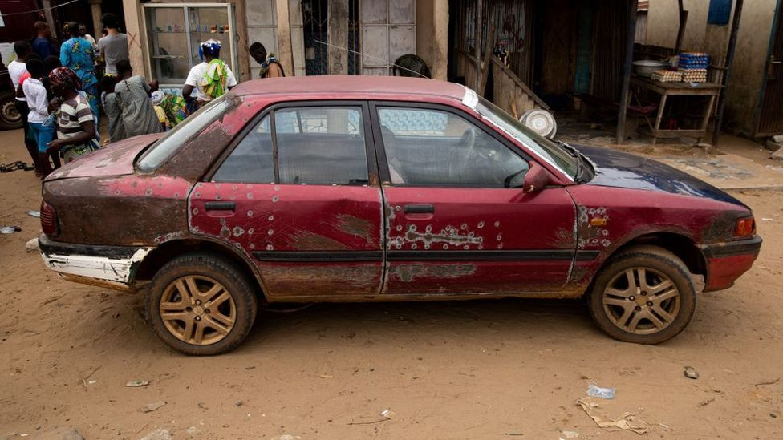
The market of Lemons
Author G. Akerlof
Lemon = used car
Main assumption
Every used car has hidden defect
If it would not have, the owner should use it instead of selling it
The owner of the good car is not motivated to sell the car
The quality of used cars on the market is very low

Slide 12
Conclusion for Lemons market
The price for the comparable cars will be the same
The buyer has limited possibilities to recognize the real quality of the car
If the quality of offered cars would drop under level of the price, the market would be empty
Solutions of Lemons market
The way how to deal is to create informed customer
If customer knows how to distinguish the quality, he will be able to make a business
There is still place for selling „lemons“ to less informed customers

Slide 13
Auctions models
A holder sells a special kind of product or good (art)
Not able to estimate the value for the buyer to declare a price
Someone can be willing to pay more
A customer buys a unique kind of the service
Not able to estimate the real costs to declare a price
Someone is willing to deliver the service cheaper
Solution
Move the asymmetry to the other part of market

Slide 14
Types of auctions
With common value of the product
Each participant has his own evaluation of the product
Participants do not know the valuation of others
With independent private value of the product
There is only one objective value of the product
Nobody knows it

Slide 15
Auctions with common value
English auction
The price grows according to the orders
The highest price wins
Dutch auction
The price is set on the highest lever
The price is reduced
The first call wins

Slide 16
Auctions with independent value
Closed auctions
The offers are given before
the first price auction
The highest or the lowest price wins
The second price auction
The highest and lowest offer are excluded
The second highest or lowest offer wins

Slide 17
Information gap
Subjects on the opposite sides of the market have a different information about the subject of exchange
Seller has better information about the car
The insurance company must trust in its clients responsibility
Information gap is the difference between two subjects on the market
Is positive – if the subject knows the information
Is negative – if the subject does not know the information

Slide 18
Information gap
Moral hazard – effect when the activity of one subject decreases the utility of the second subject concurrently with information gap on side of the second subject
Information gap is not stable
Examples
Try to find an example of the information gap you have met

Slide 19
How to fit information gap?
Filling the gap
By distribution of the information?
Removal of subject‘s disadvantage, based on nascence of particular information
Subject must be willing to invest to filling of the gap
The first condition is to identify the gap
The filling is the function of time
Questions
How will the subject fill the gap?
Can the gap be filled by itself?

Slide 20
Filling the information gap
Absolute
The information are distributed from one side to the other
Example
Register of insured persons
To know a history of new client
Register of debtors
To eliminate to risky clients
Subjects facing negative gaps can join even if they are competitors

Slide 21
Filling the information gap
Relative
If there is no way how to get the information
Example
Bankrupt of travel agency
The client has no power nor possibility to find the information
Solution is mandatory insurance of travel agency
The client does not need to take care about travel agency finance
Mandatory car insurance
Relative filling is the eliminating of the gap’s influence

Slide 22
Role of IT
IT is a service to:
fill the gap – to distribute information
To eliminate the gap – using IT services to interconnect subject with negative effects of a gap
Manage the information
To prevent the influence of the gaps
To eliminate the gaps

Slide 23
The price of information
Is almost individual
It is equal to the searching (opportunity) costs
It is important to divide the price of information and the price of access to information
To buy the possibility to search
To buy a possibility to share information
The question of technology
Higher speed means higher probability to find what I am looking for

Slide 24
Technology progress
costs
B
A
N
T
T₂
speed

Slide 25
Government and information
It needs the information for making of the decisions
It is important source of information
It is supervisor on the market with information

Slide 26
Government as the information receiver
The most of analysis is done by
state institutions
ministry clerks
National bank
The government is the source of information for itself
The analysis can be wrong
The decisions can be wrong – moral hazard
The question of time

Slide 27
The government and searching of information
Where is the equilibrium of searching?
Stigler model does not work
The process of searching is excluded from the process of evaluating and using of the information
The person who is searching does not know the effect
We can not be sure that the government has right information
We can not be sure the information are correct
Moral hazard
Just compare how the goverments are reaction on COVI19 pandemic

Slide 28
The government as the source of information
The government is not one source of information
The motivation of the clerks?
To publish only the information that are good for them
Moral hazard
The subjects need the information from other source to prove it

Slide 29
The government regulates the market of information
Direct influence
Problem of the identification of information gap
Absolute filling
How to do it?
Law – market subject must give some information to the register
Relative filling
Not necessary to identify a specific problem, just a group of problems
Mandatory insurance

Slide 30
The government regulates the market of information
Development of information sources and channels
Support of using services
Data mail-boxes
Digital signature
E-government
Supporting the development of the information access

