Slide 1
Understanding T-Shaped Skills
An Overview

Slide 2
Time
1960
1980
2000
2020
2040
2060
2080

Slide 3
Cost
$1,000,000,000,000
(Trillion)
$1,000,000,000
(Billion)
$1,000,000
(Million)
$1,000
(Thousand)
$1
1960
1980
2000
2020
2040
2060
2080

Slide 4
Cost of Computation (Diagonals)
$1,000,000,000,000
(Trillion)
Terascale (10¹²)
Petascale (10¹⁵)
Exascale (10¹⁸)
Zettascale (10²¹)
Yottascale (10²⁴)
Ronnascale (10²⁷)
$1,000,000,000
(Billion)
Gigascale (10⁹)
$1,000,000
(Million)
Megascale (10⁶)
$1,000
(Thousand)
Kiloscale (10³)
$1
1960
1980
2000
2020
2040
2060
2080

Slide 5
Cost of Computation (Diagonals)
$1,000,000,000,000
(Trillion)
Terascale (10¹²)
Petascale (10¹⁵)
Exascale (10¹⁸)
Zettascale (10²¹)
Yottascale (10²⁴)
Ronnascale (10²⁷)
$1,000,000,000
(Billion)
Gigascale (10⁹)
$1,000,000
(Million)
Megascale (10⁶)
Kiloscale (10³)
$1,000
(Thousand)
$1
1960
1980
2000
2020
2040
2060
2080
Note: Adjust Kilo and Mega scales slightly to fit data better (early days – more cost – learning curve).

Slide 6
Estimating Knowledge Worker Productivity
$1,000,000,000,000
(Trillion)
Terascale (10¹²)
Petascale (10¹⁵)
Exascale (10¹⁸)
Zettascale (10²¹)
Yottascale (10²⁴)
Ronnascale (10²⁷)
$1,000,000,000
(Billion)
Gigascale (10⁹)
GDP/Employee
Trend
$1,000,000
(Million)
Megascale (10⁶)
Based on USA
Historical Data
Year Value
1960 $10K
1980 $33K
2000 $78K
2020. $151K
2023 $169K
Kiloscale (10³)
$1,000
(Thousand)
$1
1960
1980
2000
2020
2040
2060
2080
Cost of computation goes down by 1000x every 20 years (left to right diagonals), driving knowledge worker productivity up.
Notes:
BiblioR2018 Rouse WB, Spohrer JC (2018) Automating versus augmenting intelligence. Journal of Enterprise Transformation, 8:1-2, 1-21, DOI: 10.1080/19488289.2018.1424059. URL: https://service-science.info/wp-content/uploads/2018/08/Rouse-Spohrer-Automating-Versus-Augmenting-Intelligence-12-21-17-copy.pdf Quotes: "Abstract: This article addresses the prospects for automating intelligence versus augmenting human intelligence. The evolution of artificial intelligence (AI) is summarized, including contemporary AI and the new capabilities now possible. Functional requirements to augment human intelligence are outlined. An overall architecture is presented for providing this functionality, including how it will make deep learning explainable to decision makers. Three case studies are addressed, including driverless cars, medical diagnosis, and insurance underwriting. Paths to transformation in these domains are discussed. Prospects for innovation are considered in terms of what we can now do, what we surely will be able to do soon, and what we are unlikely to ever be able to do.";
BiblioS2017 Imagination Challenge: Quantify and graph cost of digital workers and GDP per employee USA from 1960-2080. Service-Science.Info Blog Post. URL: https://service-science.info/archives/4741 Quotes: "Imagination challenge: Consider quantifying and graphing the decreasing cost of digital workers due to Moore’s Law, and increasing GDP/Employees USA from 1960 to 2080 (projected). A narrow digital worker will cost about a million dollars by 2025, and require a petascale computational system. The same digital worker will cost about a thousand dollars by 2045, and about $1 by 2065.";
If you are an entrepreneur or CEO you are excited about the drop in cost of digital workers, because that means GDP per employee will continue its exponential increase.
Source: http://service-science.info/archives/4741

Slide 7
We get the future we invest in: AI tools to experiment with today
“Service providers
will not be replaced by AI,
but trusted service providers
who use AI (well and responsibly)
will replace those who don’t.”
Every person in a role in an organization is a service provider.
Notes:
URL: https://twitter.com/tessardavis/status/1557711104071110656?s=27&t=bjhMxHur1FfzrOtkpxMdDg
BiblioD2022 Davis TR (2022)10 mind-blowing AI websites you probably didn't know existed. Tweeted from TessaRDavis (@Tessa Davis. URL: https://twitter.com/tessardavis/status/1557711104071110656?s=27&t=bjhMxHur1FfzrOtkpxMdDg Quotes: "TL;DR - 10 AI websites you probably didn't know existed:
• #1 Magic Eraser
• #2 Craiyon
• #3 Rytr
• #4 Thing Translator
• #5 Autodraw
• #6 Fontjoy
• #7 Talk to Book
• #8 This Person Does Not Exist
• #9 Namelix
• #10 Let's Enhance";
With URLs to AI tools below.
• #1 Magic Eraser - Have a great photo but with something annoying in the background? Remove it easily: https://www.magiceraser.io
• #2 Craiyon - Words to pictures: https://www.craiyon.com
• #3 Rytr - Writing tool: https://rytr.me
• #4 Thing Translator - Picture to words: https://thing-translator.appspot.com
• #5 Autodraw - Sketch to Drawing: https://www.autodraw.com
• #6 Fontjoy - Font pairings made simple: https://fontjoy.com
• #7 Talk to Book - Ask questions to 100,000+ books: https://books.google.com/talktobooks/
• #8 This Person Does Not Exist - Need a face that belongs to nobody? https://thispersondoesnotexist.com
• #9 Namelix - Need to name a project? https://namelix.com
• #10 Let's Enhance - Improve image resolutions and clarity: https://letsenhance.io
Also for "words to picture" try Stable Diffusion - https://huggingface.co/spaces/stabilityai/stable-diffusion
“Teachers will not be replaced by technology, but teachers who do not use technology will replaced but those who do. Hari Krishna Arya” From Microsoft report, “The Future Computed”
“Service providers will not be replaced by AI, but service providers who do not use AI will replaced by those who do.” Modified from Microsoft report, “The Future Computed”
BiblioM2018 Microsoft (2018) The Future Computed: Artificial Intelligence and Its Role in Society. With a foreword by Brad Smith and Harry Shum. URL: https://news.microsoft.com/cloudforgood/_media/downloads/the-future-computed-english.pdf Quotes: " “Teachers will not be replaced by technology, but teachers who do not use technology will be replaced by those who”do. Hari Krishna Arya";
Other AI powered tools –
Microsoft Word Editor
Microsoft PowerPoint word to image - and slide layout tool/slide enhancer tool
Zoom transcription conversation/meeting speech to text
WolframAlpha and other tools for solving math problems quickly
Word problem solvers are coming – see https://www.pnas.org/doi/10.1073/pnas.2123433119 (impressive progress, but also sloppy and hyped – see https://arxiv.org/abs/2208.06906)
ToolS2022 Stable Diffusion URL: https://huggingface.co/spaces/stabilityai/stable-diffusion
https://huggingface.co/spaces/stabilityai/stable-diffusion
20
BiblioS2022 Smith CS (2022) Coding Made AI—Now, How Will AI Unmake Coding? It won’t replace many coding jobs, but many coding jobs will be increasingly AI-dependent. URL: https://spectrum.ieee.org/ai-code-generation-language-models Quotes: "“I don’t believe AI is anywhere near replacing human developers,” said Vasi Philomin, Amazon’s vice president for AI services, adding that AI tools will free coders from routine tasks, but the creative work of computer programming will remain. If someone wants to become a developer, say, 10 years down the line, they won’t necessarily need to learn a programming language. Instead, they will need to understand the semantics, concepts, and logical sequences of building a computer program. That will open software development to a much broader population.";

Slide 8
Service Science
Service Science means curricula, training, and research programs that are designed to teach individuals to apply scientific, engineering, and management disciplines that integrate elements of computer science, operation research, industrial engineering, business strategy, management sciences, and social and legal sciences, in order to encourage innovation in how organizations create value for customers and shareholders that could not be achieved through such disciplines working in isolation

Slide 9
Multidisciplinarity
Any combination of curricula, training and research programs that are designed to teach individuals to apply their learned knowledge in order to encourage innovation in how organizations create value for their customers and shareholders that could not be achieved through such a disciplines working in isolation.

Slide 10
Interdisciplinarity
The term interdisciplinary is applied within education and training pedagogies to describe studies that use methods and insights of several established disciplines or traditional fields of study. Interdisciplinarity involves researchers, students, and teachers in the goals of connecting and integrating several academic schools of thought, professions, or technologies—along with their specific perspectives—in the pursuit of a common task

Slide 11
Transdisciplinarity
the intellectual framework where the nature of the manifold links among isolated issues can be explored and unveiled, the space where issues are rethought, alternatives reconsidered, and interrelations revealed.
disciplines offer a parallel analysis of problems; in the latter, disciplines offer their specific approaches and even basic assumptions, to a dialogue, in order to address complex issues together. In the case of transdisciplinarity, approaches and even methods are developed in a joint effort, something which is indeed difficult in complex societies, but very necessary

Slide 12
Understanding

Slide 13
Multidisciplinarity
I – shape
Dash – shape
T – shape
Deeply focused
Expert only in one branch
Interdisciplinary approach
Not expert, but is able to communicate with I-shapes
Multidisciplinary approach
Expert in one field, interdisciplinary in the others

Slide 14
T – shape professionals
Economics and finance
Soft and Other Skills
Management and marketing
Soft skills
Core disciplines
IT knowledge
Service Science

Slide 15
T-shape and university curricula
As universities transform curriculum in the AI era, the importance of preparing T-shaped professionals for career success is an important topic to explore
T-shaped professionals have deep disciplinary problem-solving skills and broad communications skills for improved teamwork and rapid learning of new areas
A T-shaped professional has deep expertise in one area (vertical stem of the “T”) and broad skills across multiple areas (horizontal top of the “T”)​​
T-shaped professionals have depth and breadth across six areas: Emerging technologies, work practices, developmental mindsets, academic disciplines, societal systems, regional cultures
Notes:
A T-shaped professional has deep expertise in one area (vertical stem of the “T”) and broad skills across multiple areas (horizontal top of the “T”)​​
​
As universities transform curriculum in the AI era, the importance of preparing T-shaped professionals for career success is an important topic to explore
T-shaped professionals have deep disciplinary problem-solving skills and broad communications skills for improved teamwork and rapid learning of new areas
T-shaped professionals have depth and breadth across six areas: Emerging technologies, work practices, developmental mindsets, academic disciplines, societal systems, regional cultures. This talk will provide an overview of the past, present, and future of the T shaped skills concept, with special attention to possible applications in Informatics curriculum development. ​

Slide 17
WHAT IS THE T-SHAPED ADVANTAGE?
T-SHAPED PROFESSIONALS HAVE THE ABILITY TO COMMUNICATE ACROSS BOUNDARIES, ADAPT TO MULTIDISCIPLINARY TEAMS, AND LEARN NEW AREAS OF EXPERTISE AS NEEDED TO TACKLE MULTICONTEXTUAL PROBLEMS.

Slide 18
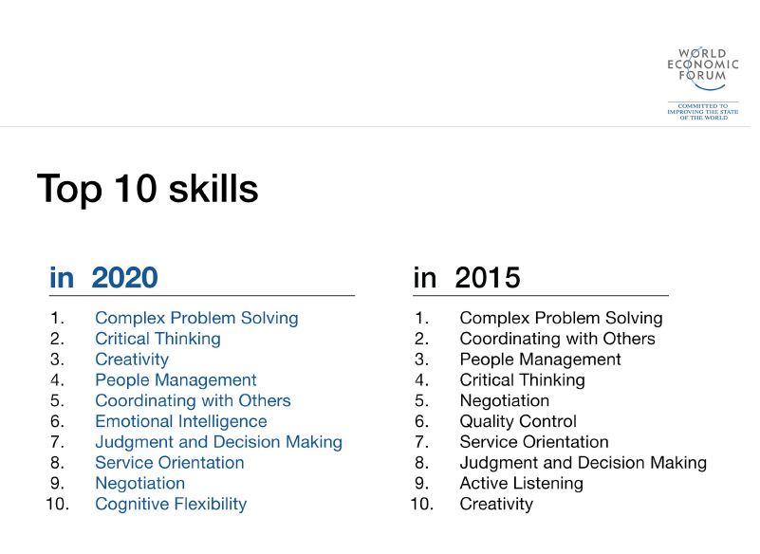

Slide 19
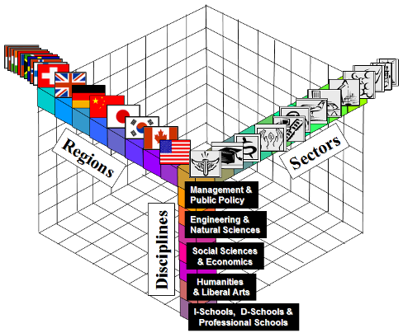
Next Generation: Future-Ready T-Shaped Adaptive Innovators
Many disciplines
Many sectors
Many regions/cultures
(understanding & communications)
Deep in one discipline
Deep in one sector
Deep in one region/culture

Slide 20
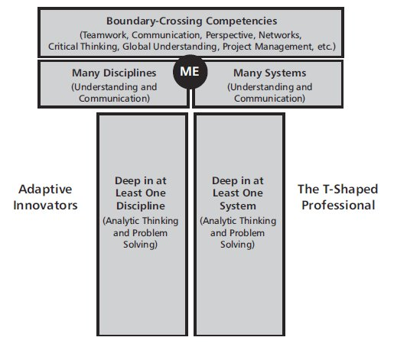
“T – Top”
Understanding and Communication
Analytic Thinking and Problem Solving
“T – Stem”
How to Thrive as IT Professionals in a Converging ICT World
Y. Moghaddam, C. Bess, H. Demirkan, and J. Spohrer
The Journal of Information Technology Management, Vol 27, 3, March, 2014.

Slide 21
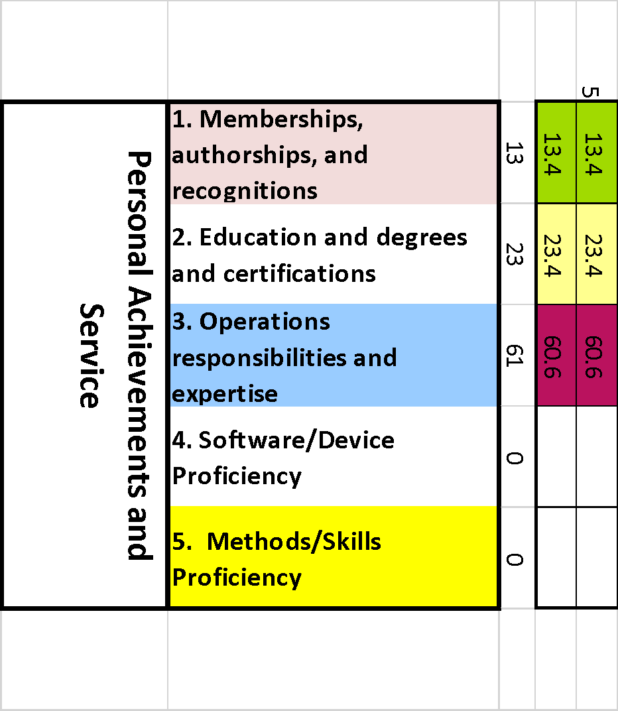
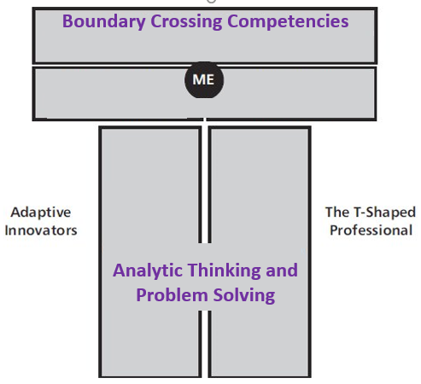
MyT-Me T-Stem Categories
Analytic Thinking and Problem Solving

Slide 22
MyT-Me T-Top Categories
*
*

Slide 23
So… MyT-Me scores your T-shape by..
using AI tools to transfer your LinkedIn® profile or resumé ….
Into this MyT-Me Framework

Slide 24
My T Me application
How does it work?
Simply provide the system with information about your activities and achievements:
Positions and responsibilities (voluntary and paid)
Education and training
“Deeds” (awards, publications, etc.)
Skills (things you can do)
Tools (things you can use)
The information can be downloaded from
your LinkedIn profile,
your professional resumé as a PDF file to the system
Or, by direct entry using easy forms to create individual records.
the MyT-Me system assigns weights to each entry based on an internal weighting algorithm.
The sums of the assigned weights become the T-Stem and T-Top metrics.

Slide 25
MyT-Me
Getting Started
Register
Link: https://getmytme.com/
Choose Get Started

Slide 26
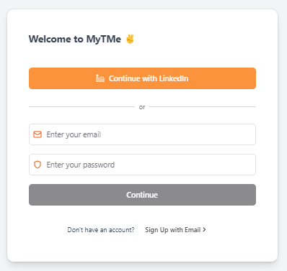

Slide 27
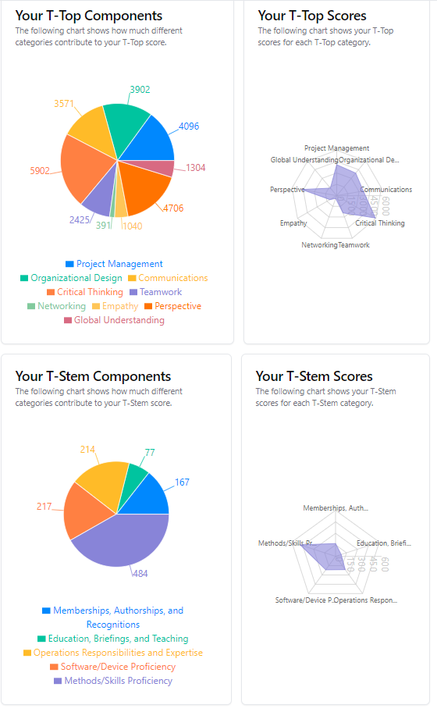
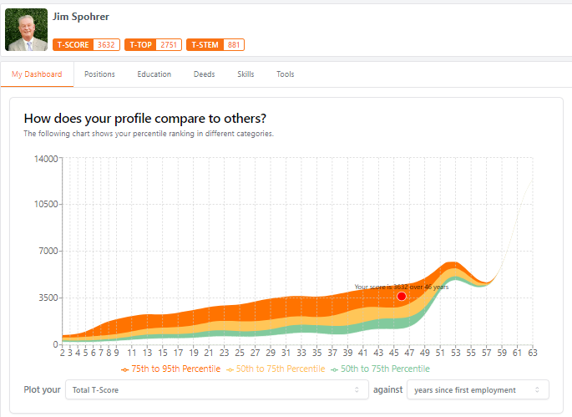
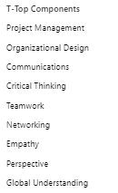
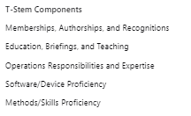
Years since…
First employment
Last education
First education
Based on over 800 ISSIP LinkedIn Profiles

Slide 28
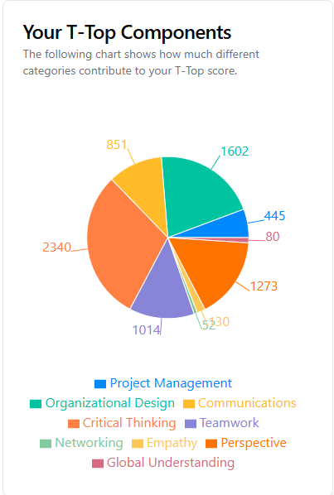
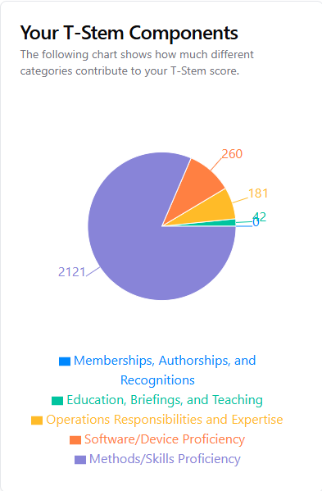
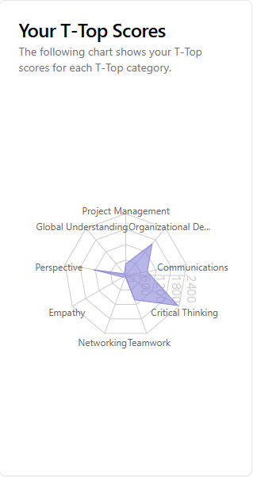
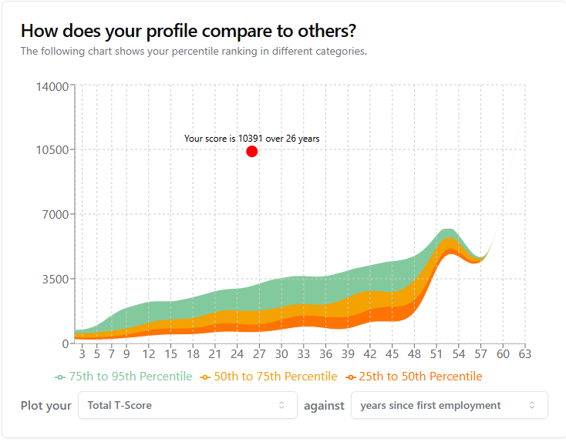

Slide 29
Conclusion
Multidisciplinary education opens new horizons for the cooperation between faculties, universities and partners
AI requires a new approach in education
T-shape is not „nice to have“ but a need for future jobs

