Slide 1
Module 12: WLAN Concepts
Switching, Routing and Wireless Essentials v7.0 (SRWE)
Notes:
Cisco Networking Academy Program
Switching, Routing and Wireless Essentials v7.0 (SRWE)
Module 12: WLAN Concepts

Slide 2
Module 12: Activities
What activities are associated with this module?
Page # | Activity Type | Activity Name | Optional?
12.1.7 | Check Your Understanding | Introduction to Wireless | Recommended
12.2.1 | Video | WLAN Components | Recommended
12.2.7 | Check Your Understanding | WLAN Components | Recommended
12.3.1 | Video | WLAN Operation | Recommended
12.3.8 | Check Your Understanding | WLAN Operation | Recommended
12.4.1 | Video | CAPWAP | Recommended
12.4.6 | Check Your Understanding | CAPWAP | Recommended
12.5.4 | Check Your Understanding | Channel Management | Recommended
Notes:
2

Slide 3
Module 12: Activities (Cont.)
What activities are associated with this module?
Page # | Activity Type | Activity Name | Optional?
12.6.1 | Video | WLAN Threats | Recommended
12.6.6 | Check Your Understanding | WLAN Threats | Recommended
12.7.1 | Video | Secure WLANs | Recommended
12.7.9 | Check Your Understanding | Secure WLANs | Recommended
Notes:
3

Slide 4
Module Objectives
Module Title: WLAN Concepts
Module Objective: Explain how WLANs enable network connectivity.
Topic Title | Topic Objective
Introduction to Wireless | Describe WLAN technology and standards.
Components of WLANs | Describe the components of a WLAN infrastructure.
WLAN Operation | Explain how wireless technology enables WLAN operation.
CAPWAP Operation | Explain how a WLC uses CAPWAP to manage multiple APs.
Channel Management | Describe channel management in a WLAN.
WLAN Threats | Describe threats to WLANs.
Secure WLANs | Describe WLAN security mechanisms.
Notes:
4
12- Introduction
12.0.2 – What will I learn in this module?

Slide 5
12.1 Introduction to Wireless
Notes:
12 - WLAN Concepts
12.1 – Introduction to Wireless

Slide 6

Benefits of Wireless
A Wireless LAN (WLAN) is a type of wireless network that is commonly used in homes, offices, and campus environments.
WLANs make mobility possible within the home and business environments.
Wireless infrastructures adapt to rapidly changing needs and technologies.
Notes:
12 – WLAN Concepts
12.1 – Introduction to Wireless
12.1.1 – Benefits of Wireless

Slide 7
Types of Wireless Networks
  Wireless Personal-Area Network (WPAN) – Low power and short-range (20-30ft or 6-9 meters). Based on IEEE 802.15 standard and 2.4 GHz frequency. Bluetooth and Zigbee are WPAN examples.
  Wireless LAN (WLAN) – Medium sized networks up to about 300 feet. Based on IEEE 802.11 standard and 2.4 or 5.0 GHz frequency.
  Wireless MAN (WMAN) – Large geographic area such as city or district. Uses specific licensed frequencies.
  Wireless WAN (WWAN) – Extensive geographic area for national or global communication. Uses specific licensed frequencies.
Notes:
12 – WLAN Concepts
12.1 – Introduction to Wireless
12.1.2 – Types of Wireless Networks

Slide 8

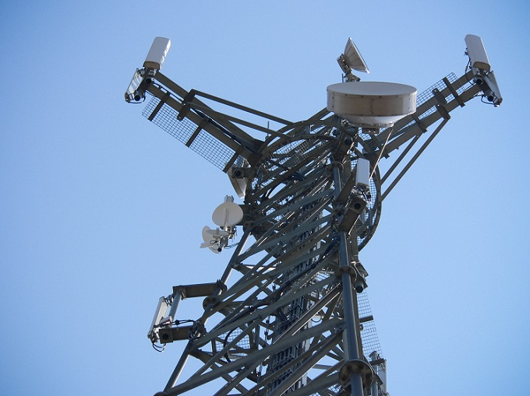
Wireless Technologies
  Bluetooth – IEEE WPAN standard used for device pairing at up to 300ft (100m) distance.
    Bluetooth Low Energy (BLE) – Supports mesh topology to large scale network devices.
    Bluetooth Basic Rate/Enhanced Rate (BR/EDR) – Supports point-to-point topologies and is optimized for audio streaming.
  WiMAX (Worldwide Interoperability for Microwave Access) – Alternative broadband wired internet connections. IEEE 802.16 WLAN standard for up 30 miles (50 km).
Notes:
12 – WLAN Concepts
12.1 – Introduction to Wireless
12.1.3 – Wireless Technologies

Slide 9
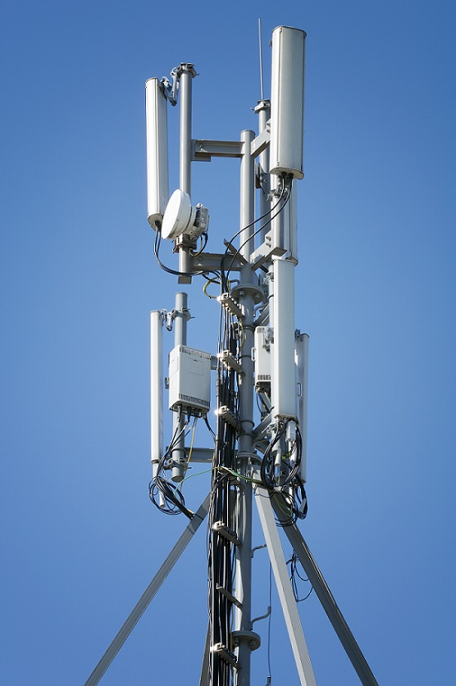

Wireless Technologies (Cont.)
  Cellular Broadband – Carry both voice and data. Used by phones, automobiles, tablets, and laptops.
    Global System of Mobile (GSM) – Internationally recognized
    Code Division Multiple Access (CDMA) – Primarily used on the US.
  Satellite Broadband – Uses directional satellite dish (talíř, miska) aligned with satellite in geostationary orbit. Needs clear line of site. Typically used in rural locations where cable and DSL are unavailable.
Notes:
12 – WLAN Concepts
12.1 – Introduction to Wireless
12.1.3 – Wireless Technologies (Cont.)

Slide 10
802.11 Standards
  802.11 WLAN standards define how radio frequencies are used for wireless links.
IEEE Standard | Radio Frequency | Description
802.11 | 2.4 GHz | Data rates up to 2 Mb/s
802.11a | 5 GHz | Data rates up to 54 Mb/s Not interoperable with 802.11b or 802.11g
802.11b | 2.4 GHz | Data rates up to 11 Mb/s Longer range than 802.11a and better able to penetrate building structures
802.11g | 2.4 GHz | Data rates up to 54 Mb/s Backward compatible with 802.11b
802.11n | 2.4 and 5 GHz | Data rates 150 – 600 Mb/s Require multiple antennas with MIMO technology
802.11ac | 5 GHz | Data rates 450 Mb/s – 1.3 Gb/s Supports up to eight antennas
802.11ax | 2.4 and 5 GHz | High-Efficiency Wireless (HEW) Capable of using 1 GHz and 7 GHz frequencies
Notes:
12 – WLAN Concepts
12.1 – Introduction to Wireless
12.1.4 – 802.11 Standard

Slide 11
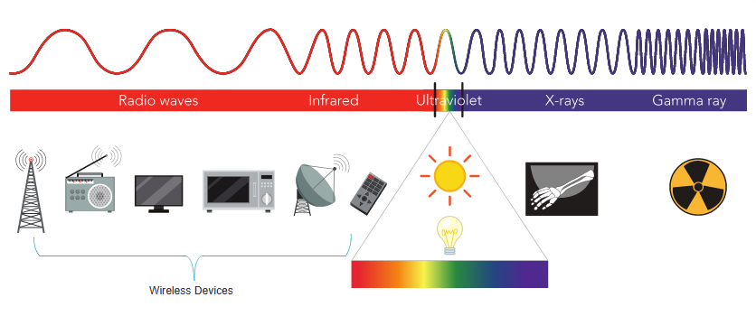
Radio Frequencies
  All wireless devices operate in the range of the electromagnetic spectrum. WLAN networks operate in the 2.4 and 5 GHz frequency bands.
  2.4 GHz (UHF) – 802.11b/g/n/ax
  5 GHz (SHF) – 802.11a/n/ac/ax
Notes:
12 – WLAN Concepts
12.1 – Introduction to Wireless
12.1.5 – Radio Frequencies

Slide 12
Wireless Standards Organizations
  Standards ensure interoperability between devices that are made by different manufacturers. Internationally, the three organizations influencing WLAN standards:
  International Telecommunication Union (ITU) – Regulates the allocation of radio spectrum and satellite orbits.
  Institute of Electrical and Electronics Engineers (IEEE) – Specifies how a radio frequency is modulated to carry information. Maintains the standards for local and metropolitan area networks (MAN) with the IEEE 802 LAN/MAN family of standards.
  Wi-Fi Alliance – Promotes the growth and acceptance of WLANs. It is an association of vendors whose objective is to improve the interoperability of products that are based on the 802.11 standard
Notes:
12 – WLAN Concepts
12.1 – Introduction to Wireless
12.1.6 – Wireless Standards Organizations
12.1.7 – Check Your Understanding – Introduction to Wireless

Slide 13
12.2 WLAN Components
Notes:
12 - WLAN Concepts
12.2 – WLAN Components

Slide 14
Video – WLAN Components
This video will cover the following:
Antennas
Wireless Router
Internet Port
Wireless Access Point
  Autonomous and controller-based access points
Notes:
12 – WLAN Concepts
12.2 – WLAN Components
12.2.1 – Video – WLAN Components

Slide 15
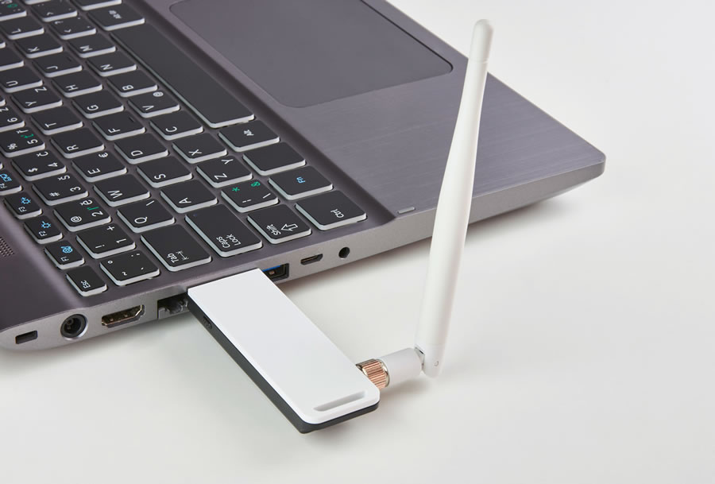
Wireless NICs
To communicate wirelessly, laptops, tablets, smart phones, and even the latest automobiles include integrated wireless NICs that incorporate a radio transmitter/receiver.
If a device does not have an integrated wireless NIC, then a USB wireless adapter can be used.
Notes:
12 – WLAN Concepts
12.2 – WLAN Components
12.2.2 – Wireless NICs

Slide 16
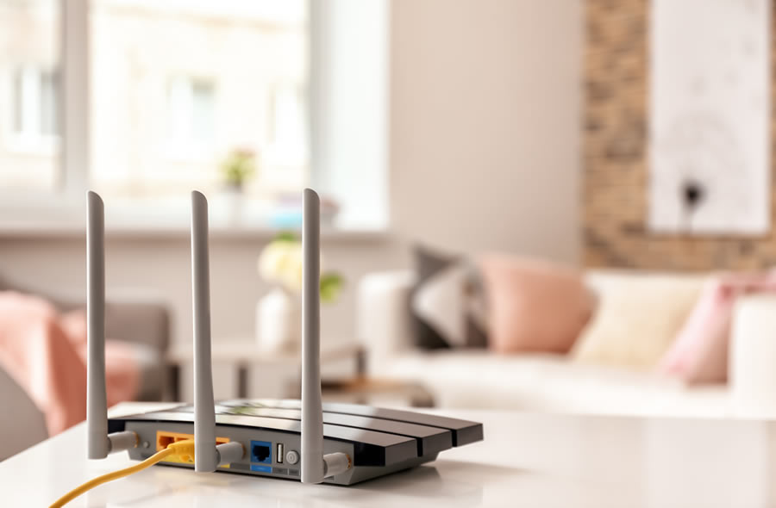
Wireless Home Router
A home user typically interconnects wireless devices using a small, wireless router.
Wireless routers serve as the following:
  Access point – To provide wires access
  Switch – To interconnect wired devices
  Router - To provide a default gateway to other networks and the Internet
Notes:
12 – WLAN Concepts
12.2 – WLAN Components
12.2.3 – Wireless Home Router

Slide 17
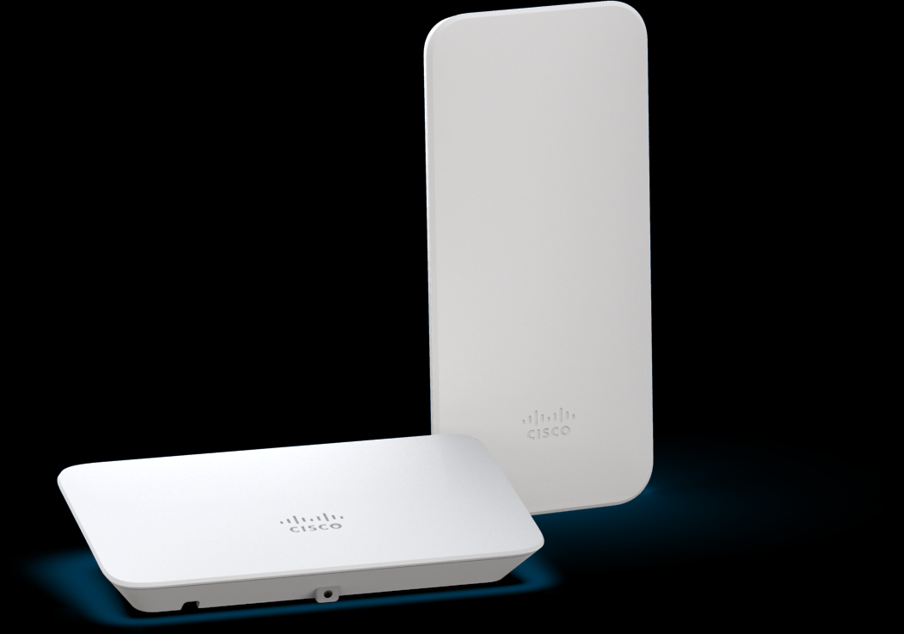
Wireless Access Point
Wireless clients use their wireless NIC to discover nearby access points (APs).
Clients then attempt to associate and authenticate with an AP.
After being authenticated, wireless users have access to network resources.
Cisco Meraki Go access points
Notes:
12 – WLAN Concepts
12.2 – WLAN Components
12.2.4 – Wireless Access Point

Slide 18
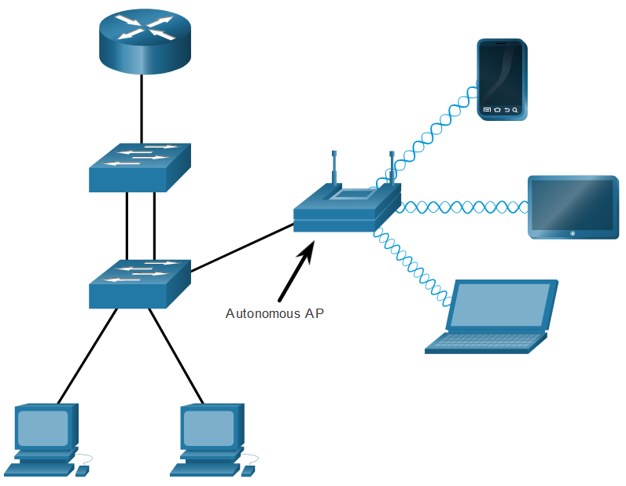
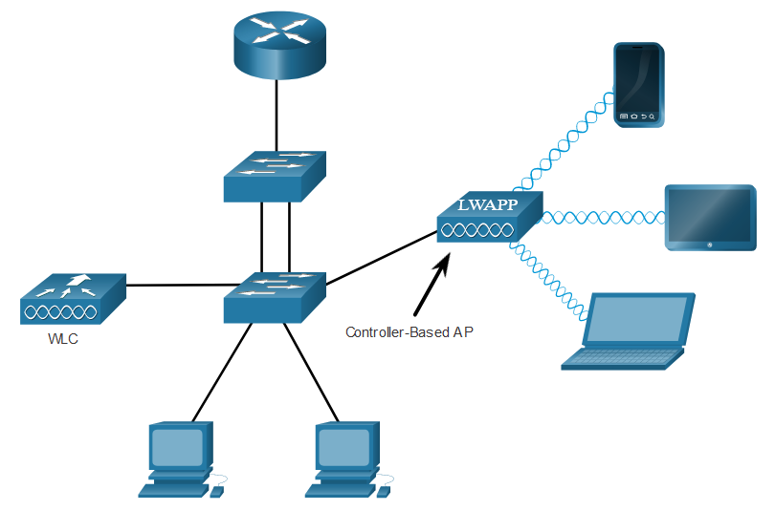
AP Categories
APs can be categorized as either autonomous APs or controller-based APs.
  Autonomous APs – Standalone devices configured through a command line interface or GUI. Each autonomous AP acts independently of the others and is configured and managed manually by an administrator.
  Controller-based APs – Also known as lightweight APs (LAPs). Use Lightweight Access Point Protocol (LWAPP) to communicate with a LWAN controller (WLC). Each LAP is automatically configured and managed by the WLC.
Notes:
12 – WLAN Concepts
12.2 – WLAN Components
12.2.5 – AP Categories

Slide 19
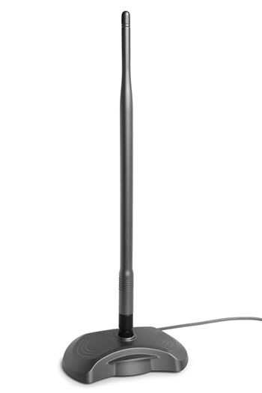
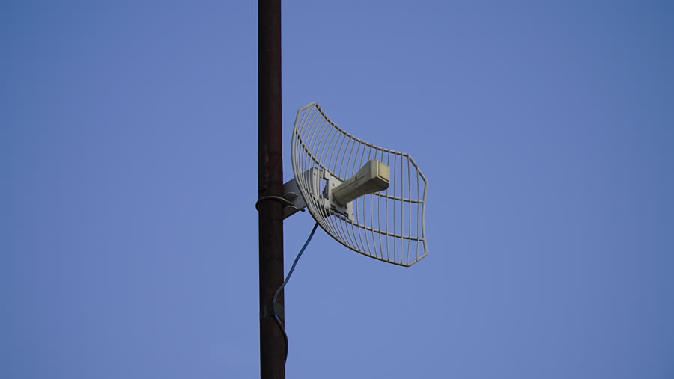

Wireless Antennas
Types of external antennas:
  Omnidirectional – Provide 360-degree coverage. Ideal in houses and office areas.
  Directional – Focus the radio signal in a specific direction. Examples are the Yagi and parabolic dish.
  Multiple Input Multiple Output (MIMO) – Uses multiple antennas (Up to eight) to increase bandwidth.
Notes:
12 – WLAN Concepts
12.2 – WLAN Components
12.2.6 – Wireless Antennas
12.2.7 – Check Your Understanding – WLAN Components

Slide 20
12.3 WLAN Operation
Notes:
12 - WLAN Concepts
12.3 – WLAN Operation

Slide 21
Video – WLAN Operation
This video will cover the following:
Infrastructure Mode
Ad hoc Mode
Tethering
Basic Service Set (BSS)
Extended Service Set (ESS)
802.11 Frame Structure
Carrier Sense Multiple Access Collision Avoidance (CSMA/CA)
Wireless Client AP Association
Passive and Active Delivery Mode
Notes:
12 – WLAN Concepts
12.3 – WLAN Operation
12.3.1 – Video – WLAN Operation

Slide 22

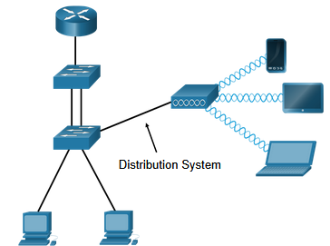
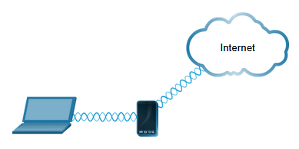
802.11 Wireless Topology Modes
  Ad hoc mode - Used to connect clients in peer-to-peer manner without an AP.
  Infrastructure mode - Used to connect clients to the network using an AP.
  Tethering - Variation of the ad hoc topology is when a smart phone or tablet with cellular data access is enabled to create a personal hotspot.
Notes:
12 – WLAN Concepts
12.3 – WLAN Operation
12.3.2 – 802.11 Wireless Topology Modes

Slide 23
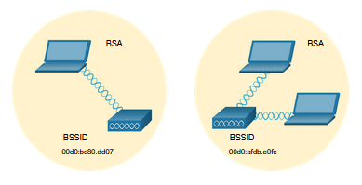
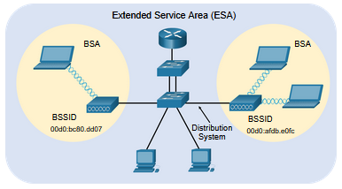
BSS and ESS
  Infrastructure mode defines two topology blocks:
  Basic Service Set (BSS)
    Uses single AP to interconnect all associated wireless clients.
    Clients in different BSSs cannot communicate.
  Extended Service Set (ESS)
    A union of two or more BSSs interconnected by a wired distribution system.
    Clients in each BSS can communication through the ESS.
Notes:
12 – WLAN Concepts
12.3 – WLAN Operation
12.3.3 – BSS and ESS

Slide 24
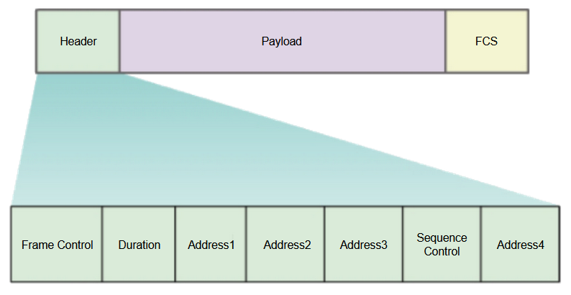
802.11 Frame Structure
  The 802.11 frame format is similar to the Ethernet frame format, except that it contains more fields.
Notes:
12 – WLAN Concepts
12.3 – WLAN Operation
12.3.4 – 802.11 Frame Structure

Slide 25
CSMA/CA
  WLANs are half-duplex and a client cannot “hear” while it is sending, making it impossible to detect a collision.
  WLANs use carrier sense multiple access with collision avoidance (CSMA/CA) to determine how and when to send data. A wireless client does the following:
  Listens to the channel to see if it is idle, i.e. no other traffic currently on the channel.
  Sends a ready to send (RTS) message the AP to request dedicated access to the network.
  Receives a clear to send (CTS) message from the AP granting access to send.
  Waits a random amount of time before restarting the process if no CTS message received.
  Transmits the data.
  Acknowledges all transmissions. If a wireless client does not receive an acknowledgment, it assumes a collision occurred and restarts the process
Notes:
12 – WLAN Concepts
12.3 – WLAN Operation
12.3.5 – CSMA/CA

Slide 26
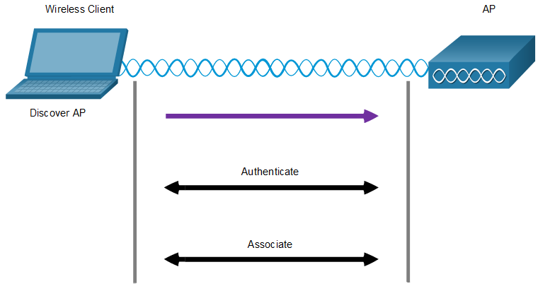
Wireless Client and AP Association
  For wireless devices to communicate over a network, they must first associate with an AP or wireless router.
  Wireless devices complete the following three stage process:
  Discover a wireless AP
  Authenticate with the AP
  Associate with the AP
Notes:
12 – WLAN Concepts
12.3 – WLAN Operation
12.3.6 – Wireless Client and AP Association

Slide 27
Wireless Client and AP Association (Cont.)
  To achieve successful association, a wireless client and an AP must agree on specific parameters:
  SSID – The client needs to know the name of the network to connect.
  Password – This is required for the client to authenticate to the AP.
  Network mode – The 802.11 standard in use.
  Security mode – The security parameter settings, i.e. WEP, WPA, or WPA2.
  Channel settings – The frequency bands in use.
Notes:
12 – WLAN Concepts
12.3 – WLAN Operation
12.3.6 – Wireless Client and AP Association (Cont.)

Slide 28
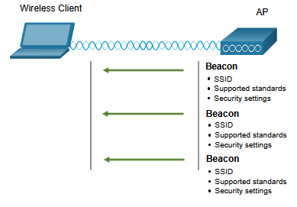
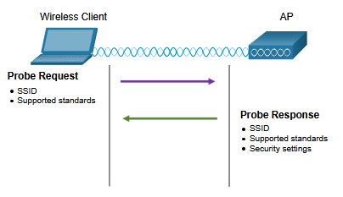
Passive and Active Discover Mode
Wireless clients connect to the AP using a passive or active scanning (probing) process.
  Passive mode – AP openly advertises its service by periodically sending broadcast beacon (maják) frames containing the SSID, supported standards, and security settings.
  Active mode – Wireless clients must know the name of the SSID. The wireless client initiates the process by broadcasting a probe request frame on multiple channels.
Passive mode
Active mode
Notes:
12 – WLAN Concepts
12.3 – WLAN Operation
12.3.7 – Passive and Active Discover Mode
12.3.8 – Check Your Understanding – WLAN Operation

Slide 29
12.4 CAPWAP Operation
Notes:
12 - WLAN Concepts
12.4 – CAPWAP Operation

Slide 30
Video – CAPWAP
This video will cover the following:
Control and Provisioning of Wireless Access Points (CAPWAP) function
Split Media Access Control (MAC) Architecture
DTLS Encryption
Flex Connect Aps
RFC 4564 defines the objectives for the CAPWAP protocol.
RFC 5418 covers the threat analysis for IEEE 802.11 deployments.
RFC 5415 defines the actual CAPWAP protocol specifications.
Notes:
12 – WLAN Concepts
12.4 – CAPWAP Operation
12.4.1 – Video – CAPWAP

Slide 31
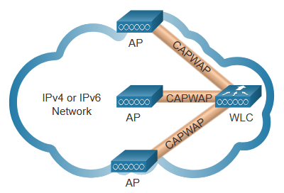
Introduction to CAPWAP
CAPWAP is an IEEE standard protocol that enables a WLC to manage multiple APs and WLANs.
Based on LWAPP but adds additional security with Datagram Transport Layer Security (DLTS).
Encapsulates and forwards WLAN client traffic between an AP and a WLC over tunnels using UDP ports 5246 and 5247.
Operates over both IPv4 and IPv6. IPv4 uses IP protocol 17 and IPv6 uses IP protocol 136.
Notes:
12 – WLAN Concepts
12.4 – CAPWAP Operation
12.4.2 – Introduction to CAPWAP

Slide 32
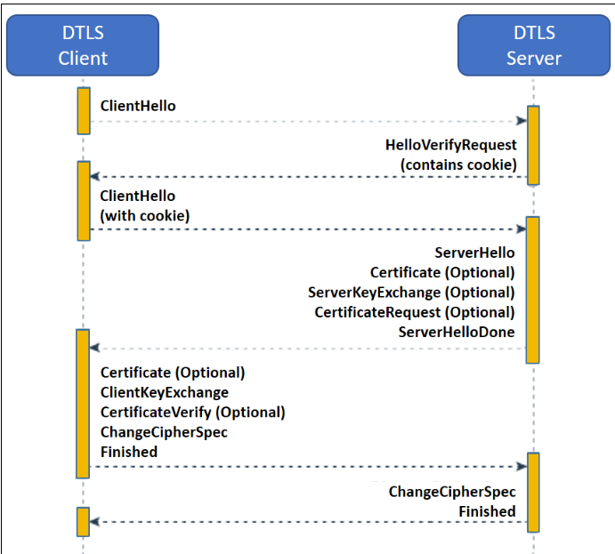
Výměna zpráv DTLS

Slide 33
Split MAC Architecture
The CAPWAP split MAC concept does all the functions normally performed by individual APs and distributes them between two functional components:
  AP MAC Functions
  WLC MAC Functions
AP MAC Functions | WLC MAC Functions
Beacons and probe responses | Authentication
Packet acknowledgements and retransmissions | Association and re-association of roaming clients
Frame queueing and packet prioritization | Frame translation to other protocols
MAC layer data encryption and decryption | Termination of 802.11 traffic on a wired interface
Notes:
12 – WLAN Concepts
12.4 – CAPWAP Operation
12.4.3 – Split MAC Architecture

Slide 34
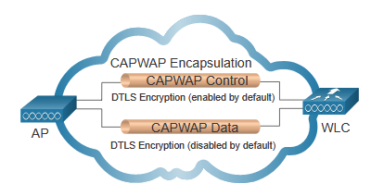
DTLS Encryption
DTLS provides security between the AP and the WLC.
It is enabled by default to secure the CAPWAP control channel and encrypt all management and control traffic between AP and WLC.
Data encryption is disabled by default and requires a DTLS license to be installed on the WLC before it can be enabled on the AP.
Notes:
12 – WLAN Concepts
12.4 – CAPWAP Operation
12.4.4 – DTLS Encryption

Slide 35
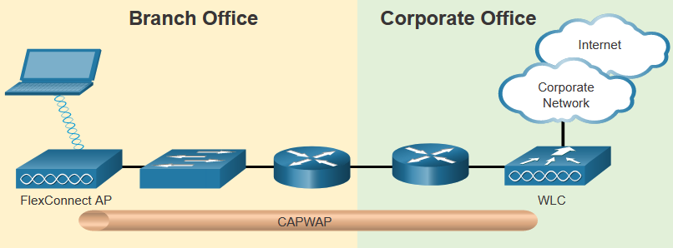
Flex Connect APs
FlexConnect enables the configuration and control of Aps over a WAN link.
There are two modes of option for the FlexConnect AP:
    Connected mode – The WLC is reachable. The FlexConnect AP has CAPWAP connectivity with the WLC through the CAPWAP tunnel. The WLC performs all CAPWAP functions.
    Standalone mode – The WLC is unreachable. The FlexConnect AP has lost CAPWAP connectivity with the WLC. The FlexConnect AP can assume some of the WLC functions such as switching client data traffic locally and performing client authentication locally.
Notes:
12 – WLAN Concepts
12.4 – CAPWAP Operation
12.4.5 – Flex Connect Aps
12.4.6 – Check Your Understanding – CAPWAP Operation

Slide 36
12.5 Channel Management
Notes:
12 - WLAN Concepts
12.5 – Channel Management

Slide 37
Frequency Channel Saturation
If the demand for a specific wireless channel is too high, the channel may become oversaturated, degrading the quality of the communication.
Channel saturation can be mitigated using techniques that use the channels more efficiently.
  Direct-Sequence Spread Spectrum (DSSS) - A modulation technique designed to spread a signal over a larger frequency band. Used by 802.11b devices to avoid interference from other devices using the same 2.4 GHz frequency.
  Frequency-Hopping Spread Spectrum (FHSS) - Transmits radio signals by rapidly switching a carrier signal among many frequency channels. Sender and receiver must be synchronized to “know” which channel to jump to. Used by the original 802.11 standard.
  Orthogonal Frequency-Division Multiplexing (OFDM) - A subset of frequency division multiplexing in which a single channel uses multiple sub-channels on adjacent frequencies. OFDM is used by a number of communication systems including 802.11a/g/n/ac.
Notes:
12 – WLAN Concepts
12.5 – Channel Management
12.5.1 – Frequency Channel Saturation

Slide 38
Začneme od Adama: Co je FDM
(frequency-division multiplexing)
Frekvenční multiplexování (FDM) je technika multiplexování, což znamená kombinování více než jednoho signálu na sdíleném médiu. Ve FDM jsou kombinovány signály různých frekvencí pro souběžný přenos.
Kmitočtové spektrum každého vstupního signálu je posunuto do jiného kmitočtového pásma; přenáší se sloučené signály, které jsou na přijímací straně od sebe odděleny pomocí pásmových propustí a posunuty do původního kmitočtového pásma.

Slide 39
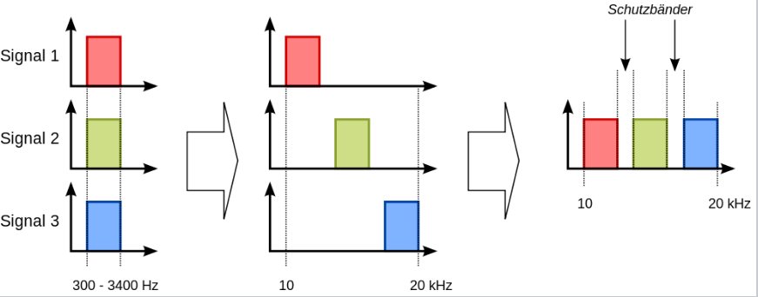
Mixování tří signálů V rámci FDM
Ochranné pásmo

Slide 40
OFDM
(Orthogonal Frequency Division Multiplexing)
OFDM (anglicky Orthogonal Frequency Division Multiplexing, ortogonální multiplex s frekvenčním dělením) je širokopásmová modulace využívající frekvenční dělení kanálu.
Pracuje s tzv. rozprostřeným spektrem, kdy je signál vysílán na více vzájemně ortogonálních frekvencích , které jsou označovány jako subnosné.

Slide 41
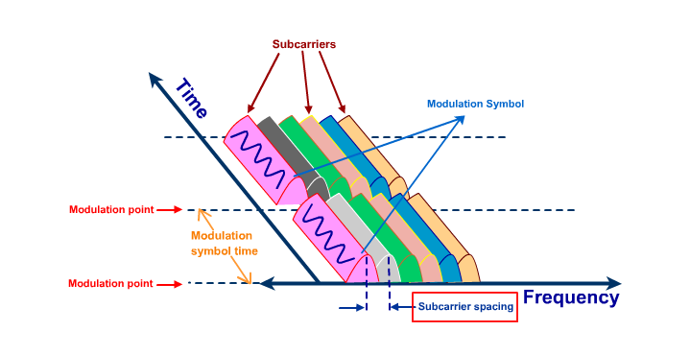
Podkanály v OFDM

Slide 42
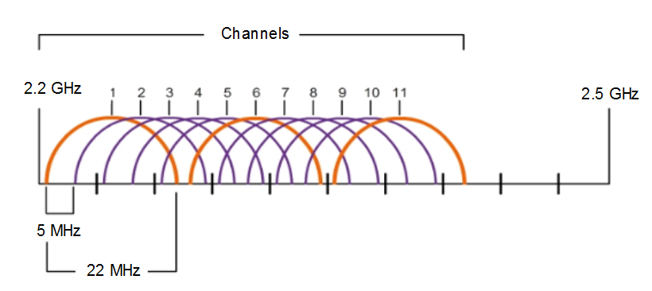
Channel Selection
The 2.4 GHz band is subdivided into multiple channels each allotted 22 MHz bandwidth and separated from the next channel by 5 MHz.
A best practice for 802.11b/g/n WLANs requiring multiple APs is to use non-overlapping channels such as 1, 6, and 11.
Notes:
12 – WLAN Concepts
12.5 – Channel Management
12.5.2 – Channel Selection

Slide 43
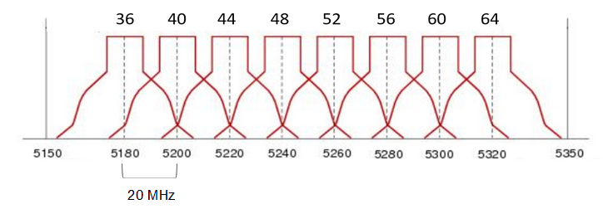
Channel Selection (Cont.)
For the 5GHz standards 802.11a/n/ac, there are 24 channels. Each channel is separated from the next channel by 20 MHz.
Non-overlapping channels are 36, 48, and 60.
Notes:
12 – WLAN Concepts
12.5 – Channel Management
12.5.2 – Channel Selection (Cont.)

Slide 44
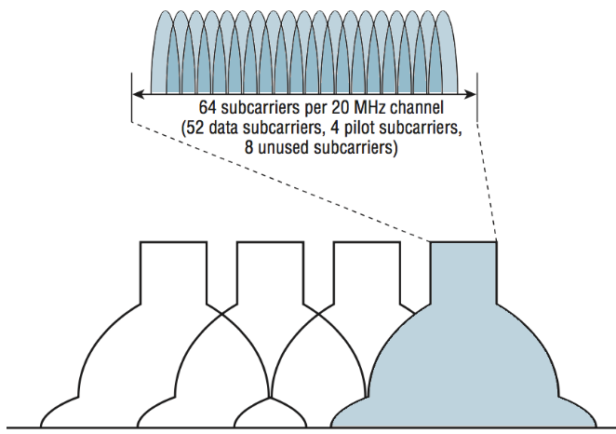
U 802.11n/ac je podkanálů 64
(Každý OFDM subcarrier je 312.5 KHz)
pilot – synchronizace

Slide 45
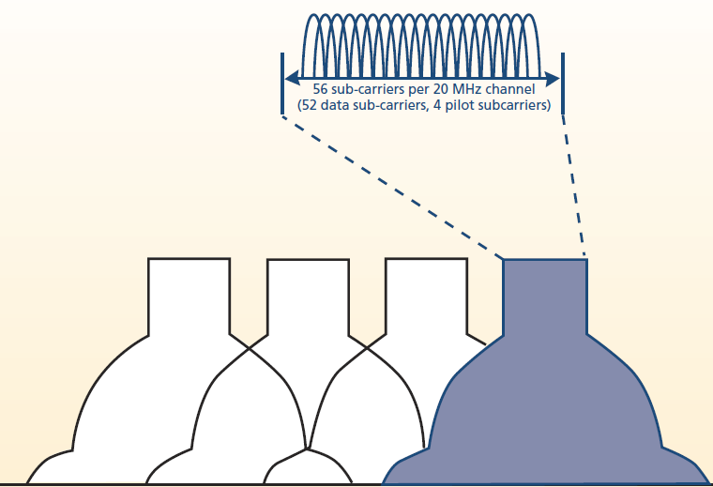
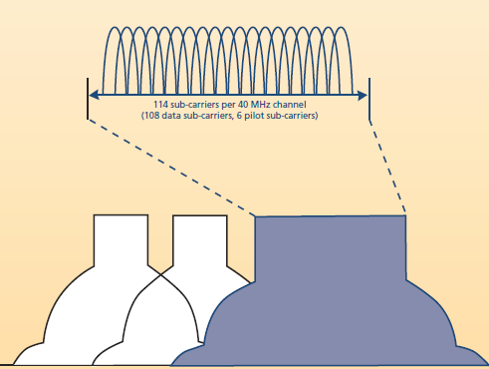
Následovalo zrychlení OFDM z 20 na 40 MHz a zvýšení počtu subkanálů
Notes:
Kanály OFDM 20 MHz a 40 MHz - jak je znázorněno na obrázku vlevo, vysílá starší 802.11a/g na kanál, který zaujímá frekvenci pásma 20 MHz. Každý kanál OFDM 20 MHz využívá 52 podskupin s 48 subnosiči, které přepravují data. Zbývající čtyři nosiče se používají jako pilotní tóny pro dynamickou kalibraci mezi vysílačem a přijímačem.
Stanice 802.11n mají schopnost také vysílat na 20 MHz kanálech, ale vysílačky 802.11n vysílají na čtyřech subnosičích, které mohou přenášet trochu více dat ve stejném kmitočtovém prostoru. Další vlastností zařízení 802.11n je schopnost přenášet a přijímat kanály OFDM o 40 MHz. Jak ukazuje obrázek vpravo, kanál 40 MHz zdvojnásobuje kmitočtovou šířku pásma, která je k dispozici pro přenos dat. Každý kanál 40 MHz využívá 114 subkanálů OFDM, z nichž 108 přenáší data. Na 40 Mhz mohou být 2 FDX přenosy, nevýhodou je ale překrývání pásem:

Slide 46
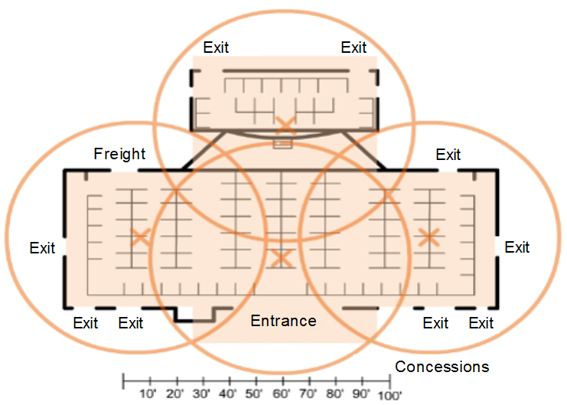
Channel Management
Plan a WLAN Deployment
The number of users supported by a WLAN depends on the following:
    The geographical layout of the facility
    The number of bodies and devices that can fit in a space
    The data rates users expect
    The use of non-overlapping channels by multiple APs and transmit power settings
When planning the location of APs, the approximate circular coverage area is important.
Notes:
12 – WLAN Concepts
12.5 – Channel Management
12.5.3 – Plan a WLAN Deployment
12.5.4 – Check Your Understanding – Channel Management

Slide 47
12.6 WLAN Threats
Notes:
12 - WLAN Concepts
12.6 – WLAN Threats

Slide 48
WLAN Threats
Video – WLAN Threats
This video will cover the following:
Interception of Data
Wireless Intruders
Denial of Service (DoS) Attacks
Rogue APs
Notes:
12 – WLAN Concepts
12.6 – WLAN Threats
12.6.1 – Video – WLAN Threats

Slide 49
WLAN Threats
Wireless Security Overview
A WLAN is open to anyone within range of an AP and the appropriate credentials to associate to it.
Attacks can be generated by outsiders, disgruntled employees, and even unintentionally by employees. Wireless networks are specifically susceptible to several threats, including the following:
Interception of data
Wireless intruders
Denial of Service (DoS) Attacks
Rogue APs
Notes:
12 – WLAN Concepts
12.6 – WLAN Threats
12.6.2 – Wireless Security Overview

Slide 50
WLAN Threats
DoS Attacks
Wireless DoS attacks can be the result of the following:
Improperly configured devices
A malicious user intentionally interfering with the wireless communication
Accidental interference
To minimize the risk of a DoS attack due to improperly configured devices and malicious attacks, harden all devices, keep passwords secure, create backups, and ensure that all configuration changes are incorporated off-hours.
Notes:
12 – WLAN Concepts
12.6 – WLAN Threats
12.6.3 – DoS Attacks

Slide 51
WLAN Threats
Rogue Access Points
A rogue AP is an AP or wireless router that has been connected to a corporate network without explicit authorization and against corporate policy.
Once connected, the rogue AP can be used by an attacker to capture MAC addresses, capture data packets, gain access to network resources, or launch a man-in-the-middle attack.
A personal network hotspot could also be used as a rogue AP. For example, a user with secure network access enables their authorized Windows host to become a Wi-Fi AP.
To prevent the installation of rogue APs, organizations must configure WLCs with rogue AP policies and use monitoring software to actively monitor the radio spectrum for unauthorized APs.
Notes:
12 – WLAN Concepts
12.6 – WLAN Threats
12.6.4 – Rogue Access Points

Slide 52
WLAN Threats
Man-in-the-Middle Attack
In a man-in-the-middle (MITM) attack, the hacker is positioned in between two legitimate entities in order to read or modify the data that passes between the two parties. A popular wireless MITM attack is called the “evil twin AP” attack, where an attacker introduces a rogue AP and configures it with the same SSID as a legitimate AP.
Defeating a MITM attack begins with identifying legitimate devices on the WLAN. To do this, users must be authenticated. After all of the legitimate devices are known, the network can be monitored for abnormal devices or traffic.
Notes:
12 – WLAN Concepts
12.6 – WLAN Threats
12.6.5 – Man-in-the-Middle Attack
12.6.6 – Check Your Understanding – WLAN Threats

Slide 53
12.7 Secure WLANs
Notes:
12 - WLAN Concepts
12.7 – Secure WLANs

Slide 54
Secure WLANs
Video – Secure WLANs
This video will cover the following:
SSID Cloaking
MAC Address Filtering
Authentication and Encryption Systems (Open Authentication and Shared Key Authentication)
Notes:
12 – Secure WLANs
12.7 – Secure WLANs
12.7.1 – Video – Secure WLANs

Slide 55
Secure WLANs
SSID Cloaking and MAC Address Filtering
To address the threats of keeping wireless intruders out and protecting data, two early security features were used and are still available on most routers and APs:
SSID Cloaking
APs and some wireless routers allow the SSID beacon frame to be disabled. Wireless clients must be manually configured with the SSID to connect to the network.
MAC Address Filtering
An administrator can manually permit or deny clients wireless access based on their physical MAC hardware address. In the figure, the router is configured to permit two MAC addresses. Devices with different MAC addresses will not be able to join the 2.4GHz WLAN.
Notes:
12 – WLAN Concepts
12.7 – Secure WLANs
12.7.2 – SSID Cloaking and MAC Address Filtering

Slide 56
Secure WLANs
802.11 Original Authentication Methods
The best way to secure a wireless network is to use authentication and encryption systems. Two types of authentication were introduced with the original 802.11 standard:
Open system authentication
No password required. Typically used to provide free internet access in public areas like cafes, airports, and hotels.
Client is responsible for providing security such as through a VPN.
Shared key authentication
Provides mechanisms, such as WEP, WPA, WPA2, and WPA3 to authenticate and encrypt data between a wireless client and AP. However, the password must be pre-shared between both parties to connect.
Notes:
12 – WLAN Concepts
12.7 – Secure WLANs
12.7.3 – 802.11 Original Authentication Methods

Slide 57
Secure WLANs
Shared Key Authentication Methods
There are currently four shared key authentication techniques available, as shown in the table.
Authentication Method | Description
Wired Equivalent Privacy (WEP) | The original 802.11 specification designed to secure the data using the Rivest Cipher 4 (RC4) encryption method with a static key. WEP is no longer recommended and should never be used.
Wi-Fi Protected Access (WPA) | A Wi-Fi Alliance standard that uses WEP but secures the data with the much stronger Temporal Key Integrity Protocol (TKIP) encryption algorithm. TKIP changes the key for each packet, making it much more difficult to hack.
WPA2 | It uses the Advanced Encryption Standard (AES) for encryption. AES is currently considered the strongest encryption protocol.
WPA3 | This is the next generation of Wi-Fi security. All WPA3-enabled devices use the latest security methods, disallow outdated legacy protocols, and require the use of Protected Management Frames (PMF).
Notes:
12 – WLAN Concepts
12.7 – Secure WLANs
12.7.4 – Shared Key Authentication Methods

Slide 58
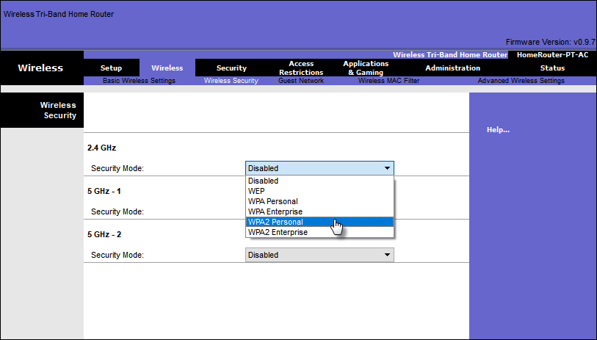
Secure WLANs
Authenticating a Home User
Home routers typically have two choices for authentication: WPA and WPA2, with WPA 2 having two authentication methods.
Personal – Intended for home or small office networks, users authenticate using a pre-shared key (PSK). Wireless clients authenticate with the wireless router using a pre-shared password. No special authentication server is required.
Enterprise – Intended for enterprise networks. Requires a Remote Authentication Dial-In User Service (RADIUS) authentication server. The device must be authenticated by the RADIUS server and then users must authenticate using 802.1X standard, which uses the Extensible Authentication Protocol (EAP) for authentication.
Notes:
12 – WLAN Concepts
12.7 – Secure WLANs
12.7.5 – Authenticating a Home User

Slide 59
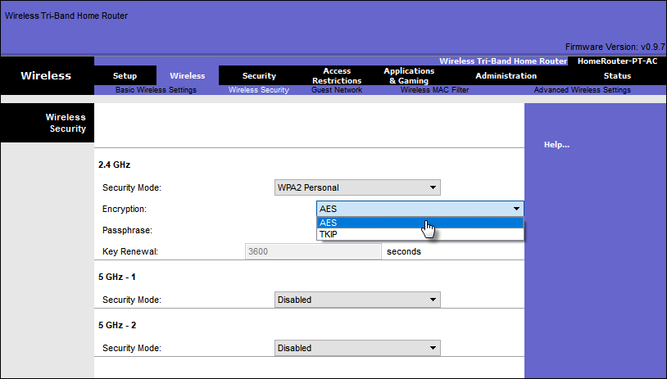
Secure WLANs
Encryption Methods
WPA and WPA2 include two encryption protocols:
Temporal Key Integrity Protocol (TKIP) – Used by WPA and provides support for legacy WLAN equipment. Makes use of WEP but encrypts the Layer 2 payload using TKIP.
Advanced Encryption Standard (AES) – Used by WPA2 and uses the Counter Cipher Mode with Block Chaining Message Authentication Code Protocol (CCMP) that allows destination hosts to recognize if the encrypted and non-encrypted bits have been altered.
Notes:
12 – WLAN Concepts
12.7 – Secure WLANs
12.7.6 – Encryption Methods

Slide 60
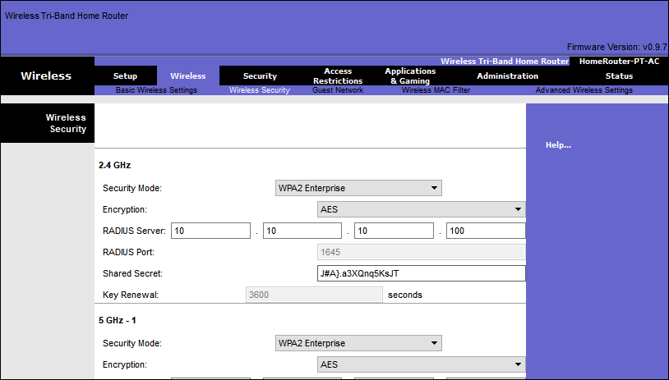
Secure WLANs
Authentication in the Enterprise
Enterprise security mode choice requires an Authentication, Authorization, and Accounting (AAA) RADIUS server.
There pieces of information are required:
RADIUS server IP address – IP address of the server.
UDP port numbers –UDP ports 1812 for RADIUS Authentication, and 1813 for RADIUS Accounting, but can also operate using UDP ports 1645 and 1646.
Shared key – Used to authenticate the AP with the RADIUS server.
Note: User authentication and authorization is handled by the 802.1X standard, which provides a centralized, server-based authentication of end users.
Notes:
12 – WLAN Concepts
12.7 – Secure WLANs
12.7.7 – Authentication in the Enterprise

Slide 61
Secure WLANs
WPA 3
Because WPA2 is no longer considered secure, WPA3 is recommended when available. WPA3 Includes four features:
WPA3 – Personal : Thwarts brute force attacks by using Simultaneous Authentication of Equals (SAE).
WPA3 – Enterprise : Uses 802.1X/EAP authentication. However, it requires the use of a 192-bit cryptographic suite and eliminates the mixing of security protocols for previous 802.11 standards.
Open Networks : Does not use any authentication. However, uses Opportunistic Wireless Encryption (OWE) to encrypt all wireless traffic.
IoT Onboarding : Uses Device Provisioning Protocol (DPP) to quickly onboard IoT devices.
Notes:
12 – WLAN Concepts
12.7 – Secure WLANs
12.7.8 – WPA 3
12.7.9 – Check Your Understanding – Secure WLANs

Slide 62
12.8 Module Practice and Quiz
Notes:
12 - WLAN Concepts
12.8 – Module Practice and Quiz

Slide 63
Module 12: Osvědčené postupy
Topic 12.1
    Explain the differences between WPAN, WLAN, WMAN and WWAN.
    Why do you think there are so many 802.11 standards?
Topic 12.2
    When would using autonomous AP and controller based AP be appropriate?
    Discuss a situation where a USB wireless adapter is needed.
Topic 12.3
    When would ad hoc and infrastructure modes be appropriate?
    What is the difference between a BSS and a ESS?
    Discuss the parameters that are negotiated between AP and wireless client for successful association. If possible list them on the board.
Topic 12.4
    Why would an organization use CAPWAP?
    What capability is provided by FlexConnect?
Notes:
63

Slide 64
Module 12: Osvědčené postupy
Topic 12.5
    What is a solution for frequency channel saturation?
    List on the board and discuss considerations when planning the location of APs in a building.
Topic 12.6
    Discuss the common attacks made against wireless networks.
    What are some ways to mitigate these attacks?
Topic 12.7
  Ask the students or have a class discussion
    Discuss the strengths and weaknesses of the various shared key authentication methods.
    If possible display the wireless security settings on an AP.
Notes:
64

Slide 65
Téma 12.1
  Vysvětlete rozdíly mezi WPAN, WLAN, WMAN a WWAN.
  Proč si myslíte, že existuje tolik standardů 802.11?
Téma 12.2
  Kdy by bylo vhodné použít autonomní AP a AP založené na řadiči?
  Diskutujte o situaci, kdy je potřeba bezdrátový adaptér USB.
Téma 12.3
  Kdy by byly vhodné režimy ad hoc a režimy infrastruktury?
  Jaký je rozdíl mezi BSS a ESS?
  Diskutujte o parametrech vyjednaných mezi AP a bezdrátovým klientem pro úspěšné přidružení.
Téma 12.4
  Proč by organizace používala CAPWAP?
  Jaké možnosti poskytuje FlexConnect?

Slide 66
Téma 12.5
  Jaké je řešení pro nasycení frekvenčního kanálu?
Téma 12.6
  Diskutujte o běžných útocích proti bezdrátovým sítím.
  Jaké jsou způsoby, jak zmírnit tyto útoky?
Téma 12.7
  Diskutujte o silných a slabých stránkách různých metod ověřování pomocí sdíleného klíče.
  Pokud je to možné, zobrazte nastavení zabezpečení bezdrátové sítě na přístupovém bodu.

Slide 67
Module Practice and Quiz
What did I learn in this module?
A Wireless LANs (WLANs) are based on IEEE standards and can be classified into four main types: WPAN, WLAN, WMAN, and WWAN.
Wireless technology uses the unlicensed radio spectrum to send and receive data. Examples of this technology are Bluetooth, WiMAX, Cellular Broadband, and Satellite Broadband.
WLAN networks operate in the 2.4 GHz frequency band and the 5 GHz band.
The three organizations influencing WLAN standards are the ITU-R, the IEEE, and the Wi-Fi Alliance.
CAPWAP is an IEEE standard protocol that enables a WLC to manage multiple APs and WLANs.
DTLS is a protocol provides security between the AP and the WLC.
Wireless LAN devices have transmitters and receivers tuned to specific frequencies of radio waves to communicate. Ranges are then split into smaller ranges called channels: DSSS, FHSS, and OFDM.
The 802.11b/g/n standards operate in the 2.4 GHz to 2.5GHz spectrum. The 2.4 GHz band is subdivided into multiple channels. Each channel is allotted 22 MHz bandwidth and is separated from the next channel by 5 MHz.
Wireless networks are susceptible to threats, including: data interception, wireless intruders, DoS attacks, and rogue APs.
To keep wireless intruders out and protect data, two early security features are still available on most routers and APs: SSID cloaking and MAC address filtering.
There are four shared key authentication techniques available: WEP, WPA, WPA2, and WPA3.
Notes:
12 – WLAN Concepts
12.8 – Module Practice and Quiz
12.8.1 – What did I learn in this module?
12.8.2 – Module Quiz – WLAN Concepts

Slide 68
Module 12: WLAN Concepts
New Terms and Commands
WPAN WLAN WMAN WWAN Bluetooth 802.11 Electromagnetic spectrum ITU IEEE Lightweight AP (LAP) Lightweight Access Point Protocol (LWAPP) Wireless LAN Controller (WLAC) SSID Autonomous AP Controller-based AP Omni directional antenna Directional antenna MIMO antenna Ad hoc mode Infrastructure mode | Tethering Basic Service Set (BSS) Extended Service Set (ESS) Control and Provisioning of Wireless Access Points (CAPWAP) protocol Datagram Transport Layer Security (DTLS) FlexConnect Direct-Sequence Spread Spectrum (DSSS) Frequency-Hopping Spread Spectrum (FHSS) Orthogonal Frequency-Division Multiplexing (OFDM) Wired Equivalent Privacy (WEP) Wi-Fi Protected Access (WPA) WPA2 WPA3 Temporal Key Integrity Protocol (TKIP) Advanced Encryption Standard (AES)

