Slide 1
Risk management seminar
Part 4

Slide 2
Definition of risk and its types
Classification of risk
Risk can be classified into several distinct classes. The most important include the following:
Pure and speculative risk
Diversifiable and nondiversifiable risk
Enterprise risk
Systemic risk
10 November 2022

Slide 3
Definition of risk and its types
Types of IT risks
Electronic threats - aiming to compromise the business information - e.g.: a hacker could get access to your website, your IT system could become infected by a computer virus, you could fall victim to a fraudulent email or website. These are commonly of a criminal nature.
Technical failures - such as software bugs, a computer crash or the complete failure of a computer component. A technical failure can be catastrophic if you cannot retrieve data on a failed hard drive and no backup copy is available.
Infrastructure failures - such as the loss of your internet connection can interrupt your business - e.g.: you could miss an important purchase order.
Human error - is a major threat - e.g.: someone might accidentally delete important data, or fail to follow security procedures properly
10 November 2022

Slide 4
Definition of risk and its types
4. Cybersecurity and identity theft
Cybersecurity and identity theft by thieves breaking into firms’ computer system and database are major problems for many firms.
Computer hackers have been able to steal hundreds of thousands of consumer credit records, which have exposed individuals to identity theft and violation of privacy. As a result, commercial banks, financial institutions, and other business are exposed to enormous legal liabilities.
Other crime exposures include robbery and burglary; shoplifting; employee theft and dishonesty; fraud and embezzlement; piracy and theft of intellectual property, and computer crimes.
10 November 2022

Slide 5
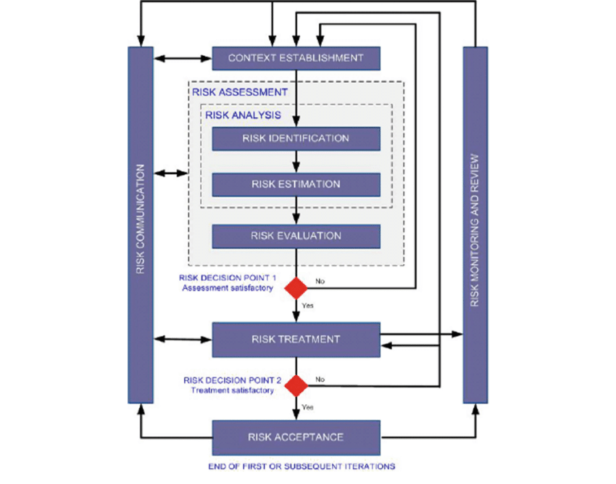
Risk management models applied in practice
Algorithm of possible risk management

Slide 6
SBU definition with using 7S Methods
SBU - Euromedica s.r.o.
Strategy : corporate strategy for 2020 – 2023, integrated with financial strategy and HR strategy.
Structure :
Managing board, Supervisory board.
Direktor.
IT Servises.
Sales Department.
Ekonomics Department.
Logistik manager.

Slide 7
Systems :
IT Systems – MS Office, MS SQL Server
Account system Money S7
Small company managed by direcktor and head off the departments.
Marketing system integrated in Money S7.
Logistik system integrated in Money S7.
Style: process oriented organization, with process maps and managed dokumentation.
Staff:
Managing board 3 persons.
Supervisory board 3 persons.
Direktor 1 person.
IT department 3 persons.
Logistik manager 1 person.
Sales department : 12 persons.
Economy department : 2 persons.

Slide 8
Skills:
Categorizing date.
Audit skills.
Process modeling.
Process analyzing.
Project management.
Lead auditor for ISO 9001, 14001, 18001, 20001, 27001.
Coordinating.
Risk management.
Shared values:
Strategic thinking.
Interviewing.
Diplomacy.
Advising.

Slide 9
Types of risks
Human factor :
Substance abuse
Stres sitaution
Certifikation
Information and technology risks:
Integrity of application systems
Incorrectly specified requirements for HW and SW and their evaluation
Unauthorized use of information, destruction, damage and its modification
Intentional interference with SW or HW
Operation risks:
Defective feedback system
Complexity of processes, operations

Slide 10
Organizational risk:
Ineffective methodological, control activities and supervision
Non-optimized circulation of documents, records, shredding of documents
Financial risk:
Manipulation of income and expenses
State guarantees, financial assistance

Slide 11
Definition of risk and its types
Thank you for your attention!

