Slide 1
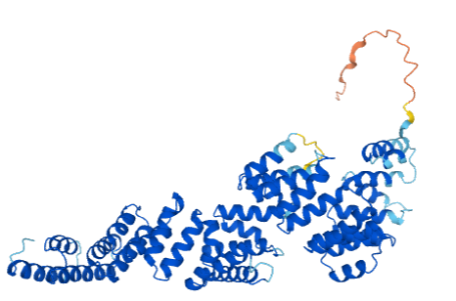
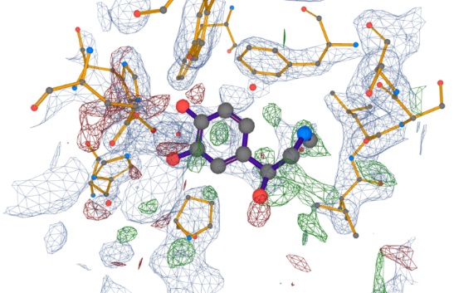
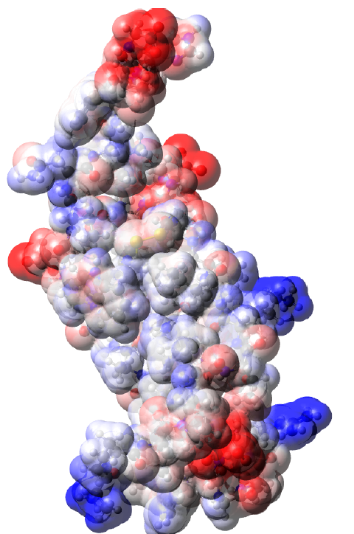
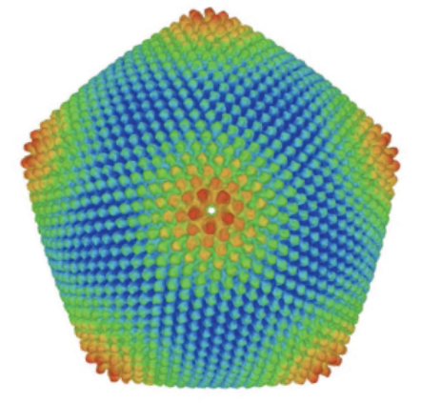
Computer model of a molecule
Radka Svobodová

Slide 2
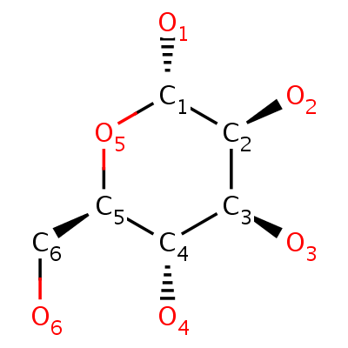
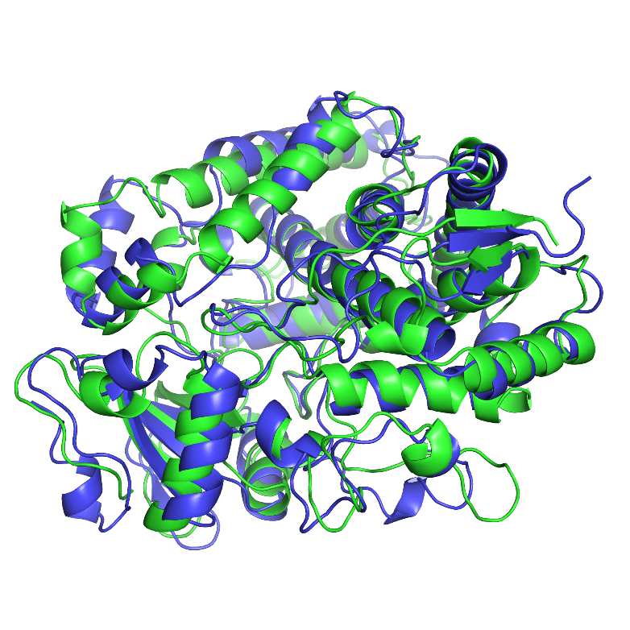
Content
  Introduction: concept of chemoinformatics, content of the subject, history of the field
  Computer model of a molecule: 1D, 2D and 3D structure, molecule representation using graph and matrix
  2D structure (topology) of a molecule:
    writing a molecule using a string (SMILES, InChi, InChiKey)
    Molecular graphs: Isomorphism and canonical indexing
    Cycle search, fingerprints
  3D structure (geometry) of the molecule:
    representation using Cartesian and internal coordinates, data formats, geometry comparison

Slide 3
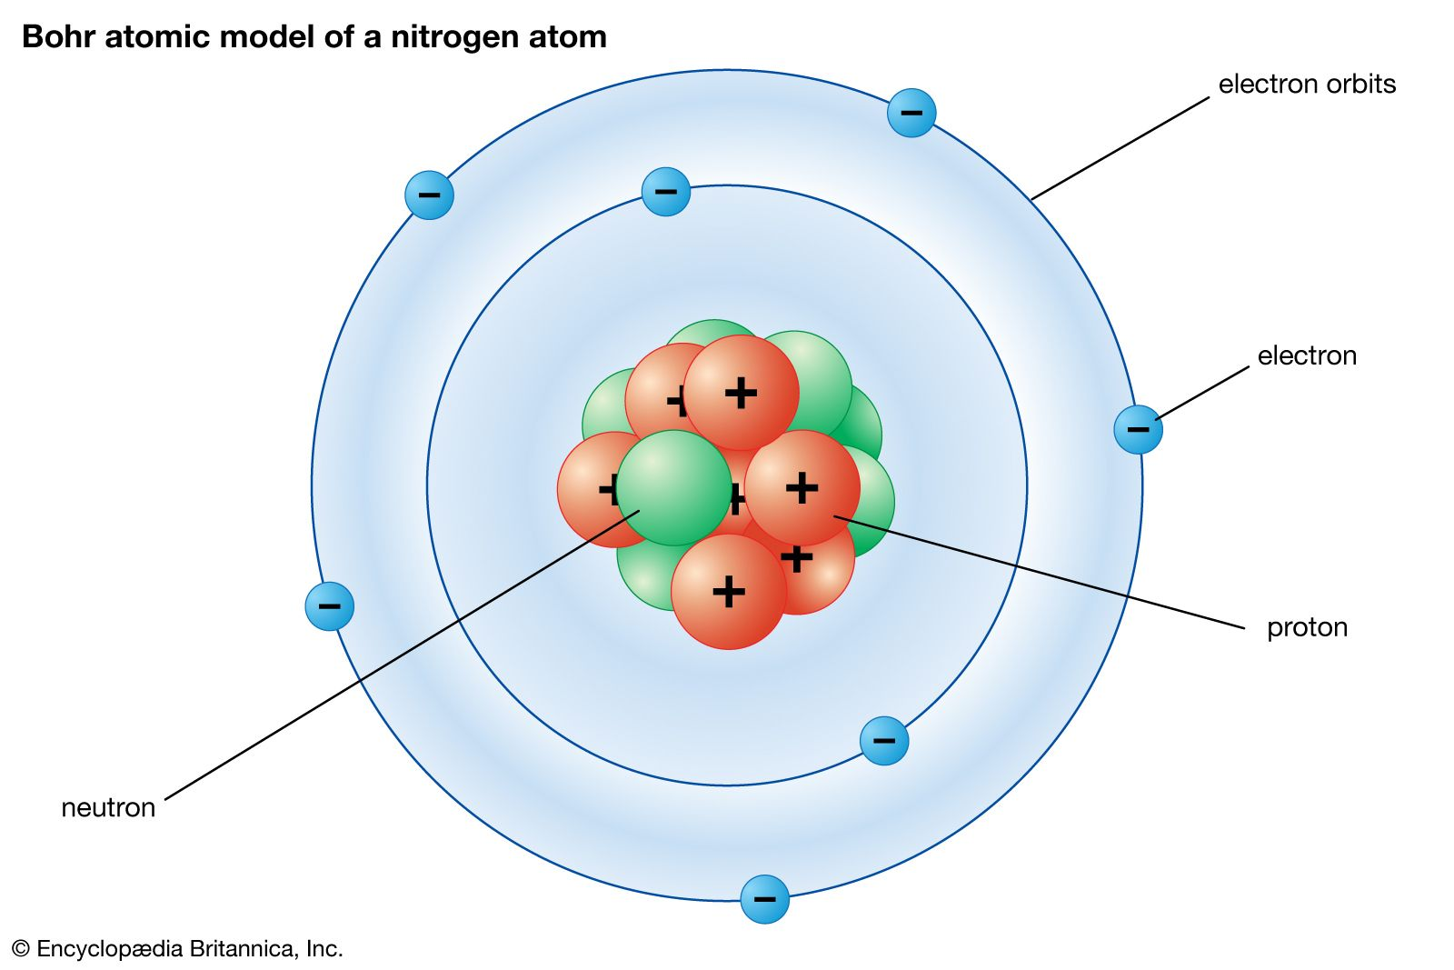
Basic chemical terms I
Atom: basic building block from which substances are formed
Structure of an atom:
  Atom core: protons (positive charge), neutrons (no charge)
  Electron shell: electrons (negative charge)

Slide 4
Basic chemical terms II
All systems tend to occupy the state with the lowest possible total energy.

Slide 5
Basic chemical terms III
The space of the electron shell can be divided into so-called layers.
All electrons in a layer have the same energy value (this energy is characteristic of that layer).
The further the layer is from the nucleus, the higher the energy of the electrons in it.
The electrons in the electron shell therefore fill first the layer closest to the nucleus (the most energetically favorable), then the second closest, and so on.

Slide 6
Basic chemical terms IV
The non-empty layer that is farthest from the core is called the valence layer.
In this layer are the so-called valence electrons.
These valence electrons are the subject of the study of chemistry because they can participate in chemical bonding.

Slide 7
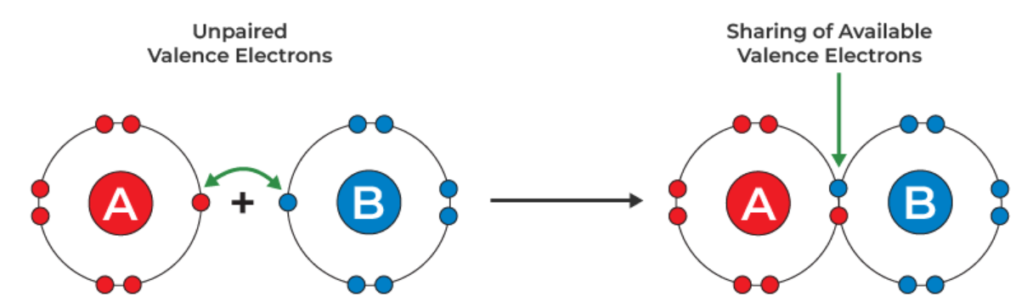
Basic chemical terms V
Chemical bond:
  Two atoms come together at a sufficiently small distance (bonding distance) => overlapping of their electron shells.
  The valence electrons of both atoms change their trajectories.
  If the resulting system has a lower energy than the original, the atoms remain at bonding distance => chemical bonding is formed.

Slide 8
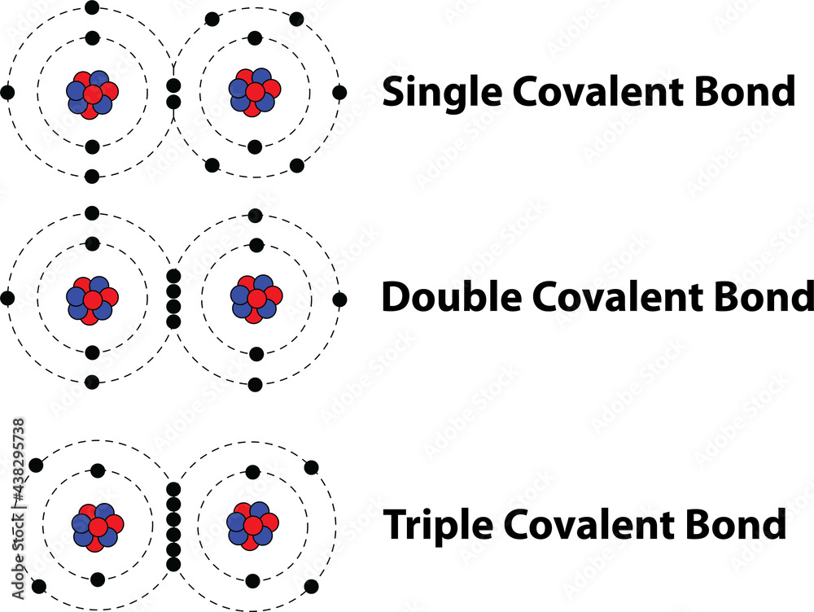
Basic chemical terms VI
Bond order:
  single bond: two valence electrons are involved (binding electron pair)
  double bond: two bonding electron pairs are involved
  Triple bond: analogous
  higher multiplicities do not occur in real chemical environments
  Aromatic bond: when single and double bonds alternate, the electrons are delocalised among them. These bonds have properties between single and double bonds.

Slide 9
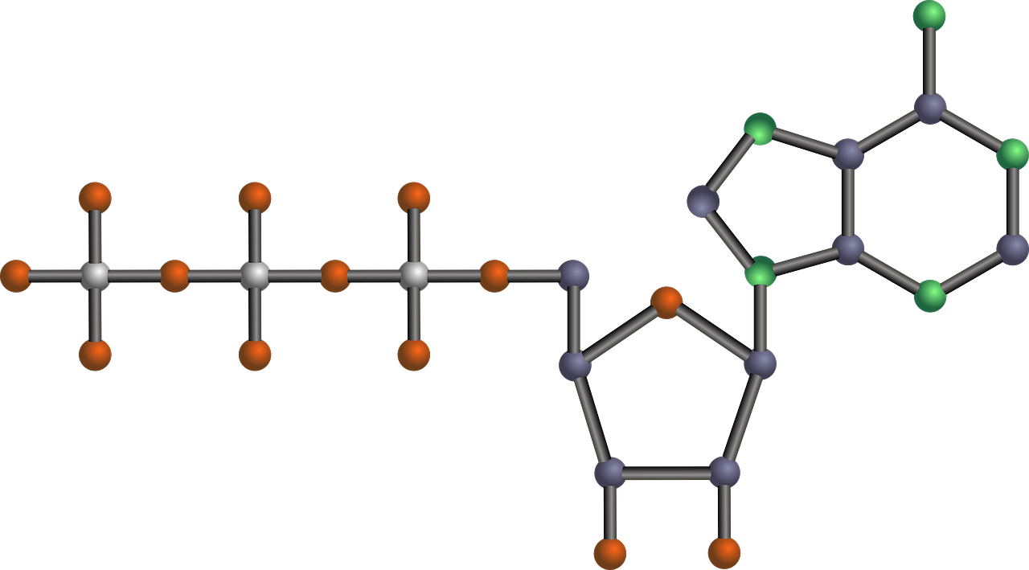
Basic chemical terms VII
Molecule: A system of atoms joined together by bonds to form a single unit. The basic structural unit of a substance. The carrier of the chemical properties of a substance.
Example: adenosine triphosphate (ATP)

Slide 10
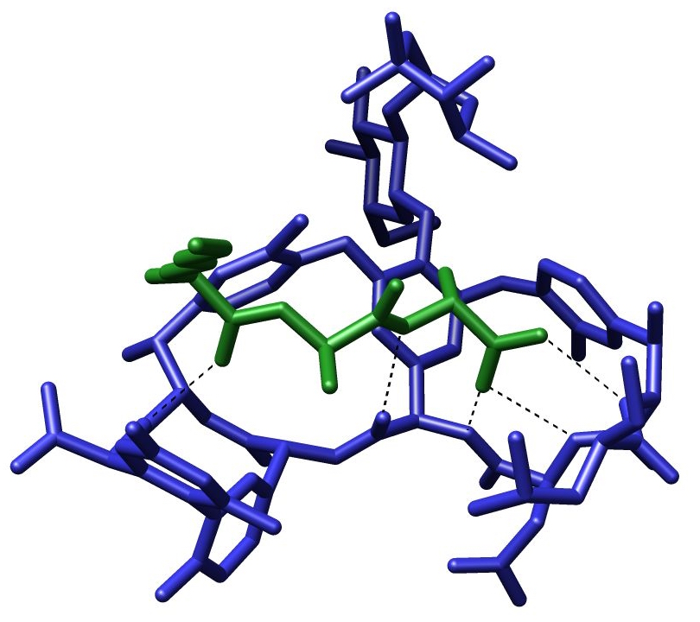
Basic chemical terms VIII
Molecular system: A system containing one or more molecules.
Example:

Slide 11
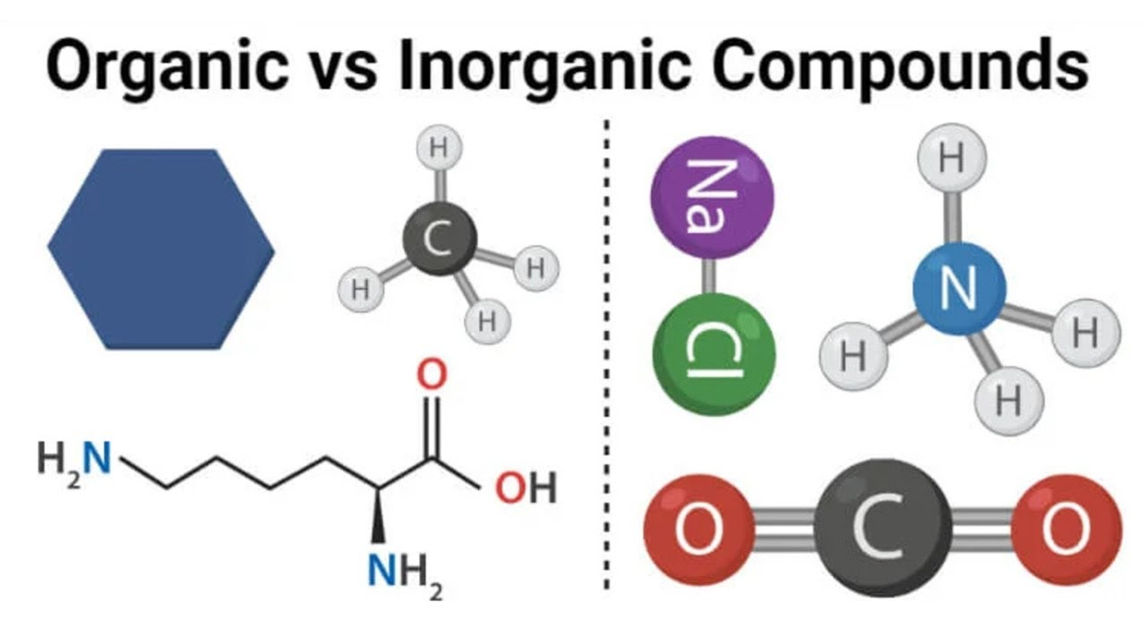
Basic chemical terms IX
Organic molecules:
  Their main component is carbon, the only element that is able to form longer chains of the (-C-)n type, n > 10.
  This property of carbon allows the formation of complex molecules - the building blocks of living systems.
  Organic molecules also contain elements: H, O, S, N, F, Cl, Br, I
Inorganic molecules:
  All molecules, that are not organic.

Slide 12
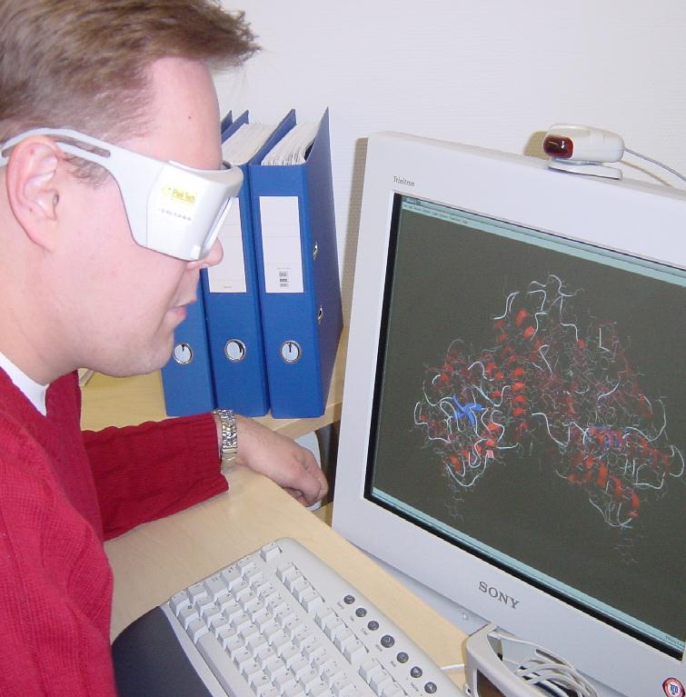
How to describe a molecule in a computer?
Find out which information describes the molecule
Write them into the computer

Slide 13
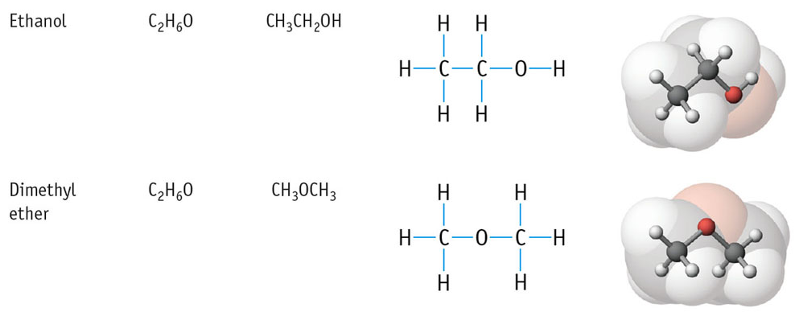
Which information describes the molecule?
Number of atoms?

Slide 14
Which information describes the molecule?
Number of atoms? Not enough
Number of atoms and positions of bonds?

Slide 15
Which information describes the molecule?
Number of atoms? Not enough
Number of atoms and positions of bonds? Better
Number of atoms, positions of bonds and positions of atoms in 3D space? Yes

Slide 16
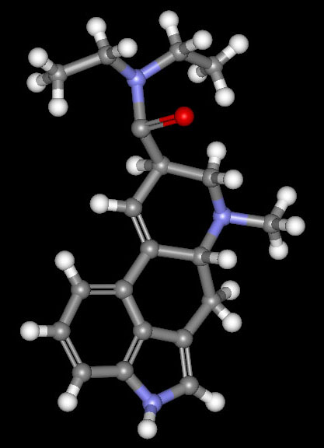
Model of molecule for computer processing
Atoms:
Points in space
Chemical symbol of the element listed for each
Bonds:
Pairs of atoms that are bonded
Bond order

Slide 17
Description of a molecule in a computer

Slide 18
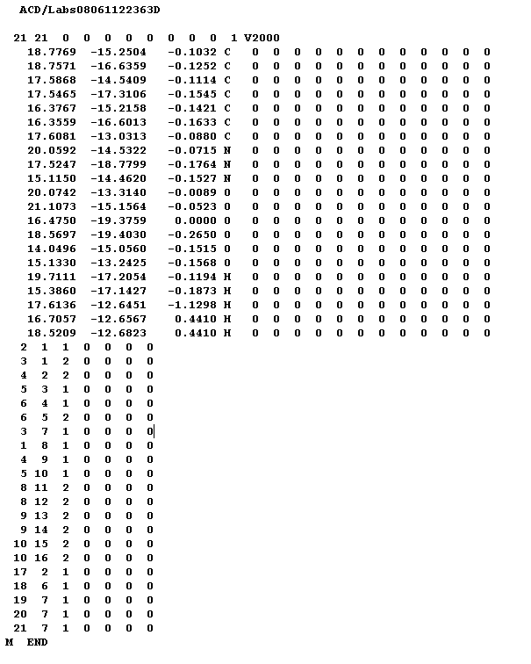
Challenge:
Draw this molecule. What is the name of the molecule?

Slide 19




Databases of small organic molecules
> 1 M structures of small molecules
Small molecule: < 100 atoms
Small molecules = “drug-like” molecules
Experimental structures
Predicted (computed) structures
19

Slide 20
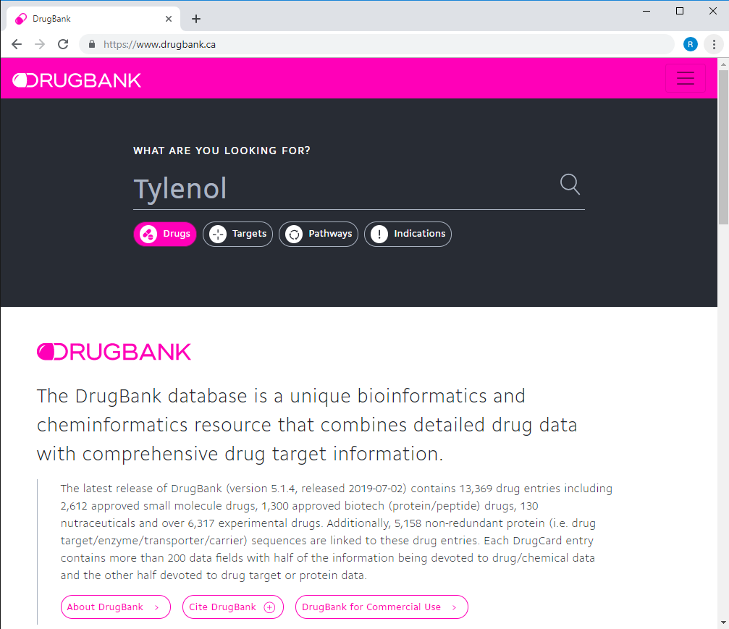
DrugBank – database of drugs

Slide 21
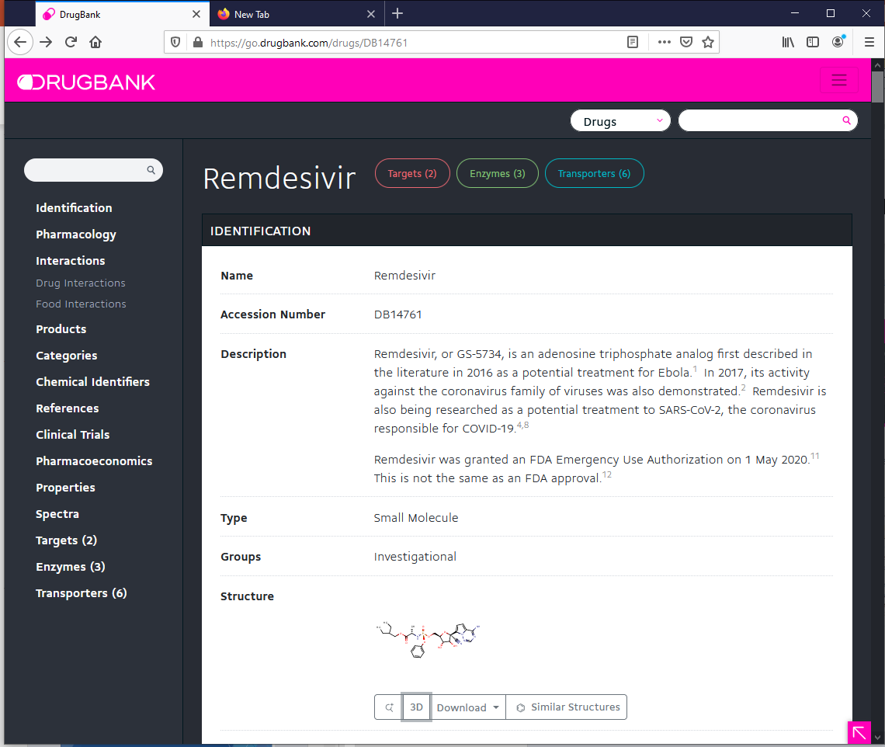
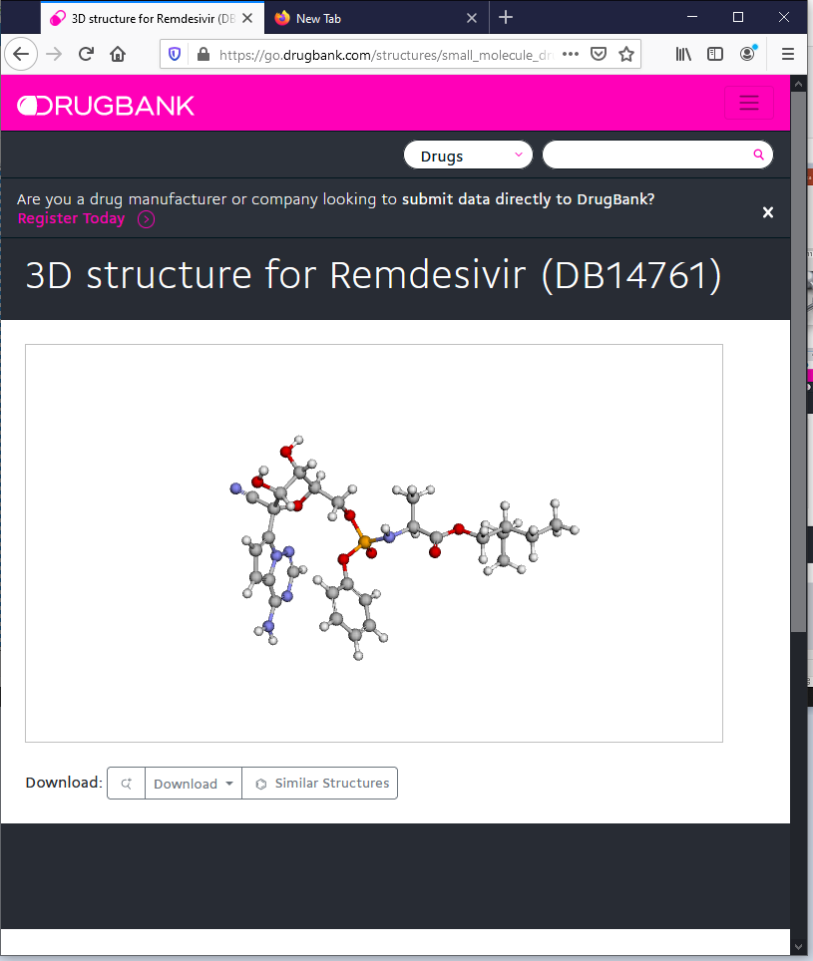
DrugBank – database of drugs

Slide 22
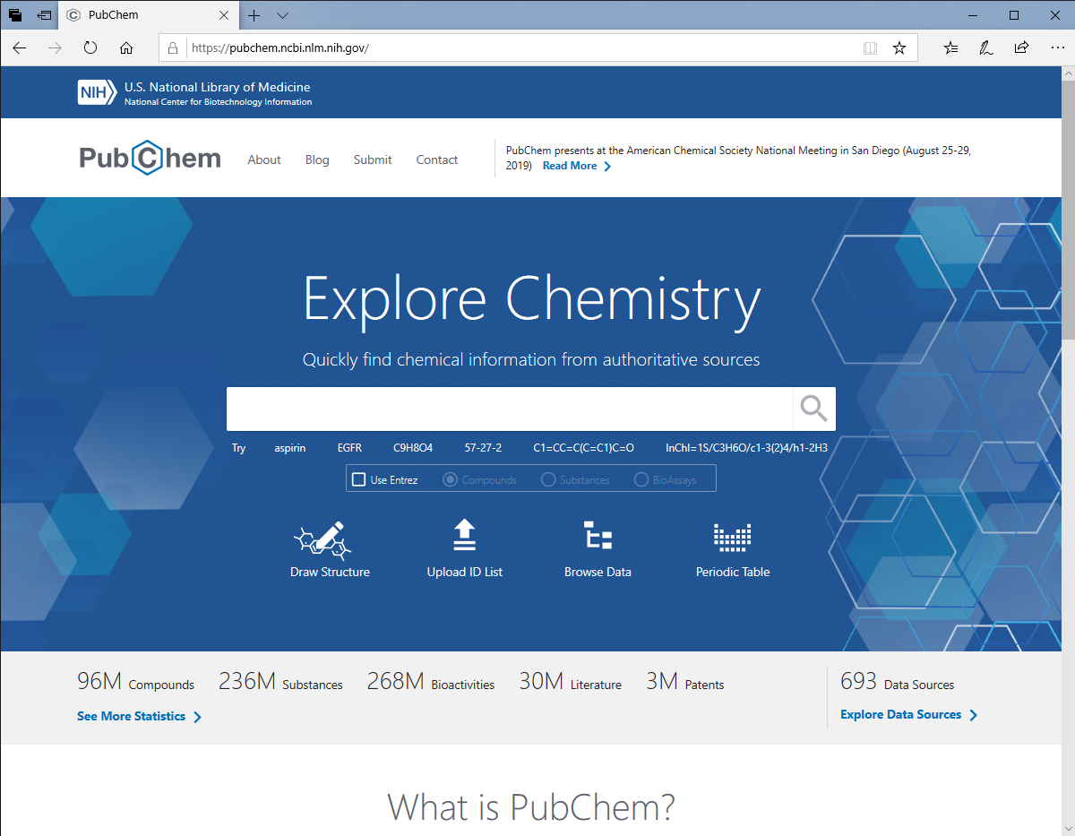
PubChem – database of organic molecules

Slide 23
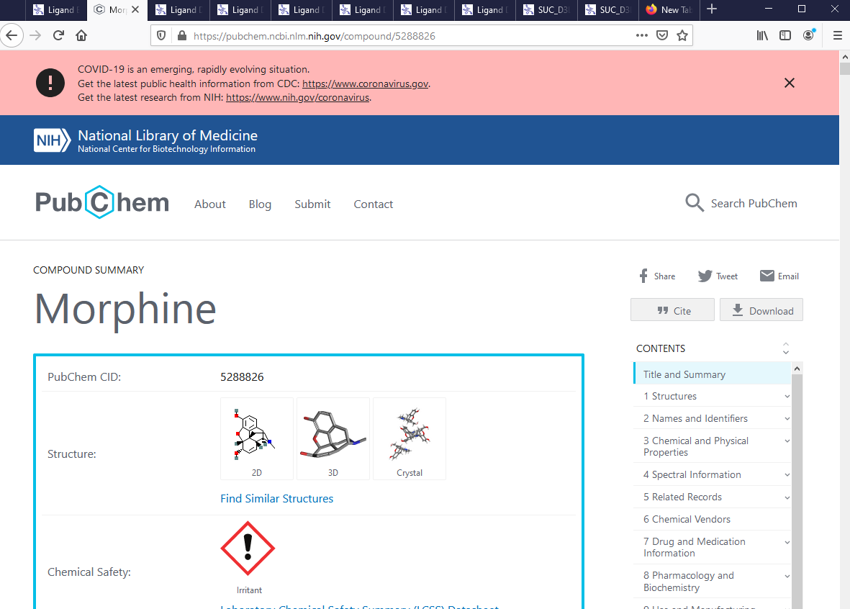
PubChem – database of organic molecules
23

Slide 24
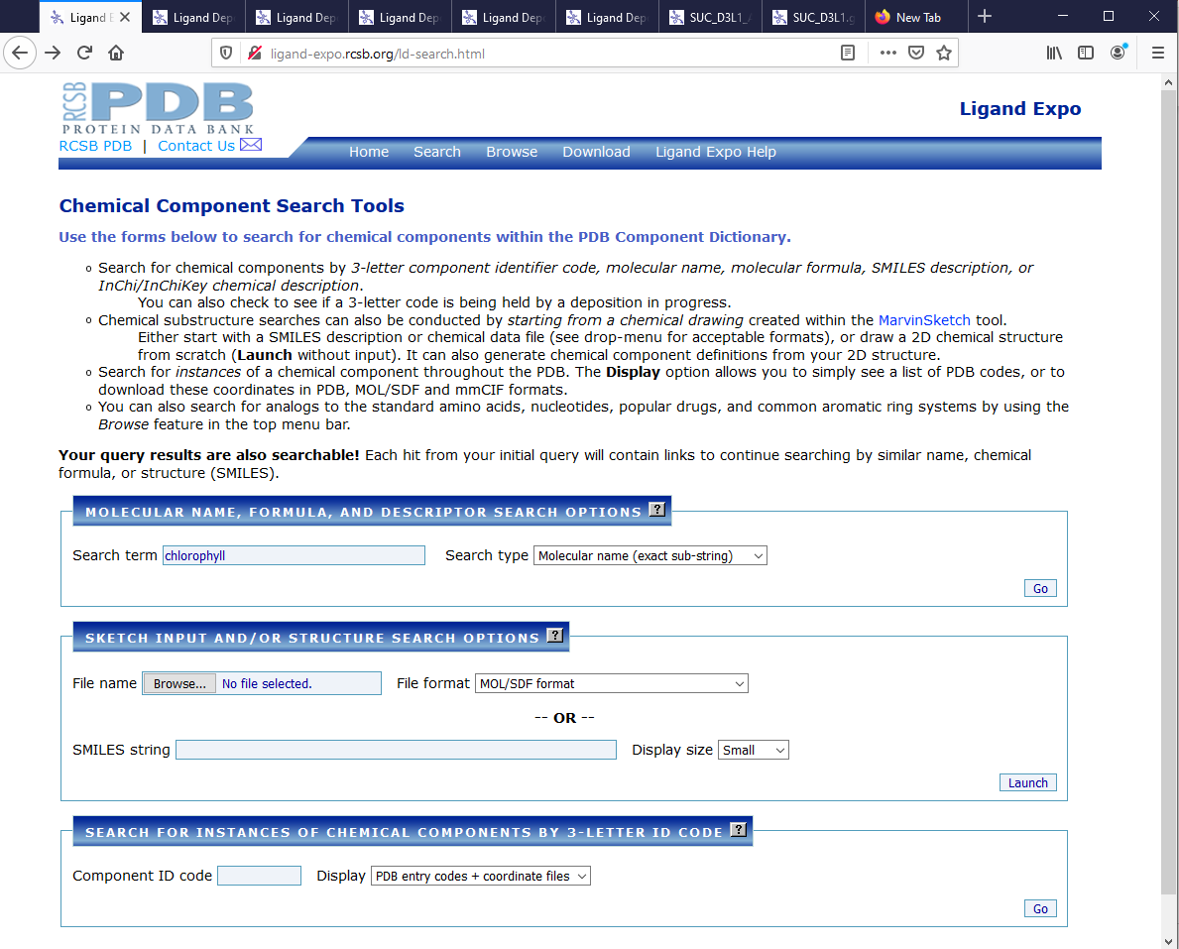
Ligand Expo – database of ligands
Ligand = molecule bound in a protein
24

Slide 25
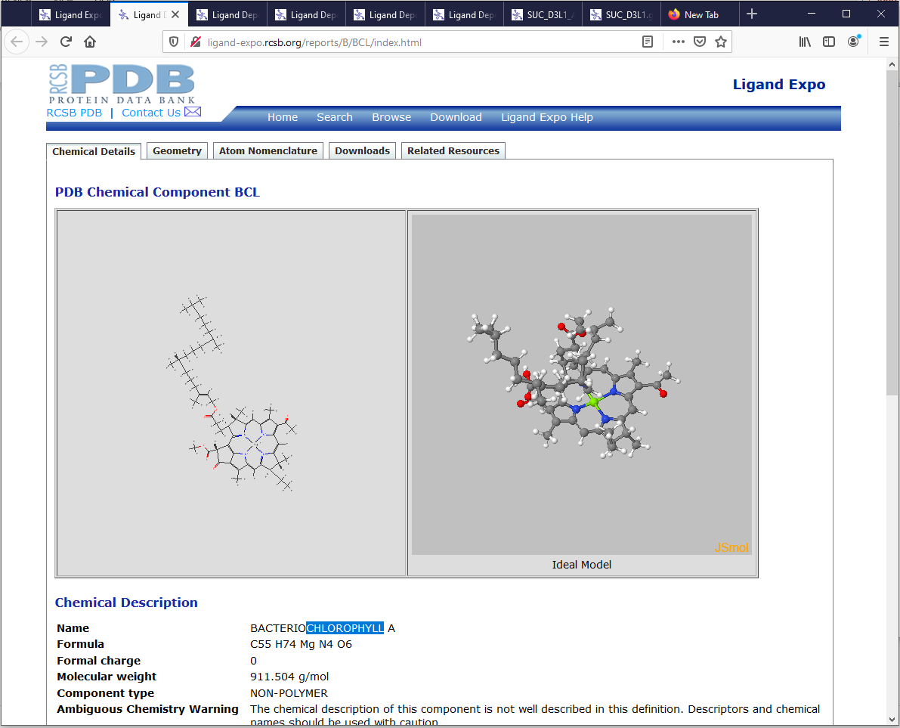
Ligand Expo – database of ligands
Ligand = molecule bound in a protein
25

Slide 26


Databases of biomacromolecules
Mainly proteins
> 200 k experimental structures
> 200 M computed structures
26

Slide 27
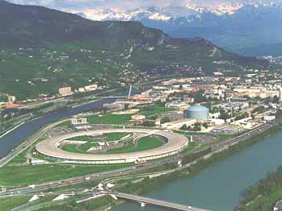
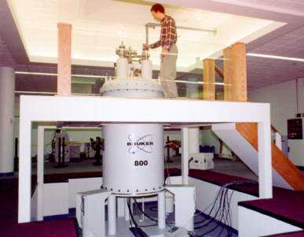
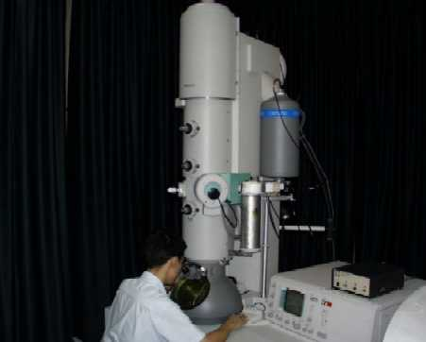
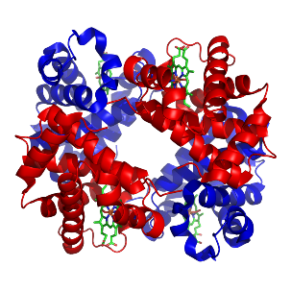

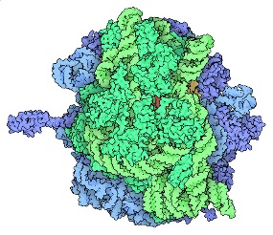
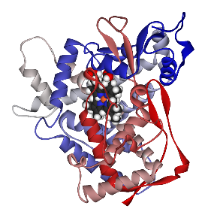

Protein Data Bank – sources of data
89% X-ray crystallography
10% NMR
spectroscopy
1% cryoelectron microscopy
3D struktura
...
ATOM 46 C GLY A 70 51.536 23.360 40.507
ATOM 47 O GLY A 70 50.947 22.279 40.325
ATOM 48 N ILE A 71 50.965 24.532 40.270
ATOM 49 CA ILE A 71 49.595 24.644 39.786
...

Slide 28
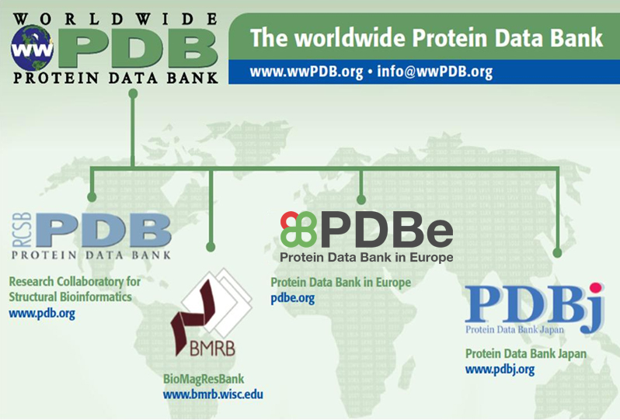
Protein Data Bank
> 225 000 biomacromolecular structures

Slide 29
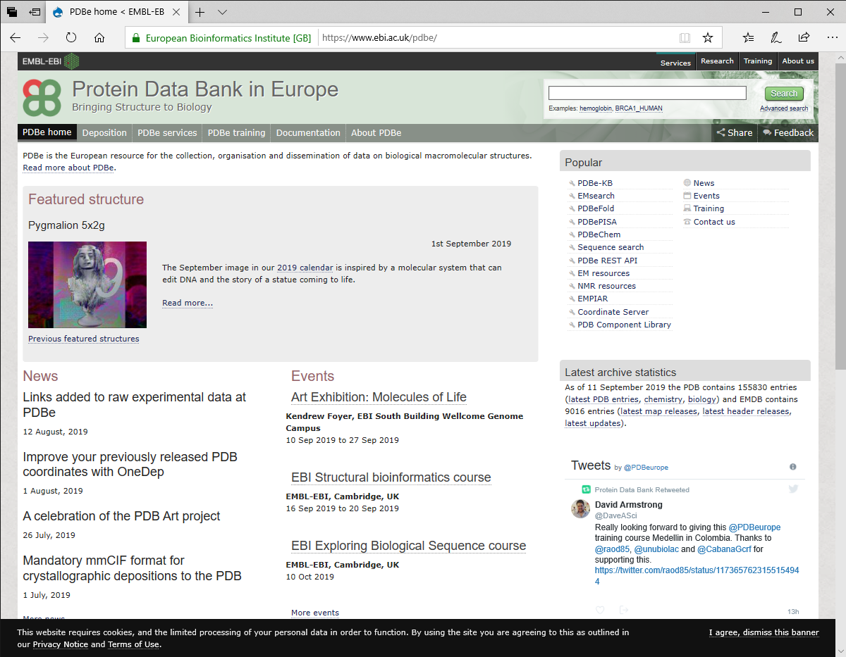
Protein Data Bank

Slide 30
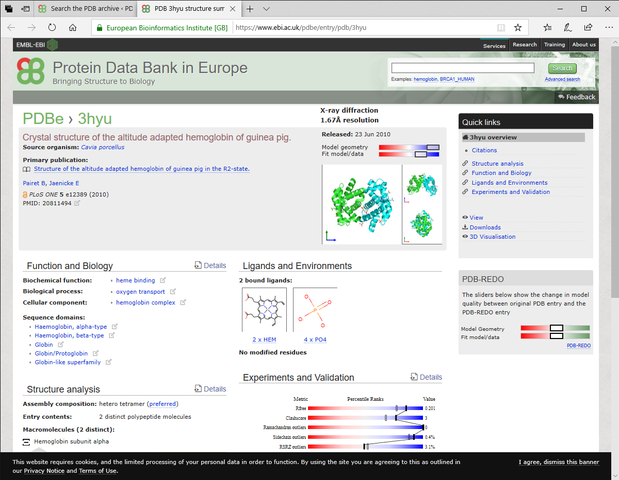
Protein Data Bank

Slide 31
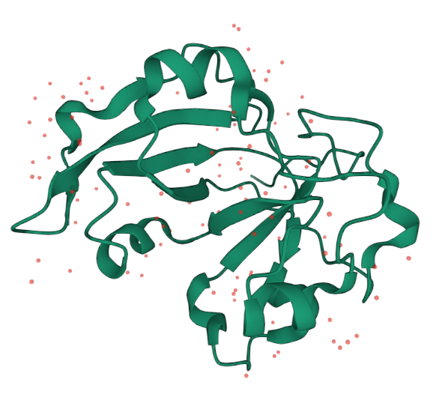
Protein Data Bank
Scabin
6vv4
β-sheet
α-helix

Slide 32
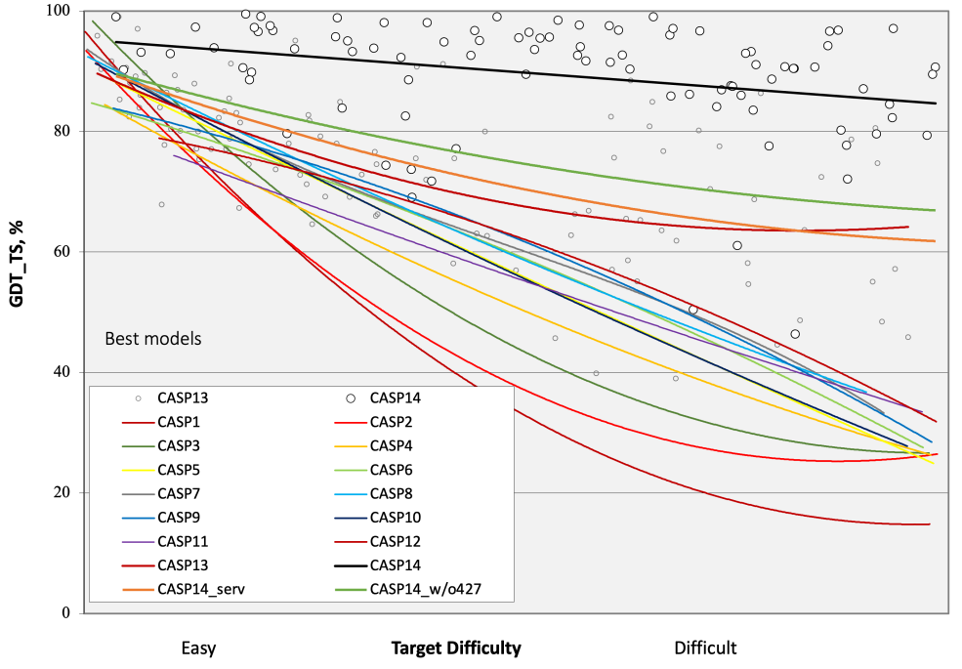
Prediction of protein structures by
AlphaFold
Structures generated by artificial intelligence
Structure prediction challenge 2020: AlphaFold2 wins
https://predictioncenter.org/casp14/doc/presentations/2020_11_30_CASP14_Introduction_Moult.pdf
32

Slide 33
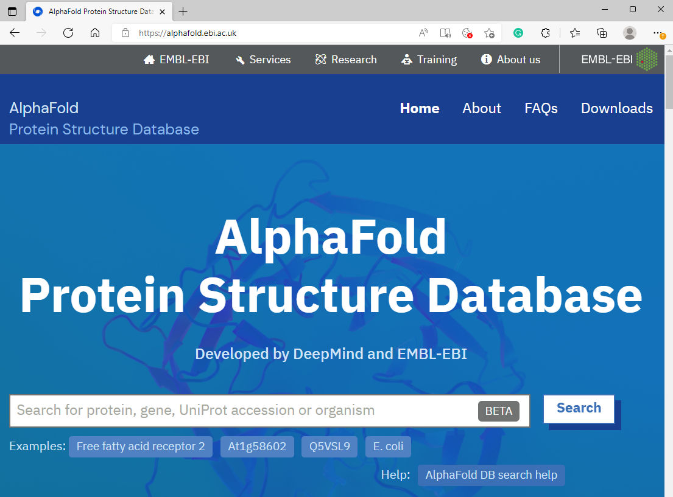
Prediction of protein structures by
AlphaFold
Structures generated by artificial intelligence
> 200M protein structures
33

Slide 34
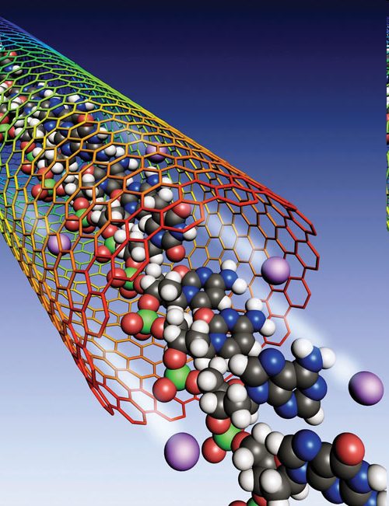
Exercises
Search the PubChem database for a testosterone molecule:
  See its 2D structure. How many O's does it have?
  Look at its 3D structure. Is any of its cycles planar?
  Look at its SDF file. What are the x, y, and z coordinates of the first atom?
Search the DrugBank database for a penicillin molecule:
  How many S atoms does it have?
  Are any of its cycles planar?
  Look at its SDF file. What 2 atoms form the first bond?
Search the LigandExpo database for a fructose molecule:
  How many double bonds does it has?
  How many C's are off cycle?
  Look at its SDF file. What are the coordinates of the first hydrogen?
Look up the green mamba venom molecule in the Protein Data Bank:
  How many beta-sheets does it have?
  Look at the PDB file. Which amino acid is the first?

Slide 35
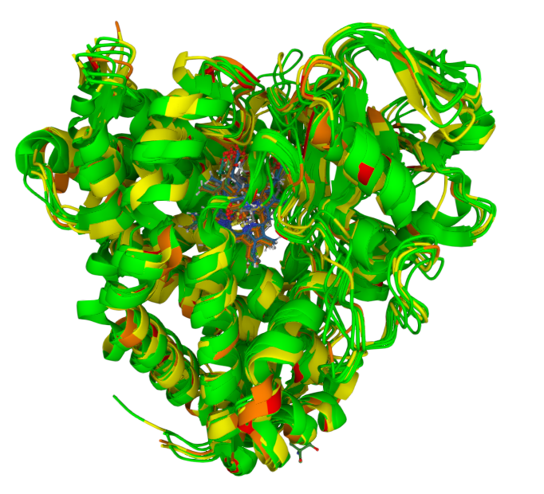
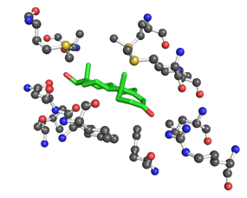
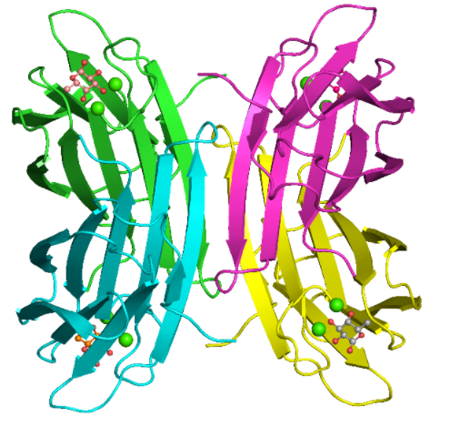
Thank you for your attention
Bioinformatics
Chemoinformatics
Tools
Databases
AI

