Slide 1
Visualization of proteins and ligands

Slide 2
MolStar
Web application for visualization of proteins and ligands
Handles even extremely large systems
Integrated in Protein Data Bank
Developed in house at the National Center for Biomolecular Research, in collaboration with EMBL EBI and RCSB PDB
https://molstar.org/

Slide 3
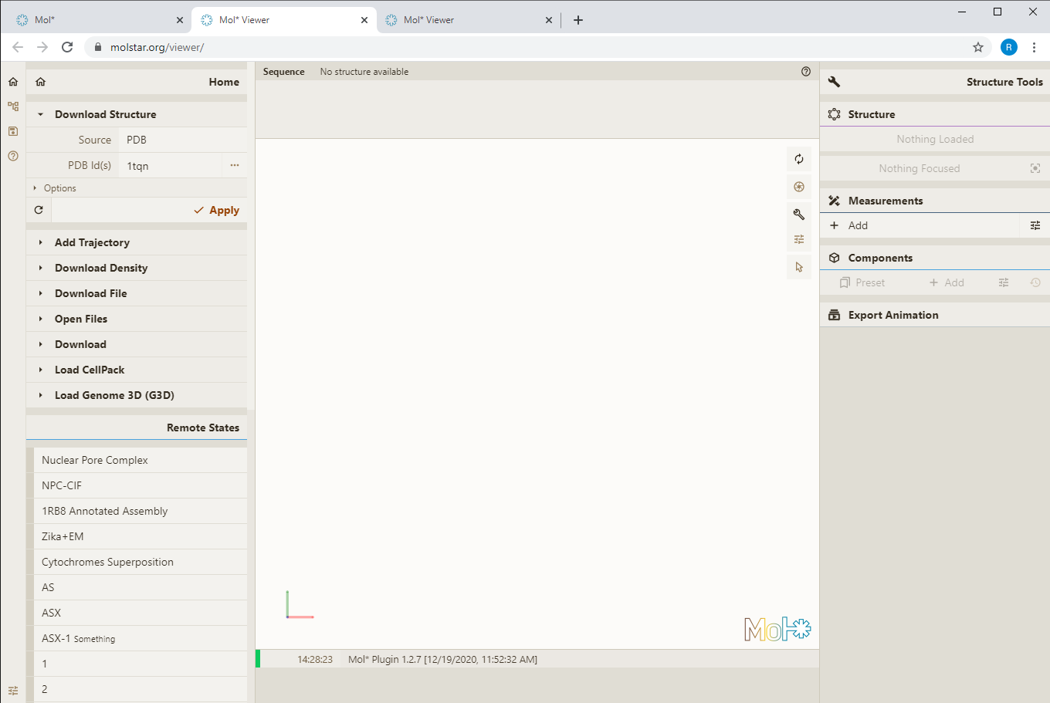
MolStar

Slide 4
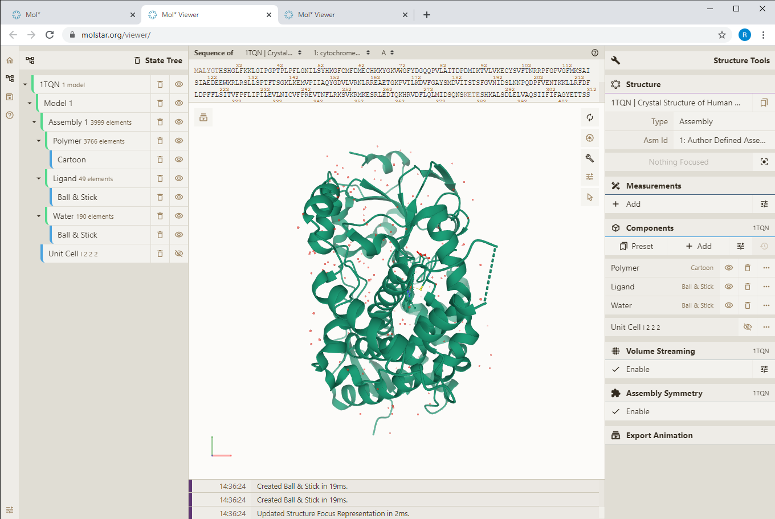
Visualization of 3D coordinates of the molecule Visualization model cartoon

Slide 5
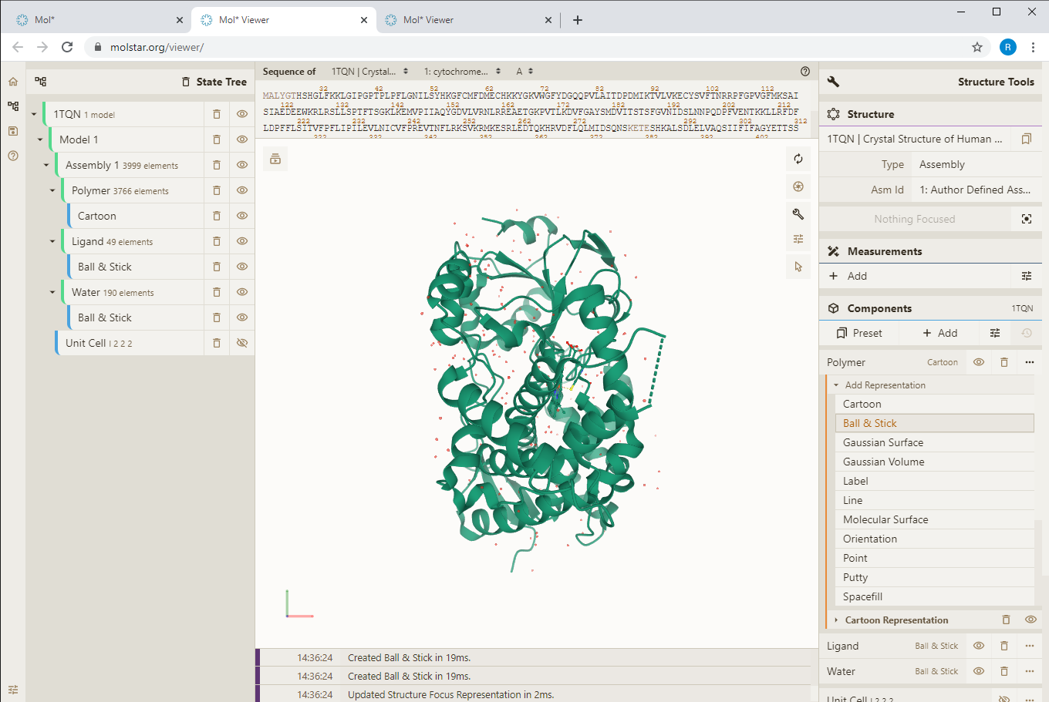
Visualization of 3D coordinates of the molecule Choice of visualization models

Slide 6
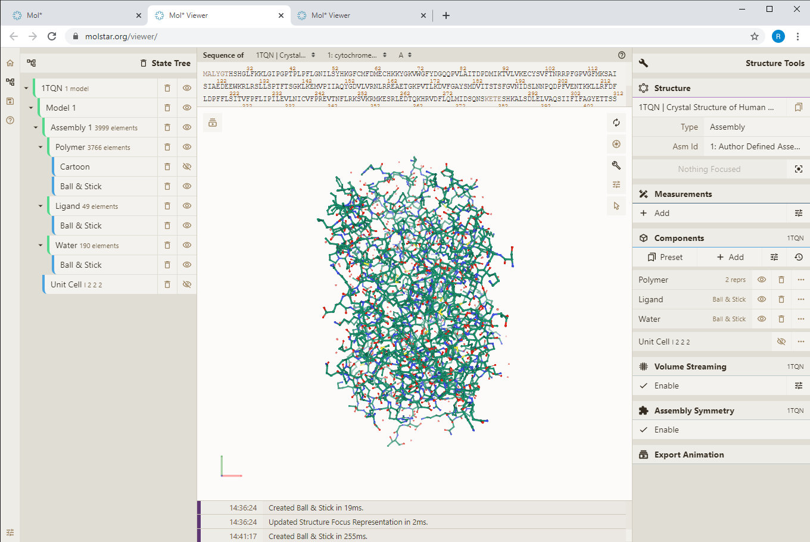
Visualization of 3D coordinates of the molecule Ball & Stick visualisation model
Other modes must be switched off

Slide 7
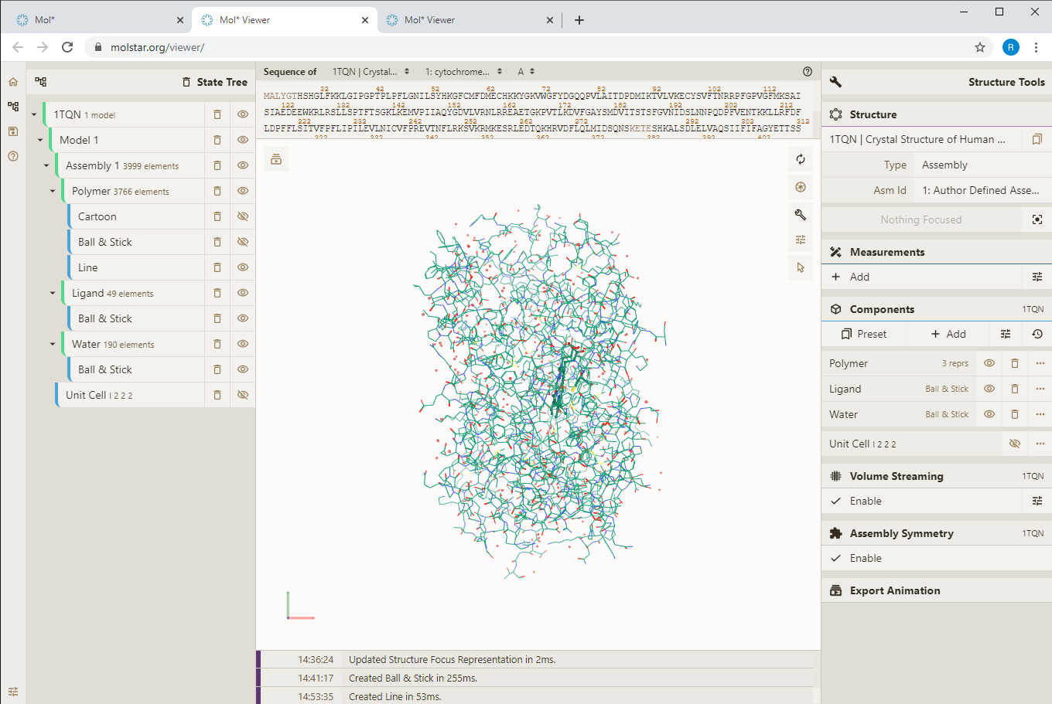
Visualization of 3D coordinates of the molecule Visualization Model Line

Slide 8
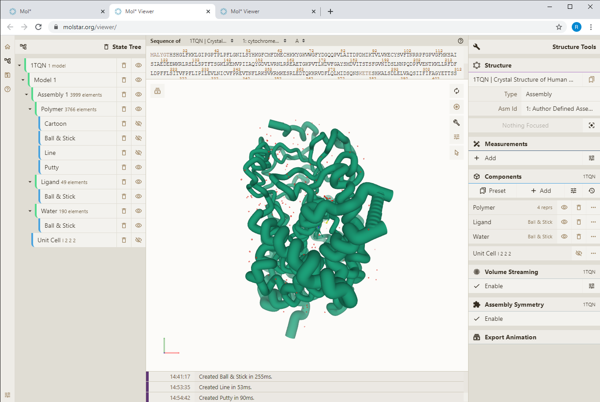
Visualization of 3D coordinates of the molecule Putty visualization model

Slide 9
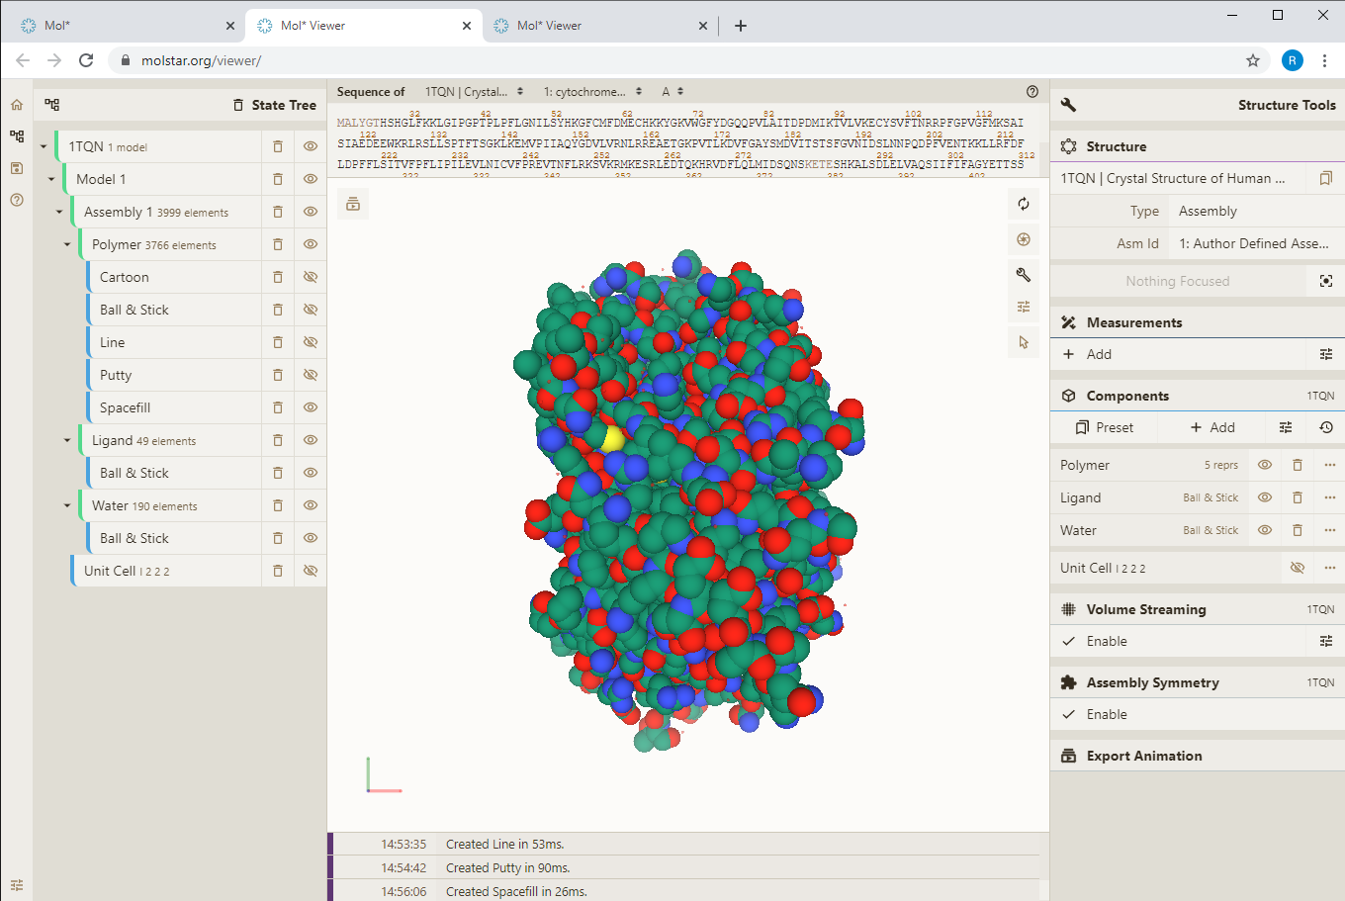
Visualization of 3D coordinates of the molecule Spacefil visualization model

Slide 10
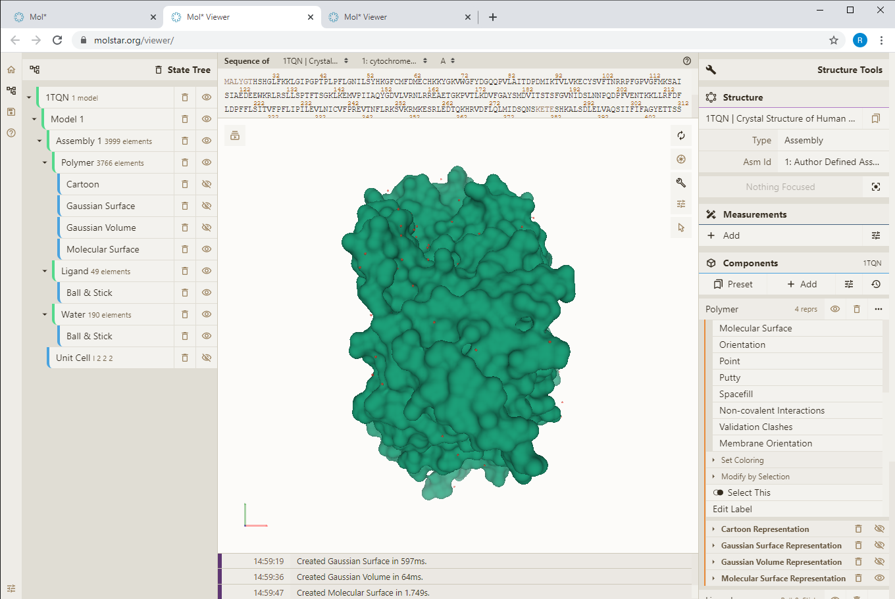
Visualization of the surface of a molecule Molecular Surface Visualization Model

Slide 11
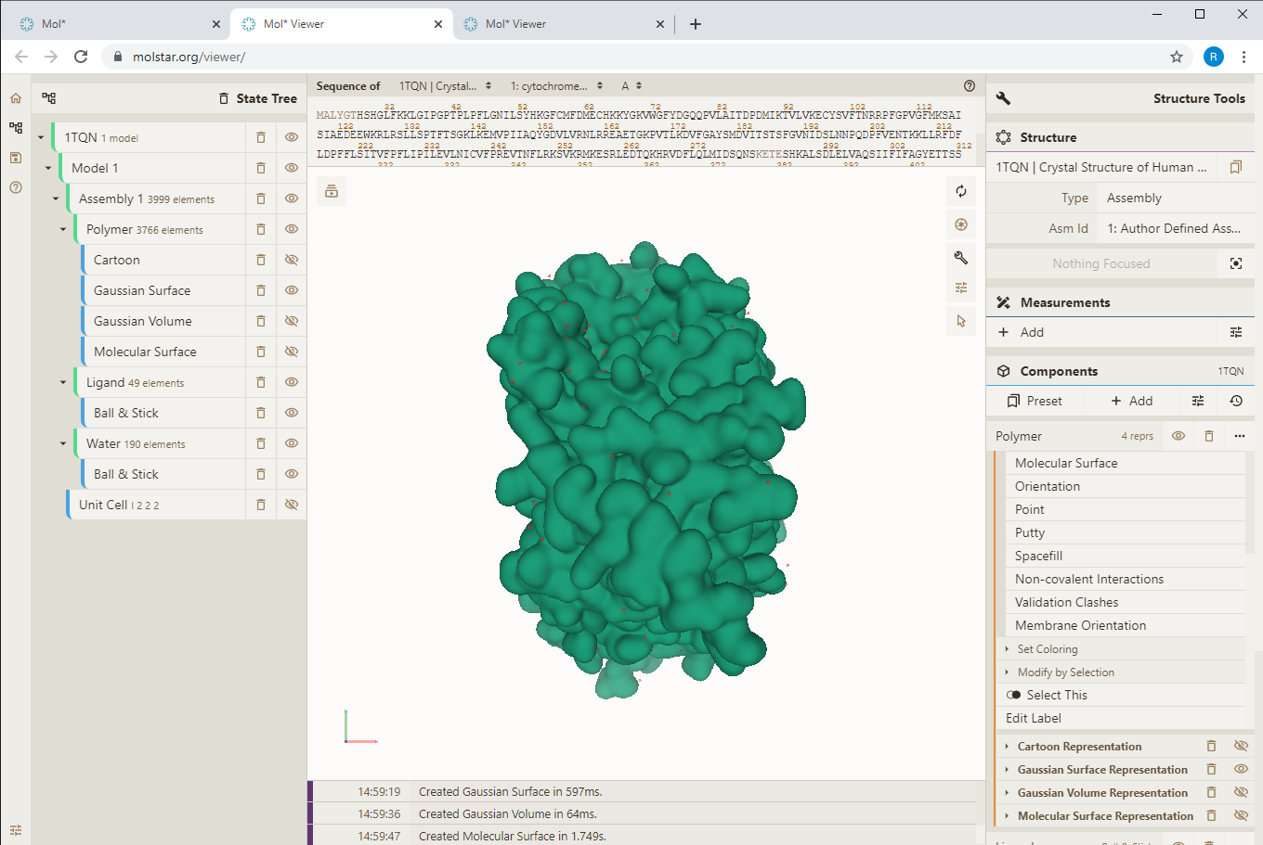
Visualisation of the surface of a molecule Gaussian Surface Visualization Model

Slide 12
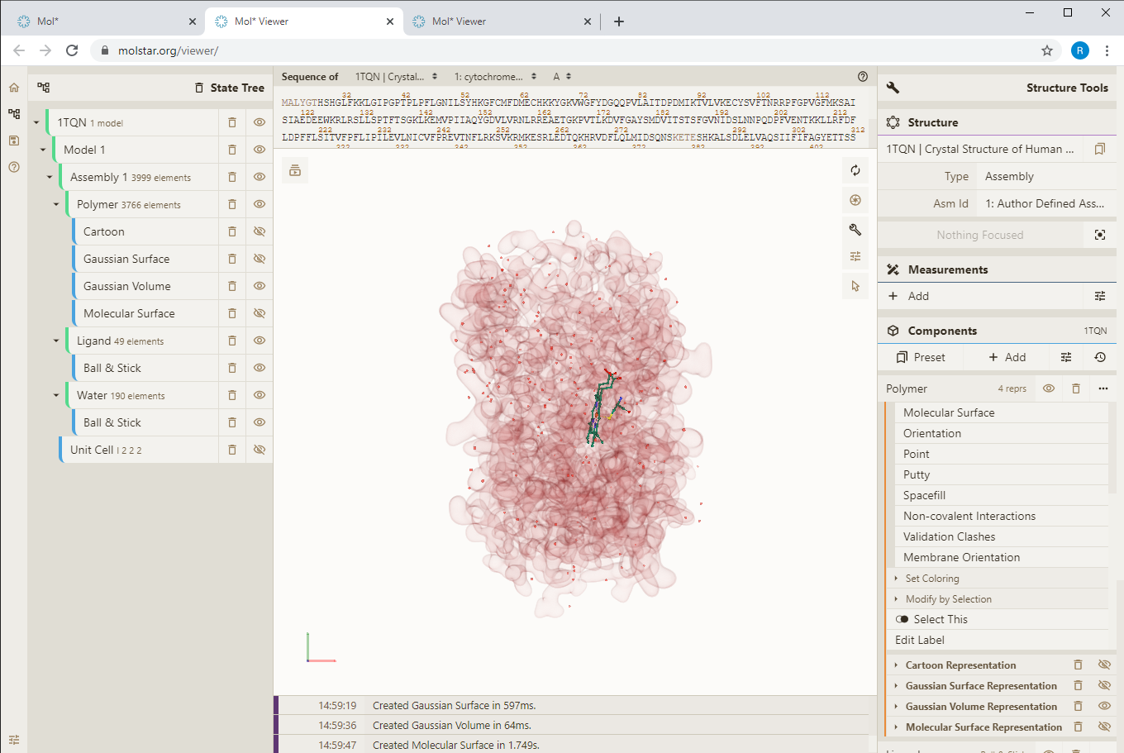
Visualisation of the surface of a molecule Gaussian Volume Visualization Model

Slide 13
Visualization of experimental data Electron density

Slide 14
Visualization of experimental data Electron density

Slide 15
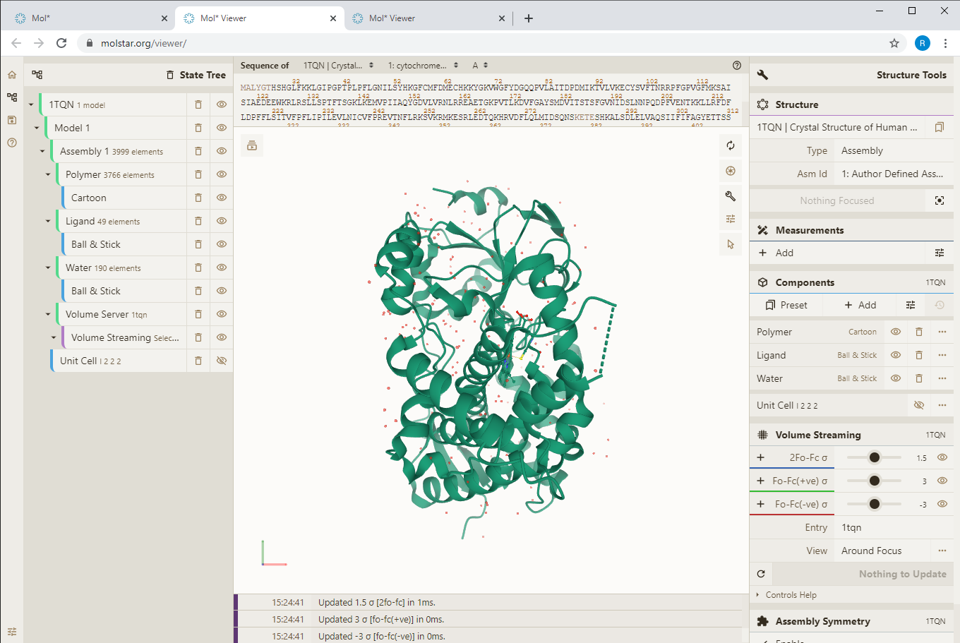
Visualization of experimental data Electron density

Slide 16
Visualization of experimental data Electron density
Click on the selected atom

Slide 17
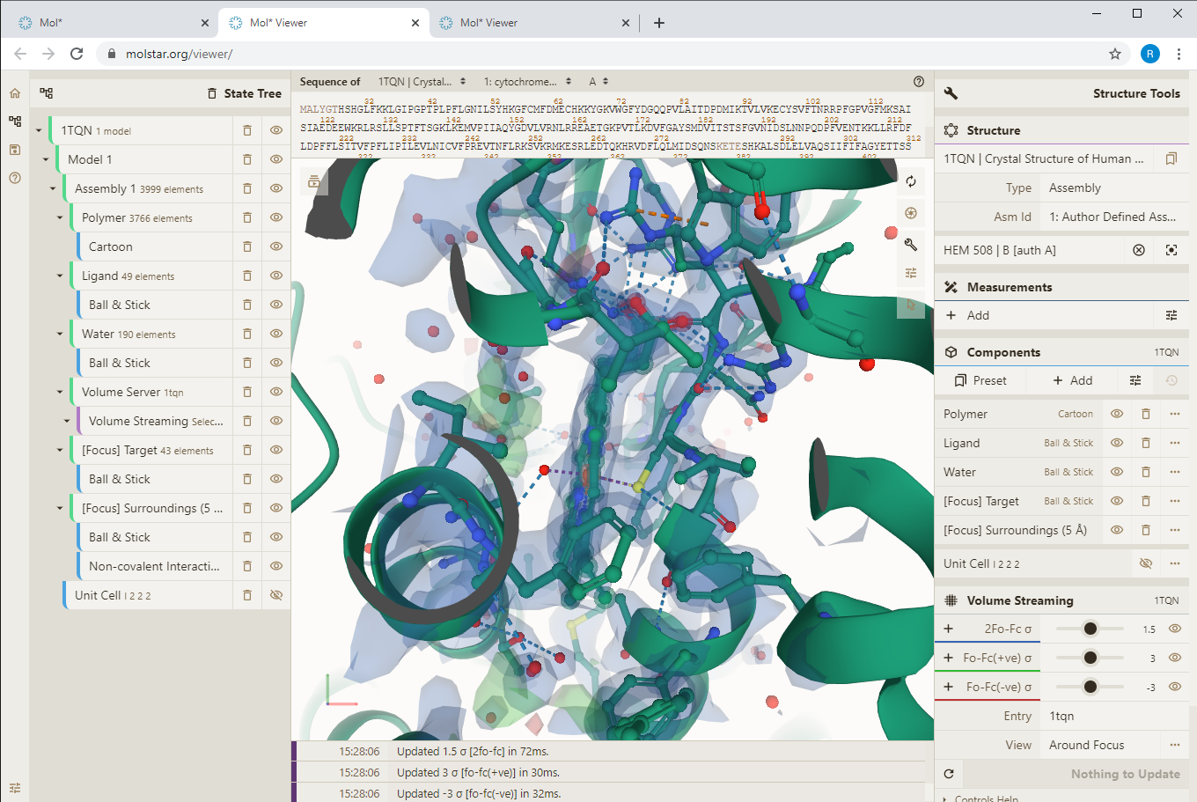
Visualization of experimental data Electron density

Slide 18
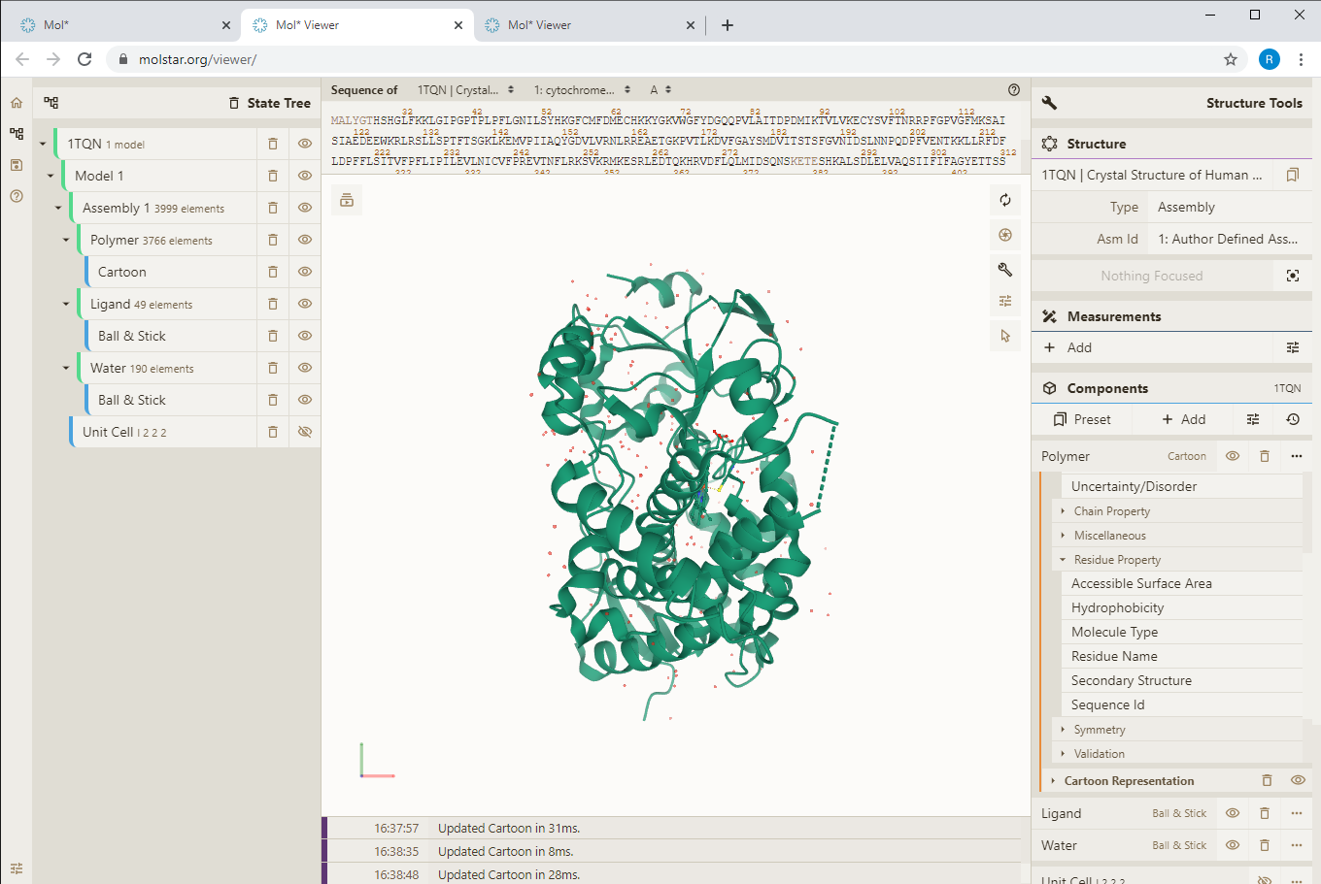
Visualisation of annotations Colouring by properties

Slide 19
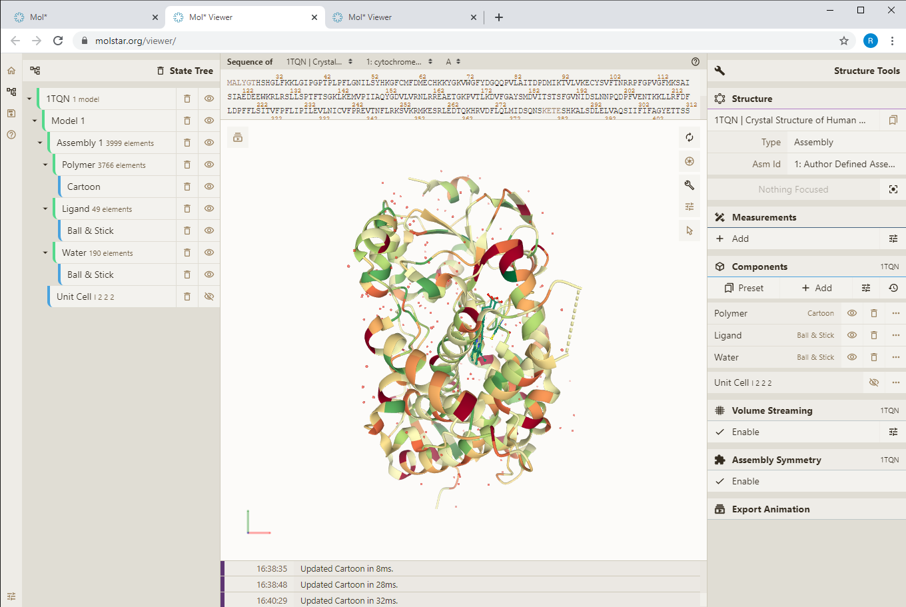
Visualisation of annotations Colouring by properties - hydrophobicity

Slide 20
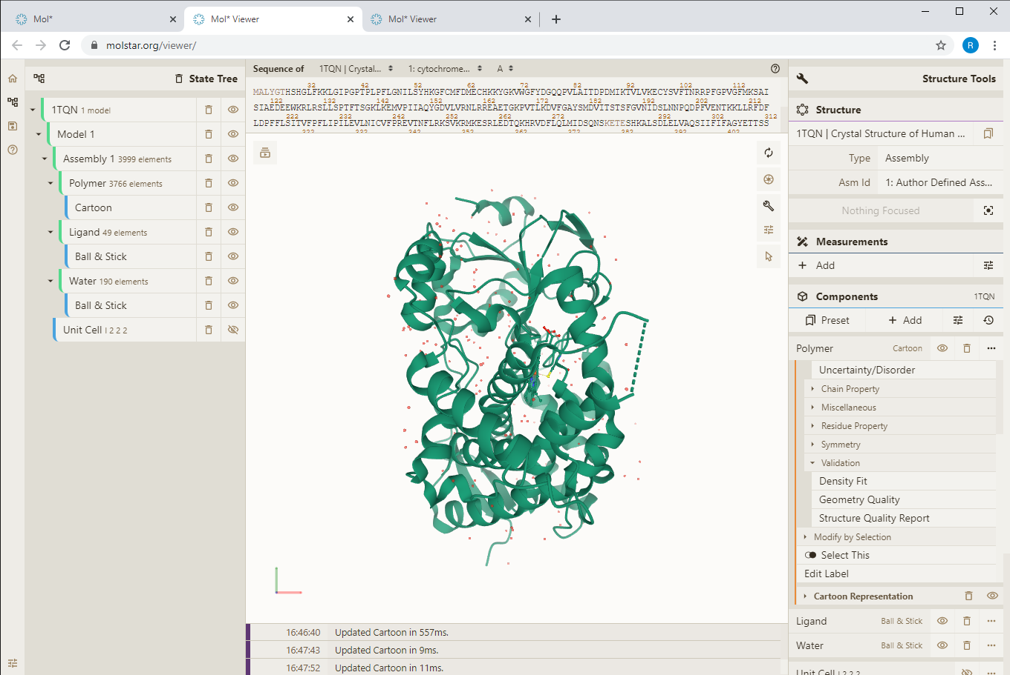
Visualisation of annotations Colouring by properties - quality

Slide 21
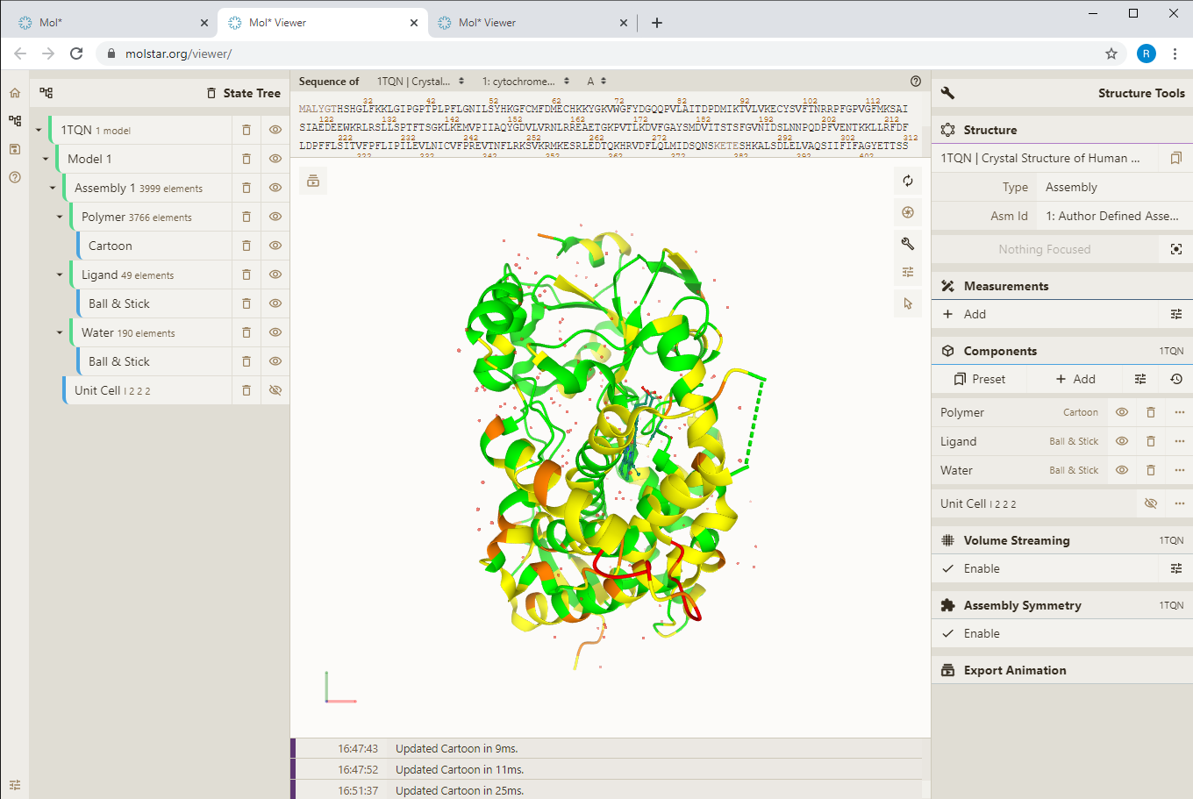
Visualisation of annotations Colouring by properties - quality

Slide 22
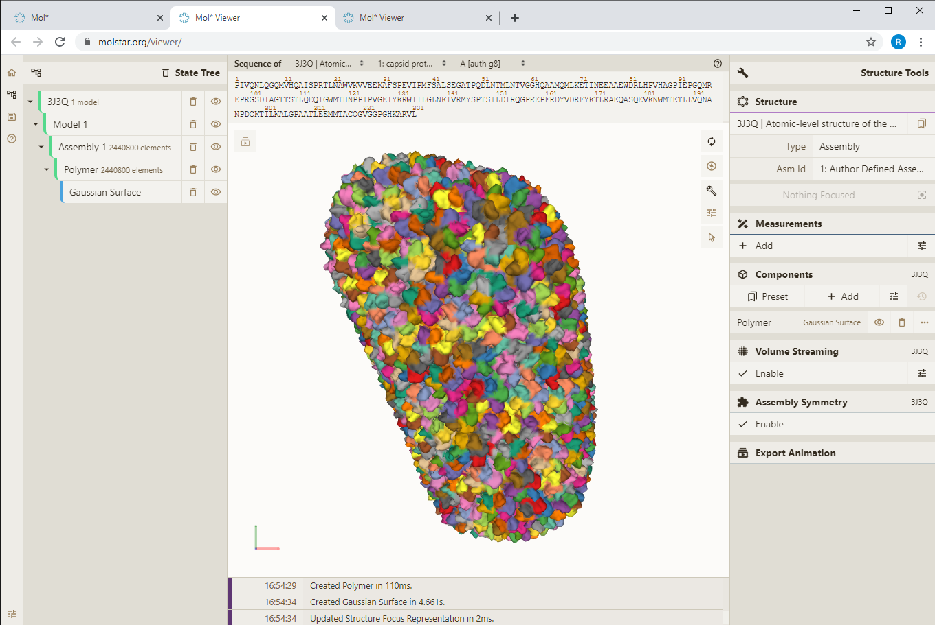
Visualization of protein assemblies

Slide 23
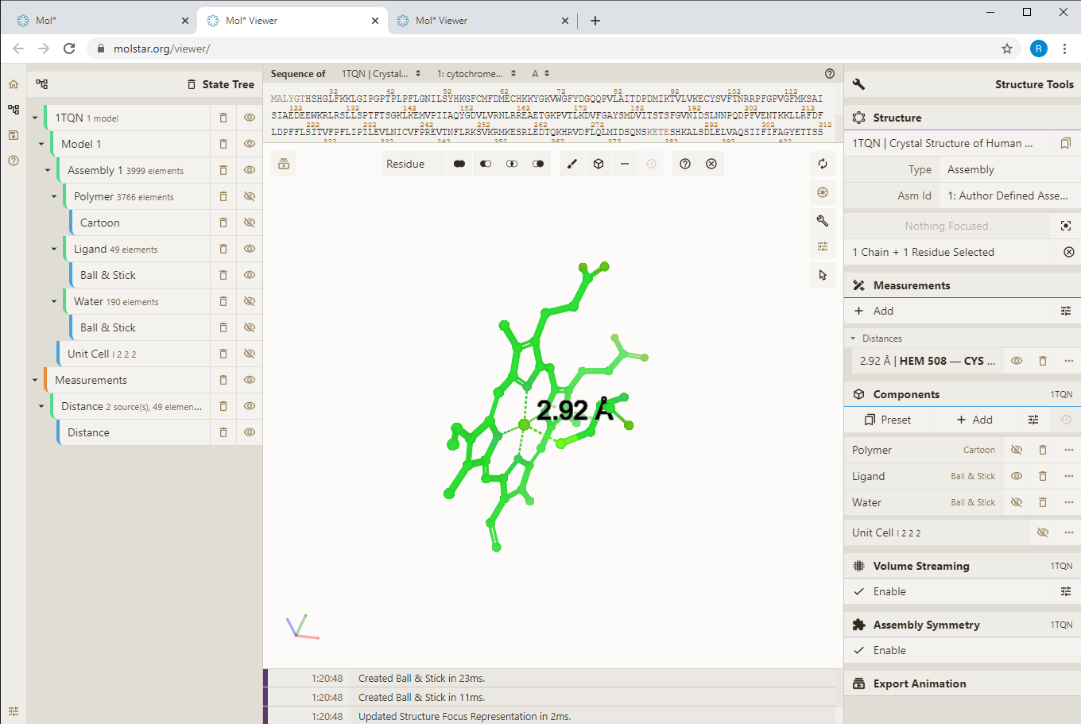
Measurements

Slide 24
Superimposition of structures

Slide 25
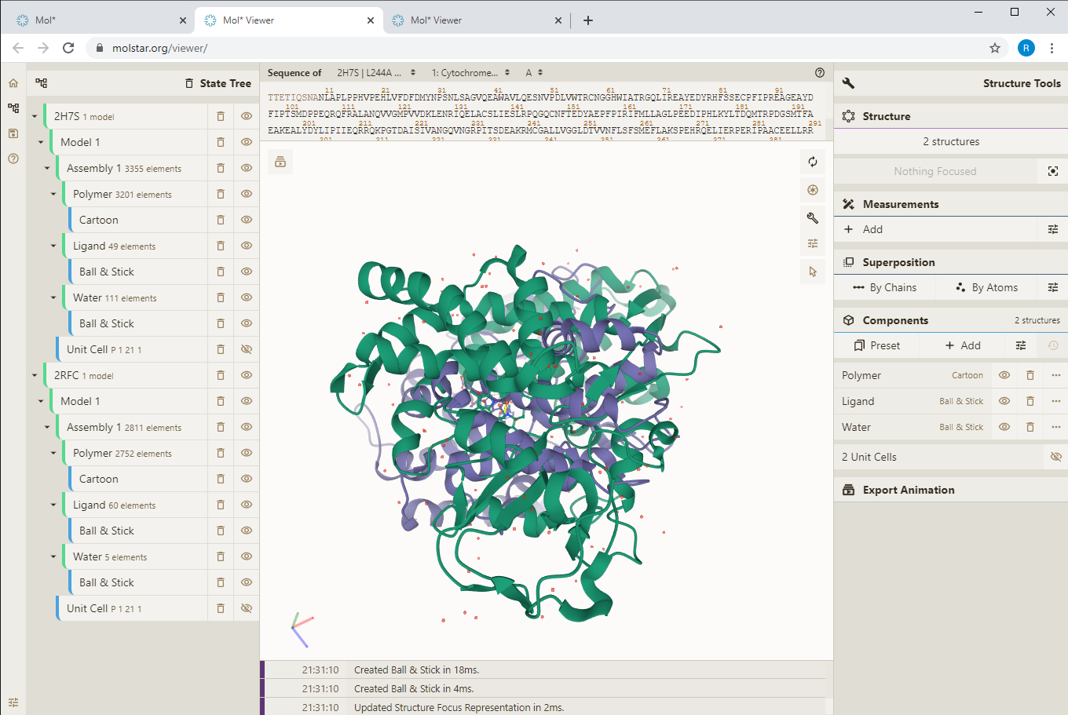
Superimposition of structures

Slide 26
Superimposition of structures

Slide 27
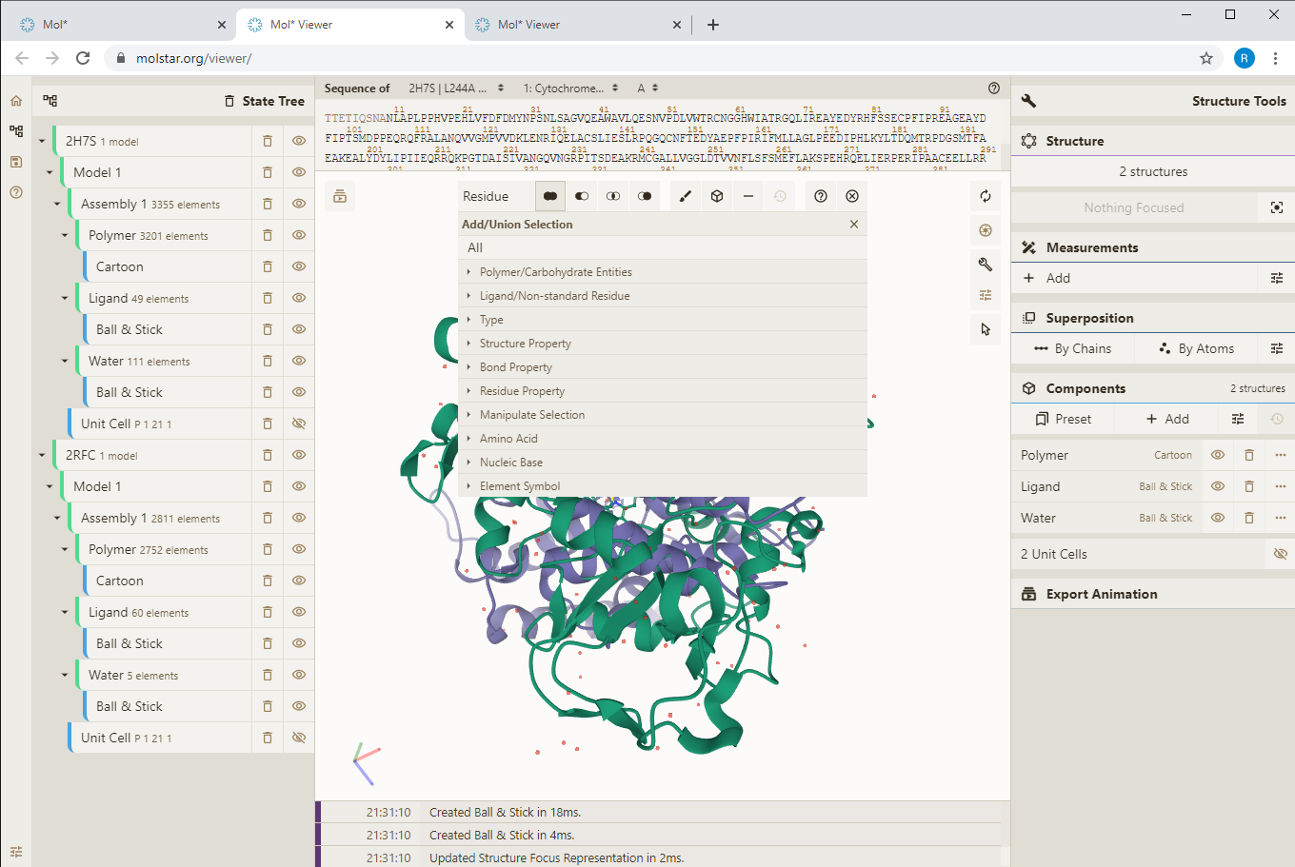
Superimposition of structures

Slide 28
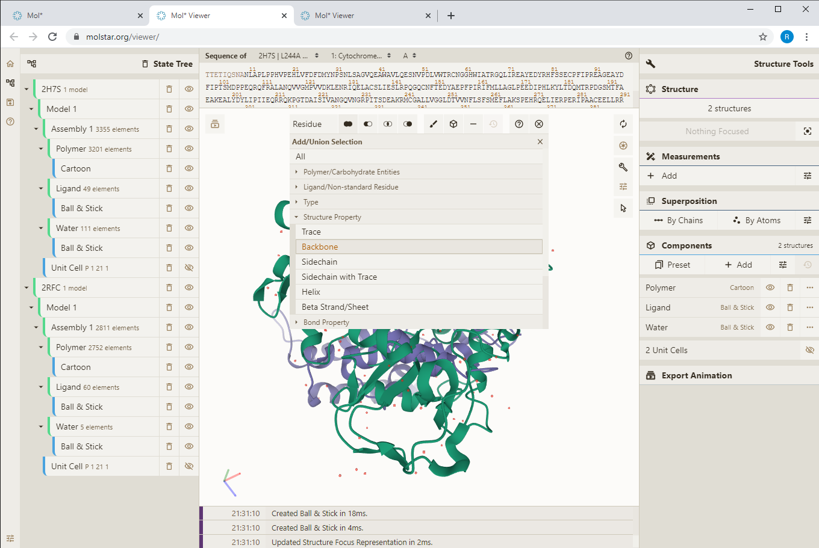
Superimposition of structures

Slide 29
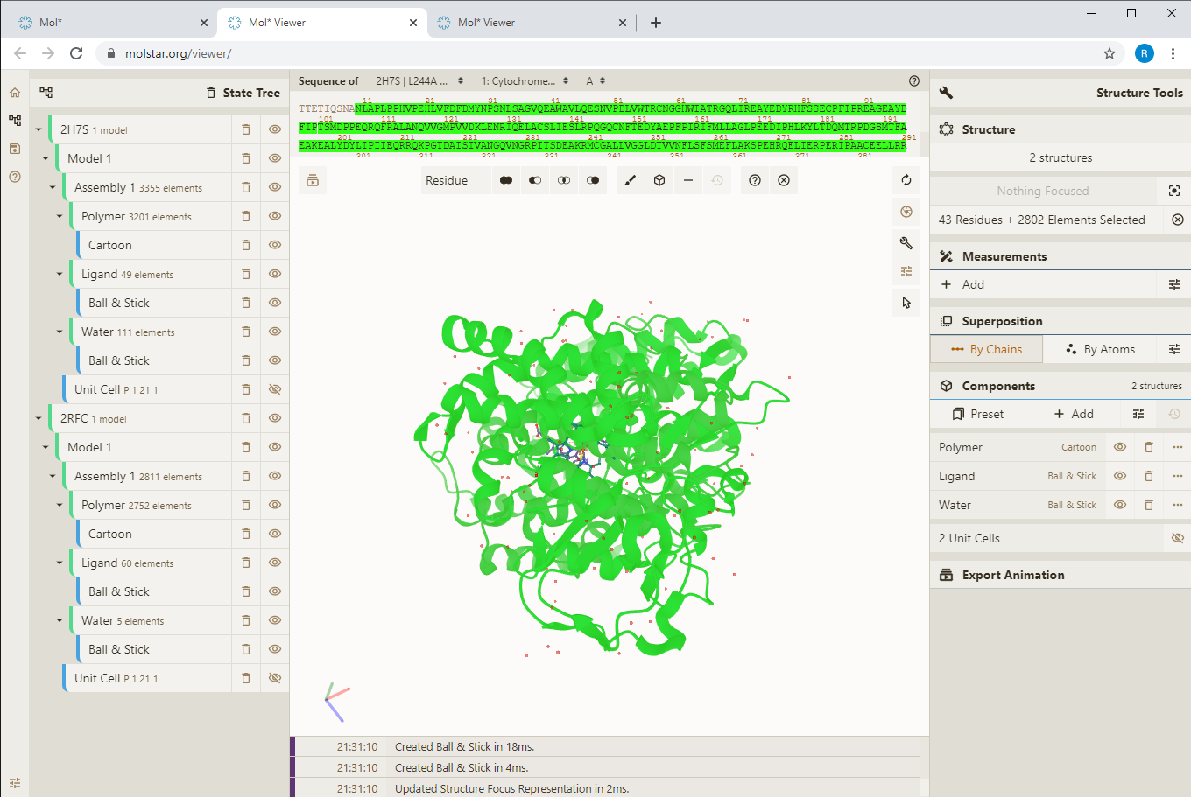
Superimposition of structures

Slide 30
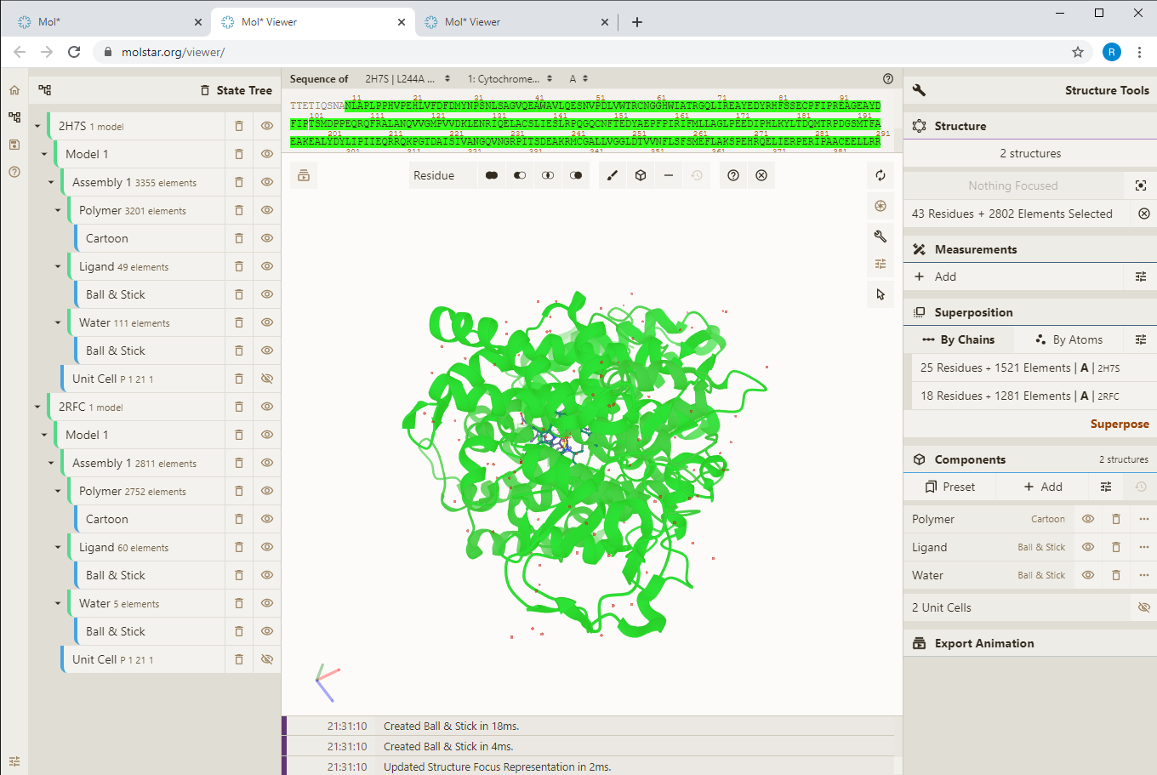
Superimposition of structures

Slide 31
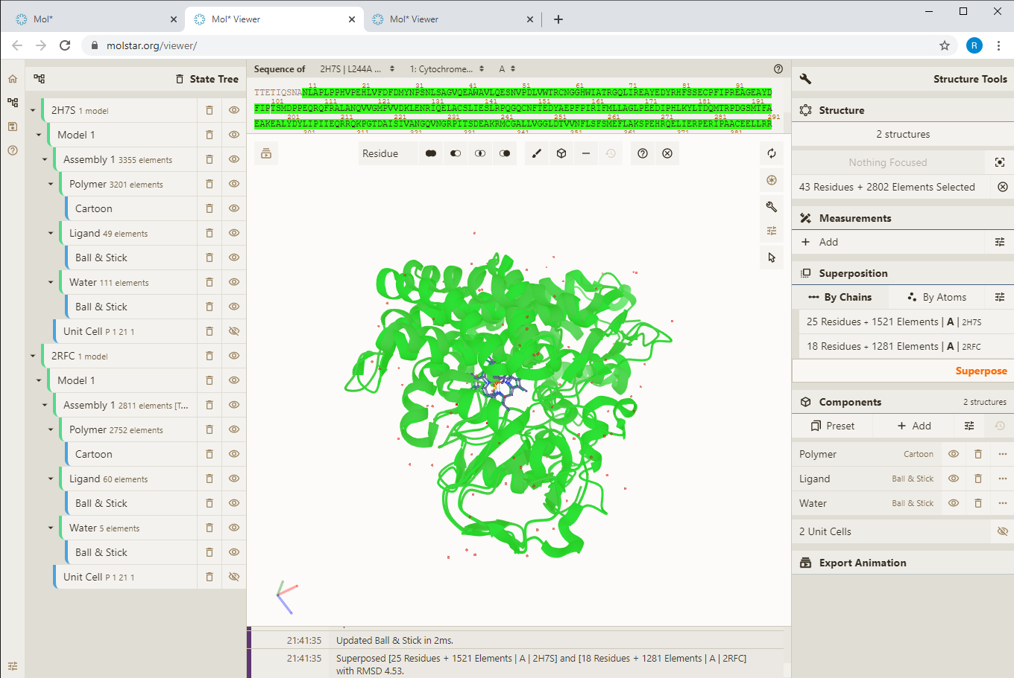
Superimposition of structures

Slide 32
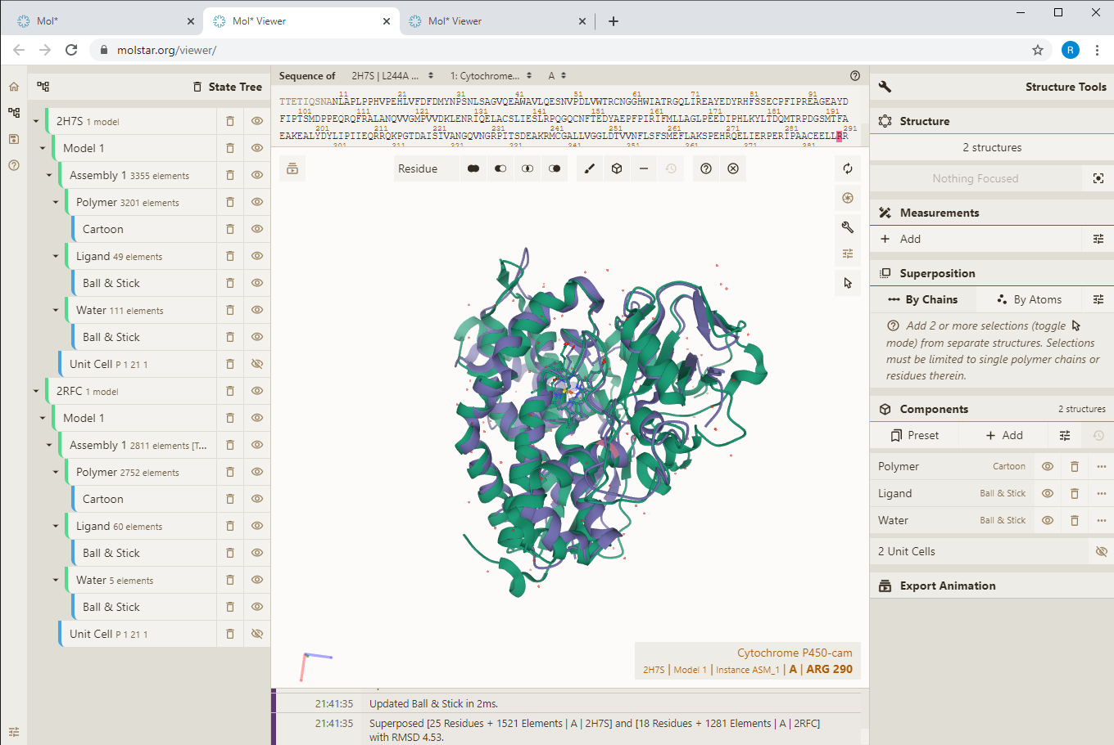
Superimposition of structures

Slide 33
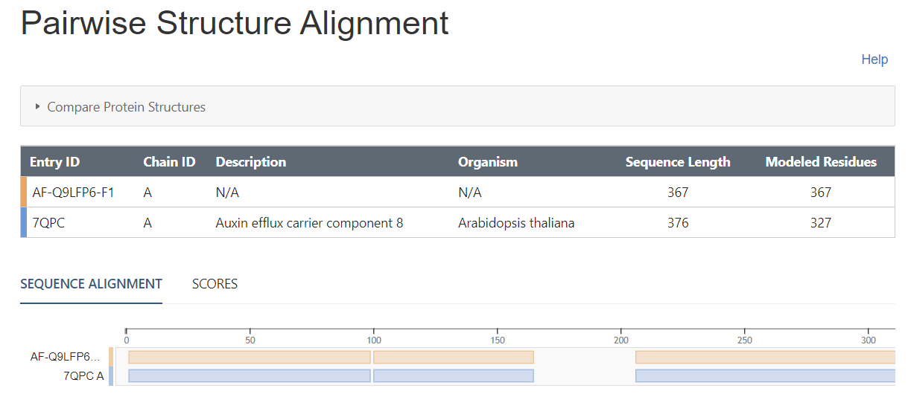
Superimposition of structures – PDB and AlphaFold
https://www.rcsb.org/alignment/

Slide 34
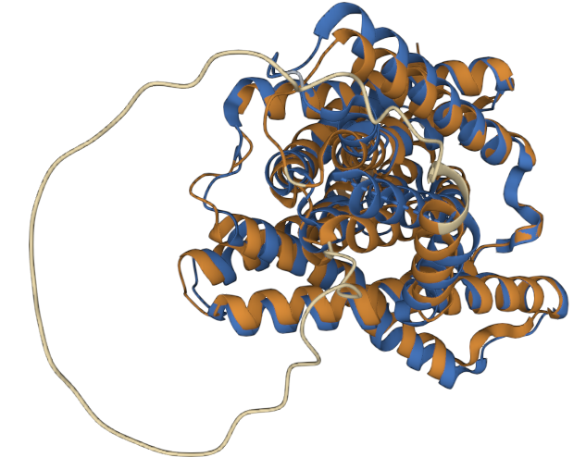
Superimposition of structures – PDB and AlphaFold

