Slide 1
VB035 Session 4

Slide 2
Agenda
Warm-up (IT related abbreviations)
How to give feedback
Email peer feedback
The escape game presentation
Grammar: questions, question tags

Slide 4
Peer review benefits
Develop your own critical and evaluative capacities
As the reviewer you gain just as much if not more than the reviewee
If you learn what to look for in a piece of writing of others you will be much better equipped to evaluate your own writing

Slide 5
1 Take turns giving definitions / explanations of these words.
FEEDBACK PEER
CONSTRUCTIVE CONSIDERATE
ENCOURAGING IMPROVEMENT
REVIEWER REVIEWEE
SPECIFIC

Slide 6
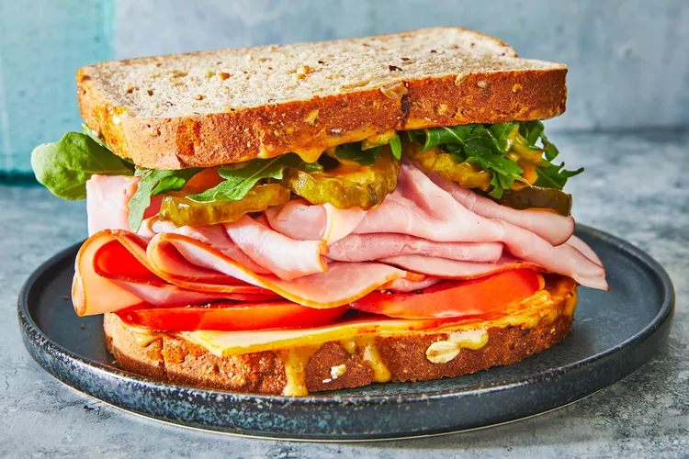
You might have heard of the sandwich feedback approach. What do you think it means? Would you like to be given feedback this way? Why? Why not?
1. ____________________
2_____________________
3._____________________

Slide 7
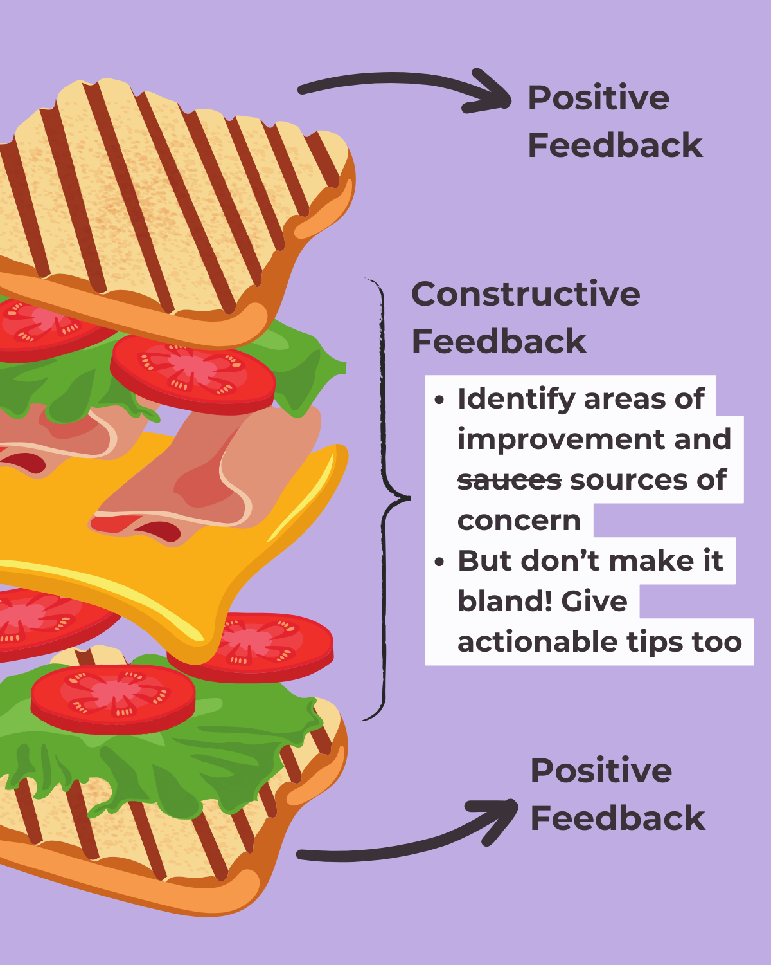

Slide 8
What to keep in mind when giving constructive feedback. In pairs, try to suggest the most appropriate adjectives for the letters in this acronym.
Your feedback should be C____________________________
R____________________________
I____________________________
S____________________________
P____________________________

Slide 9
Strategies to give feedback
Provide both positive and negative aspects of a performance
Language to praise: I appreciate how you…
I was impressed by… You did well with… Great job on…
Language to express criticism and suggestion: You could … I would like to see more … I think you should… One area to work on …. One suggestion is… It might help to…

Slide 10
1) Describe what your peer did rather than pass judgment
ie. Instead of saying “it’s good”, say something like “you used a wide variety of sentence structures that made it more interesting to read”
2) Praise
Tell your peer what they did well!
I think you used a lot of good details
I liked when you used the word ______
My favorite part was ________ because…
This was really fun to read because…

Slide 11
3) Suggestions
These should be specific!
How can your peer improve their assignment?
Instead of, “It didn’t make sense,” say, “If you add more details after this sentence, it would be more clear.”
Instead of, “Your word choice was boring/inappropriate,” say, “Instead of using the word good, maybe you can use the word exceptional .”

Slide 13
Take-aways
Be specific
Stay positive
Your goal is to help your peer improve
Feedback is not about correcting mistakes and editing
Feedback is providing guidance

Slide 14
Comment on a letter written by a fellow student. In your comments consider the following aspects
Content (Is the email relevant? Do you understand the key points?)
Structure (Appropriate salutation and title of address, intro, purpose, description of the problem, solution, conclusion, polite closing phrases, sign-off, signature (name + surname)
Style (appropriate, formal)
Vocabulary (formal, accurate, etc.)
Grammar (word order, articles etc)
Punctuation
Tone (polite)

Slide 15
Question tags exceptions
aren’t I?
I am I am still a part of the team,
Need (negative) He doesn’t need to repeat the year,
does he?
Let’s
Let’s try this new restaurant.
Shall we?
Wait a minute,
can you?
Have some more rice,
will you?
There is a mosque in that street,
isn’t there?
Someone’s been taking my food again,
haven’t they?
Nobody has planned,
have they?

Slide 16
2) Complete the question tags.
Get me some chewing gum when you go to the shop, ____________ you?
b) Let’s watch a new film, ____________ we?
c) There’s not really much point waiting, ____________ there?
d) Tonia will put us up for the weekend, ____________ she?
e) Nobody seems to like Jessica, ____________ they?
f) I’m not making much sense now, ____________ I?
g) Let’s go because it’s getting late, ____________ it?
h) If you borrow my coat, don’t get it dirty, ____________ you?
i) Bill should be here by now, ____________ he?
j) I’m making you feel uncomfortable, ____________ I?
k) Someone left the door open, ____________ they?
l) Nobody knows about this, ____________ they?

