Slide 1


Biomechanics 5
Kinematics 2
Daniel Jandačka, PhD.

Slide 2
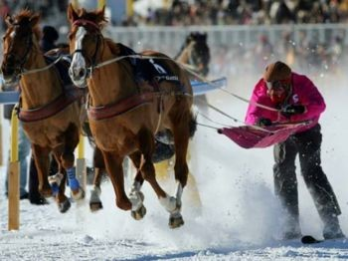
Velocity
When we say that somebody is slow or fast we are actually describing his/her velocity
In biomechanics one of our tasks is to quantitatively describe velocity.
If a property is quantifiable, it means that certain aspects of such property are measurable and can be expressed by a number.

Slide 3
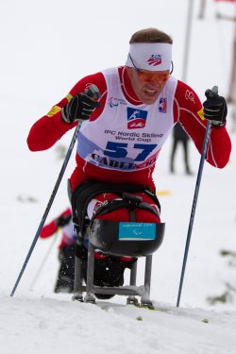

Mean Speed
Mean speed v is the distance s divided by time t taken to cover the distance
The SI unit is metre per second (m/s).
Mean speed is important in describing performance in many sport events. In the events where athletes must cover the same distance their speed is the direct measure of their success.
In cross country skiing, for example, the winner covers the given distance in shortest possible time. The mean speed of an athlete is the distance he/she covers divided by his/her final time.

Slide 4
Mean speed, however, does not say much about the actual course of the race. We know nothing about their maximum speed and about those sections of the track where racers speeded up or slowed down.
Table Split times and mean speeds of pacemaker in sections 1-5, 10-15, 20-25, 30-35 and 40-marathon, to make the final time of 3 hours.
Distance covered (m) | Split time (hod:min:s) | Section mean speed (m/s)
1 000 | 4:28 | 3,73
5 000 | 22:20
10 000 | 43:50 | 3,94
15 000 | 01:05:00
20 000 | 01:25:10 | 3,90
25 000 | 01:47:30
30 000 | 02:09:00 | 3,97
35 000 | 02:30:00
40 000 | 02:51:30 | 4,17
42 125 | 03:00

Slide 5
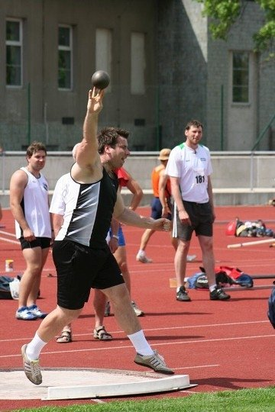
Instantaneous velocity
Instantaneous velocity is the velocity of a moving object at a particular instant of time. It is the velocity attained by the object in a very short period of time (approaching zero).
For example - release velocity
Instantaneous velocity is vector quantity

Slide 6
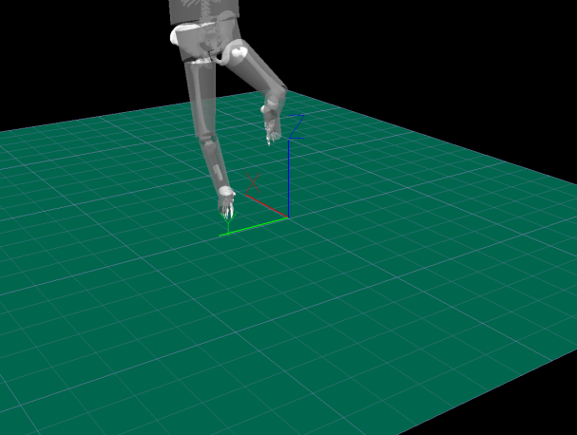
Mean and standard deviation of the kicking toe’s velocity (n = 9): The solid, dashed, and dotted lines represent the mean for kicks when starting from the 0°, 45°, and 90° stance positions, respectively. The solid area represents the standard deviation from the 45° curve.
Magnitude

Slide 7
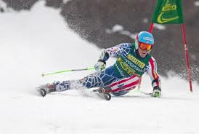
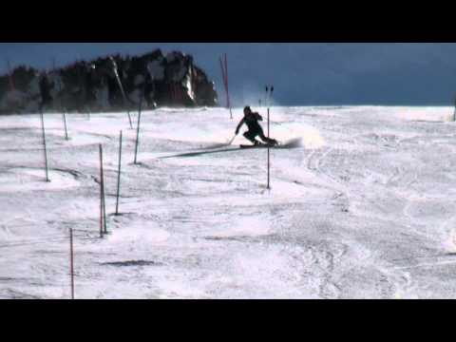
Displacement Velocity
The displacement divided by the length of the time interval
In downhill skiing, for example, we are not that interested in mean speed but rather in displacement velocity, i.e. how fast skiers moved from start to finish, regardless the actual speed of going around gate poles

Slide 8
Importance of Speed
There are many sport events in which the winner is the competitor with the highest mean speed.
Speed is also important in sport events where it is only one of the factors influencing the overall performance.
Let us have a look at tennis serve. After a good serve the ball flies with the speed of 100 - 200 km/h and it is really difficult to come up with an equally good return. Why? The faster the ball flies the less time the opponent has to move. For example Ivan Karlovič is able to serve with the record speed of 251 km/h (70 m/s). The distance between the opponents is about 24 m. How much time does the opponent have to react to Ivan Karlovič’ serve?

Slide 9
time = displacement / speed
time = 0.34 s
The opponent has only about 0.3 second for a motor task of precisely returning the ball. We can see that in tennis the speed of the ball determines the time players have to manage a stroke or to move to a desired position.
In the same way in sports such as football, floorball, hockey, and handball the speed of a flying projectile is important for goal keepers because it determines the amount of time they have to catch it.
Speed is also a positive factor of performance in long jump, triple jump, high jump, and ski jumping.
Gymnasts need high speed in vault so that they can manage the given number of rotations.

Slide 10
Thank you for your attention

