Slide 1


Biomechanics 9
Kinetics 2
Daniel Jandačka, PhD.

Slide 2
Impulse of Force
Impulse of force is the product of the resultant force ΣF and the duration of this force Δt, if the force is constant.
I = ΣF Δt
Unit of Impulse of Force is Ns

Slide 3


Impulse of Force and Momentum
Resultant external force acting on a human body for certain time causes changes to its momentum.
To cause greater change to momentum we have to either use greater force for the same period of time, or the same force for a longer period of time.

Slide 4
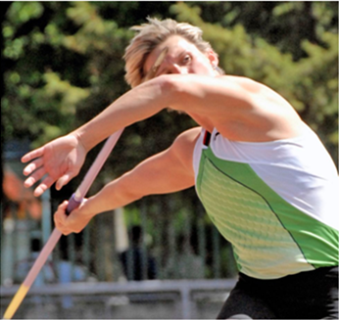
How to use impulse of force to increase momentum in sport?
The greater the impulse of force, the greater the change to momentum of a body (projectile, human body, tennis racket, ball, etc.)
The important thing is that to change momentum we have to either use greater force or increase the duration of the same force.

Slide 5
When throwing light objects,
the technique used (duration of force) is much more important for the longest possible throw than the magnitude of the force.
When throwing heavy objects,
the magnitude of the force is more important. Shot-putters are usually stronger and bigger than javelin throwers. Their preparation is focused on enhancing their ability to exert great force (ΣF in the impulse of force).
Top javelin throwers do not have the same maximum strength as shot-putters but they are successful because their technique maximizes the duration of the force they exert (Δt in the impulse of force).

Slide 6
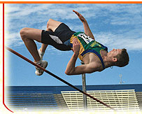
How to use impulse of force to decrease momentum in sport?
Certain sport activities, on the other hand, necessitate decreasing a high initial velocity of a human body to zero velocity. In other words we need to decrease momentum of given bodies.
As examples we can easily imagine all kinds of landing, catching of balls, pucks, etc.
For example pole vaulters cannot land on their feet, due to the technique they use, but they land on their backs. Landing on the hard ground means a very short time of deceleration of human body, so the forces acting on human body in such a situation would be massive and devastating. Landing pads are made of soft and floppy material which prolongs the time of breaking the fall. The impulse of force is the same as in landing on the ground but its magnitude is decided rather by the duration of landing than by the magnitude of the force.

Slide 7
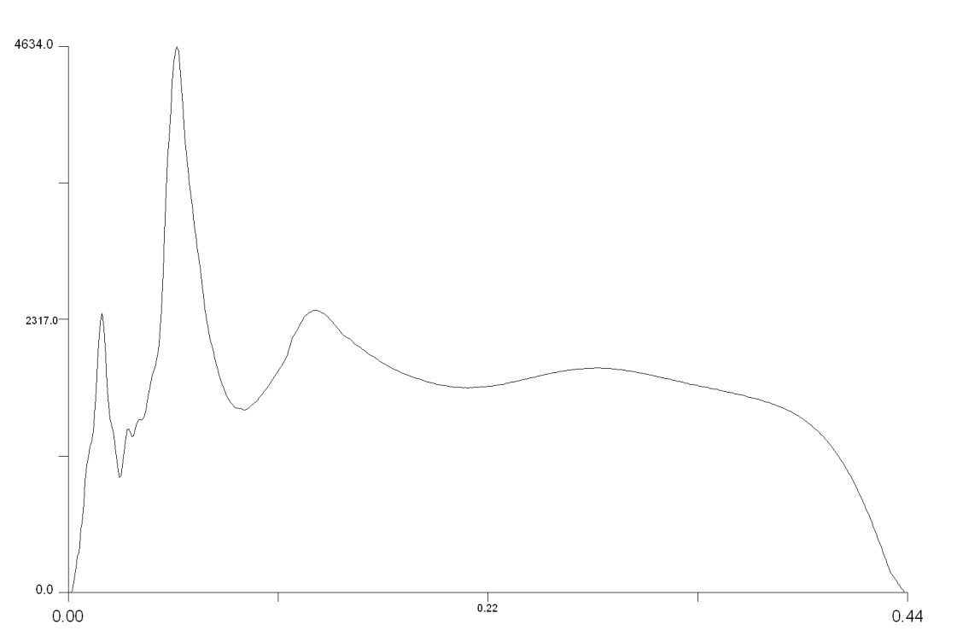
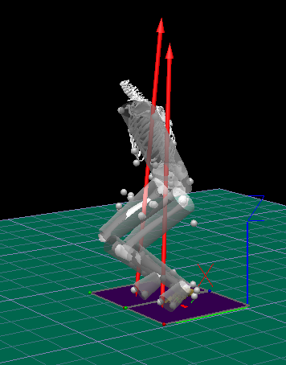
Ground reaction force
GRF= Δp/ Δt
Longer time= lower force

Slide 8
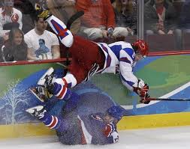
Newton's Third Law of Motion
For every action, there is an equal and opposite reaction.
When one body exerts a force on another body, the second body exerts a force on the first body that is equal in magnitude but opposite in direction.
In such a collision we can see that ramming into an opponent with less mass has more movement effect (assumption of same velocity).

Slide 9

Newton's Law of Universal Gravitation
Bodies attract other bodies with a force that is directly proportional to the product of their masses and inversely proportional to the square of the distance between them
Gravitational forces between bodies are insignificant in sport activities and we can neglect their existence.
Only one body has a significant effect on other bodies in sporting activities (and everyday life) – planet Earth.

Slide 10
Tíhová síla
Tíhová síla působící na těleso může být matematicky vyjádřena takto:
Fg = mg

Slide 11
Thank you for your attention

