Slide 1


Biomechanics 11
Moment of Force
Daniel Jandačka, PhD.

Slide 2
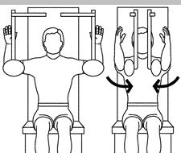
Moment of Force
Moment of force is a measure of the force’s tendency to cause a body to rotate.
Motions of our extremities about our joints are caused by moments of force generated by our muscles. Thanks to muscles that produce moments of force in our joints we can move.
During the exercise the 50 kg load might sometimes seem to you as „half load“. Why is it so that we can lift heavy loads with a relatively small force?

Slide 3
There are three kinds of situations in which an external force acts on a free body
1. Central force – external force whose vector line goes through the centre of gravity of the body. Central force causes only linear motion. It is a force that acts on a bobsleigh in the straight part of the tracks.
2. Eccentric force – external force whose vector line does not go through the centre of gravity of the body. Eccentric force causes changes to both linear and rotary motion. The force acting on a gymnast at a moment of take-off in squat vault over the horse is a good example here.
3. Pair of forces – forces of identical magnitude but opposite direction, not lying in the same line. Such pairs of forces cause only changes in rotary motion. Resultant of these two forces is zero, therefore according to Newton’s first law these forces do not cause a change to linear motion.

Slide 4
Moment of force definition
The magnitude of the moment of force acting about a point is directly proportional to the magnitude of the acting force and to the distance of this point from the vector line of the force that produces the moment.
The distance between the vector line of the force and a selected point is called moment arm.

Slide 5
Free body diagram – pole vault. Blue dot is the centre of gravity of the athlete. Black arrows represent reaction forces through which the pole acts on the athlete’s arms. Blue arrows represent moment arms in relation to the axis of rotation and the centre of gravity.
r₂
F₂
r₁
F₁

Slide 6
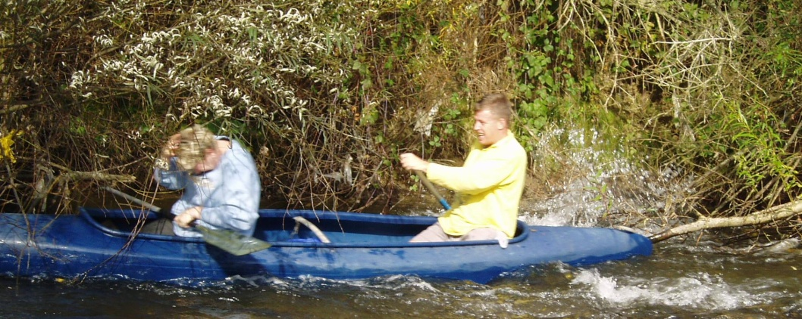
Examples of using moment of force in sport
As the point of rotation is where we hold the paddle with our top arm, the lower we put our bottom arm the bigger the moment of force is. It practically means that our strokes will be longer but with higher rotating effect of the same force of stroke.
In tennis, golf, ice hockey, etc. moment of force depends on the way we hold the racket, golf club, ice hockey stick, etc.
Moment of force must also be used in sports where either the athlete or the equipment he/she uses rotates.
In martial arts, such as judo or Greco-Roman wrestling, athletes choose holds to produce highest possible moment of force.

Slide 7
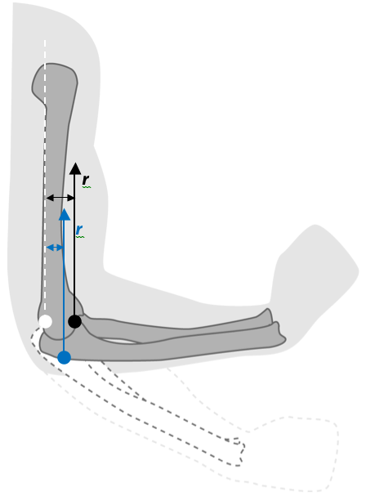
Moment of muscle force
In Figure we can see a force produced by biceps brachii on forearm when the position of elbow joint changes from full extension to 90° flexion. Do muscles always produce the same moment of force during that motion? The ability of biceps brachii to produce moment of force in elbow joint depends on the position of elbow joint. Moment arm of muscle force varies depending on the mutual position of the individual segments of the joint
Moment arm of muscle force of biceps brachii decreases from r₁ to r₂ during extension in elbow joint. The centre of rotation of the elbow joint is marked with the white dot. Insertion of biceps brachii is marked with black dot in 90° position and blue dot in 120° position. The arrows mark forces by which the insertion of biceps brachii acts on tuberosities of radius and on bicipital aponeurosis of deep fascia on medial section of forearm.

Slide 8
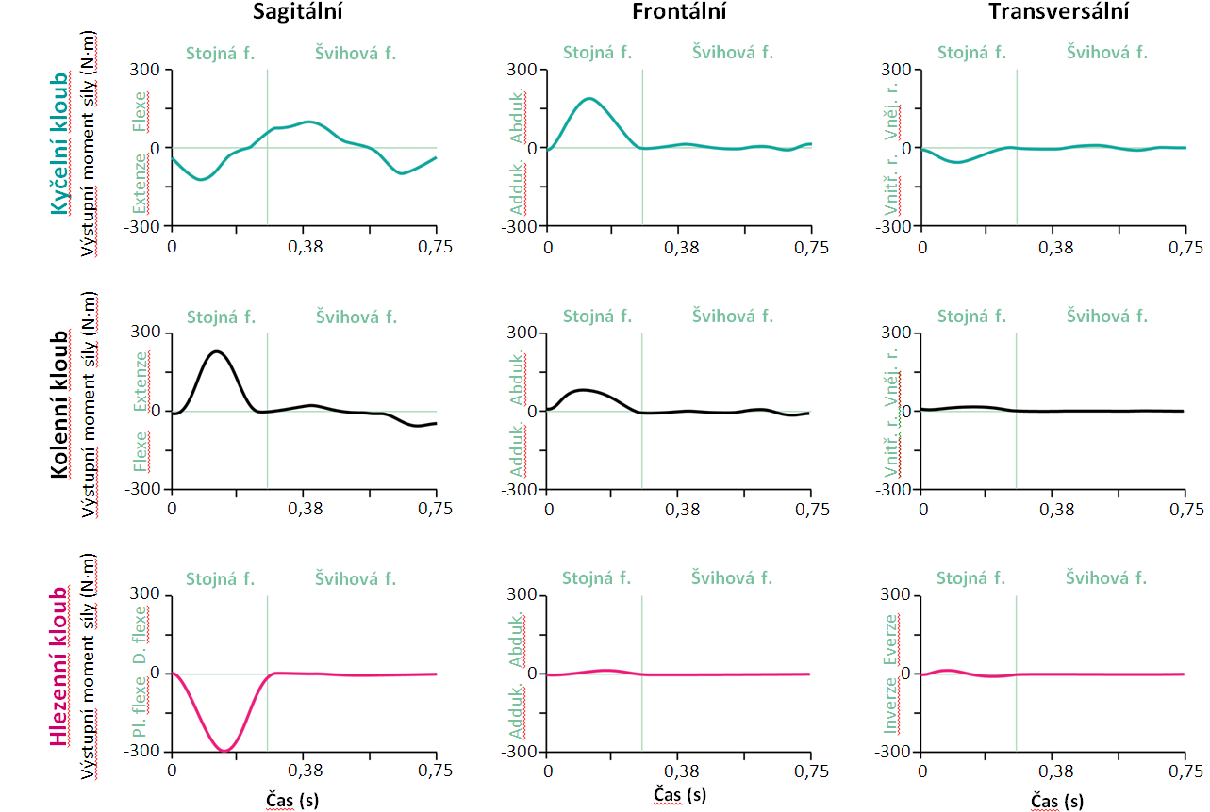
Net joint moment of force, left hip, knee and ankle during gait cycle (4 m/s) (first contact - forefoot).
Measured at Human Motion Diagnostic Center OU

Slide 9
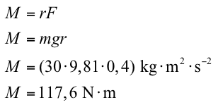
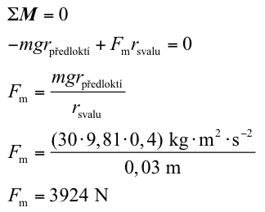
Forces and moments of force in static balance
To keep a body in static balance the sum of external forces and the sum of external moments of force acting on that body must be zero.
Estimate of muscle forces with the help of the equations of static balance
If elbow flexors are fixed approximately 0.03 m from the axis of elbow joint on the forearm, the following holds true:
Imagine we are holding a 30kg barbell. Our elbow joint is in 90° flexion and our forearm is parallel with the floor. If the length of our forearm is 0.4 m, with what moment will the barbell act on our forearm in relation to the axis of rotation (elbow joint)?

Slide 10
Elbow flexors must produce force with the magnitude of almost 4,000 N to hold a 30kg barbell! This means that our muscles must produce relatively great forces to produce effective moments in our joints because their moment arm is often quite short. The good point is that to produce effective moments it is enough for our muscles to only slightly contract (shorten).

Slide 11
Thank you for your attention

