Slide 1
Ice Hockey

Slide 2
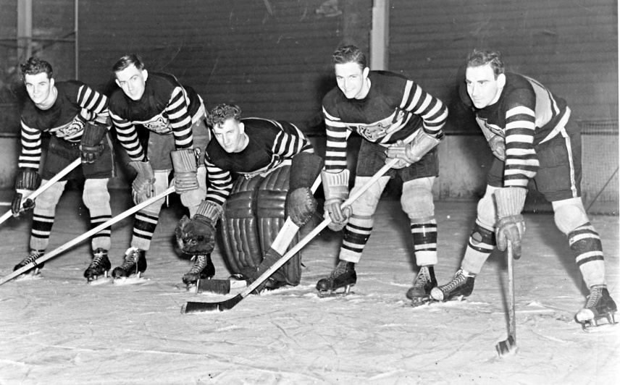
History and Development of Ice Hockey
There is a number of viewpoints and opinions on where the game actually originated and who created it. The roots of ice hockey are to be looked for deep in the past. In Athens National Museum, there is a painting of boys playing a game with curved sticks and a ball. This game was called Keratizein by ancient Greeks. All is depicted on an embossment dated approximately 480 AD. At that time, it was field hockey, i.e. without skates and most probably without any fast movements and rough clashes. It was played for amusement not to compete between two opponents. Paintings by Flemish painters from the 16th Century depict a man with a hockey stick on ice. Sliding on ice must have definitely played a certain role during the game. Similar proofs are to be found at other places in Europe: Russia, Germany, Scotland and England. First references about a European game similar to hockey come from 1600. This game was called “hurley” and it was played prevailingly in Ireland, Scotland and England. The game resembled present golf and hockey mixed together. Thanks to Irish immigrants, this game spread to Nova Scotia in Canada around 1770. Subsequently, it spread from Nova Scotia to Boston in 1860 which are the first references about the game in the USA. Canada plays an important part among the countries where hockey or some similar game was played. According to historians, Halifax became the first place where hockey started to be played. Therefore, Halifax in Canada is nowadays considered the birthplace of hockey. Current hockey as we know it today developed in North America in the course of many years. (historie.hokej.cz).

Slide 3
Basic Characteristics and Rules of Ice Hockey
Ice hockey is one of the fastest team sports played on an ice rink. It is specific in a high number of unusual activities. Such activities include skating, controlling the puck with a hockey stick or very frequent physical contact with the opponent.
The aim of the game is for skating players to score the puck controlled with the hockey stick into the opponent’s goal.
The winner of the match is the team who scored more goals.
Two teams – each is formed of six players on the ice one of whom is the goalkeeper.
The whole team can comprise up to 22 hockey players who can change in a more or less arbitrary way.
The match lasts for 60 minutes and is composed of three periods each lasting 20 minutes.
The whole game is supervised by the referees.
Czech hockey observes the rules of IIHF (International Ice Hockey Federation).

Slide 4
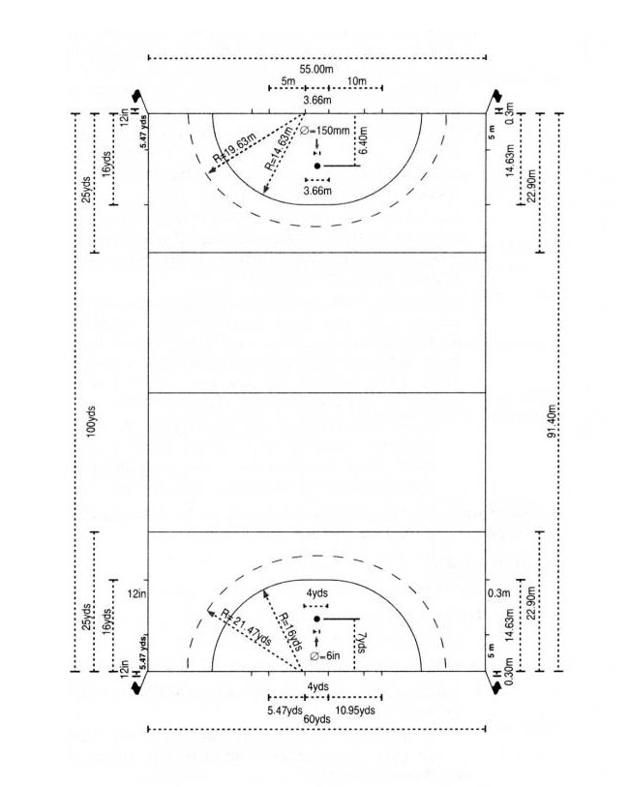
Ice Rink

Slide 5
OFFENSIVE GAME ACTIVITIES OF AN INDIVIDUAL
Passing
Shooting
Sweep
Snap sweep
Clearing with the puck
Controlling the puck
Controlling by short and long dribbling
Controlling by dragging and pushing the puck

Slide 6
DEFENSIVE GAME ACTIVITIES OF AN INDIVIDUAL
Stealing the puck
By poking the puck out
By raising the stick
By hitting the stick (or the puck)
Personal fight
The fight has got three stages:
Approaching the player
Getting into contact
Winning the puck
Shot blocking

Slide 7
COMBINATIONS IN THE GAME
Offensive game combinations based on the principle of:
pass and go
criss-crossing
back pass
screening
Defensive game combinations based on the principle of:
take-over
safeguarding
doubling
backing- off

Slide 8
Thank you for your attention.

