Slide 1
Soccer

Slide 2
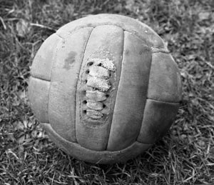
History of International Soccer
According to resources, Soccer as it is known today was born in England in 1860s. Previous forms of soccer were only a little similar to the present game. When going into the history, we must first speak generally about ball games (Kilián, 2007).
“The thing used for playing was called a ball,” Plato wrote in his work “Faidon” when he was describing a ball composed of 12 colorful parts. The Greeks were said to play with a stuffed ball but as early as at that time, also an inflated ball was used. In the Middle Ages, the Romans distinguished 5 kinds of balls: small, medium, big, biggest and empty. In Greek it was called “palla”, in French “balle” and in German and English “ball”. The words “foot” and “ball” formed the name football.

Slide 3
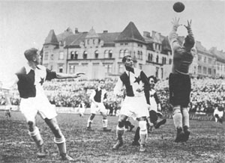
History of Czech Soccer
In Czech lands, soccer started to be played in late 19th Century in Cycling, Sculling and student clubs. The first public match took place in early 1890s (precisely on August 15, 1892) in Roudnice. Soccer had been played seven years before but only as a part of other sports activity. The real “father” of Czech soccer is considered to be Josef Rössler-Ořovský.

Slide 4
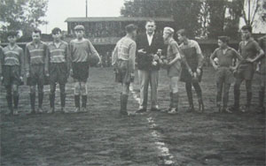
Soccer Characteristics
Soccer is a collective sports goal game which involves two teams of 11 players attempting to score as many goals as possible into the opponent’s net and at the same time have as few scores as possible in the team’s own net, without violating the rules. The game itself is carried out in a specific match which is characterized by certain actions and sticking to general rules (VOTÍK a ZALABÁK, 2000).

Slide 5
Basic Rules of Soccer
The pitch dimensions: length 90-120 m, width 45-90 m
Inner dimensions of the goal: 7.32×2.44 m
The match is played by two teams, each team has a maximum of 11 players and 1 goalkeeper
6 substitutes out of whom 3 can take part in the match
There are two halves, each lasting for 45 minutes, there is a 15-minute intermission
The number of scored goals is decisive
A goal is scored when the whole ball (i.e. the whole size of the ball) runs over the goal line between the goal posts and below the crossbar and the offensive team has not broken any real prior to scoring the goal

Slide 6
Differentiation of Soccer Skills
Game activities of an individual (defensive and offensive)
Offensive:
choosing position (play without the ball)
passing
bringing the ball under control
ball control
circumvention
shooting
defensive:
marking player with the ball
marking player without the ball
marking space
stealing the ball
Goalkeeper’s play:
offensive phase: without the ball – managing the game
selecting location
with the ball – kick-off
throw-out
passing
controlling the ball
circumvention
bringing the ball under control

Slide 7
Thank you for your attention.

