Slide 1
Biomechanics 4
Kinematics 1
Daniel Jandačka, PhD.

Slide 2
Kinematics describes the motion of bodies
In sport and physical exercise we need to describe motor skills for the purposes of teaching, training and skills evaluation.
Moreover, the results in many sport disciplnes actually have the form of kinematic measures.

Slide 3
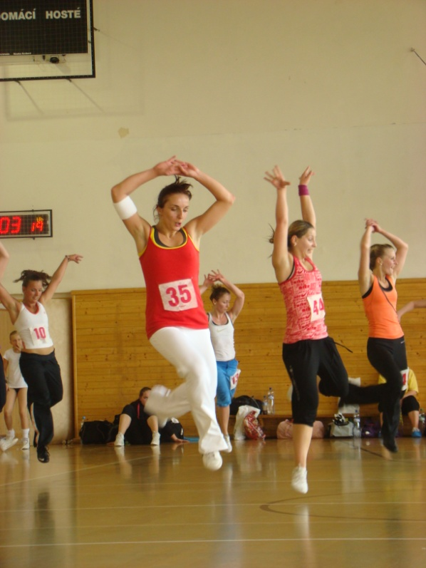
Motion is the process of changing position.
Motion of a body can be described only if we know its position with respect to time.
In order to study motion more easily, we classify motion as
linear
rotary
general.

Slide 4
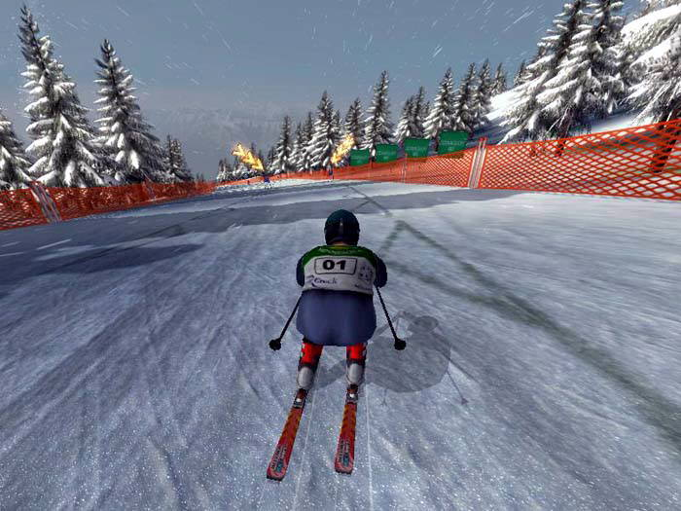
Linear Motion
In linear motion all particles of human body travel the same distance during the same time.

Slide 5
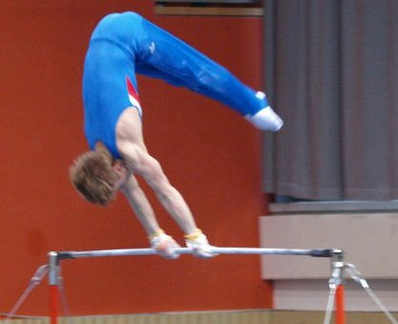
Rotary Motion
In rotary motion all particles of human body travel along a circle or its part, unless they are in the axis of rotation.

Slide 6
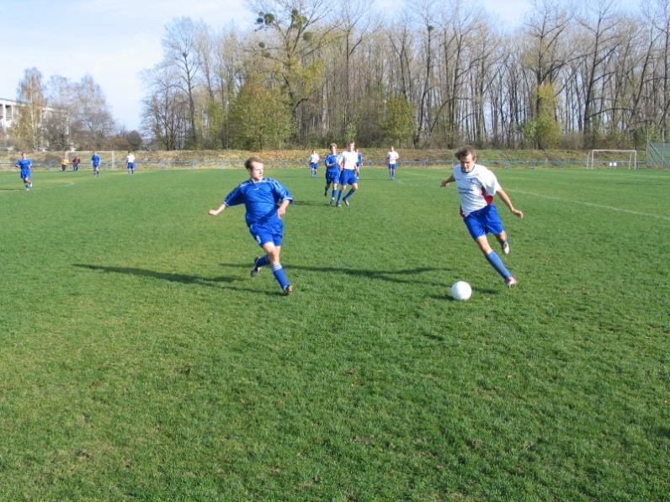
General Motion
General motion is a combination of linear and rotary motions.
If we resolve general motion into linear and rotary motions, it is easier to analyze.

Slide 7
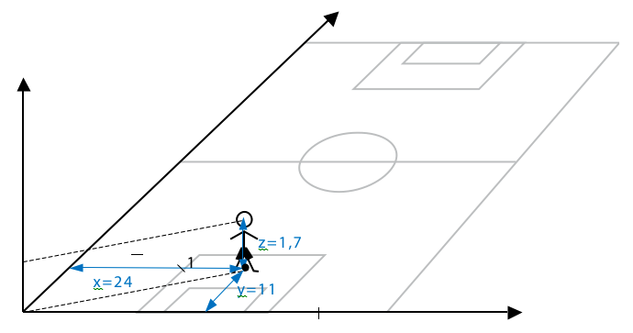
Position
In mechanics the position of a body defines its exact location in space.
Figure Football pitch as the system of Cartesian coordinates (metrs).
In three-dimensional space we need three coordinates to describe the position of a body.
One coordinate of the Cartesian system of coordinates is vertical (z) and two coordinates are horizontal (x, y).

Slide 8
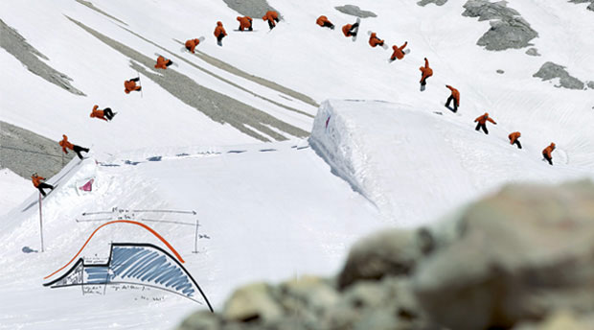
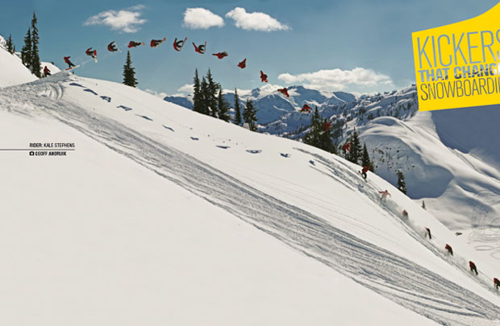
Trajectory
Trajectory is the path that a moving object follows through space.

Slide 9
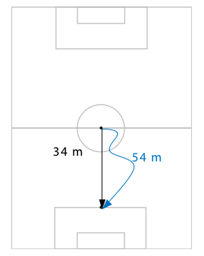
Distance travelled
Figure Distance travelled (blue) and displacement (black) of a footballer.
Distance travelled is length of trajectory.

Slide 10
Displacement
Displacement is the shortest distance in the specific direction from the initial to the final position of a body’s motion.
Displacement is a vector with both the length and direction.
The unit of measure is metre (m) and the symbol used is d.

Slide 11
Thank you for your attention

