Slide 1


Biomechanics 6
Kinematics 3
Daniel Jandačka, PhD.

Slide 2
Acceleration
If a human body decreases its velocity, increases its velocity, or changes the direction of its motion, it moves with acceleration.
In mechanics acceleration is the rate of change of velocity over time.
Therefore a body accelerates if there is a change to the magnitude or direction of its velocity.

Slide 3

Average acceleration
The average acceleration is the ratio between the change to velocity and the time interval:
Negative acceleration is called deceleration (the velocity of the body is decreasing). In SI units, acceleration is measured in meters per second squared (m/s²).

Slide 4
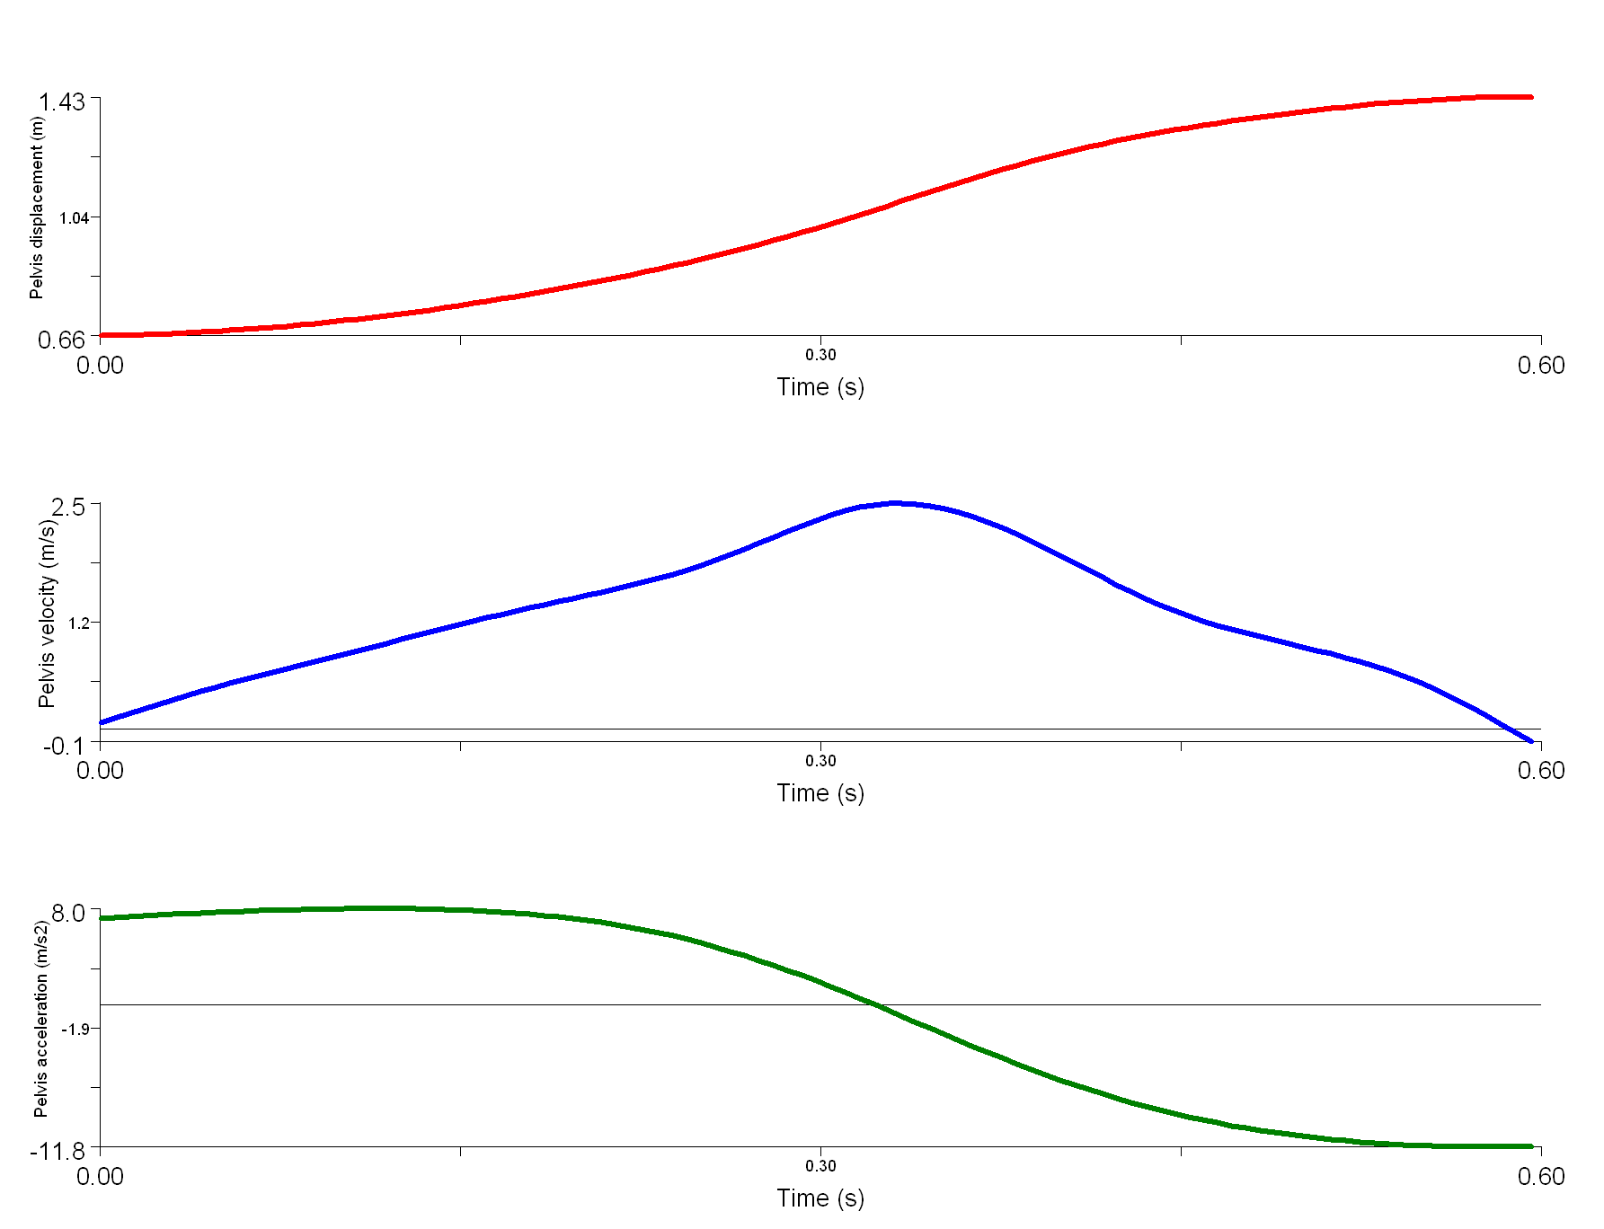
Instantaneous acceleration
Instantaneous acceleration is the acceleration in a very short interval of time as Δt approaches zero.
Maximal jump hight
Squat Jump of Shot Putter with barbell
Measured at Human Motion Diagnostic Center University of Ostrava
Maximal velocity
Acceleration
Deceleration
Figure Displacement, velocity and acceleration of pelvis during countermovement squat jump of shot putter (with barbell - 54 kg).

Slide 5
Acceleration is vector quantity
Since acceleration is a vector, just as velocity and displacement are, it can be resolved in space into three components of acceleration.
Vector of instantaneous acceleration, however, has a unique feature compared to vector of instantaneous velocity:
The direction of the vector of instantaneous acceleration is not always identical to the direction of the body’s motion.
When you start running, your acceleration has the same direction as your motion. When you start slowing down, your acceleration has exactly the opposite direction to the direction of your motion.

Slide 6
Motion of bodies with constant acceleration

Slide 7
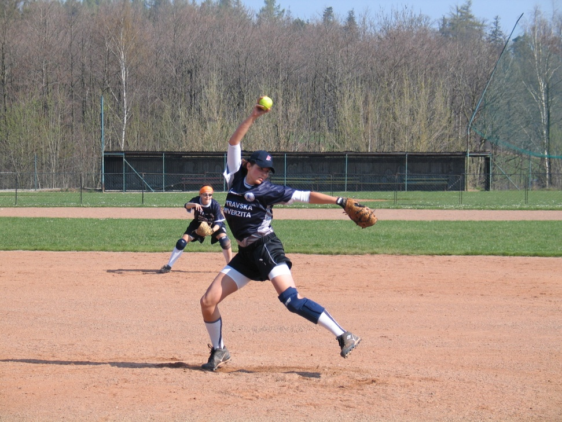
Projectile
Any body that is launched, thrown, or shot into air in any direction, or simply dropped to the ground. A number of objects in sport and physical exercise can be considered to be projectiles: javelin, shot, discus, but also human body itself. Two forces always act on such projectiles:
1. gravitational force
2. resistance of the environment.

Slide 8


Projectile vertical motion
When neglecting friction (such as air resistance), projectiles always move in vertical direction either in uniformly decelerated motion (if going up) or uniformly accelerated motion (if falling down) with the gravitational acceleration of 9,81 m/s².
Projectile motion can be described with equations that relate velocity, displacement, acceleration, and time.
Any object falling to the ground accelerates each second by 9,81 m/s² and its distance travelled grows with the time squared.

Slide 9
Let us imagine a tennis service. To hit the ball correctly we need enough time for a proper stroke. Which position of the ball is the best for the stroke?
V nejvyšším bodě trajektorie mají projektily při vrhu svislém nulovou rychlost a v jeho okolí setrvají nejdelší dobu.
For vertical motion of a body in the Earth's gravitational field the following holds true:
1. the time of ascending equals the time of descending,
2. the initial velocity equals the impact velocity.

Slide 10



Projectile horizontal motion
Motions of bodies are mostly composed of vertical and horizontal components. For biomechanical analysis, however, it is useful to describe horizontal motion separately from vertical motion.
Horizontal velocity of projectiles is constant and the trajectory of horizontal motion is straight line.

Slide 11
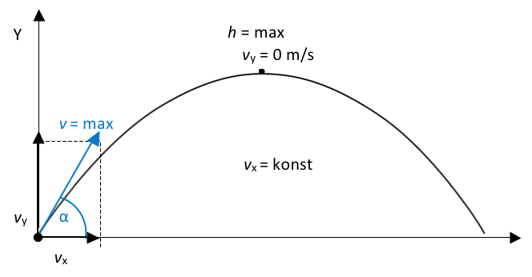


Angular Projection
Part of this parabola represents a set of positions through which the projectile moved during its motion.
Projectile position in vertical and horizontal directions. However, we must know the initial vertical and horizontal components of velocity and the initial projectile position.

Slide 12
Even a human body, once it loses contact with the ground, cannot influence the trajectory of its flight which is fully controlled by the above equations.
The initial conditions (initial position and velocity) influence the following motion of the projectile and thus also the success of the given sporting action.
In sporting actions such as throwing, putting, kicking, jumping, etc. the most important factors are:
1. duration of flight
2. maximum height reached by the projectile
3. horizontal displacement.

Slide 13
Flight duration
Flight duration of projectiles in sport depends on the initial vertical velocity and initial vertical position.
Falling object will fall longer from a higher initial position. If at the beginning of a fall a projectile already has certain initial velocity directed downwards, it will fall for a shorter period of time than in other cases.
If a projectile is tossed upwards, the higher its initial velocity is, the longer it will stay airborne before falling back to the ground.
All acrobatic jumps are a good example of maximisation of the flight duration in sport, when acrobats need enough time to perform all planned elements. In these sporting events the angle between the vector of initial velocity and the horizontal line (so called elevation angle) is close to 90°.

Slide 14
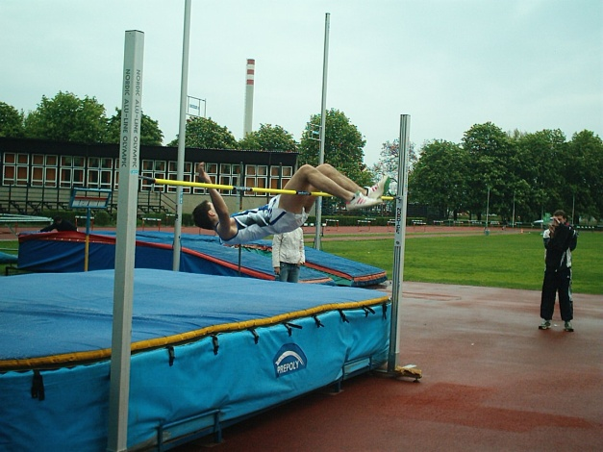
The maximum height
The maximum height reached by a projectile in sport depends mostly on the initial vertical velocity and position.
A projectile tossed from a bigger height and with higher velocity will fly higher.
Maximisation of the height reached by a projectile is important in sport events like volleyball and basketball, where athletes need to jump as high as possible.
High jump is another example of maximisation of the height reached. In these activities the elevation angle is bigger than 45°.

Slide 15
Maximisation of horizontal displacement
In discus and javelin the resistance of the environment is very important, therefore the following analysis will not apply to them.
In other events the resistance of the environment is so weak it can be neglected and the basic knowledge following from our analysis can be applied here.
x_{k} = v_{x}Δt, Říká: describes horizontal displacement as the function of horizontal velocity and flight duration. The bigger the horizontal velocity is, the further the projectile flies. We also know that the flight duration is longer with higher vertical velocity and position. This means that horizontal displacement will depend on three parameters at the moment of throwing (take-off):
1. vertical velocity
2. horizontal velocity
3. vertical position.

Slide 16
In many cases the initial position is zero, as is the case in many take-offs. Horizontal displacement depends only on vertical and horizontal velocities.
Unless there are other forces acting on the projectile, it holds true that both horizontal and vertical velocities should have the same – and the highest possible – magnitude and the angle of take-off (throw) should be 45°.
Let us have a look at the angle of throwing shot put. The best shot-putters in the world manage the angle of throwing of about 35°.
That is much less than 45°. But what is the height of the throw? It is about 2 metres, depending on the height of the athlete
Higher position of the projectile above the ground at the moment of the throw means lower need of vertical velocity for reaching maximum horizontal displacement – assuming the projectile will land on the ground.
Human body has developed in such a way that the arms can reach horizontal velocity against external resistance more easily than vertical velocity. This means that the resulting velocity of a throw decreases with the growing angle of the throw.

Slide 17
When we look at the angles of throwing javelin or discus we find out they are even smaller than the angle of throwing shot by the top shot-putters.
During the flight of a shot, discus, or javelin the resistance of the environment generates lifting forces that cause the resultant acceleration to be lower than the gravitational acceleration. Therefore the discus or javelin stays in the air longer. For this reason the vertical velocity of the throw does not have to be very high.
We should be reminded again that it is easier for an athlete to give horizontal velocity to a projectile, compared to vertical velocity. This is one of the reasons why the angle of the throw is relatively small.
Frisbee throwing is an extreme example of making use of lifting forces. Here the lifting forces are so intense that the angle of the throw is almost zero.

Slide 18
Thank you for your attention

