Slide 1


Biomechanics 7
Angular Kinematics
Daniel Jandačka, PhD.

Slide 2
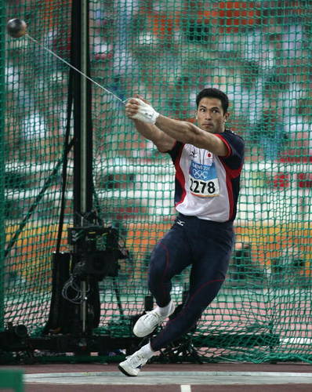
Kinematics of Rotary Motion
Majority of human motions results from the rotary motion of individual segments of human body about joints as axes.
Hammer throw is a typical example of rotary motion. How is it possible to throw a hammer weighing 7,265 kg into the distance of 86,74 m (which is the world record made by Yurij Sedych from the Soviet Union at a track and field event in Stuttgart on 30 August 1986)? How did Yurij Sedych use rotary motion to throw the hammer that far? Considering that the shot used in shot put has the same weight of 7,265 kg as the hammer and the world record in shot put, made by the American Randy Barnes at a track and field event in Westwood on 20 May 1990, is „only“ 23,12 m?

Slide 3
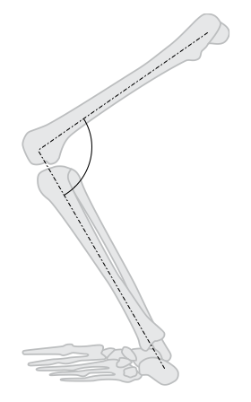
Angle and Angular Displacement
Angles express mutual orientation of lines, planes, or a line and a plane.
We often need to know the angle between individual body segments to describe, evaluate, and improve skills in physical exercise and sport

Slide 4

Angle and Position
For example the angle between shin and a fixed horizontal plane is an absolute angle.
If both lines, or planes, move relative to each other, we are talking about relative angles.
Angles measured in individual joints of human body are angles that describe the relative mutual position of individual parts of human body.
where φ is planar angle (rad), l is the length of a circular arc, centred at the vertex of the angle (m) and r is the radius of the circle (m).

Slide 5
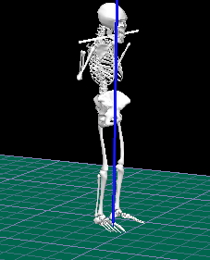
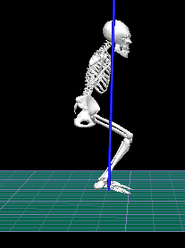
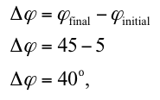
Angular Displacement
Angular displacement is the change of the absolute angle between the initial and the final position of a given segment of human body.
Angular displacement is a vector and its vector line lies in the axis of rotation with counter clockwise direction.
We can also use the right-hand rule: if the thumb of our right hand shows the correct direction of angular displacement vector in the axis of rotation, the fingers show positive direction of rotation.

Slide 6
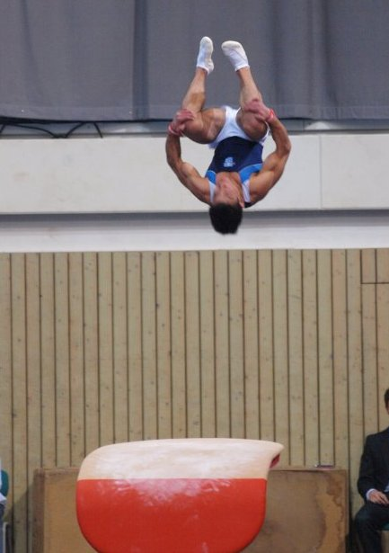
The number of turns in somersaults that we can see in gymnastics, freestyle skiing, or diving, is a measure of angular displacement and is a very important criterion for the overall result in a given sport.
Backward swings in certain gymnastics elements, such as roll into swing, must be described with the angle of backward swing.
Iron cross in gymnastics is also assessed with the use of angular displacement.
Angular displacement of a swing in football, tennis, golf, etc. has a substantial influence on the resulting stroke into a projectile.

Slide 7
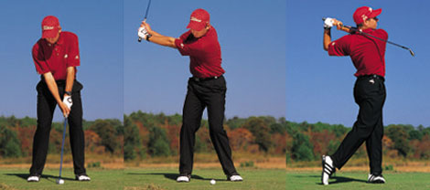

Angular displacement, distance and displacement
When we use ice hockey sticks, tennis rackets, golf clubs, etc., we make longer otherwise short distances our arms would have travelled without using these instruments.
Distance travelled l of any point of a rotating body

Slide 8
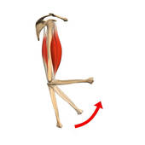
Try to imagine elbow flexion when lifting a weight: our hand travels about ten times longer distance than the insertion of our biceps brachii.
The fact that insertions of our muscles are very near to the axes of our joints brings an important benefit, as it is becoming clear now. Muscles can thus contract over shorter distance to effect longer distances of motion of our extremities.
The length of muscle contraction is limited to 50 % of their original rest length. For this reason extremities’ motions would be increasingly limited with the growing distance between the axis of rotation and the muscles insertion.

Slide 9

Angular Velocity
Angular velocity is a vector quantity and its direction is specified by the right-hand rule. The SI unit of angular velocity is radian per second (rad/s).
Angular velocity is a ratio of the change of angular displacement and the time during which the change occurred.
Instantaneous angular velocity of a tennis racket at the moment of a stroke (i.e. contact with the ball) determines the following velocity of the ball.
In sports such as gymnastics the more important factor of performance is mean angular velocity because it determines how many somersaults and twists the given athlete can manage.

Slide 10
Relation between angular velocity and peripheral velocity
The magnitude of peripheral velocity of any point on a rotating body equals the product of angular velocity of that body and the radius of the circle along which that point is moving.
For example longer golf clubs are used for driving with higher initial velocity to longer distances.
Shorter golf clubs are used for shorter distances.
If we hold a tennis racket at the very end of its handle, we can produce the highest peripheral velocity of its functional end and thus the highest initial velocity of the ball after the stroke.

Slide 11
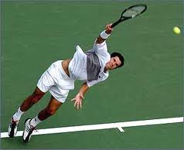
Effective radius
Effective radius is achieved not only with the length of athlete’s arm and the length of an instrument but also with the overall technique of the stroke execution.

Slide 12
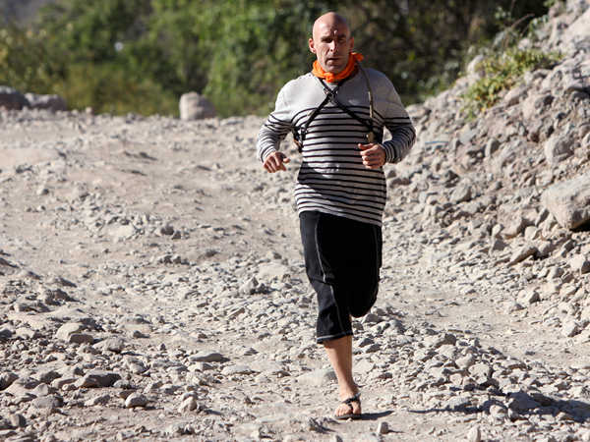
The relation between peripheral and angular velocity provides us with a theoretical basis of understanding why the specific arrangement of human muscles and their insertions, in relation to the axis of rotation in given human joints, gives us such an advantage.
For example our feet move much faster than is the speed of muscle contraction in those muscles that control the motion of legs in walking and running.

Slide 13
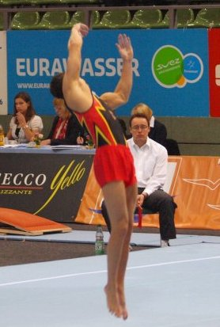

Úhlové zrychlení
Angular acceleration is the rate of change of angular velocity over time.
Angular acceleration is measured in radians per second squared (rad/s²).
Angular acceleration is generated when the speed of rotation of a body increases or decreases, or if the axis of rotation changes its orientation.

Slide 14
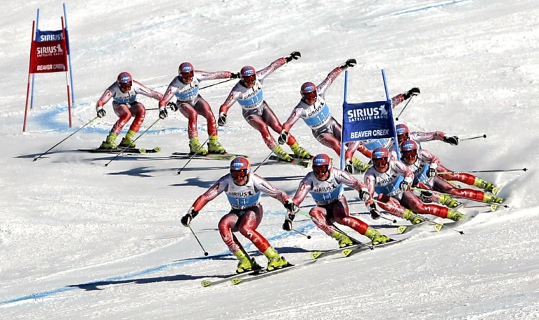


Angular acceleration, Tangential acceleration, Centripetal acceleration
If the magnitude of angular velocity ω grows, peripheral velocity v also grows.
Tangential acceleration is a component of acceleration and it has the direction of the tangent to the circular trajectory.
Tangential acceleration
Centripetal acceleration
or
Even if a body rotates with a constant angular velocity, non-zero acceleration results. This acceleration is related to the change in the direction of peripheral velocity .
If we imagine what force we have to exert in order to change the direction of a carving turn in downhill skiing, we can realize the direction of centripetal acceleration. Our lean, as well as the forces that incurvate the trajectory of our downhill motion, are directed towards the centre of our ski turns.

Slide 15
We are running in the first track, we have to exert greater centripetal force and thus accelerate towards the centre more than if we are running in the last track. For this reason the friction between track shoes and the surface is greater if we are running in the first track. In this case our tangential velocity is the same, only the radius of the trajectory is different.
Let us imagine a hockey player with two hockey sticks of various lengths. Both sticks have approximately the same weight but their length is different. What force must the hockey player exert with these two different sticks during a slap shot, if he keeps the same angular velocity?

Slide 16
Thank you for your attention

