Slide 1


Biomechanics 8
Kinetics 1
Daniel Jandačka, PhD.

Slide 2
Kinetics is part of mechanics that studies motion and its causes. In combination with kinematics it is a powerful instrument of complex biomechanical analysis.

Slide 3
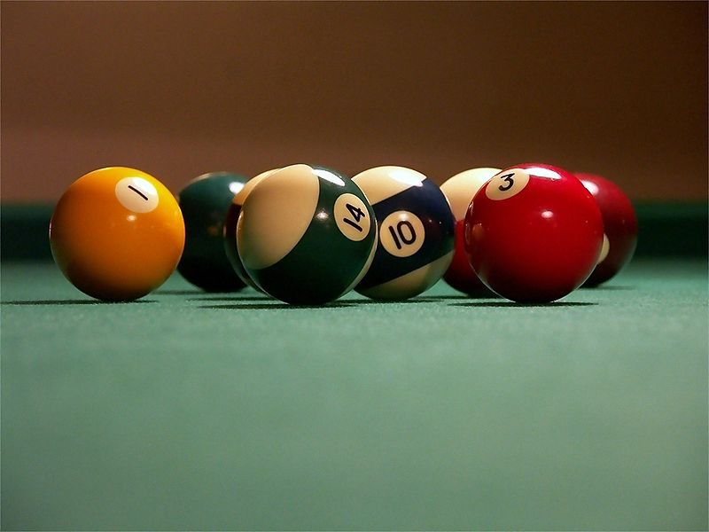
Newton's First Law of Motion
A body at rest stays at rest and a body in motion stays in motion with the same speed and in the same direction unless the body is acted upon by an external force.
If resultant forces acting on a human body are zero, the body stays at rest or stays in motion with the same speed and in the same direction.

Slide 4
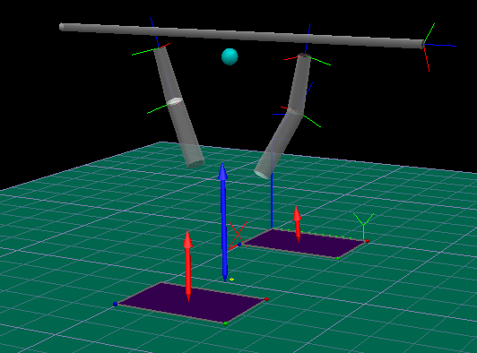
Let us imagine that we are holding a barbell weighing 100 kg. With what force do we have to act on the barbell to keep it at rest?

Slide 5
Momentum
In biomechanics momentum p is the product of mass of a human body m (or mass of any object) and its velocity v
p = mv
Momentum allows us to use a single value to express the measure of both motion and inertia of the given body

Slide 6
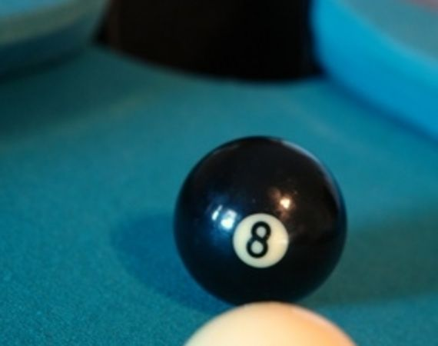

Elastic collisions
If two bodies encounter in a totally elastic collision, their resultant total momentum is conserved.
There are three types of elastic collisions
A moving body encounters a static body, acting with a central force. Generally the moving ball gives all its momentum to the static ball.
Two bodies encounter with opposite velocities and exchange their momenta.
The first body is faster than the second body and both bodies move before encounter in the same direction. Again, they exchange their momenta.

Slide 7
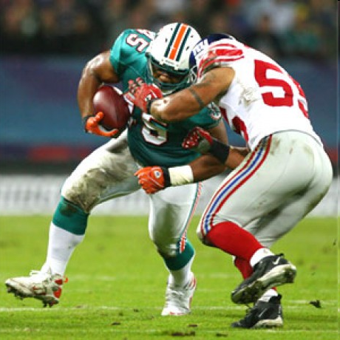

Inelastic collisions
In totally inelastic collisions momentum is also conserved but after the collision both bodies move together in the same resultant direction.
Let us imagine a situation of a defender with the weight of 80 kg colliding with a forward weighing 120 kg. Just before the collision the defender’s velocity is 6 m/s while the forward’s velocity is -5 m/s (opposite direction). Will the forward move ahead and score or will he be stopped?

Slide 8

Newton's Second Law of Motion
Every time a human body, or any object in sport, decreases its velocity, increases its velocity, or changes the direction of its motion, it moves with non-zero acceleration. Resultant external force is the cause of this acceleration.

Slide 9
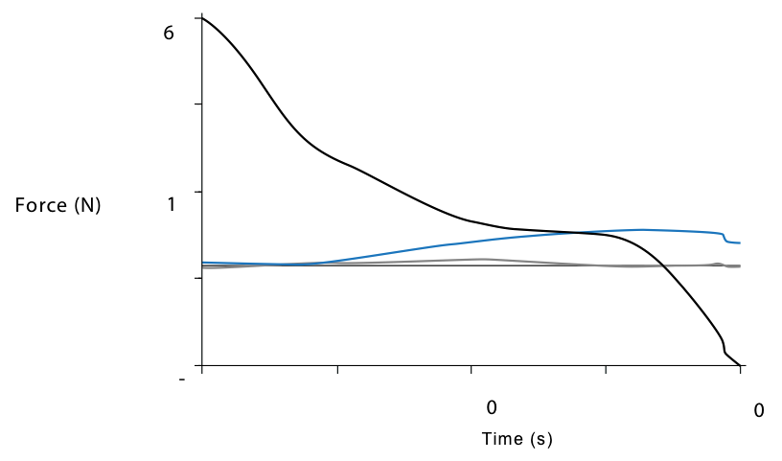
Let us have a look, for example, at weight training exercises. What forces must act on a 30kg barbell during bench press exercise? There is gravitational force with downward direction and reaction force exerted by our arms in the opposite direction. The resultant external vertical force (black line) is the difference between these two forces.
Please note that the resultant force is greater at the beginning of the motion when we start moving the barbell and hence we are accelerating. Later we move the barbell with little acceleration and therefore the resultant force is lesser. In the opposite direction, when we are stopping the barbell, a breaking force must be acting and therefore the barbell decelerates (negative force).

Slide 10
Thank you for your attention

