Slide 1


Biomechanics 12
Center of Gravity
Daniel Jandačka, PhD.

Slide 2
Centre of Gravity
In the centre of gravity the total weight of the body may be thought to be concentrated because it is the point of application of gravitational force of given body.
Centre of gravity is the point of balance.
Human body can be imagined in a simplified way as a model of fifteen segments. Gravitational force acts on each of these fourteen segments. These gravitational forces acting on individual segments produce moments of force whose vector sum, in relation to the body’s centre of gravity, is zero. In the centre of gravity our body is in balance. But non-zero moments of gravitational force are produced in relation to all other points in human body and human body (or any object) is thus not in balance.

Slide 3
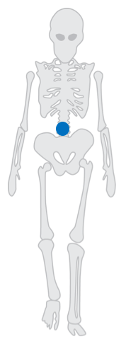
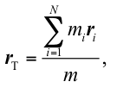
Determination of centre of gravity in human body
If we know the gravitational force acting on individual segments and their position in relation to the origin of the chosen frame of reference, we can calculate the centre of gravity as

Slide 4
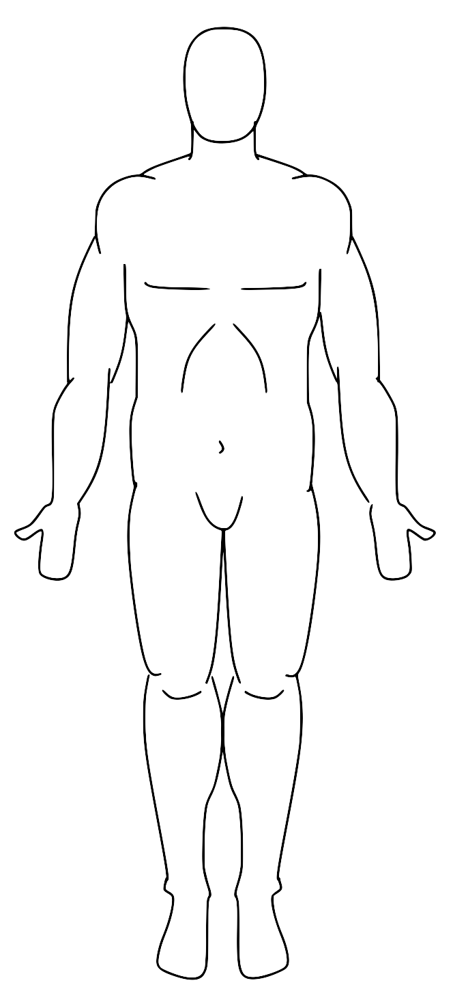
Let us imagine we are standing in the basic anatomical position.
Sagittal plane divides the body into right and left sections. Because human body is almost symmetrical in relation to sagittal plane, the centre of gravity will be placed very near this plane.
If we lift our right arm, the centre of gravity will shift to the right and up. Even though human body is not symmetrical in sagittal direction, the centre of gravity is somewhere on a frontal plane that divides the body into front and back sections. This plane goes approximately through shoulders and hips, and then slightly in front of anklebones. If we stretch our arms forward, the centre of gravity will shift forward, too.
It is much more difficult to estimate the position of the centre of gravity in vertical plane. In basic anatomical position the centre of gravity lies in the area of the 3rd to 4th sacral vertebra.ě leží v základní anatomické poloze v oblasti 3. až 4. křížového obratle.

Slide 5
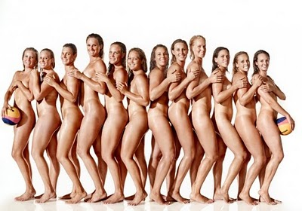

Gender and age differences
Women have centre of gravity vertically lower than men because their bodies are bigger in the area of pelvis but their shoulders are narrower.
The position of centre of gravity in women is in the relative height of 55 % of the total height, while in men it is 57 %.
In children the position of centre of gravity is relatively higher compared to adults because children have relatively bigger head and shorter legs than adults.

Slide 6
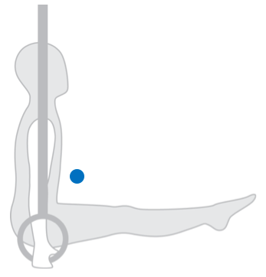
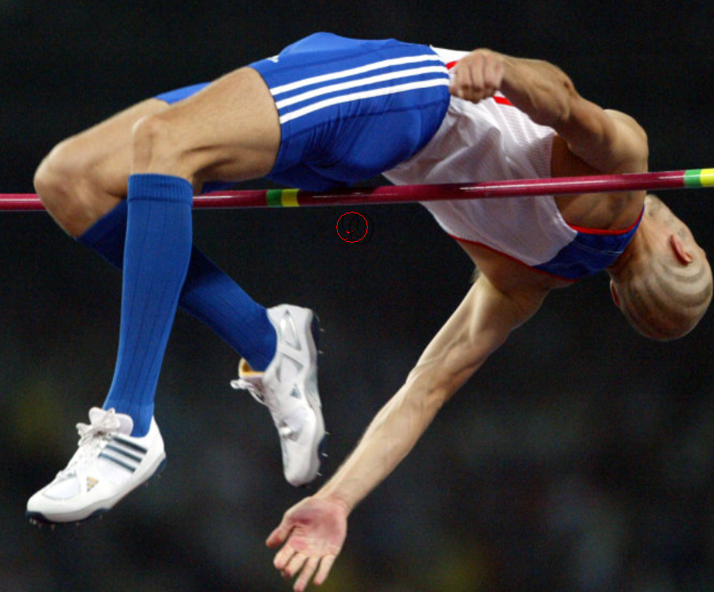
Centre of gravity does not have to lie inside human body

Slide 7
Využití konceptu těžiště ke zvýšení výkonnosti
If we jump up in the air and lose contact with the floor, only gravitational force acts on us and we become a projectile. The trajectory of our body’s centre of gravity cannot be influenced by our moving arms and legs but the motions of individual arms and legs influence each other. So for example if we bend our knees during the jump, the height of arms is reduced so that centre of gravity still moves along the same trajectory, determined from the moment of moment of take-off.
Basketball players, for example, when trying to block the ball, jump up with only one arm raised. The other arm and both legs are not bent and do not move in relation to trunk. Volleyball players would also jump highest with only one arm raised and their legs outstretched. Why, then, volleyball players, unlike basketball players, jump with both arms raised above their heads?
When we look at some spectacular jumps of basketball players, figure skaters, dancers, gymnasts, etc., we can see that they sometimes seem to be suspended in the air. It is only an effect of relative motions of individual body segments toward each other.

Slide 8
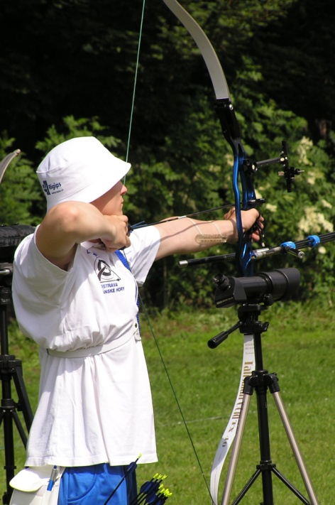
How the position of centre of gravity influences the stability of human body?
The stability of a body is a measure of its ability to return to a position of equilibrium after being disturbed.
In many sports and human activities athletes, or people in general, do not want to be unbalanced from a certain stance or position. Wrestlers try to maintain the most stable position in order not to be overturned by their opponents. Biathlonists, tennis players, basketball players, archers, they all need a stable position to perform their skills best. I
Sprinters at start need to leave their starting position soonest possible. Downhill skiers, tennis players serving, swimmers at start, football goal keepers, they all must be able to change their position fastest possible when the right moment comes. For this purpose they produce a preparatory position which is not very stable.

Slide 9
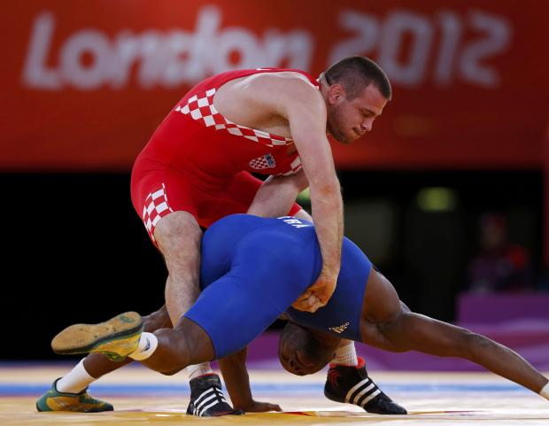

Factors influencing stability
Stabilita těles je ovlivňována výškou těžiště nad podložkou, velikostí základny opory a hmotností tělesa.
Factors on the left side of the equation minimize the increase in stability, while factors on the right side of the equation maximize the increase in stability.
The most stable stance or position of a human body is the one with minimum potential energy.

Slide 10
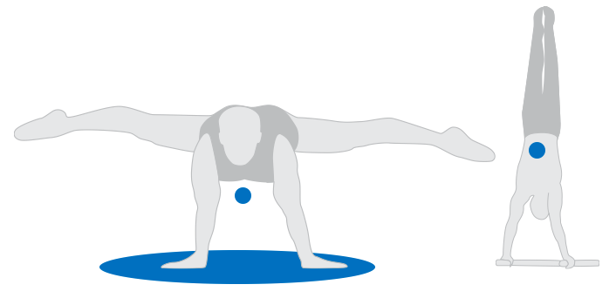
Position:
Indifferent
Stable
Unstable

Slide 11
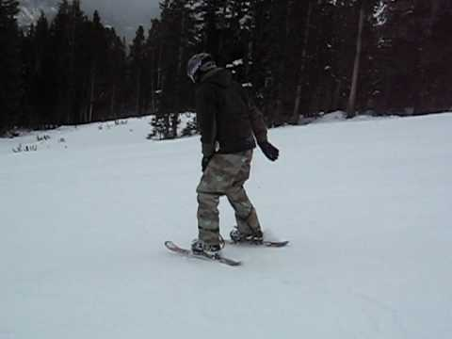
Skiers increase their stability in front to back direction with the help of skis themselves. The longer the skis, the better the front to back stability.
We often use short skis to practice funcarving. If a student starts to fall forward or backward during training with short skis, it is a sign of incorrect basic skiing position in the sense of front to back stability.

Slide 12
Thank you for your attention

