Slide 1
Biomechanics 10
Energy
Daniel Jandačka, PhD.

Slide 2
How is the vaulter able to convert the speed of run into the height needed to get over the crossbar?
The relationship between work and energy provides an answer.

Slide 3
Work
Work is product of force and displacement of a body along the same line as that force is acting.
where W is work (J), F is the magnitude of force (N), and d is displacement of the body (m).
To specify work performed when a force is acting on a body we must know three pieces of information:
1. Average force acting on a body.
2. Direction of that force.
3. Displacement of the body in the direction of the acting force during the time when the force is acting on the body.

Slide 4
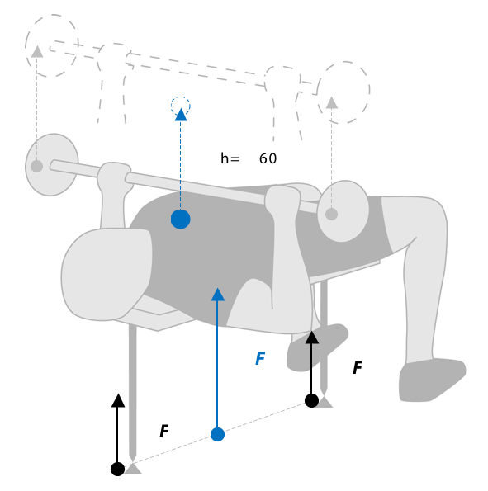
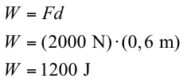
For example a body builder during a bench press exercise acts against a barbell and his arms with a constant force of 2000 N. The centre of gravity of the barbell – arms system is vertically displaced by 0,6 m. What is the work performed by body builder?

Slide 5
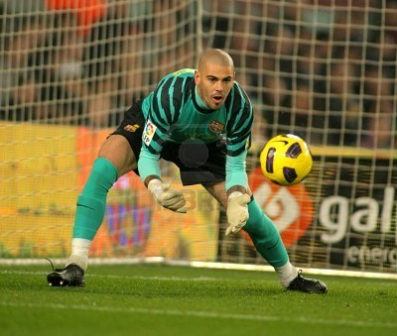
Positive and negative work
Mechanical work can also have a negative value. It is so when a body is displaced against the direction of the acting force.
The goal keeper performs negative work when catching a ball into his arms, weight lifter when he drops the barbell from the top to the bottom position, the pad does it when gymnast lands on it, friction force of skis is also negative.
Breaking forces generally perform negative work.

Slide 6
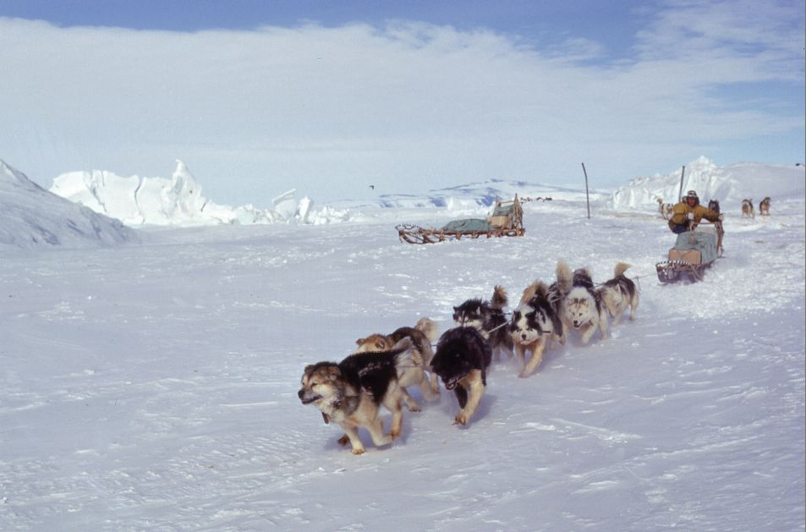
Positive work is performed when the body is displaced along the same line as the force is acting.
Javelin thrower performs positive work when moving javelin in the direction of the throw, weight lifter does it when lifting the barbell, the surface of ski jump does it in the moment of the ski jumper’s take-off.

Slide 7
Muscles work
Muscles can also perform mechanical work. When muscles contract, they produce tractive forces that act on muscles’ insertions. Muscle contractions are divided into:
Concentric contraction – „the force generated is sufficient to overcome the resistance, and the muscle shortens as it contracts“ (Knuttgen a Kraemer, 1987). Muscles then perform positive mechanical work because muscle force acts along the line of muscles’ insertions. The muscle shortens.
Eccentric contraction – „the force generated is insufficient to overcome the external load on the muscle and the muscle fibres lengthen as they contract“ (Knuttgen a Kraemer, 1987). Muscles then perform negative mechanical work because muscle force acts against the direction of the motion of muscles’ insertions. The muscle lengthens.
Isometric contraction – „the muscle remains the same length“ (Knuttgen a Kraemer, 1987). There is no displacement of muscles’ insertions in relation to each other, therefore no work is performed.

Slide 8
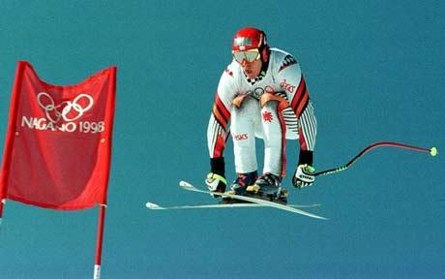
Energy
In mechanics energy is defined as an ability of a body to perform work.
There are two forms of mechanical energy: kinetic energy, related to motion of a body, and potential energy, related to the position of a body in the Earth’s gravitational field.
Kinetic energy
Potential energy
A body in motion has ability to perform work through its motion.
Potential energy is ability of a body to perform work due to its position.

Slide 9
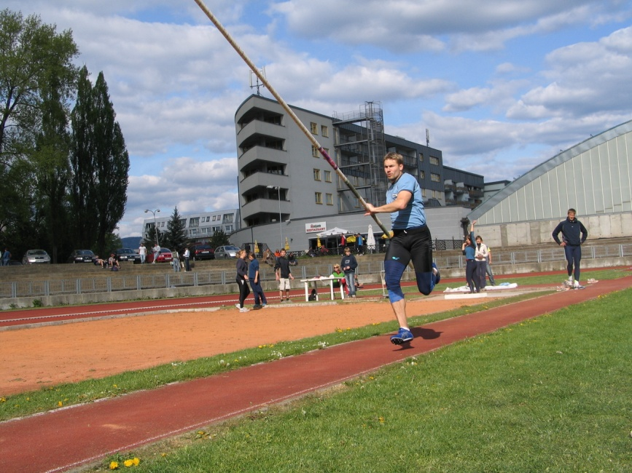
Elastic energy
Elastic energy depends on the measure of deformation and stifness of the body.
Elastic energy is an ability of a body to perform work due to its being deformed.
When, for example, the pole of a pole vaulter is bent, elastic energy is stored in the glass fibre of the vault. The more deformed the pole is, the larger elastic energy is stored in the glass fibre. The amount of elastic energy also depends on rigidity, which is determined by the material qualities of the body.

Slide 10
Total energy
The total energy of an athlete is a sum of kinetic, potential, and elastic energy.

Slide 11
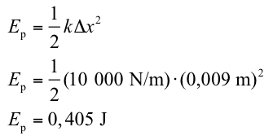
Example
What elastic energy is stored in a tendon of an athlete which stretches by 0,009 m, if the rigidity of tendon is 10 000 N/m?

Slide 12
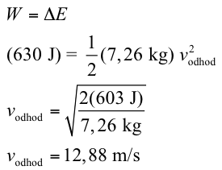
Relation between work and energy
Work performed by external forces that are acting on a body is the cause of the change of energy of the body: W = ΔE
Let us have a look at a shot-putter, for example. He used a force of 1206 N to displace the shot by 0,5 m in the direction of the throw. The force used was constant. We will neglect vertical displacement of the shot and thus also its potential energy. Let us imagine that all work was used up to change the kinetic energy of the shot. If we know that the work of 603 J was performed, then the change of the kinetic energy of the shot in the place of throw was 603 J. What was the velocity vodhod of the shot weighing 7,26 kg at the moment of the throw?

Slide 13
Increasing energy by performing work
In order to maximize kinetic energy of human body or sport equipment we must exert the greatest possible force along the longest possible distance.
This way we can make us of the knowledge of the relation between energy and work to improve our technique in certain sports, especially in athletics.
Shot-putters therefore often start their throw by standing on one foot, bent forward over the edge of the shot-put circle, with their back towards the direction of the throw, to maximize the distance along which their force will act on the shot and thus to also maximize the initial velocity of the shot at the moment of the throw.

Slide 14
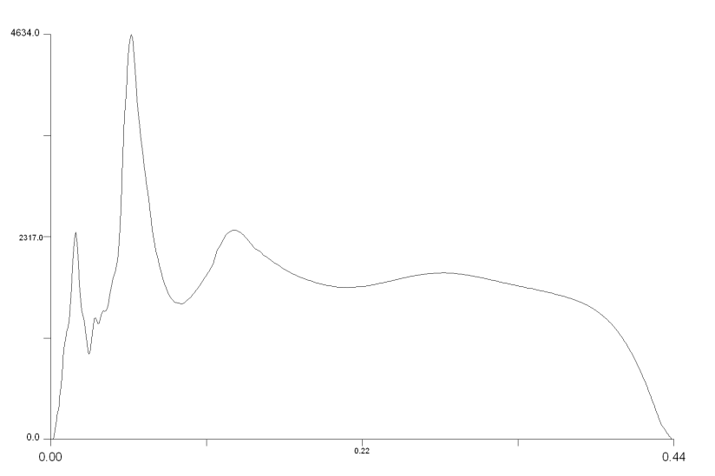
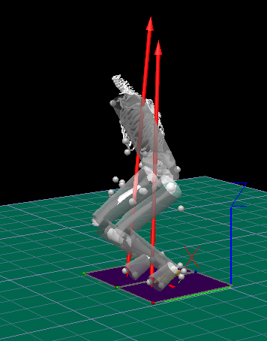
Decreasing energy by performing work
The relation between energy and work can also be used to explain techniques of absorbing energy of a body to prevent potential injuries of athletes. This happens mostly in catching projectiles, landing, etc. when negative work is performed.
Reakční síla
During landing it is important to maximize the distance along which the projectile is decelerating. By making stopping distance longer we make impact forces smaller. We must realize, however, that prolonging the stopping distance by bending our knees deeply, for example, does not necessary lead to smaller reaction forces in specific joints.

Slide 15
Law of Conservation of Mechanical Energy
Total mechanical energy of a body is constant unless external forces act on it (other than gravitational force).
For example if we assume that a pole vaulter does not perform any work after taking off, his total mechanical energy at the beginning of the vault is equal to his kinetic energy at the end of his run-up. This kinetic energy is transformed into deformation energy of the pole and subsequently into the increase in potential energy of the athlete. In other words, the faster the pole vaulter runs and the better his pole is able to transform kinetic energy into potential energy through deformation energy, the higher he jumps

Slide 16
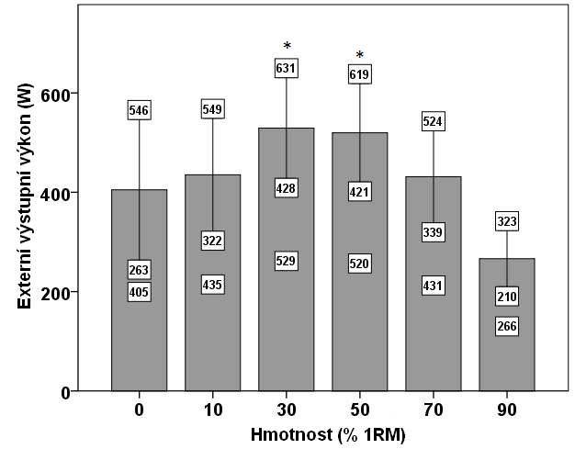
Power
Power measures speed with which work is performed..
What is the optimum gear ratio for cycling as fast as possible under the given conditions? What is the optimum length of step to walk as fast as possible under the given conditions?
In complex human motions the maximum output mechanical power is reached with approximately 50 % of maximum force and velocity of a given athlete.
U komplexních pohybů ovlivňují výsledný výkon nejenom vlastnosti jednotlivých svalů, ale také svalová koordinace

Slide 17
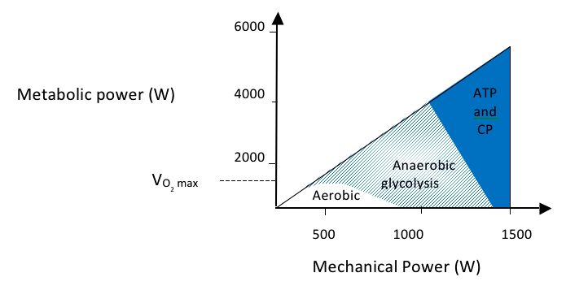
Human metabolic system influences the ability of athletes to produce power
The force with which the weightlifter acts on the barbell and the velocity of his motion indicates enormous muscle power (about 3.200 W) but only for a very short time.
Marathon runners produce lower power output because they run for two to four hours.

Slide 18
Thank you for your attention

