Slide 1


Biomechanics 13
Angular Kinetics
Daniel Jandačka, PhD.

Slide 2
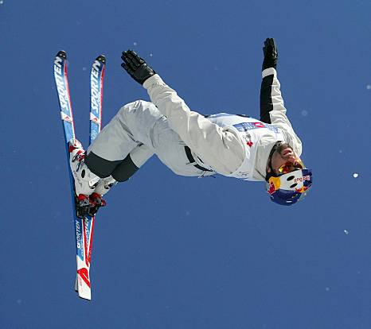
How is it possible that during a single jump they are able to rotate their body with skis on their feet, to speed up that rotation or slow it down, and to rotate very slowly shortly before their landing?
How are gymnasts, figure skaters and other athletes able to increase and decrease the speed of their rotation without being in contact with the ground?
Why do athletes use rotating technique in hammer throw?

Slide 3

Inertia of rotating bodies
An object's resistance to changes to its rotation is called the inertia of a rotating body.
Only people with outstanding sense of balance are able to stay motionless on a bicycle, while practically anybody can keep balance on a moving bicycle.
Moreover, while rotating the wheel resists any changes to the position of its axis of rotation – that’s why it is so much easier to keep balance on a moving bicycle.

Slide 4
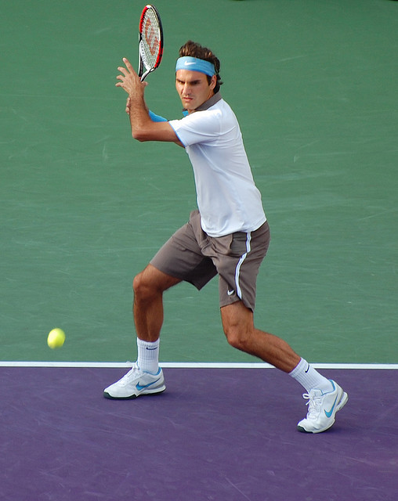

Moment of inertia
Is a kvantitative measure of an object's resistance to changes to its rotation
Each segment of a human body resists changes of rotary motion. Measure of such resistance is product of the mass of a segment and the square of its distance from the axis of rotation, i.e. moment of inertia.
The influence of mass on the inertia of rotating bodies is much smaller than the influence of the distribution of mass.
For example the length of a baseball bat has much larger influence on the time needed to strike a projectile (a ball), using identical technique, than the mass of the baseball bat.

Slide 5
When assessing qualitatively the resistance of a body to a change of rotation in sporting practice, the distance of the mass of the body from the axis of rotation is the most important factor influencing the inertia of the given rotating body.
Each body has infinitely many possible moments of inertia because it can rotate about infinitely many axes of rotation.
In physical education and sport we mostly use three major axes to evaluate motion: Anteroposterior (cartwheel in gymnastic is performed about anteroposterior axis), transversal (somersaults are performed about transversal axis), and longitudinal (pirouettes are performed about longitudinal axe).

Slide 6

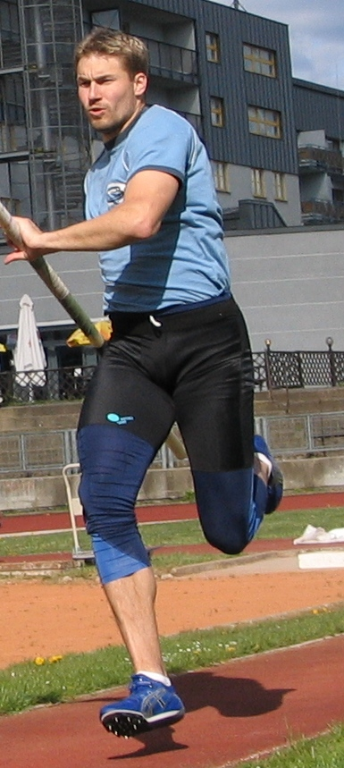
Intentional change of moment of inertia of a human body
Gymnast performing a complicated vault with double forward somersault in squatting position in the second phase of his flight - Roche vault. Gymnast curls up during the somersault to intentionally decrease moment of inertia.
Human body is not solid because individual segments of human body can move in relation to each other. For this reason the moment of inertia of human body in relation to one axis is a variable quantity.
Athlete flexes his knees and hip joints when he is increasing angular velocity of his legs by which he reduces moment of inertia of his leg in relation to axis of rotation going through hip joints.
Downhillers use longer skis than slalom racers. Why?

Slide 7
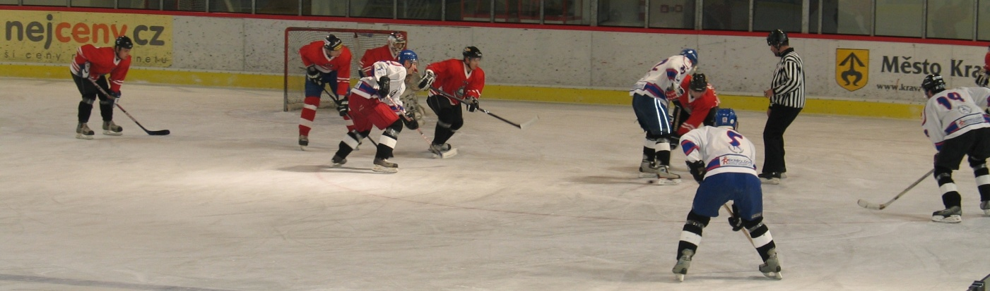
Moment of inertia and linear velocity
longer hockey stick produces higher velocity of the blade if we are able to strike with the same angular velocity.
Why then hockey players don’t use hockey sticks two metres long?
Unfortunately, if we make hockey stick longer, we also increase its moment of inertia which makes it much harder to increase the angular velocity of such hockey stick because more energy must be used, i.e. more work must be performed.

Slide 8
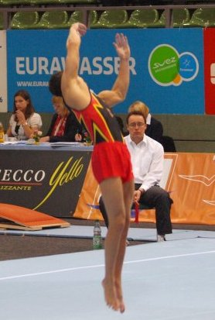

Angular momentum
Angular momentum L (kg·m/s) is defined as product of the moment of inertia J (kg·m²) of a body about an axis and its angular velocity ω (rad/s) with respect to the same axis:
Jednotkou momentu hybnosti je kilogram metr za sekundu (kg·m/s).
U těles, která nejsou dokonale tuhá (lidské tělo) změna momentu hybnosti může být zapříčiněna jak změnou úhlové rychlosti, tak změnou momentu setrvačnosti.

Slide 9
Angular momentum of human body
Angular momentum of a given body is constant unless non-zero resultant external moment of force starts acting on it.
That is why coaches in gymnastics and acrobatics teach their charges to start rotating already at the moment of take-off.
Therefore the angular velocity of the body can be changed after the take-off (during the jump), if we actively change the body’s angular momentum. Angular velocity of the body is then changed in such a way that the angular momentum after the take-off is always constant: L = Jω = constant.
When for example a skier after a badly done jump over a mogul decides to uncurl, he thus increases the angular momentum of his body in relation to his axis of rotation and his angular velocity of rotation decreases.

Slide 10
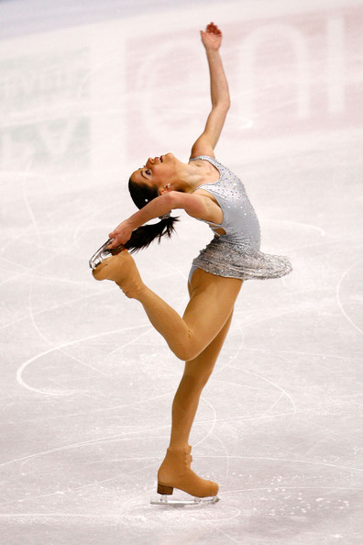
Another very typical example of using intentional change of angular momentum in sport is the effect of changing the velocity of rotation by figure skaters when doing pirouettes.
Gymnasts, skiers, dancers, figure skaters, etc. control the velocity of rotation of their bodies by changing moment of inertia of their body in relation to the axis of rotation (curling – uncurling, abduction – adduction, etc.)

Slide 11

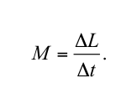
Interpretation of Newton’ second law for rotary motion
Change of angular momentum of a body is directly proportional to the resultant moment of force which is acting on this body and such change has the direction of the external moment of force.
For perfectly rigid bodies with constant moment of inertia about the chosen axis of rotation we can describe relations between kinematic and kinetic quantities as follows:
The above equation does not apply to bodies that are not perfectly rigid, such as human body. For human body the resultant external moment of force is equal to the rate with which angular momentum changes:
Resultant moment of external force acting on a body is directly proportional to the rate with which angular momentum changes.

Slide 12
Change of angular momentum can have the following consequences:
1. angular velocity decrease or increase
2. change of position of the axis of rotation
3. change of moment of inertia
Angular acceleration of a body or a change of moment of inertia does not necessarily mean that an external moment of force is acting on the body, because the total angular momentum of a body that is not perfectly rigid can stay constant even if the body accelerates or if its moment of inertia changes

Slide 13
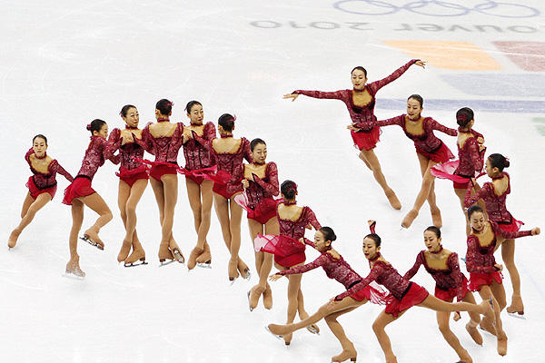
Angular impulse and angular momentum
Angular impulse equals a change of angular momentum.
Figure skater, for example, rotates about longitudinal axis by standing on the tip of one skate and pushing against the ice with the other skate. Pushing leg should be as far as possible from the longitudinal axis to create greatest possible moment of force. If the figure skater arranges his body in such a way that his moment of inertia in relation to longitudinal axis is as small as possible, he can have sufficient acceleration at take-off. At another take-off he already has high angular velocity and thus less time for pushing against the ice. The skater can therefore uncurl his body to increase moment of inertia shortly before take-off. Greater moment of inertia results in lower angular velocity about the longitudinal axis and thus in more time for take-off. The longer the skater is acting with force during take-off, the greater angular impulse is bestowed and the greater change of angular momentum will occur.

Slide 14
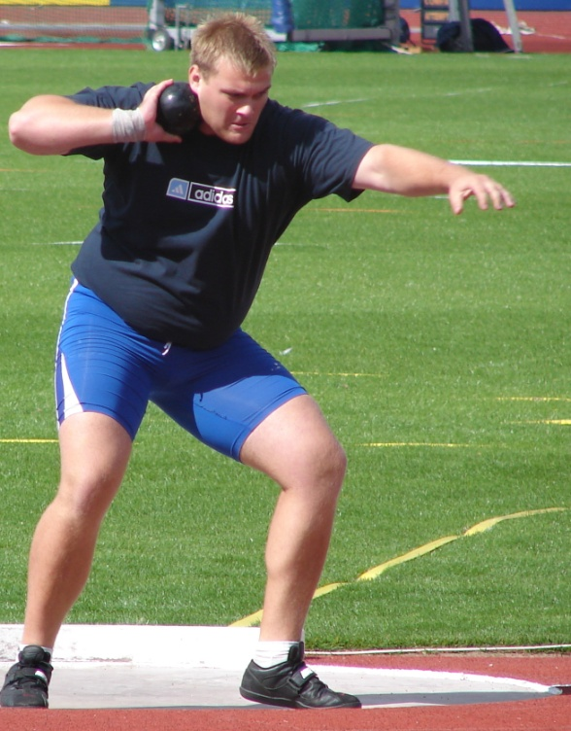
Interpretation of Newton’ third law for rotary motion
Moment of force by which the first body acts on the second body produces moment of force of equal magnitude by which the second body acts on the first body at the same time but with opposite direction. We must also not forget that these moments of force have the same axis of rotation.
A good example of the use of Newton’ third law for rotary motion is the moment of force produced by quadriceps femoris (specifically vastus femoris) during extension of knee joint. When these muscles contract a moment of force is produced which rotates shin in one direction and at the same time another moment of force is produced, with equal magnitude but opposite direction, which rotates thigh. These two opposite rotations produce extension in knee joint.

Slide 15
Comparison of kinetic quantities of linear motion and rotary motion
Linear motion
Quantity | Symbol used and basic equation | SI unit
Mass | m | kg
Force | F | N
Momentum | p = mv | kg·m/s
Impulse of force | I = ΣFΔt | N·s
Rotary motion
Moment of inertia | J = Σmr² | kg·m²
Moment of roce | M = r x F | N·m
Angular momentum | L = Jω | kg·m²/s
Angular impulse | H = ΣMΔt | N·m·s

Slide 16
Thank you for your attention

