Slide 1
Zone diet
by Dr. Barry Sears

Slide 2
Základ
Protizápalová dieta
Kvalita a MNOŽSTVO
0.75 – “ratio between proteins and carbohydrates“ = pomer bielkovín so sacharidmi (rovnováha inzulin-glukagon)
Nízky glykemický index
3+2=5 – stabilná hladina inzulínu
B-S-T = 30%-40%-30%

Slide 3
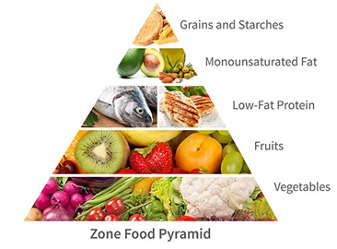
Základ

Slide 4
BLOK
7g proteinov
9g sacharidov
3g tuku

Slide 5
Výpočet blokov
Lean Body Mass (lb)*activity level (0-1)
/
7 (gram proteinu v 1 bloku)

Slide 6
Proteiny 15 blokov * 7 g = 105 g (420 cal)
Sacharidy 15 blokov * 9 g = 135 g (540 cal)
Tuky 15 blokov * 3 g = 45 g (405 cal)
Total Cal = 1,365 (+ skryté cal)

Slide 7
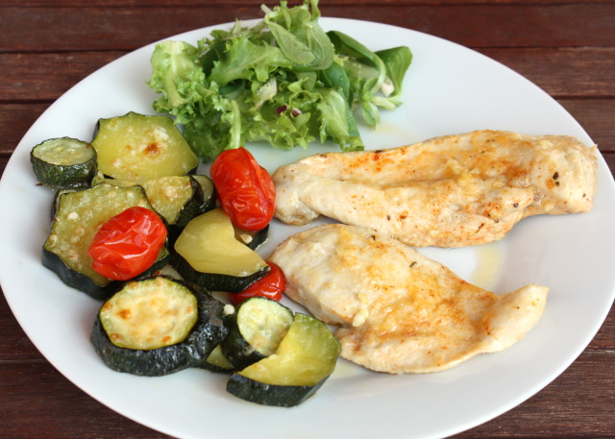
Príklad jedla:
-270g Kuracích pŕs
- 1 Artyčok
- 250ml (OBJEM!)
Dusenej zeleniny
- 24 Arašidov
- 1 Jablko
28g proteiny, 36g sacharidy 12g tuky.
4-blokové jedlo

Slide 8
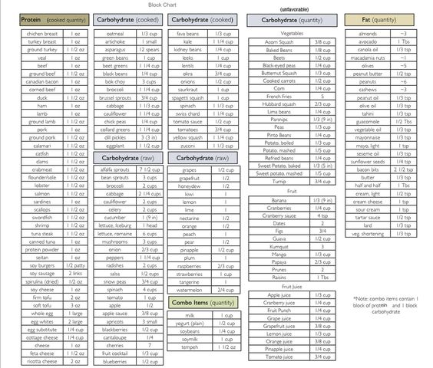
10 OZ =
280 g

Slide 9
Zmeny
Zvýšený príjem mononenasýtených mastých kyselín
(Doporučený) zvýšený príjem Omega-3
Zvýšený príjem zeleniny (?)
Znížený príjem zložených sacharidov
Meranie & váženie (+/-)

Slide 10
Výskumy
Nepotvrdili proklamované účinky
Cheuvront SN: The Zone Diet phenomenon: a closer look at the science behind the claims. J Am Coll Nutr. 2003 Feb;22
Baron M. Fighting obesity Part 1: Review of popular low-carb diets. Health Care Food Nutr Focus. 2004 Oct;21

Slide 11
Bell, S.J. and Sears, B. “Low-glycemic load diets: Impact on obesity and chronic diseases.” Crit Rev Food Sci and Nutr 43: 357-377 (2003).
Bell SJ and Sears B. “A Proposal for a New National Diet: A Low Glycemic- Load Diet with a Unique Macronutrient Composition.” Metabol Synd and Related Disord 1:199-208 (2003).
Bell SJ and Sears B. “The Zone Diet: An Anti-Inflammatory, Low Glycemic-Load Diet.” Metabol Synd and Related Disord 2:24-38 (2004).
Johnston CS, Tjonn SL, Swan PD, White A, and Sears B. “Low-carbohydrate, high-protein diets that restrict potassium-rich fruits and vegetables promote calciuria.” Osteoporos Int 17: 1820-1821 (2006).
Johnston, CS, White AM, Tjonn, S, Swan PD, Hutchins H, and Sears B. “Ketogenic low-carbohydrate diets have no metabolic advantage over nonketogenic low-carbohydrate diets.” Am J Clin Nutr 85: 239 (2007).
Sorgi PJ, Hallowell EM, Hutchins HL, and Sears B. “Effects of an open-label pilot study with high-dose EPA/DHA concentrates on plasma phospholipids and behavior in children with attention deficit hyperactivity disorder.” Nutr J 13:16 (2007).
White AM, Johnston CS, Swan PD, Tjonn SL, and Sears B. “Blood ketones are directly related to fatigue and perceived effort during exercise in overweight adults adhering to low-carbohydrate diets for weight loss: A pilot study.” J Am Diet Assoc 107: 1792-1796 (2007).

Slide 12
Sears B. “Anti-inflammatory diets for obesity and diabetes.” J Coll Amer Nutr 28: 482S-491S (2009).
Mills JD, Bailes JE, Sedney CL, Hutchins H, and Sears B. “Omega-3 dietary supplementation reduces traumatic axonal injury in a rodent head injury model.” J Neurosurgery 114: 77-84 (2011).
Sears B and Ricordi C. “Anti-inflammatory nutrition as a pharmacological approach to treat obesity.” J Obesity 2011: 431985 (2011).
Sears B and Ricordi C. “Role of fatty acids and polyphenols in inflammatory gene transcription and their impact on obesity, metabolic syndrome, and diabetes.” Eur Rev Med Pharmacol Sci 16: 1137-1154 (2012).
Lotrich, FE, Sears, B, and McNamara RK. “Elevated ratio of arachidonic acid to long-chain omega-3 fatty acids predicts depression development following interferon- alpha treatment: Relationship with interleukin-6.” Brain, Behavior, and Immunity 31: 48-53 (2013).
Sears B, Bailes J, and Asselin B. “Therapeutic uses of high-dose omega-3 fatty acids to treat comatose patients with severe brain injury.” PharmaNutrition 1: 86-89 (2013).
Lotrich FE, Sears B, and McNamara R.K. “Anger induced by interferon-alpha is moderated by ratio of arachidonic acid to omega-3 fatty acids.” J Psychosomatic Res 75:475-483 (2013).
McNamara RK, Perry M, and Sears, B. “Dissociation of C-reactive protein levels from long-chain omega-3 fatty acid status and anti-depressant response in adolescents with major depressive disorder: an open-label dose-ranging trial.” J Nutr Therapeutics 2:235-243 (2013).
Georgiou T, Neokleous A, Nikolaou D, and Sears B. “Pilot study for treating dry age-related macular degeneration (AMD) with high-dose omega-3 fatty acids.” PharmaNutrition 2:8-11 (2014).
Sears B and Perry M. “The role of fatty acids in insulin resistance.” Lipids Health Disease. 14:121 (2015).
Sears B. “Anti-inflammatory diets.” J Am Coll Nutr 34: Suppl 1 14-21 (2015).
Lotrich FE, Sears B, and McNamara RK. “Polyunsaturated fatty acids moderate the effect of poor sleep on depression risk.” Prostaglandins Leukot Fatty Acids 106: 19-25 (2016).

Slide 13
300 ludí s nadváhou
low-carb (Atkins),
low-fat (Ornish),
low-saturated-fat/moderate-carb (LEARN)
Zone
Dva mesiace: všetci schudli o cca 3 kilá – Atkins 4,5kg
Rok:
low-carb (Atkins) – 5kg
low-fat (Ornish) – 2,5kg
low-saturated-fat/moderate-carb (LEARN) – 3kg
Zone - 2,3kg

Slide 14
300 ludí s nadváhou
low-carb (Atkins)
Weight Watchers
low-fat (Ornish)
Zone
Po roku:
low-carb (Atkins) – 2,5kg
Weight Watchers – 3kg
low-fat (Ornish) - 4kg
Zone - 3,5kg
Všetky skupiny u 10% sledovaných znížili o 8-10% telesnej hmotnosti

Slide 15
Štúdia z roku 2014 – Circulation: Cardiovascular Quality and Outcomes
Atkins, South Beach, Weight Watchers a the Zone diet:
Ani jedna nepreukázala viac ako 5% stratu hmotnosti y dlhodobého hľadiska (2roky+)

Slide 16
Finančný rozbor
Výber potravín!
Vstupné náklady (váha, odmerky)
Denne: 220kc (zelenina, ovocie, orechy, losos, vajicka, kura)
2 týždne cca 2800

