Slide 1
Methodology of Kinanthropology
A Collection of Study Materials
Mgr. Martin Sebera, Ph.D.
Faculty of Sports Studies, Masaryk University Brno
2021
Notes:
Tuto šablonu lze použít jako počáteční soubor pro aktualizace projektu. projektu.
Oddíly
Po kliknutí na snímek pravým tlačítkem myši lze přidat oddíly. Oddíly mohou pomoci uspořádat snímky nebo usnadnit spolupráci mezi více autory.
Poznámky
Oddíl Poznámky použijte k zadání poznámek k doručení nebo dalších podrobností pro posluchače. Tyto poznámky lze zobrazit během prezentace.
Vezměte v úvahu velikost písma (důležité pro usnadnění, viditelnost, pořízení videozáznamu a online provoz).
Sladěné barvy
Věnujte zvláštní pozornost grafům a textovým polím.
Zvažte, zda účastníci budou tisknout černobíle nebo ve stupních šedé. Provedením zkušebního tisku ověřte, zda barvy fungují správně při vytištění černobíle i ve stupních šedé.
Obrázky, tabulky a grafy
Vsaďte na jednoduchost: pokud je to možné, použijte konzistentní a nerušivé styly a barvy.
Označte popisky všechny grafy a tabulky.

Slide 2
Course objectives
The aim is to prepare the student for the necessary steps in the thesis.
Adoption of principles of professional work, access to the world of professional literature, methods of selecting topics and methods of professional work, work with literature and information sources. They will be acquainted with citation methods and bibliographic references.
Basic research strategies, research plans and methods of data collection and analysis.
Statistics – basic characteristics and methods in sw Statistica

Slide 3
Assessment methods
Written test from terminology - the test consists of 30 questions, 66% of correct answers is needed to pass.
Project of thesis at chosen topic.

Slide 4
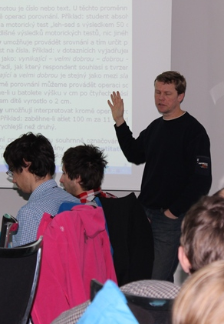
References
YIN, Robert K. Case study research and applications: design and methods. Sixth edition. Los Angeles: Sage, 2018. xxx, 319. ISBN 9781506336169.
THOMAS, Gary. How to do your case study : a guide for students and researchers. 1st ed. Los Angeles: Sage, 2011. xi, 231. ISBN 9780857025623.
Single case research methodology : applications in special education and behavioral sciences. Edited by David L. Gast - Jennifer R. Ledford. Second edition. London: Routledge, Taylor & Francis Group, 2014. xix, 415. ISBN 9780415827911.
MERTENS, Donna M. a John A. MCLAUGHLIN. Research and evaluation methods in special education. Thousand Oaks: Corwin Press, 2004. xiv, 275. ISBN 0761946535.
THOMAS, Gary. How to do your research project : a guide for students in education and applied social sciences. 2nd ed. London: Sage, 2013. xix, 307. ISBN 9781446258873.
Notes:
Čeho se projekt týká?
Definujte cíl tohoto projektu.
Podobá se projektům v minulosti, nebo se jedná o novou záležitost?
Definujte rozsah tohoto projektu.
Jedná se o nezávislý projekt, nebo souvisí s jinými projekty?
* Všimněte si, že tento snímek není nutný pro týdenní schůzky shrnující stav projektu.

Slide 5
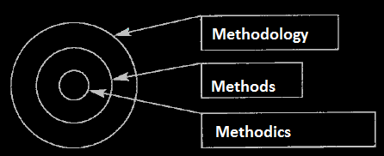
Delineation of the terms
“methodology of science”, “method of science” and “methodics of scientific work”
Methodology: study of methods
Method: tool to research a given research subject
Methodics: procedures which are related to research aim implementation
Notes:
* V případě, že kterékoli z těchto problémů způsobí zpoždění plánu nebo vyžadují hlubší diskusi, uveďte podrobnosti na dalším snímku.

Slide 6
Aims of Science
1. Description
2. Explanation
3. Prediction
4. Understanding of events
To describe various structures and relationships in this world and explain them rationally
Notes:
Následující snímky zobrazit několik příkladů časové osy pomocí obrázků SmartArt.
Můžete zahrnout časovou osu projektu s jasným označením milníků a důležitých dat a označit, kde se projekt nachází nyní.

Slide 7
Characteristics of Research
a process of gathering data
a systematic process
it questions the knowledge so far and makes a synthesis
it leads to widening knowledge
it leads to widening knowledge
it is a combination of all of the above characteristics

Slide 8
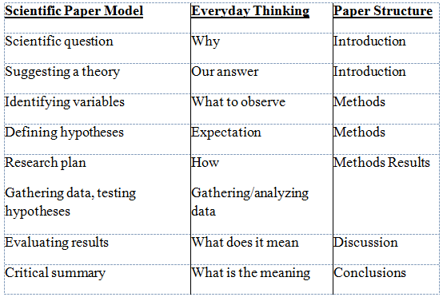
Research Model

Slide 9
The basic stages of creating the final paper
Project
1. Defining the problem
2. Background research in literature
3. Aims and plan
4. Implementing the plan
5. Analyzing data and reflection
6. Composing the final paper
Notes:
Jaké jsou závislosti, které mají vliv na časovou osu, náklady a výstup tohoto projektu?

Slide 10
KinantHropologY
AS A SCIENCE ON HUMAN MOVEMENT
kinésis (to move)
anthrópos (human)
logos (word)
Notes:
Připravte snímky pro dodatek pro případ, že budou nutné další podrobnosti nebo doplňkové snímky. Dodatek je užitečný také tehdy, pokud je prezentace později distribuována.

Slide 11
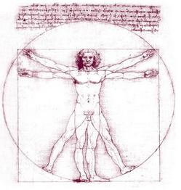
Kinanthropology
research methodology
research subject
scientific language
theory

Slide 12
The subject of Kinanthropology
researching a human in motion
researching human movement
researching human motorics (motor activity)
researching physical (motor) activity of a human
researching human kinetics

Slide 13
Validity, Reliability, Objectivity
Validity (content, criteria, concurrent, predictive, constructive)
we measure what we assume we are measuring
the user has to make the right decisions from the measurement results
Reliability
degree of agreement of measurement results performed under the same conditions
Objectivity
It is determined by the degree of concordance of test results obtained simultaneously by different examiners
evaluation of sets in aesthetic - coordination sports (figure skating)
Without reliability we cannot achieve validity
The measurement method may have high reliability but still low validity

Slide 14
Homework 1
To next lesson…:
Think and specifiy topic of thesis
Find citation standard at our university

Slide 15
2nd lesson

Slide 16
Literary research synthesis of knowledge / theoretical part
It precedes the creation of scientific work and it is, among other things, the design of a research project and the selection of a suitable methodology
A systematic and repeatable procedure for finding and merging already created results
Searching for literature and information sources
Libraries, electronic information resources, other Internet resources
Identification of keywords.
Choice of citation index: Web of Science, SCOPUS, Google Scholar.
Edit a search query.
Selection of relevant articles.
Study of selected articles.
2. Literary research and citations

Slide 17
Literary research
You identify gaps in the literature
Avoid researching the researched
Don't make the same mistakes as your predecessors
Start where the others left off
You can compare your project with others
You will find the procedure, methods and results suitable for your project
You identify conflicting opinions
Discovery.muni.cz (access vpn.muni.cz)
Google Scholar (scholar.google.com)
2. Literary research and citations

Slide 18
Citation standard
Publication and citation ethics
citation creation: APA
a citation record can be found
in http://discovery.muni.cz
in the library system http://aleph.muni.cz
Zotero citation manager integrated with all browsers can be used
2. Literary research and citations

Slide 19
The Basics of APA Formatting
2. Literary research and citations

Slide 20
In-Text Citations
Used to cite information that you have taken from another source and used in your paper in the form of:
Direct Quotes
Paraphrasing
Summary
Whenever you use a source, provide in parenthesis:
the author’s name and the date of publication
for quotations and close paraphrases, provide the author’s name, date of publication, and a page number
2. Literary research and citations

Slide 21
In-text Citations: Formatting Quotations
With a signal phrase
Caruth (1996) states that a traumatic response frequently entails a “delayed, uncontrolled repetitive appearance of hallucinations and other intrusive phenomena” (p. 11).
Without a signal phrase
A traumatic response frequently entails a “delayed, uncontrolled repetitive appearance of hallucinations and other intrusive phenomena” (Caruth, 1996, p. 11).
2. Literary research and citations

Slide 22
In-text Citations: Formatting a Summary or Paraphrase
With a signal phrase
Smith (2002) explained that sibutramine suppresses appetite by blocking the reuptake if the neurotransmitters serotonin and norepinephrine in the brain (p. 594).
Sibutramine suppresses appetite by blocking the reuptake of the neurotransmitters serotonin and norepinephrine in the brain (Smith, 2002, p. 594).
Without a signal phrase
2. Literary research and citations
Notes:
This slide can be supplemented by the “Quoting, Paraphrasing, and Summarizing” section from OWL
http://owl.english.purdue.edu/owl/resource/563/01/
and sections on APA in-text citations:
http://owl.english.purdue.edu/owl/resource/560/01/
http://owl.english.purdue.edu/owl/resource/560/02/

Slide 23
In-text Citations: A Work with Two Authors
According to feminist researchers Bergin and Tate (1997), “It is no longer true to claim that women's responses to the war have been ignored” (p. 2).
With a signal phrase
When citing a work with two authors, use “and” in between authors’ name in the signal phrase, but use“&” between their names in parenthesis.
Some feminists researchers question that “women's responses to the war have been ignored” (Bergin & Tate, 1997, p. 2).
Without a signal phrase
2. Literary research and citations

Slide 24
In-text Citations: A Work with Three to Five authors
When citing a work with three to five authors, identify all authors in the signal phrase or in parenthesis.
In subsequent citations, only use the first author's last name followed by "et al." in the signal phrase or in parentheses.
(Harklau, Siegal, and Losey, 1999)
(Harklau et al., 1993)
2. Literary research and citations

Slide 25
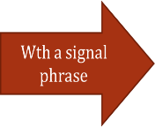
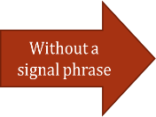
In-text Citations: A Work with Six and More Authors
When citing a work with six and more authors, identify the first author’s name followed by “et al.”
Smith et al. (2006) maintained that….
(Smith et al., 2006)
OR…
2. Literary research and citations

Slide 26
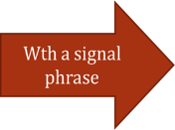
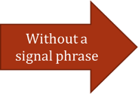
In-text Citations: A Work of Unknown Author
When citing a work of unknown author, use the source’s full title in the signal phrase and cite the first word of the title followed by the year of publication in parenthesis. Put titles of articles and chapters in quotation marks; italicize titles of books and reports.
According to “Indiana Joins Federal Accountability System” (2008), …
(“Indiana,” 2008)
2. Literary research and citations
Notes:
This slide explains and exemplifies the specific cases of in-text citations. It might be supplemented with “Author/Authors” section from OWL http://owl.english.purdue.edu/owl/resource/560/03/

Slide 27
In-text Citations: Organization
When citing an organization, mention the organization the first time when you cite the source in the signal phrase or the parenthetical citation.
If the organization has a well-known abbreviation, include the abbreviation in parenthesis the first time the source is cited and use only the abbreviation in later citations.
The data collected by the Food and Drug Administration (2008) confirmed that…
Food and Drug Administration (FDA) confirmed … FDA’s experts tested…
2. Literary research and citations
Notes:
This slide explains and exemplifies the specific cases of in-text citations. It might be supplemented with “Author/Authors” section from OWL http://owl.english.purdue.edu/owl/resource/560/03/

Slide 28
References Page
Center the title (References) at the top of the page. Do not bold it.
Double-space reference entries
Flush left the first line of the entry and indent subsequent lines
Order entries alphabetically by the author’s surnames
2. Literary research and citations

Slide 29
References: Basics
Invert authors’ names
last name first followed by initials:
Alphabetize reference list entries by the last name of the first author of each work
Capitalize only the first letter of the first word of a title and subtitle, the first word after a colon or a dash in the title, and proper nouns:
Smith, J.Q.
Toward effective poster presentations: An annotated bibliography
2. Literary research and citations

Slide 30
References: Basic Format for Books
Author, A. A. (Year of publication). Title of work: Capital letter also for subtitle. Location: Publisher.
Ex.:
Calfee, R. C., & Valencia, R. R. (1991). APA guide to preparing manuscripts for journal publication. Washington, DC: American Psychological Association.
2. Literary research and citations

Slide 31
References: Article form an Online Periodical
With DOI Assigned
Author, A. A., & Author, B. B. (Date of publication). Title of article. Title of Journal, volume number, page range. doi:0000000/000000000000
Brownlie, D. (2007). Toward effective poster presentations: An annotated bibliography. European Journal of Marketing, 41, 1245-1283. doi:10.1108/03090560710821161
2. Literary research and citations

Slide 32
References: Article form an Online Periodical
With no DOI Assigned
Online scholarly journal articles without a DOI require the URL of the journal home page.
Author, A. A., & Author, B. B. (Date of publication). Title of article. Title of Journal, volume number. Retrieved from http://www.journalhomepage.com/full/url/
Kenneth, I. A. (2000). A Buddhist response to the nature of human rights. Journal of Buddhist Ethics, 8. Retrieved from http://www.cac.psu.edu/jbe/twocont.html
2. Literary research and citations

Slide 33
References: Online Encyclopedias and Dictionaries
Online Encyclopedias and Dictionaries
Often encyclopedias and dictionaries do not provide bylines (authors' names). When no byline is present, move the entry name to the front of the citation. Provide publication dates if present or specify (n.d.) if no date is present in the entry.
Feminism. (n.d.). In Encyclopædia Britannica online. Retrieved from http://www.britannica.com/EBchecked/topic/724633/feminism
2. Literary research and citations

Slide 34
References: Web Document, Web Page, or Report
You may have to hunt around to find the information; don't be lazy!
List as much of the following information as possible
Author, A. A., & Author, B. B. (Date of publication). Title of document. Retrieved from http://Web address
Angeli, E., Wagner, J., Lawrick, E., Moore, K., Anderson, M., Soderland, L., & Brizee, A. (2010, May 5). General format. Retrieved from http://owl.english.purdue.edu/owl/resource/560/01/
2. Literary research and citations

Slide 35
Conclusion
Don't trust citation managers ☺
Knowledge of the standard is crucial !!!
OR
Search and check data from books, printed magazines, electronic documents,…
2. Literary research and citations

Slide 36
Homework 2
Do library research for 1 pages on the selected topic.
Use of at least 5, at most 5 years old, sources
Process the search using the citation standard APA
2. Literary research and citations

Slide 37
3rd lesson

Slide 38
Research proposal
what is the proposed research about,
what it is trying to reveal or what it wants to achieve,
how to proceed,
what we will learn and why it is valuable.
Three general but central questions:
What?
How?
Why?
3. Research proposal

Slide 39
Research proposal
What is the subject that the research seeks to reveal (do or achieve). Formulated in this way, it refers directly to research questions, first in general and then specifically.
How does it mean how we want to answer research questions through research. Answering the question of how it means dealing with research methods. The methods here depend on research questions.
Why it means for what purpose this research is necessary. It points out the rationale (or significance or importance and expected contribution) of the research. It recognizes that any research requires significant investments in time, energy and other resources, and these investments require justification. It also includes the notion of research design (and research itself). The arguments presented in the proposal are intended to answer to some extent the question of why research is valuable.
Generally, a good way to proceed when preparing a research proposal is to focus on what before how.
3. Research proposal

Slide 40
Hierarchy of concepts
research area,
research topic,
general research questions,
specific research questions,
questions in data collection.
Areas differ in the level of abstraction and generality and it is necessary to logically interconnect them by induction and deduction.
The upper level is the most general and most abstract. The lower level is the most specific and concrete.
3. Research proposal

Slide 41
Hierarchy of concepts
Questions At a very general level: What? What is my research about? What is its purpose? What does he want to come up with or what does he want to answer? Specially: What questions does he want to answer? How How will my research answer the questions asked? Why Why is it important to do this research? | More specifically What is my research area? Did I identify it clearly? What is my topic? I identified it clearly, does it belong to the given research area? What are my general research questions? What are my specific research questions? Does each specific research question meet the empirical criterion? - Is it clear what data is needed to answer each question?
3. Research proposal

Slide 42
Selection of respondents
In quantitative research, a sample can be random (if representativeness is important) or intentional (if, for example, the aim of the research is to study the relationship between variables).
Many different sampling strategies are used in qualitative research (maximum homogeneity and variation, critical case, typical case).
Selection of respondents
is part of the research process,
is in line with the logic of the study and
the selection plan is described
Quantitative study: the sampling strategy of the sample, especially if it is purposeful or representative (or both), what will be the objectives in relation to the generalization of results; what size the sample will be; how will be selected. | Qualitative study: the sampling strategy, including the intention to generalize the results; the size of the proposed sample; how the research sample will be selected.
Methods

Slide 43
Data Collection
Execution of design - data collection
Each method has a different way of obtaining data.
Quantitative data
Tools - questionnaires, standardized measuring instruments, ad hoc rating scales or observation forms.
Use an existing measuring tool or develop your own measuring tool (or part of it)?
One or both of these options are acceptable and depend on the study. Each alternative has implications for what needs to be included in the research proposal.
existing tool - state a brief history of its origin, its use in research and its psychometric characteristics.
own tool - give an outline of the steps to be taken, including the method of tool verification.
Methods

Slide 44
Data Collection
Qualitative data
More difficult, a number of options
If interviews are to be conducted, what type of interview and, above all, what degree of structuring will be used? If standardized, how will the tool be prepared and tested (if appropriate)?
We think the same with observation: What degree of structuring and standardization do we assume? How will the forms or manuals used be prepared and tested?
If documents are used, which and how? Will we indicate the method of selection and consideration of the possibility of access?
If diaries, notes, reports or other qualitative material are used, how will their collection and possible selection be organized? What instructions will be given to participants in the case of diaries, notes and reports on critical events?
Methods

Slide 45
Data analysis
The analysis of quantitative data is performed using statistics - a well-established and documented technique
Analysis of qualitative data - dynamic development, there are various approaches and options for how to proceed, such as coding
In the project proposal - at a general level, define which analytical technique can be used, including computer programs, if any are used in the analysis.
Data analysis is an area where the student must seek the advice of an expert, because the level of methodological qualification plays a big role here (eg multiple regression or grounded theory).
It is permissible for students not to have technical proficiency at the stage of design preparation, before starting the research. The student will gain this proficiency only during the research and should demonstrate it after completing the research. It is good if the student acquires technical proficiency before starting the research ☺
Methods

Slide 46
Homework - Project
1. Study population or selection
Describe the subject or object (expected number, distribution according to eg gender, age structure or other specific characteristics that lead to the selection of the respondent and his inclusion in the research), the method of his selection: random, intentional, stratified
2. Measuring procedures, data acquisition
HOW (specify: instrument, instrument, questionnaire, other method, validated procedure, observation, interview, ...) and WHAT (specify specific variables to focus on) I will measure
define variables, scales and their properties (continuous, discrete, ordinal, qualitative…).
Are measurement procedures standardized? Yes/No. If yes (how is standardization ensured), if not (how do you ensure validity, reliability and objectivity, eg pilot verification)?
Methods

Slide 47
Homework - Project
4. Pilot study / pilot verification
It was / was not, will be / will not be. Describe how it will go…
5. Data collection
Indicate the expected schedule and procedure for data collection
6. Data analysis
Indicate which approach will be used in the analysis of the data:
statistical characteristics, frequencies, percentages, graphs,
comparison of average values of two or more selections (t-test, ANOVA), search for mutual relations (correlation, linear regression), etc.
other procedures: analysis, synthesis…
7. Solution of special situations
If necessary, mention some atypical areas that may make research more difficult:
Time, financial demands, human resources issues
8. Limits of research
weaknesses, limitations, anticipated difficulties
Methods

Slide 48
Systematic review
Systematic review (research work) starts with a well-thought-out review / research question
The main disadvantage - be as good as the primary studies (data) that it finds
Input search
In the search tools discovery.muni.cz, ezdroje.muni.cz, MEDLINE, google scholar... find out if there is no answer to our review question, ie a systematic review.
The review question is the first step in creating a systematic review and its correct formulation is absolutely essential for the whole systematic review.
Exclusion and inclusion criteria
Search strategy
The goal of a search strategy is to find all relevant sources published on a given topic.

Slide 49
Systematic review
Evaluation of the relevance of the scientific evidence sought
The evaluation of relevance within systematic reviews must always be performed independently by two authors of systematic review..
Quality evaluation / Critical evaluation
Critical evaluation of studies is another important step in the process of creating a systematic review. The protocol for the critical evaluation of the studies must be stated in the protocol.
Data extraction
The goal of data extraction is to identify and extract relevant data that will be used in data synthesis in quality studies
Data synthesis
Depending on the type of scientific evidence, the planned output of data synthesis must also be described in the systematic review protocol.
statistical (meta-analysis) and narrative or
carried out using contingency tables

Slide 50
STATISTICS
If you bet in EuroJackpot, it's a gamble.
If you bet that you will get three straight lines in the cards, it's fun.
If you bet the price of gas rises by 10%, it's a business. Do you see the difference?
Martin Sebera, www.fsps.muni.cz

Slide 51
Research rules from the point of view of data analysis
The preparation of a research survey is the most important part
data collection and analysis is used to reject / reject predetermined work tasks and hypotheses (exploratory vs. confirmatory approach)
always keep in mind the factual aspect of the research, especially in relation to the interpretation of statistical results
Software offer (Masaryk university):
https://inet.muni.cz/app/soft/licence?app.setlang=EN

Slide 52
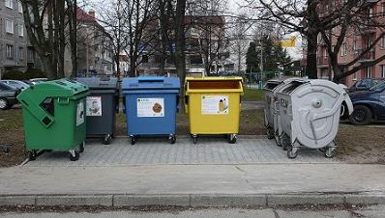
Basic concepts
Basic and sample set and its scope (N)
Choice:
random (each element has the same probability of selection)
systematic (nth object, n <N)
stratified (random selection in groups)

Slide 53
Types of variables
type of variable
continuous | temperature, pressure, dew point, time, length, weight
discrete | number of people
nominal | type of temperament, sex, name of product
ordinal | performance in the 100 m run, grades in school, price of a product
interval | length, weight, time, velocity, acceleration
rational | length, weight, time, velocity, acceleration
categorical | type of work: sedentary, physical, physical and sedentary. means of transportation to work: on foot, by bike, bus, car, own transport
dichotomous | sex: male, female truth, lie

Slide 54
Basic statistical characteristics
numbers that tell us some information about our data.
Characteristics:
levels
mean values
Arithmetic (weighted) mean – a sum of all values divided by the number of values.
Geometric mean – a product of all values extracting the n-th root.
Median – such a value that represents the median in data arranged by size and thus divides data into two halves having the same number of values.
variability
Extent of dispersion – difference between the maximum and the minimum
Quantiles – a number of values divided into equal parts. It is assumed that values are sorted from the lowest to the highest value.
Quartiles – divide values into 4 parts. The lower quartile is located in the first quarter, the upper quartile in the third quarter.
Percentiles – divide a series of values into 100 parts.
Variance – a sum of squared deviations from the arithmetic mean divided by the number of values. It informs about the homogeneity of values, or how much the values vary from the mean.
Standard deviation – the square root of the variance
Coefficient of variation – the proportion of the arithmetic mean and standard deviation. It enables us to compare the variability of files with unequal units.
By using various statistical characteristics we lose a lot of valuable information about the original data.

Slide 55
Hypotheses testing statistical significance α
In the statistics applies only what we can prove by calculation.
The level α is usually selected 0.05 (5%).
Thus, if we reject the level of statistical significance and our hypothesis, it means nothing to our scientific hypothesis and our research.
α = 0,05
p < α, reject null hypothesis
p > α, not reject null hypothesis

Slide 56
Correlation
It is usually denoted by r.
It takes values ranging from -1 to 1, the sign then decides whether the correlation is direct (plus sign) or indirect (minus sign).
Correlation can measure a relationship between two or more variables.
start with the graphic interpretation of data (scatter plot)
Correlation usually take the absolute values from 0 (very little or no relationship) to 1 (relationship is very strong).

Slide 57
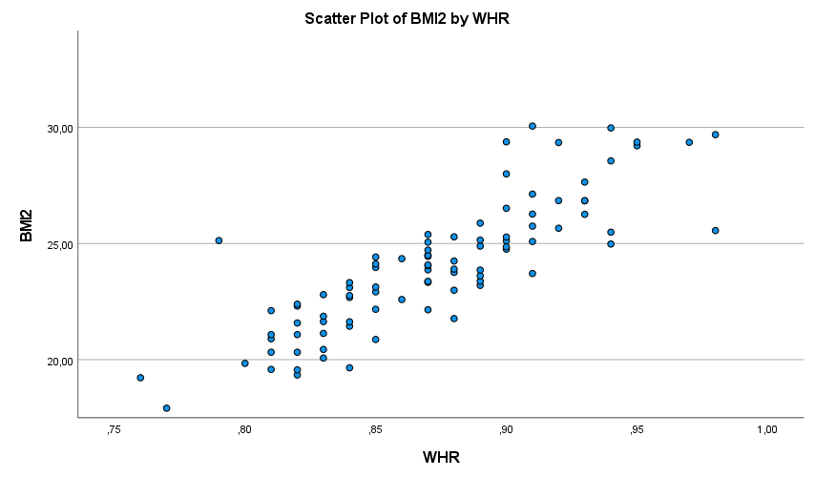
Correlation
Limitations of this coefficient:
it measures only linear relationships.
it does not recognize which variable is dependent and which is independent.
We cannot decide on the causality of the relationship between variables.
r = 0,85
r = 0,00

Slide 58
Myths, mistakes, fakes and explanations in statistics

