Slide 1
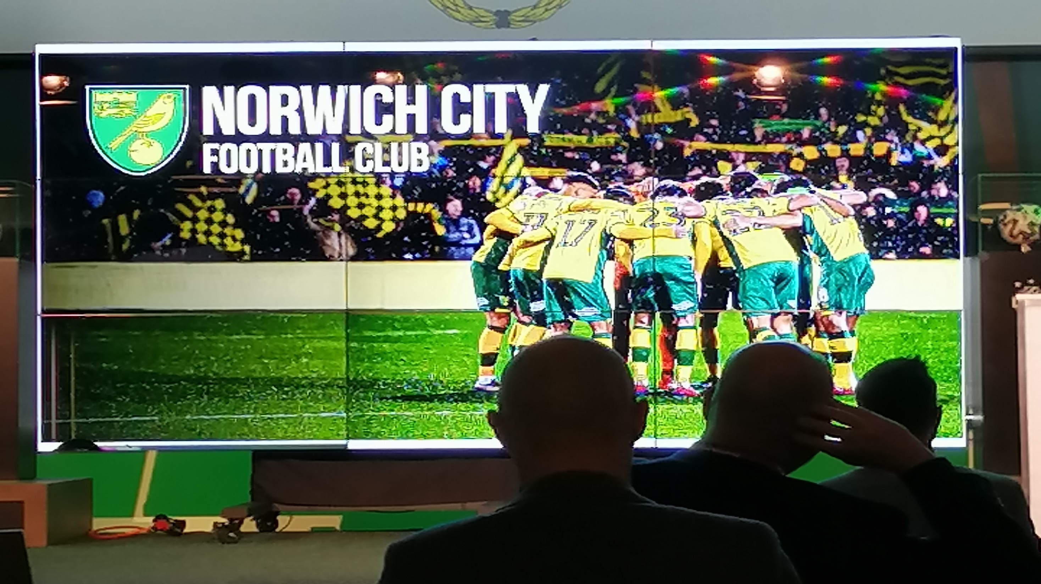

Slide 14
Summary
Norwich City FC
Club info
Club philosophy (Second video)
https://www.youtube.com/watch?v=TAtFw4rJVKw
International strategy (first video – aiming for the Finnish market)
https://www.youtube.com/watch?time_continue=2&v=fxhD9Lx890g

