Slide 1
Training plan for Unleashing the boxing champion
Made by: Dziugas Klimas

Slide 2
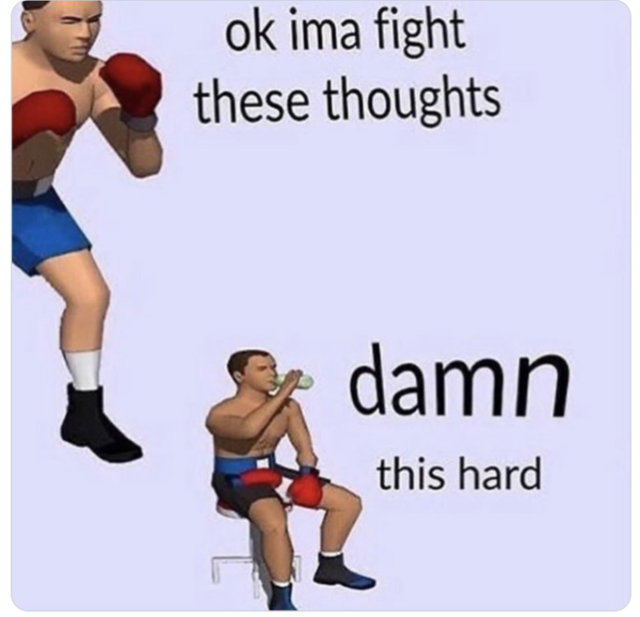
What is boxing
Boxing is a combat sport, that require a high level of cardiorespiratory fitness and anaerobic power output. Muscle strength in both the upper and lower limbs is paramount for a fighter's victory and is one of the keys to success in boxing. As boxing punches are brief actions and very dynamic, high-level boxing performance requires well-developed muscle power in both the upper and lower limbs (Chaabène et al., 2015)

Slide 3
Goals:
Speed;
Aerobic and anaerobic endurance;
Strength;
Power.

Slide 4
From zero to hero
I will be working with amateur boxers, which are taking every opportunity to have a fight. So They can collect wins and reach new level in their carrier.
They will be fighting every month, so I’ll use 1 Meso cycle which will contain 4 Micro cycles of training.

Slide 5
3 weeks of micro cycles:
Monday | warm up and technique/combination/foot work drills, cool down ;
Tuesday | Running warm up, sprints and cross, cooldown
Wednesday | Day off, active rest ( jogging, team games, swimming, cycling)
Thursday | Warm up, sparring session, cool down
Friday | Warm up and HIIT training (type 3, to target anaerobic, o2)
Saturday | Mobility / flexibility, strength and power training
Sunday | Recovery day ( massage, sauna, cryotherapy)
4th week will be easier, we will drop the training volume and let the body deload the stress and get ready for the competition

Slide 6
More details
For warm up I will use dynamic agility and coordination movements ( jumps, jogs, ladders work, shadow boxing, dodging and moving) 40-45 minutes.
For cool down I will go for mobility and flexibility exercises (full body stretch) 15-20minutes.
Technique drills for 50-60 minutes of hitting combination moving, defending and dodging.
Warm up before running 10 mins (focusing on lower body mobilization and activation). Sprints 50 m. sprints using 50/60/70/80/90/100% of efficiency. 1 min rest between. 5 max efficiency sprints of 100m. 2-3 mins rest. 1 hours of high intensity jogging (110-160 HRB/min).
Sparring session – 10 rounds of 2minutes sparring and one minute rest.

Slide 7
HIIT short intervals
Exercise | Sets | Interval | Efficiency | Rest
Punching the boxing bag | 3 | 30sec. | 90-100% | 30sec.
Burpees | 3 | 30sec. | 90-100% | 30sec.
Jumping lunges | 3 | 30sec. | 90-100% | 30sec.
Mountain climber | 3 | 30sec. | 90-100% | 30sec.

Slide 8
HIIT long intervals
Exercise | Sets | Interval | Efficiency | Rest
Hammer tire slam | 1 | 3mins | 80% | 3mins
Jumping jack | 1 | 3mins | 80% | 3min
Resisted boxing | 1 | 3mins | 80% | 3mins
Kettlebell swing | 1 | 3mins | 80% | 3mins
3kg ball throws with squat | 1 | 3mins | 80% | 3mins

Slide 9
Game based HIIT
Relay | Sets | Interval | Efficiency | rest
Ladder race | 1 | 2-5mins | max | 1.30-2mins
Bringing the props | 1 | 2-5mins | Max | 1.30-2mins
Punching the bag | 1 | 2-5mins | Max | 1.30-2mins
sparring | 1 | 2-5min | max | 1.30-2mins
Shadow Boxing | 1 | 2-5mins | max | 1.30-2mins

Slide 10
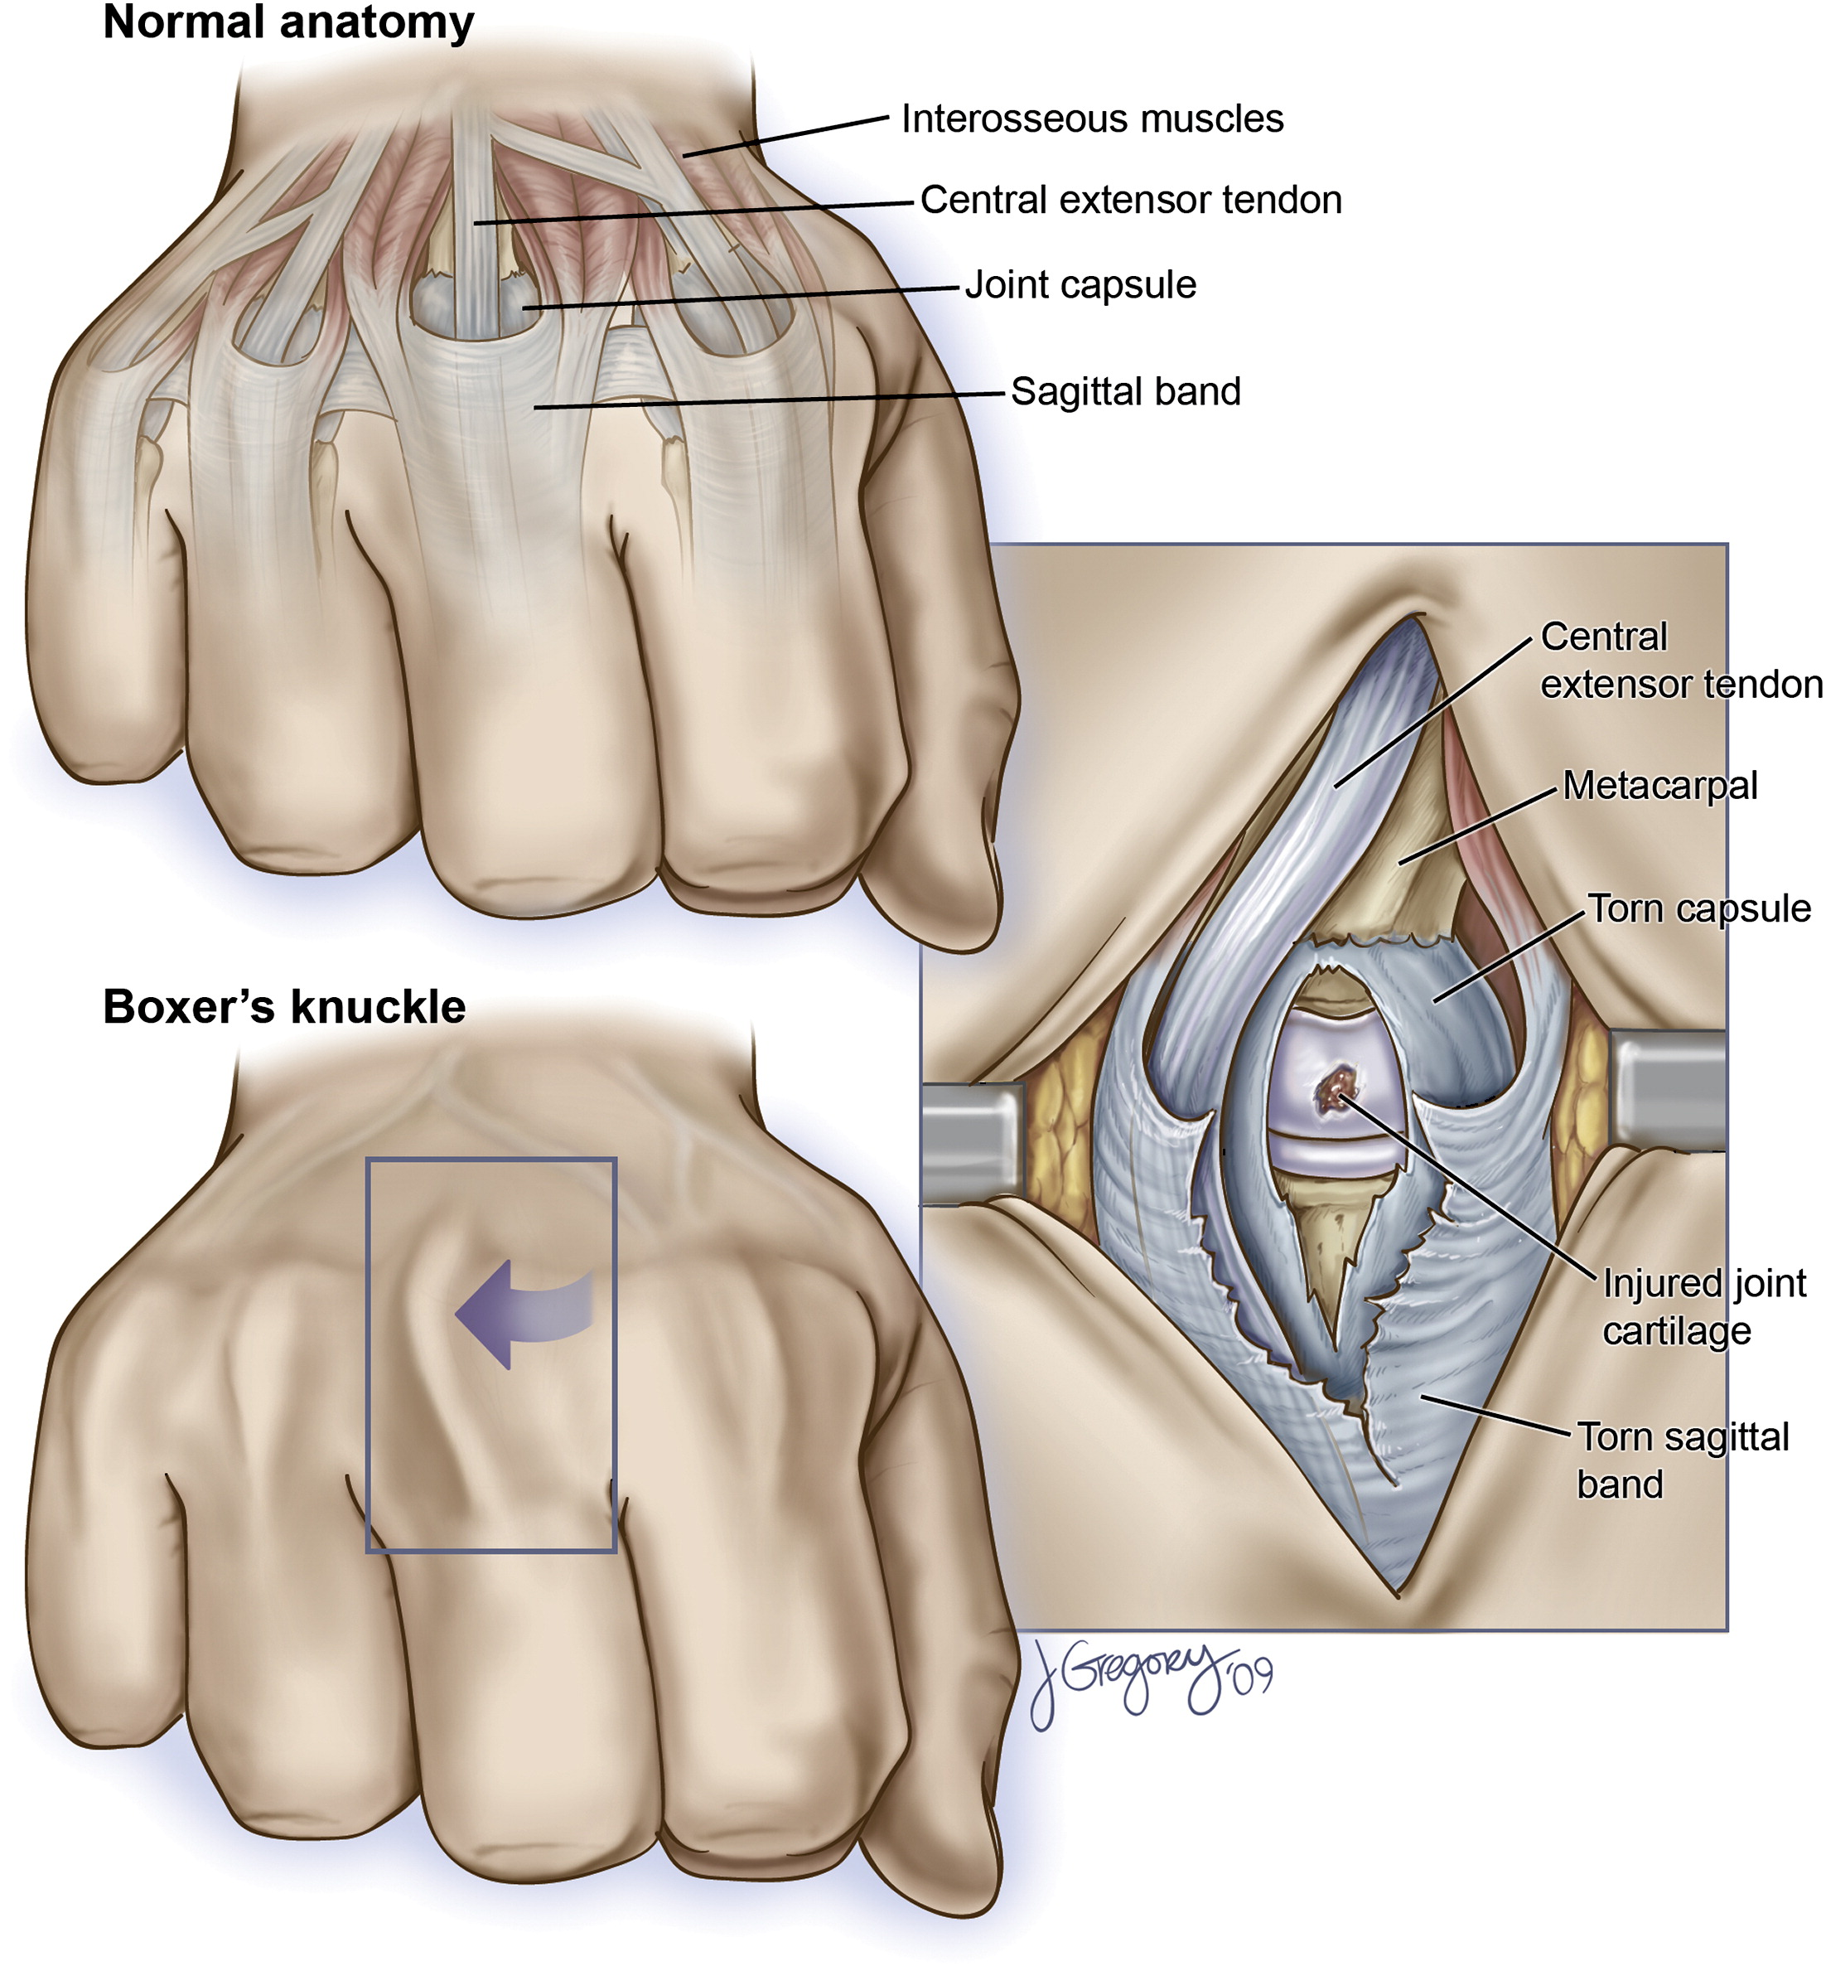
Most common injuries
A wide variety of hand injuries are encountered in combat sports. These are often specific to the combat and contact techniques that are unique to each sport.
Saggital band (boxers knuckle)
Carpometacarpal joint dislocation
Fractures
(Drury, Lehman & Rayan, 2017).

Slide 11
Injury prevention
Prevention of hand injury in boxing centers around 4 main concepts:
Hand and wrist wraps/taping;
Modifications of glove padding and design;
Proper striking technique;
Proper conditioning.
(Drury, Lehman & Rayan, 2017).

Slide 12
Thanks for your attention

Slide 13
References:
Chaabène, H., Tabben, M., Mkaouer, B., Franchini, E., Negra, Y., Hammami, M., ... & Hachana, Y. (2015). Amateur boxing: physical and physiological attributes. Sports medicine, 45(3), 337-352.
Drury, B. T., Lehman, T. P., & Rayan, G. (2017). Hand and wrist injuries in boxing and the martial arts. Hand clinics, 33(1), 97-106.
Kalina, T. (2022). Learning material of Strength Training and Conditioning course.

