Slide 1
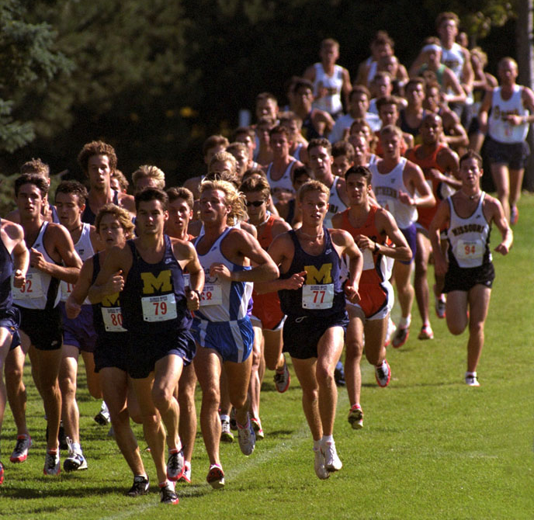
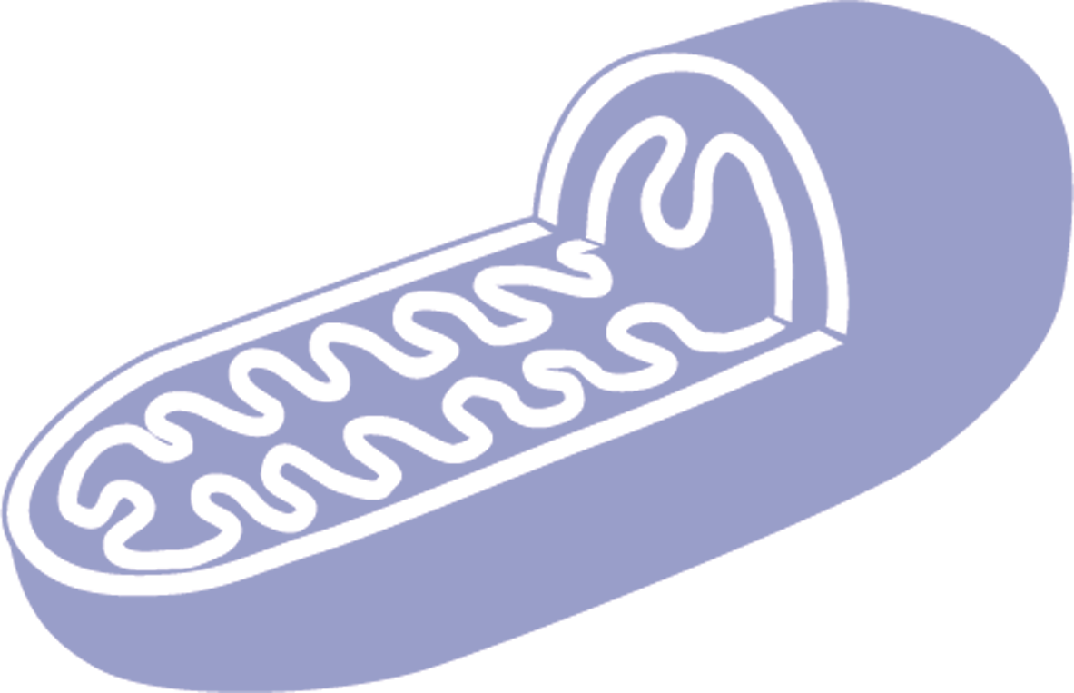
C H A P T E R 4
METABOLISM, ENERGY, AND THE BASIC ENERGY SYSTEMS

Slide 2

Energy for Cellular Activity
w What do we need energy for?
w Food sources are processed via catabolism—the process of “breaking down.”
w Energy is transferred from food sources to our cells to be stored as ATP.
w ATP is a high-energy compound stored in our cells and is the source of all energy used at rest and during exercise.

Slide 3

Energy Sources
w At rest, the body uses carbohydrates and fats for energy.
w Protein provides little energy for cellular activity but serves as building blocks for the body's tissues.
w During moderate to severe muscular effort, the body relies mostly on carbohydrate for fuel.

Slide 4

Carbohydrate (saccharide)
w Readily available (if included in diet) and easily metabolized by muscles
w Once ingested, it is transported as glucose and taken up by muscles and liver and converted to glycogen
w Glycogen stored in the liver is converted back to glucose as needed and transported by the blood to the muscles where it is used to form ATP
w Glycogen stores are limited, which can affect performance

Slide 5

Fat (lipid)
w Provides substantial energy at rest and during prolonged, low-intensity activity
w Body stores of fat are larger than carbohydrate reserves
w Less accessible for metabolism because it must be reduced to glycerol and free fatty acids (FFA)
w Only FFAs are used to form ATP
w Fat is limited as an energy source by its rate of energy release

Slide 6
Body Stores of Fuels and Energy
g kcal
Carbohydrates
Liver glycogen 110 451
Muscle glycogen 500 2,050
Glucose in body fluids 15 62
Total 625 2,563
Fat
Subcutaneous and visceral 7,800 73,320
Intramuscular 161 1,513
Total 7,961 74,833
Note. These estimates are based on an average body weight of 65 kg (143 lb) with 12% body fat.

Slide 7

Protein
w Can be used as an energy source if converted to
glucose via gluconeogenesis
w Can generate FFAs in times of starvation through lipogenesis
w Only basic units of protein—amino acids—can be
used for energy: ~4.1 kcal of energy per g of protein

Slide 8
Energy Content
1g Saccharide = 4.1 kcal (17 kJ)
1g Protein = 4.1 kcal (17 kJ)
1g Lipid = 9.0 kcal (38 kJ)
(1 kcal = 4.2 kJ)

Slide 9
Enzymes
w Specific protein molecules that control the breakdown of chemical compounds
w Names are often complex, but always end in “ase”
w Work at different rates and can limit a reaction
w Glycolytic enzymes act in the cytoplasm, while oxidative enzymes act in the mitochondria

Slide 10
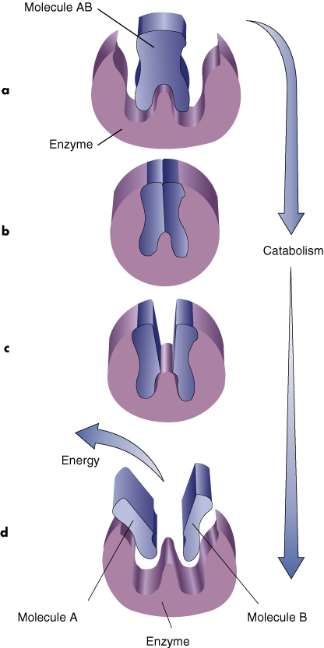
ACTION OF
ENZYMES

Slide 11
Key Points
Energy for Cellular Metabolism
w Carbohydrate, fats, and protein provide us with fuel that our bodies convert to ATP.
w ATP is the high-energy compound released and stored within our cells.
w Carbohydrate and protein provide about
4.1 kcal/g while fat provides about 9 kcal/g.
w Carbohydrate energy is more accessible
to the muscles than protein or fat.

Slide 12
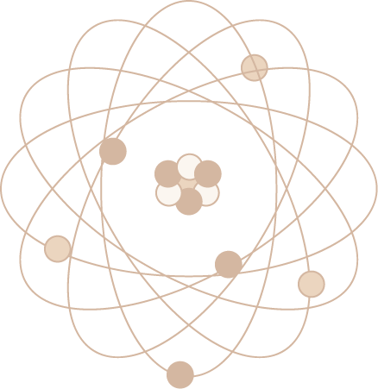
Basic Energy Systems
1. ATP-PCr system (phosphagen system)—cytoplasm
2. Glycolytic system—cytoplasm
3. Oxidative system—mitochondria

Slide 13
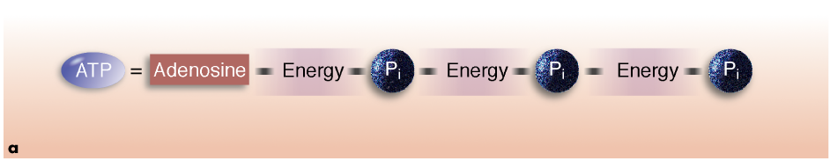
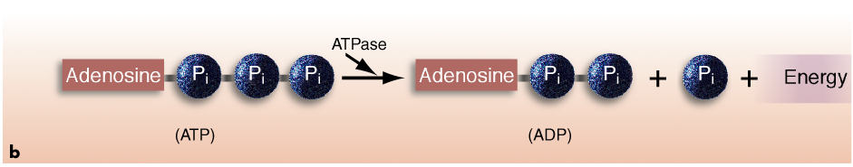
ATP MOLECULE
(Law of conservation of energy)

Slide 14
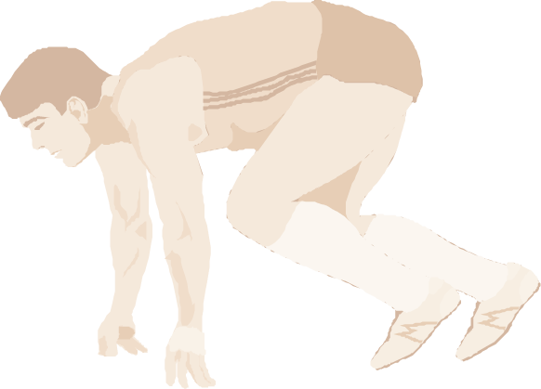
1) ATP-PCr System
w This system can prevent energy depletion by quickly reforming ATP from ADP and P_{i}.
w This process is anaerobic—it occurs without oxygen.
w 1 mole of ATP is produced per 1 mole of
phosphocreatine (PCr). The energy from the breakdown of PCr is not used for cellular work but solely for regenerating ATP.

Slide 15
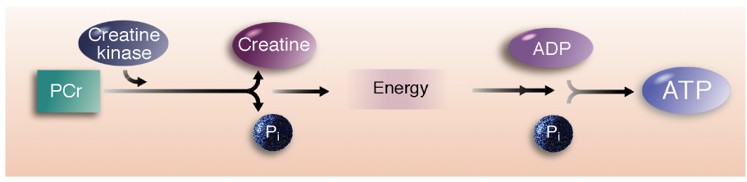
RECREATING ATP WITH PCr

Slide 16
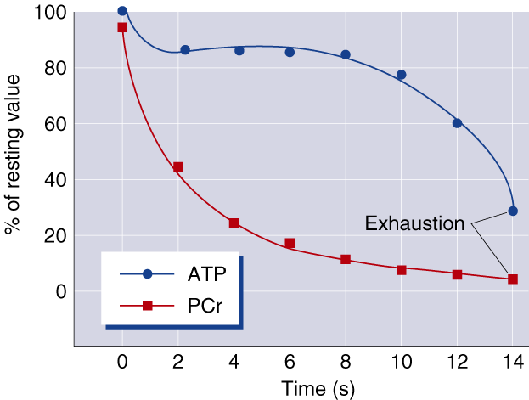
ATP AND PCr DURING SPRINTING

Slide 17
Glycogen Breakdown and Synthesis
Glycolysis—Breakdown of glucose; may be anaerobic or aerobic
Glycogenesis—Process by which glycogen is synthesized from glucose to be stored in the liver
Glycogenolysis—Process by which glycogen is broken
into glucose-1-phosphate to be used by muscles

Slide 18
2) Glycolytic System
w Requires 12 enzymatic reactions to breakdown glucose and glycogen into ATP
w Glycolysis that occurs in glycolytic system is generally anaerobic (without oxygen)
w The pyruvic acid produced by anaerobic glycolysis becomes lactic acid
w 1 mole of glycogen produces 3 mole ATP; 1 mole of glucose produces 2 mole of ATP. The difference is due to the fact that it takes 1 mole of ATP to convert glucose to glucose-6-phosphate, where glycogen is converted to glucose-1-phosphate and then to glucose-6-phosphate without the loss of 1 ATP.

Slide 19
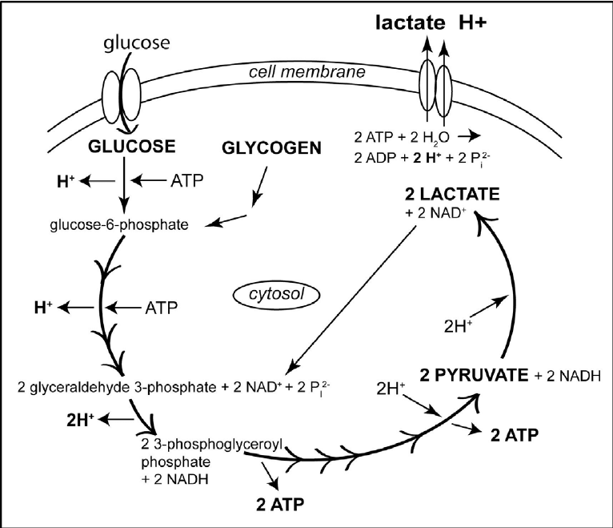
https://images.app.goo.gl/C9WhQsbTwYtYB67t8

Slide 20
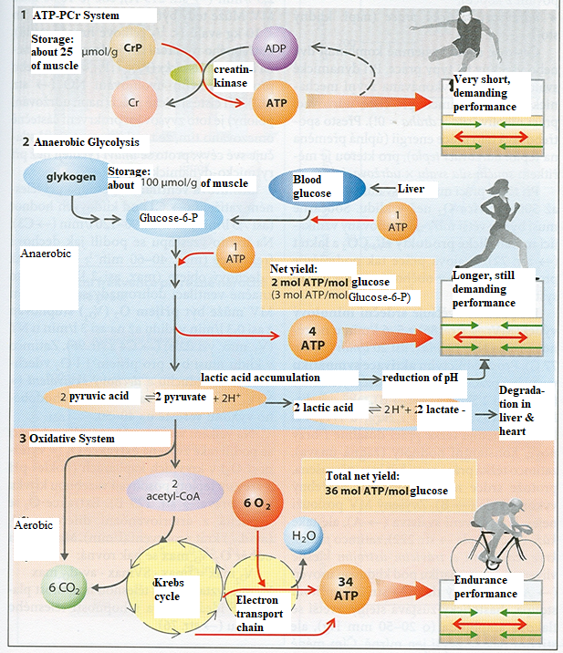

Slide 21

Did You Know…?
The combined actions of the ATP-PCr and glycolytic systems allow muscles to generate force in the absence of oxygen; thus these two energy systems are the major energy contributors during the early minutes of high-intensity exercise.

Slide 22

3) Oxidative System
w Relies on oxygen to breakdown fuels for energy
w Produces ATP in mitochondria of cells
w Can yield much more energy (ATP) than anaerobic systems
w Is the primary method of energy production during endurance events

Slide 23

Oxidative Production of ATP
1. Aerobic glycolysis—cytoplasm
2. Krebs cycle—mitochondria
3. Electron transport chain—mitochondria

Slide 24
Oxidation of Carbohydrate
1. Pyruvic acid from glycolysis is converted to acetyl coenzyme A (acetyl CoA).
2. Acetyl CoA enters the Krebs cycle and forms 2 ATP, carbon dioxide, and hydrogen.
3. Hydrogen in the cell combines with two coenzymes that carry it to the electron transport chain.
4. Electron transport chain recombines hydrogen atoms to produce ATP and water.
5. One molecule of glycogen can generate up to 39 molecules of ATP.

Slide 25
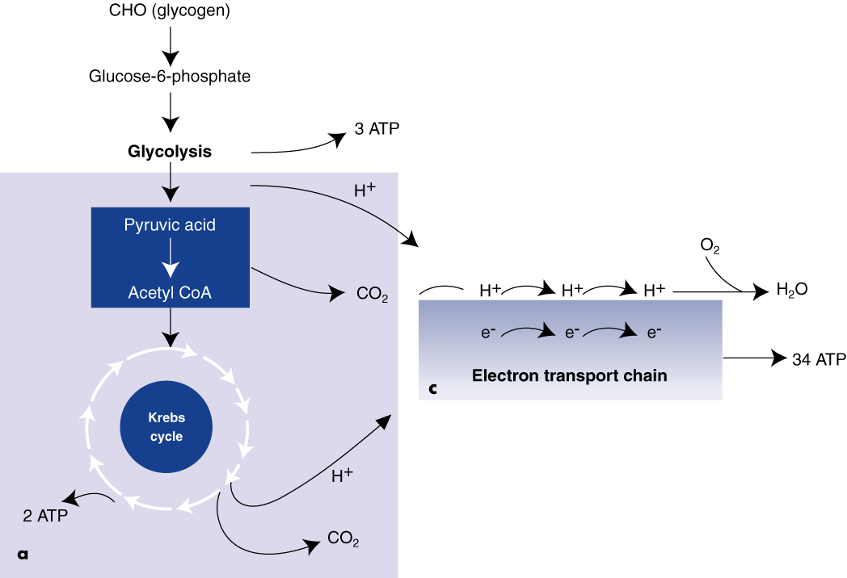
AEROBIC GLYCOLYSIS AND THE ELECTRON TRANSPORT CHAIN

Slide 26
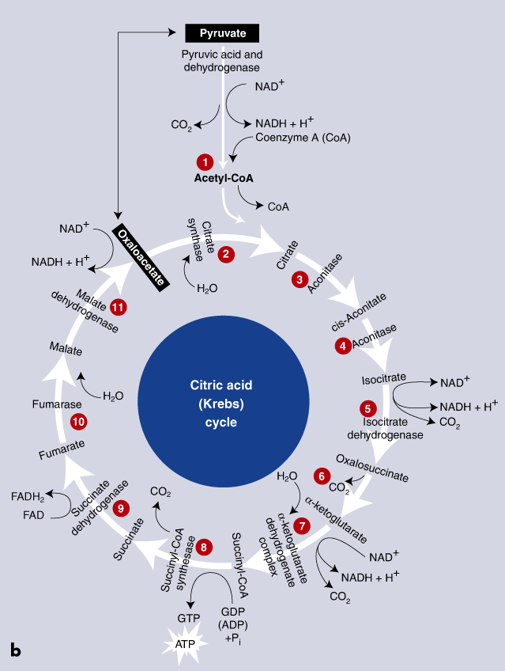
KREBS CYCLE

Slide 27
Oxidation of Fat
w Lipolysis—breakdown of triglycerides into glycerol and free fatty acids (FFAs).
w FFAs travel via blood to muscle fibers and are broken down by enzymes in the mitochondria into acetic acid which is converted to acetyl CoA.
w Aceytl CoA enters the Krebs cycle and the electron transport chain.
w Fat oxidation requires more oxygen and generates more energy than carbohydrate oxidation.

Slide 28
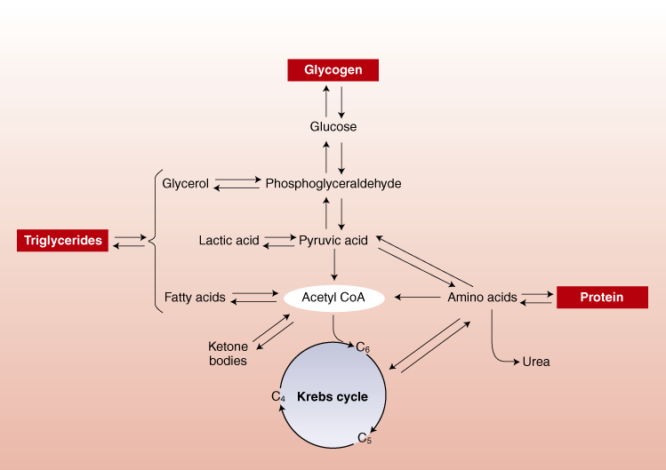
Metabolism of Fat and Protein

Slide 29
Protein Metabolism
w Body uses little protein during rest and exercise
(less than 5% to 10%).
w Some amino acids that form proteins can be converted
into glucose.
w The nitrogen in amino acids (which cannot be oxidized) makes the energy yield of protein difficult to determine.

Slide 30
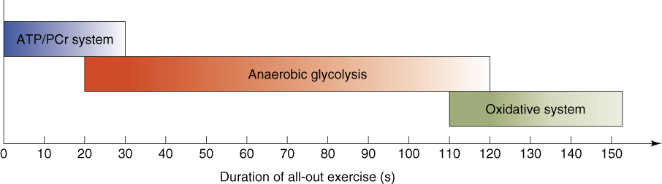
INTERACTION OF ENERGY SYSTEMS ILLUSTRATING THE PREDOMINANT ENERGY SYSTEM
ATP/PCr system
Oxidative system
% of energetic cover (%)
Anaerobic glycolysis
Duration (s)

Slide 31

What Determines Oxidative Capacity?
w Oxidative enzyme activity within the muscle
w Fiber-type composition and number of mitochondria
w Endurance training
w Oxygen availability and uptake in the lungs

Slide 32

Measuring Energy Costs of Exercise
Direct calorimetry—measures the body's heat production to calculate energy expenditure.
Indirect calorimetry—calculates energy expenditure from the respiratory exchange ratio (RER) of VCO₂ and VO₂.
.
.

Slide 33
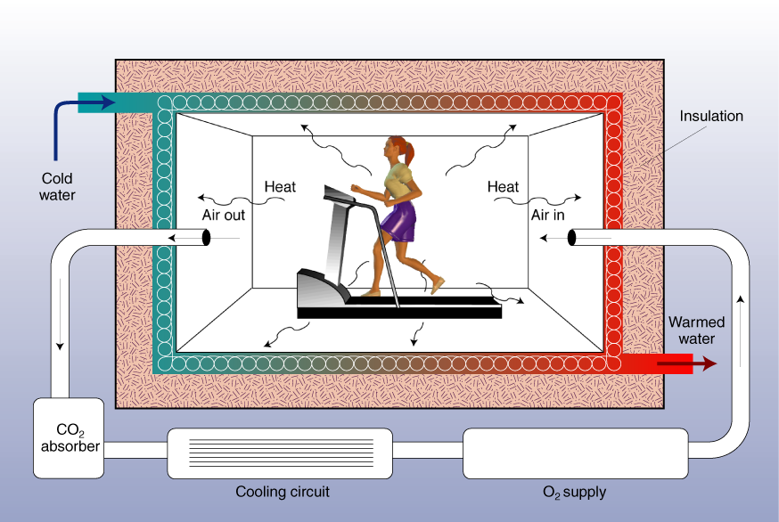
CALORIMETRIC CHAMBER

Slide 34
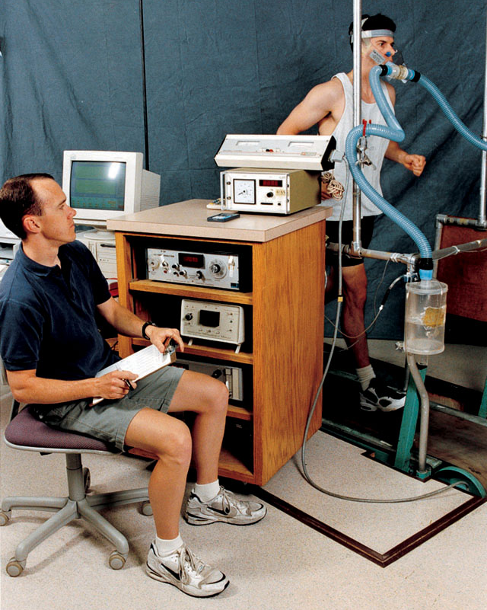
MEASURING RESPIRATORY GAS EXCHANGE

Slide 35

Respiratory Exchange Ratio
.
w The ratio between CO₂ released (VCO₂) and oxygen consumed (VO₂)
.
.
.
w RER = VCO₂/VO₂
w The RER value at rest is usually 0.78 to 0.80
w The RER value can be used to determine energy substrate used at rest and during exercise, with a value of 1.00 indicating carbohydrates and 0.70 indicating fat (higher need for O₂).

Slide 36
Caloric Equivalence of the RER (VCO₂/VO₂) and % kcal From Carbohydrates and Fats
Energy % kcal
RER kcal/L O₂ Carbohydrates Fats
0.71 4.69 0.0 100.0
0.75 4.74 15.6 84.4
0.80 4.80 33.4 66.6
0.85 4.86 50.7 49.3
0.90 4.92 67.5 32.5
0.95 4.99 84.0 16.0
1.00 5.05 100.0 0.0

Slide 37
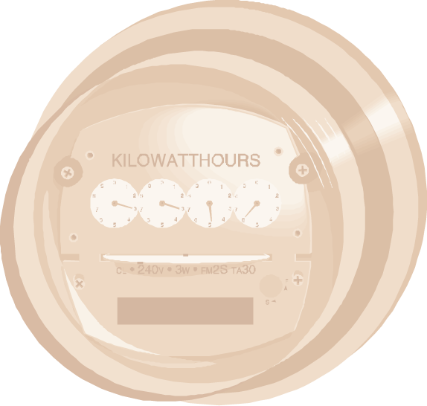
Metabolic Rate
w Rate at which the body expends energy at rest and
during exercise
w Measured as whole-body oxygen consumption and
its caloric equivalent
w Basal or resting metabolic rate (BMR) is the minimum energy required for essential physiological function
(varies between 1,200 and 2,400 kcal/24 hr)
w The minimum energy required for normal daily activity is about 1,800 to 3,000 kcal/24 hr
w 1 kcal = 4.2 kJ

Slide 38
.
Maximal Oxygen Uptake (VO₂max)
w Upper limit of a person's ability to increase oxygen uptake.
w Good indicator of cardiorespiratory endurance and aerobic fitness.
w Can differ according to sex, body size, age, and is greatly influenced by the level of aerobic training.
w Expressed in ml of O₂ consumed per body weight per min (ml · kg⁻¹ · min⁻¹).

Slide 39
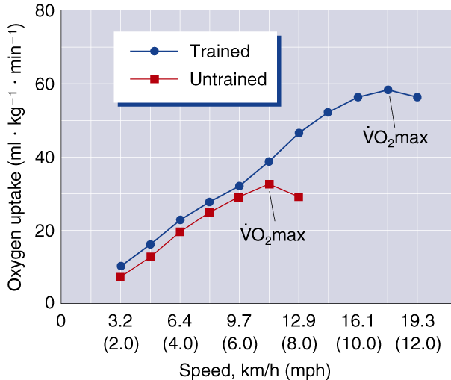
EXERCISE INTENSITY AND OXYGEN UPTAKE

Slide 40
Estimating Anaerobic Effort
There is not yet available a method that definitively measures anaerobic capacity, however there are ways to estimate it:
w Examine excess postexercise oxygen consumption (EPOC)—the mismatch between O₂ consumption and energy requirements during recovery from exercise
w Estimate lactate accumulation in muscles through blood analysis; estimate lactate threshold (LT)
w Use the maximal accumulated oxygen deficit test, the spiroergometry, or the Wingate anaerobic test which also show good promise for estimating the metabolic potential of anaerobic capacity

Slide 41
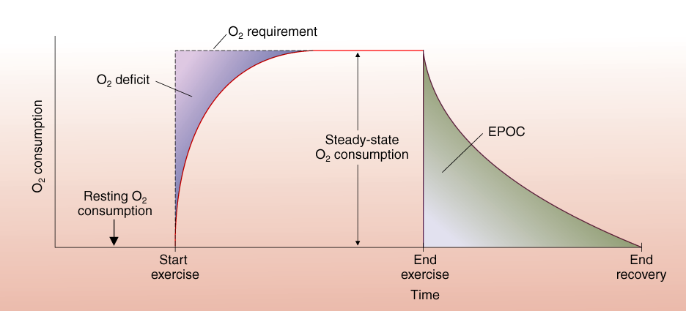
OXYGEN DEFICIT AND EPOC

Slide 42
Factors Responsible for EPOC
w Rebuilding depleted ATP supplies
w Balancing pH dropped by anaerobic metabolism
w Replenishing O₂ supplies borrowed from hemoglobin
and myoglobin
w Removing CO₂ that has accumulated in body tissues
w Increased metabolic and respiratory rates due to increased body temperature and norepinephrine and epinephrine levels

Slide 43

Lactate Threshold
w The point at which blood lactate begins to accumulate above resting levels during exercise of increasing intensity, where lactate production exceeds lactate clearance (by oxidation)
w Sudden increase in blood lactate with increasing effort can be the result of an increase in the production of lactate or a decrease in the removal of lactate from the blood
w Can indicate potential for endurance exercise; lactate formation contributes to fatigue

Slide 44
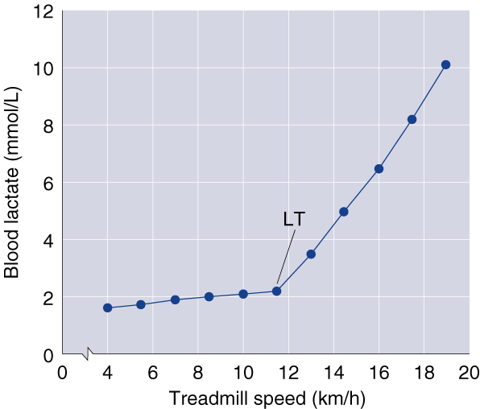
EXERCISE INTENSITY AND BLOOD LACTATE ACCUMULATION

Slide 45
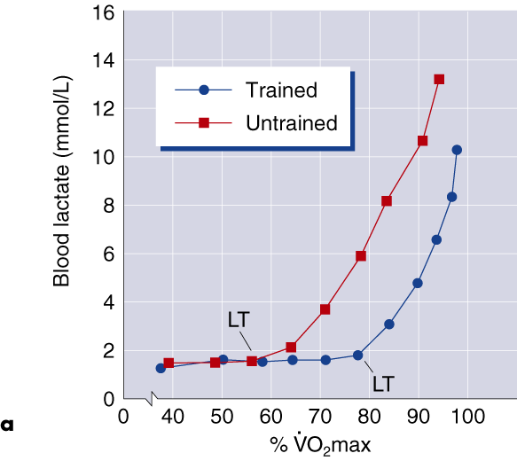
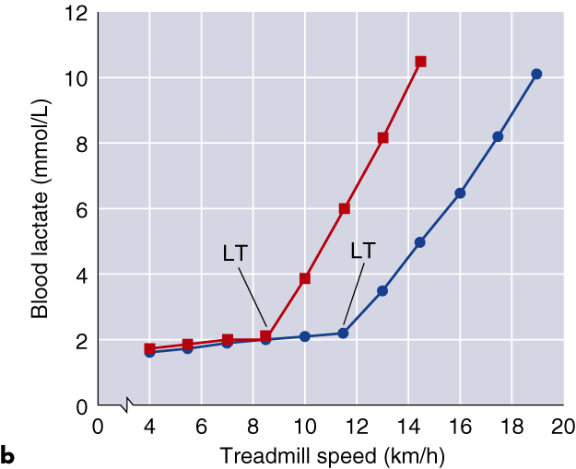
CHANGES IN LACTATE THRESHOLD WITH TRAINING

Slide 46

Did You Know…?
Lactate threshold (LT), when expressed as a percentage of VO₂max, is one of the best determinants of an athlete's pace in endurance events such as running and cycling. While untrained people typically have LT around 50% to 60% of their VO₂max, elite athletes may not reach LT until around 70% or 80% VO₂max.
.
.
.

Slide 47

Determining Endurance Performance Success
.
w High maximal oxygen uptake (VO₂max)
w (High lactate threshold)
w High economy of effort
w High percentage of slow-twitch muscle fibers

Slide 48

Fatigue and Its Causes
w Phosphocreatine (PCr) depletion
w Glycogen depletion (especially in activities lasting longer than 30 minutes)
w Accumulation of phosphate (especially in events shorter than 30 minutes), and H⁺ increased acidity
w Neuromuscular fatigue (Na⁺ and K⁺ imbalance)

Slide 49
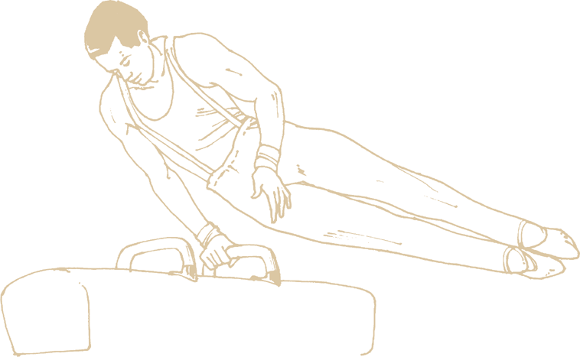
Aerobic vs Anaerobic Training
Aerobic (endurance) training leads to
w Improved blood flow, and
w Increased capacity of muscle fibers to generate ATP.
Anaerobic training leads to
w Increased muscular strength, and
w Increased tolerance for acid-base imbalances during highly intense effort.

Slide 50
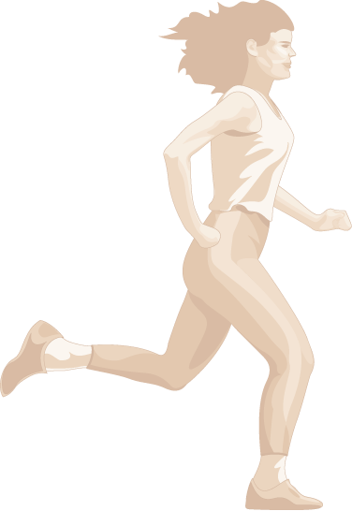
Adaptations to Aerobic Training
.
w Improved submaximal aerobic endurance and VO₂max
w Muscular changes in fiber size, blood and oxygen supply, and efficiency of functioning
w Improved efficiency of energy production
w The magnitude of these changes depend on
genetic factors

Slide 51
Muscular Adaptations
w Increased cross-sectional area of ST fibers
w Small transition of FT_{b} to FT_{a} fibers, but there can
also be a small transition of FT to ST fibers
w Increased number of capillaries supplying the muscles
which likely is an important factor that allows increase in
VO₂max
.
w Increased myoglobin content of muscle by 75% to 80%
(allowing muscle to store more oxygen)
w Increased number, size, and oxidative enzyme activity of
mitochondria

Slide 52
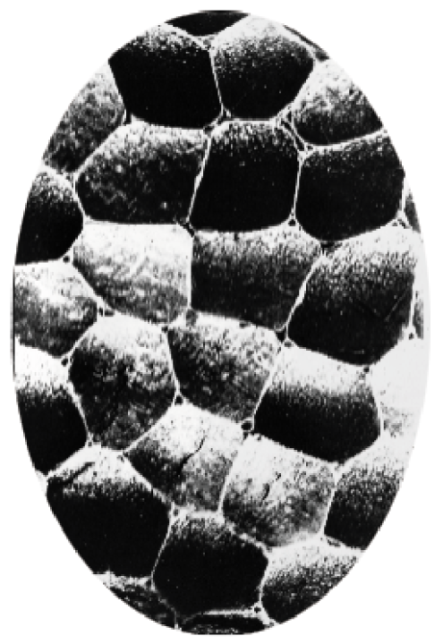
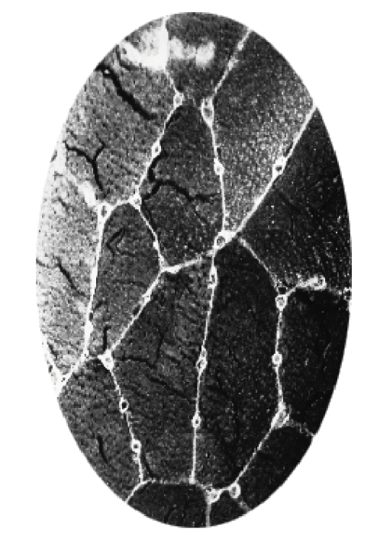
Capillarization in muscles
Untrained
Trained

Slide 53

Adaptations to Anaerobic Training
w Increased muscular strength
w Slightly increased ATP-PCr and glycoytic enzymes; changes in muscle enzyme activity depend on type of training.
w Improved mechanical efficiency
w Increased muscle oxidative capacity (for sprints longer than 30 s)

Slide 54

Did You Know…?
Performance improvements after anaerobic training (short, high-intensity training) appear to be related more to muscular strength gains than improvements in the anaerobic yield of ATP through the ATP-PCr and glycolytic systems.

