Slide 1
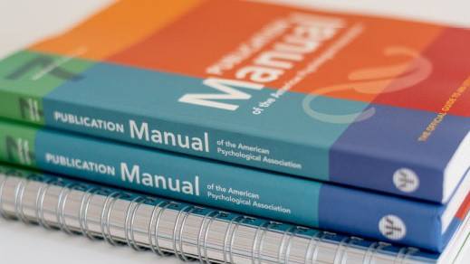
Citation norm The American Psychological Association
7th edition

Slide 2
Different types of citation styles
Different Citation Styles
Table 1
an Overview of Different Citation Styles and their In-text Citation
Citation Styl | Discipline | Type of Citation | In-text Example
MLA | Humanities | Parenthetical (author-page number) | (Surname 163)
Chicago A | History, humanities, Politics | Notes | …text ¹ ¹ Name Surname, Title
Chicago B | Sciences, social sciences, humanities | Parenthetical (author-date) | „ … text …“ (Author year, ##)
Vancuver | Medicine | Numeric | …text (1, 41–45, 50)
Harvard | Economic | Parenthetical (author-date) | (Author, Author and Author, 2021)
OSCOLA (Oxford University) | Law | Notes | … text ³¹, and text. ³² ³¹ Boulting (n 32) 639 ³² Human Rights Act 1998, s 2.
IEEE | Engeneering, IT | Numeric | … text [5, 7, 14–17]
APA (7th edition) | Psychology, education, social sciences | Parenthetical (author-date) | … text (Author, year)

Slide 3
Different types of citation styles
Different Citation Styles
Table 2
an Overview of Different Citation Styles and their Journal Citation
Citation Styl | Examples of Journal Citation
MLA | Surname, Name. “Title of Article.“ Journal title, day, Month abbreviation. Year, URL.
Chicago A | Surname, Name. “Title of Article.“ Journal title, no. # (year): ##-##. DOI.
Chicago B | Surname, Name. “Title of Article.“ Journal title, no. # (year): ##-##. DOI.
Vancouver | Surname A, Surname B. Surname C. Title of Article. Journal Title, 2020 feb. 21; 99(4):250-59. URL
Harvard
OSCOLA (Oxford University) | Surname Name, ‘Title‘ (year) #(#) Journal title <http://xxxx> accessed ## Month year
IEEE | A. Surname. “Title of article,“ Journal Title, vol. #, pp.##-##, Month year. Available: DOI [Accessed ## Month year].
APA (7th edition) | Surname, A., & Surname, B. B. (year). Title of article. Title of Periodical, volume(issue), #–#. DOI or URL

Slide 4
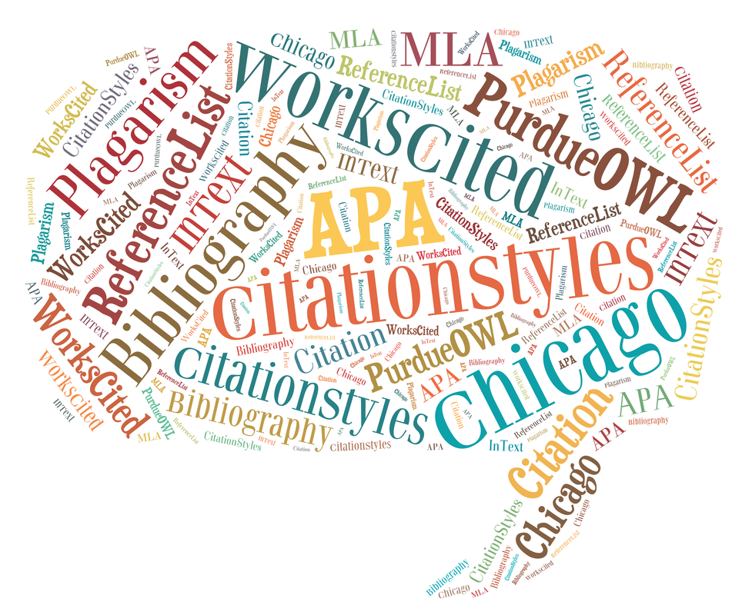
Different types of citation styles
Others Citation Styl
Turabian, AMA, ACS, NLM, AAA, APSA

Slide 5
APA
In-text Citation Styles
Table 1
Basic In-text Citation Styl
Author type | Parenthetical Citation | Narative citation
One author | (Cobley, 2015) | Cobley (2015)
Two authors | (Müller & Ferrauty, 2019) | Müller and Ferrauty (2019)
Three and more authors | (Hendl et al., 2016) | Hendl et al. (2016)
Group author with abbreviation - First citations - Subsequent citations | (National Istitute of Mental Health [NIMH], 2021) (NIMH, 2021) | National Istitute of Mental Health (NIMH, 2021) NIMH (2021)
Group author without abbreviation | (Masaryk University, 2020) | Masaryk University (2020)

Slide 6
APA
In-text citation styles
Plagiarism
“act of presenting the word, idea, or images of another as your own (APA, p. 254).
Paraphrasing
Narrative citation: Author (year)
Parenthetical citation: (Author, year)
Quotations
Short Quotations (fewer that 40 words)
Narrative citation: Autor “…“ (year, p. #)
Parenthetical citation: “…“ (Author, year, pp. #-#).
Block Quotations (40 words or more)
no quation marks
Starts at new line (indent whole block 0.5 in, left margin)
Narrative citation: Autor (year) …text… . (p. #)
Parenthetical citation: Text…. . (Autor, year, p. #)

Slide 7
APA
In-text citation styles
Specific approaches to citation
Interview
Publish interview, Personal interview, Research participant interview
Personal Communications
Narrative citation: A. Author (personal communication, Month day, year)
Parenthetical citation: (A. Author, personal communication, Month day, year)

Slide 8
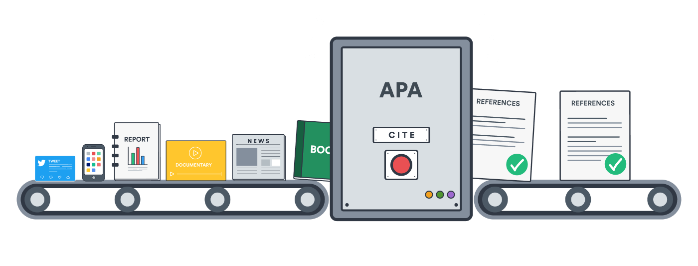
APA
Reference Examples
Periodicals
Books
Edited chapters
Dissertations and Theses
Webpages and Websites

Slide 9
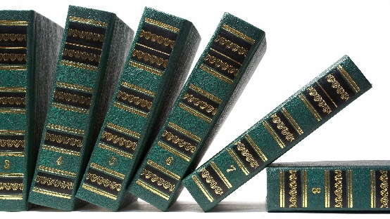
Reference List
Book and Reference Work
Author or editor | Date | Title | Source
 |  |  | Publisher information | DOI or URL
Author, A. A., & Author, B. B. Name of Group. Editor, E.E. (Ed.). Editor, E.E., & Editor, E.E. (Eds.). | (2022). | Title of book. Title of book (2nd ed., Vol. 3). Title of book [Audiobook]. Title of book (P. Translator, Trans.). | Publisher Name. | https://doi.org/xxx https://xxxx
Model
Author, A., & Author, B. (year). Title of book: Subtitle (edition). Publisher. DOI nebo URL
Example
Hendl, J., & Remr, J. (2017). Metody výzkumu a evaluace. Portál.

Slide 10
Reference List
Edited Book Chapter and Entries in Reference Work
Author kapitoly | Date | Chapter title | Source
 |  |  | Edited book imformation | DOI or URL
Author, A. A., & Author, B. B. Name of Group. | (2020). | Title of chapter. | In E. E. Editor (Ed.), Title of book (pp. 2-14). Publisher Name. | https://doi.org/xxx https://xxxx
Model
Author, A., & Author, B. (year). Title of chapter. In E. E. Editor & B. B. Editor (Eds.), Title of book or proceedings: Subtitle (3rd ed., s. #–#). Publisher Name. DOI or URL adresa
Example
Iwamasa, G. Y., Hsia, C., & Hinton, D. (2019). Cognitive behavior therapy with Asian Americans. In G. Y. Iwamasa & P. A. Hays (Eds.), Culturally responsive cognitive behavior therapy: Practice and supervision (s. 129–159). American Psychological Association. https://doi.org/10.1037/0000119-006

Slide 11
Reference List
Academic Journal
Author | Date | Title | Source
 |  |  | Periodical information | DOI or URL
Author, A. A., & Author, B. B. Name of Group. | (2022). (2020, January). (2021, February 20). | Title of article. | Title of Periodical, xx(x), xx-xx. Title of Periodical, xx(x–x), Article ##. | https://doi.org/xxx https://xxxx
Model
Author, A. A., & Author, B. B. (year). Title of article. Title of Periodical, volume(issue), #–#. DOI or URL adresa
Example
Gimunová, M., Bozděch, M., Skotáková, A., Grün, V., & Válková, H. (2021). Comparison of forward and backward gait in males with and without intellectual disabilities. Journal of Intellectual Disability Research, 65(10), 922-929. https//doi.org/10.1111/jir.12873

Slide 12
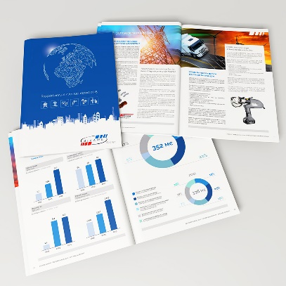
Reference List
Webpages, Websites and Annual Report
Autor | Date | Title | Source
 |  |  | Website name | URL
Author, A. A., & Author, B. B. Name of Group. | (2020). (2020, March). (2020, Jarnuary 20). (n.d.). | Title of work. | Site Name. | https://xxxx Retrieved december 21, 2022, from https://xxxx
Model
Author, A. (year, Month day). Title of work. Site title. URL
Examples
World Health Organization. (2021, 1. January). Advice for the public: Coronavirus disease (COVID-19). https://www.who.int/emergencies/diseases/novel-coronavirus-2019/advice-for-public
Eurostat. (n.d.). Health statistics at regional level. Retrieved November 12, 2022 from https://ec.europa.eu/eurostat/statistics-explained/index.php?title=Health_statistics_at_regional_level

Slide 13
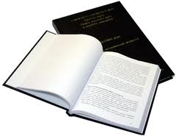
Reference List
Dissertation and Theses
Author | Date | Title | Source
 |  |  | Database or archive name | URL
Autor, A. A. | (2020). | Title of dissertation [Master‘s thesis, Name of institution Awarding the Degree]. | Database Name. Archive Name. | https://xxxx
Model
Author, A. A. (year). Title of dissertation [Doctoral dissertation, Name of Institution Awarding the Degree]. Database or Archive Name. URL
Example
Čížová, D. (2021). Léčebně-rehabilitační plán a postup u poškození mediálního menisku [Bacholar thesis, Masaryk University]. Is.muni.cz. https://is.muni.cz/auth/th/da8ut/

