Slide 1
Cardiovascular system
Cardiovascular control during exercise
Mgr. Tereza Brůžová

Slide 2
Cardiovascular system
Functions
Heart and cardiovascular system
  Anatomy
  Heart rate
  Cardiac cycle
  Intrinsic conduction system
  ECG
  Blood pressure
  Blood distribution
Cardiovascular system
and exercise
  Useful terms
  Responses vs adaptations
  Parameters
Blood
  Hematocrit, viscosity
  Functions
  Hemoglobin

Slide 3
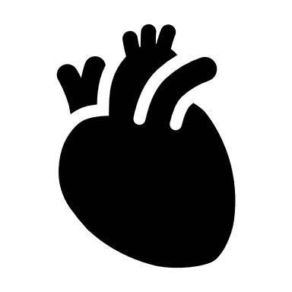


1. Cardiovascular system and its functions
A pump – the heart
A system of channels – the blood vessels
A fluid medium – blood
What are the roles of the heart and the vessels?

Slide 4
1. Cardiovascular system and its functions
Delivery (e.g., oxygen and nutrients)
Removal (e.g., carbon dioxide, lactate, other waste products)
Transportation (e.g., hormones)
Maintenance (e.g., body temperature, pH)
Prevention (e.g., infection—immune function)

Slide 5
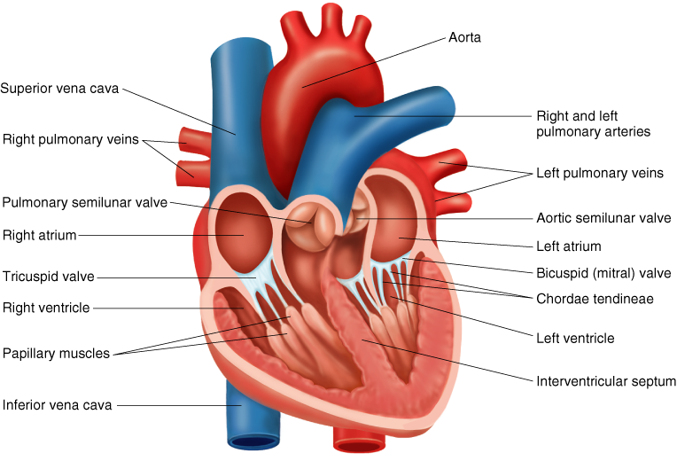
2a) Heart anatomy
Notes:
https://www.gettyimages.com/detail/illustration/anatomy-of-heart-interior-frontal-section-royalty-free-illustration/188057943

Slide 6
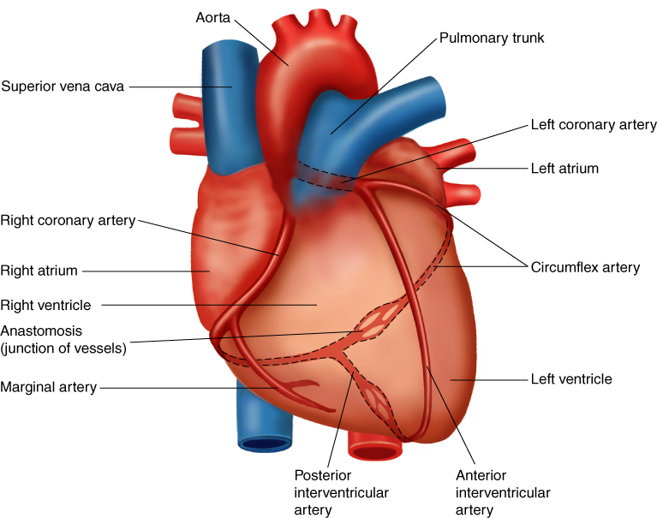
2a) Heart anatomy

Slide 7
Key points
The two atria receive blood into the heart; the two ventricles send blood from the heart to the rest of the body.
The left ventricle has a thicker myocardium due to hypertrophy resulting from the resistance against which it must contract.

Slide 8
2b) Heart Rate
Resting heart rates in adults tend to be between 60 and 85 beats/min. However, extended endurance training can lower resting heart rate to 35 beats/min or less. This lower heart rate is thought to be due to decreased intrinsic heart rate and increased parasympathetic stimulation.
What is the average resting heart rate frequency?

Slide 9
2b) Heart Rate
Resting heart rates in adults tend to be between 60 and 80 beats/min. However, extended endurance training can lower resting heart rate to
40 beats/min or less. This lower heart rate is thought to be due to decreased intrinsic heart rate and increased parasympathetic stimulation.

Slide 10
2b) Cardiac Arrhythmias
BRADYCARDIA – Resting heart rate below 60 beats/min
TACHYCARDIA – Resting heart rate above 100 beats/min
PREMATURE VENTRICULAR CONTRACTIONS (PVCs)
– feels like skipped or extra beats
VENTRICULAR TACHYCARDIA – three or more consecutive
PVCs that can lead to ventricular fibrillation in which contraction
of the ventricular tissue is uncoordinated

Slide 11
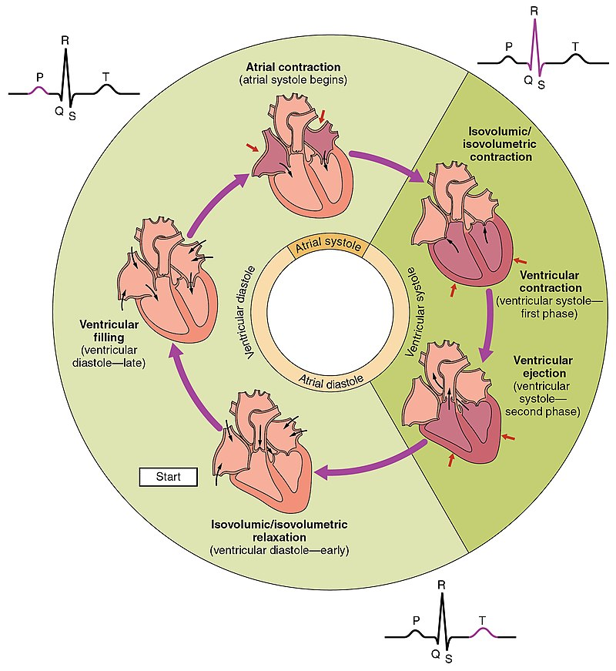
2c) Cardiac cycle
The event that occurs between two consecutive heartbeats (systole to systole)
Diastole — relaxation phase during which the chambers fill with blood — 62% of cycle duration
Systole — contraction phase during which the chambers expel blood — 38% of cycle duration
Notes:
https://en.wikipedia.org/wiki/Cardiac_cycle#/media/File:2027_Phases_of_the_Cardiac_Cycle.jpg

Slide 12
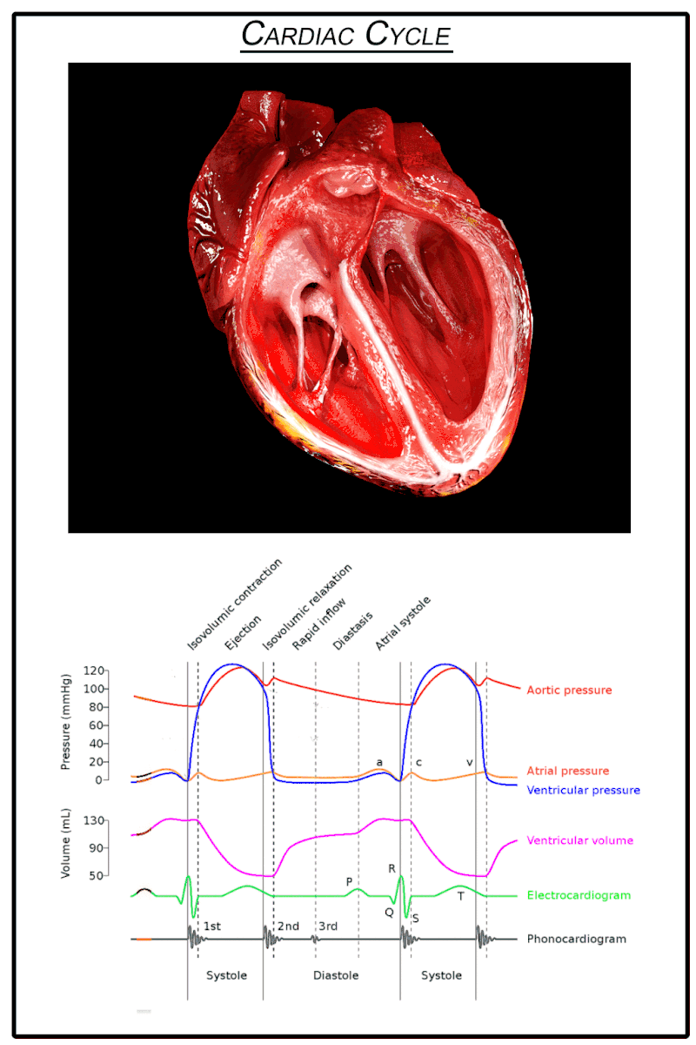

Slide 13
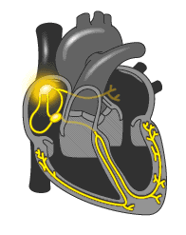
2d) Intrinsic Conduction System

Slide 14
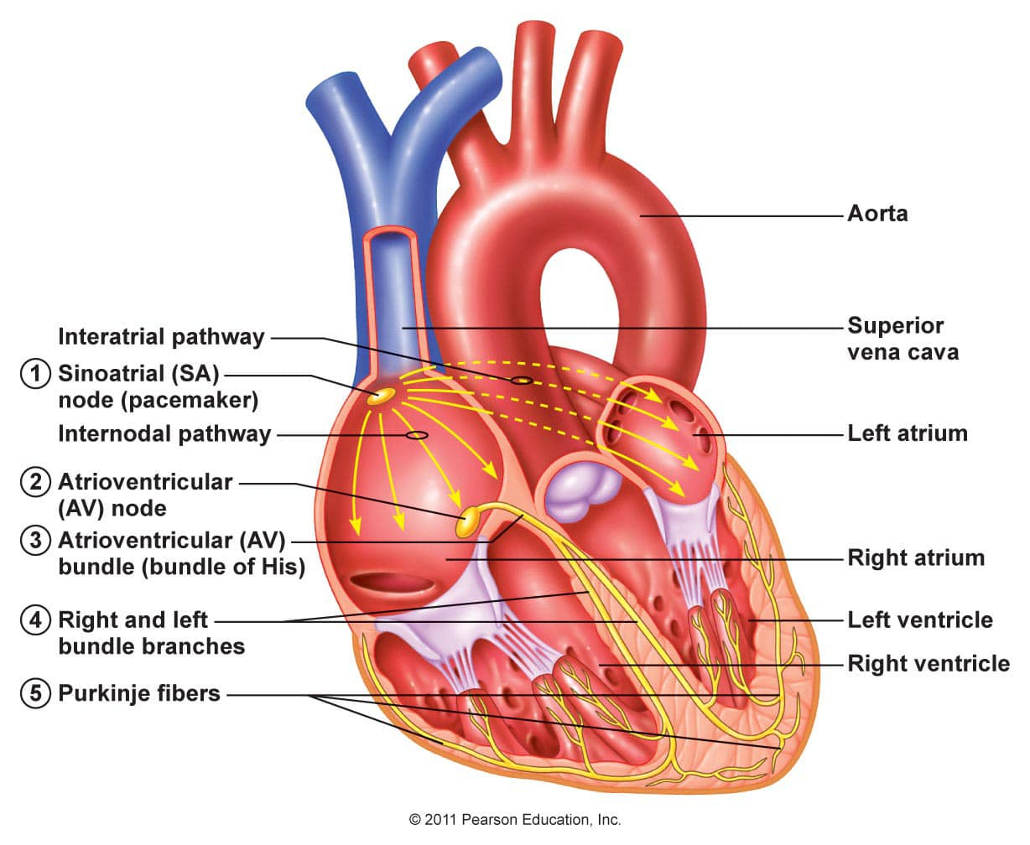
2d) Intrinsic Conduction System
Cells of Intrinsic conduction system (ICS) generate their own electrical impulses
Sinoatrial node (SA node) – the pacemaker
  it generates electrical impulses the fastest and sets the rhythm for the rest of ICS; heavily controlled
Atrioventricular node (AV node)
AV bundle
Bundle branches
Purkinje fibers (subendocardial conducting network) – contractions of the ventricles
Notes:
https://www.facebook.com/photo/?fbid=497597494434803&set=pcb.497598781101341

Slide 15
2d) Intrinsic Conduction System
Cells of Intrinsic conduction system (ICS) generate their own electrical impulses
Sinoatrial node (SA node) – the pacemaker
  it generates electrical impulses the fastest and sets the rhythm for the rest of ICS; heavily controlled
Atrioventricular node (AV node)
AV bundle
Bundle branches
Purkinje fibers (subendocardial conducting network) – contractions of the ventricles
Notes:
https://www.facebook.com/photo/?fbid=497597494434803&set=pcb.497598781101341
https://www.youtube.com/watch?v=sysTSvey4Ow&ab_channel=AnatomyHero
https://www.frontiersin.org/articles/10.3389/fphys.2020.00170/full

Slide 16
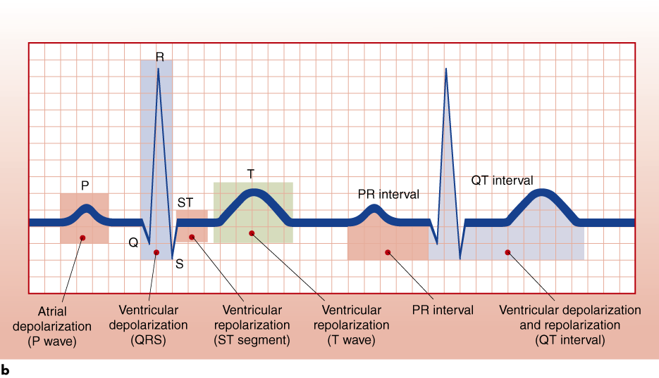
2e) Electrocardiogram (ECG)
Printout shows the heart's electrical activity – can be used to monitor cardiac changes
The P wave – atrial depolarization
The QRS complex – ventricular depolarization and
atrial repolarization
ST segment – plateau of action potential, ventricles pump blood
The T wave – ventricular repolarization (diastole)
Notes:
https://www.youtube.com/watch?v=RYZ4daFwMa8&ab_channel=AlilaMedicalMedia
https://www.youtube.com/watch?v=v7Q9BrNfIpQ&ab_channel=AlilaMedicalMedia
Q – depolarization of the interventricular septum
R – depolarization of the main mass of the ventricles
S – depolarization at the base of the heart

Slide 17
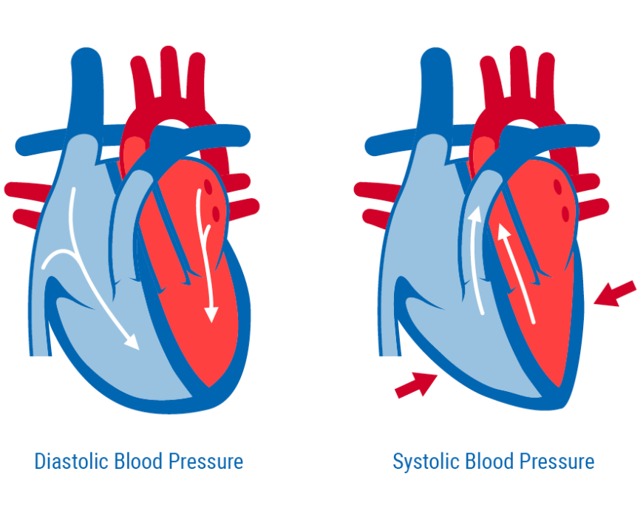
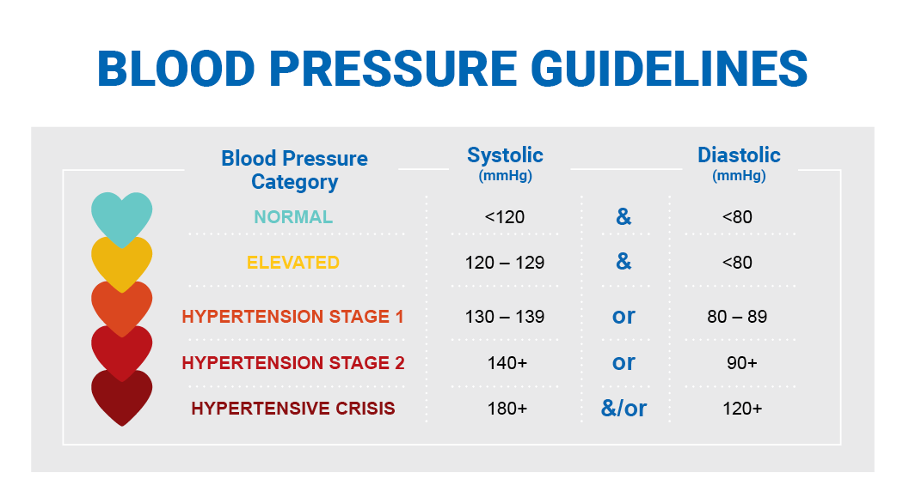
2f) Blood pressure
Systolic blood pressure (SBP) is the highest pressure and diastolic blood pressure (DBP) is the lowest pressure
Mean arterial pressure (MAP) — average pressure exerted by the blood as it travels through arteries
MAP = DBP + [0.333 ´ (SBP – DBP)]
Rest Blood Pressure is about 120/80
Hypertension: BP = more than 140/90
Hypotension: BP = less than 90/60
Notes:
https://medical.andonline.com/systolic-vs-diastolic-blood-pressure/

Slide 18
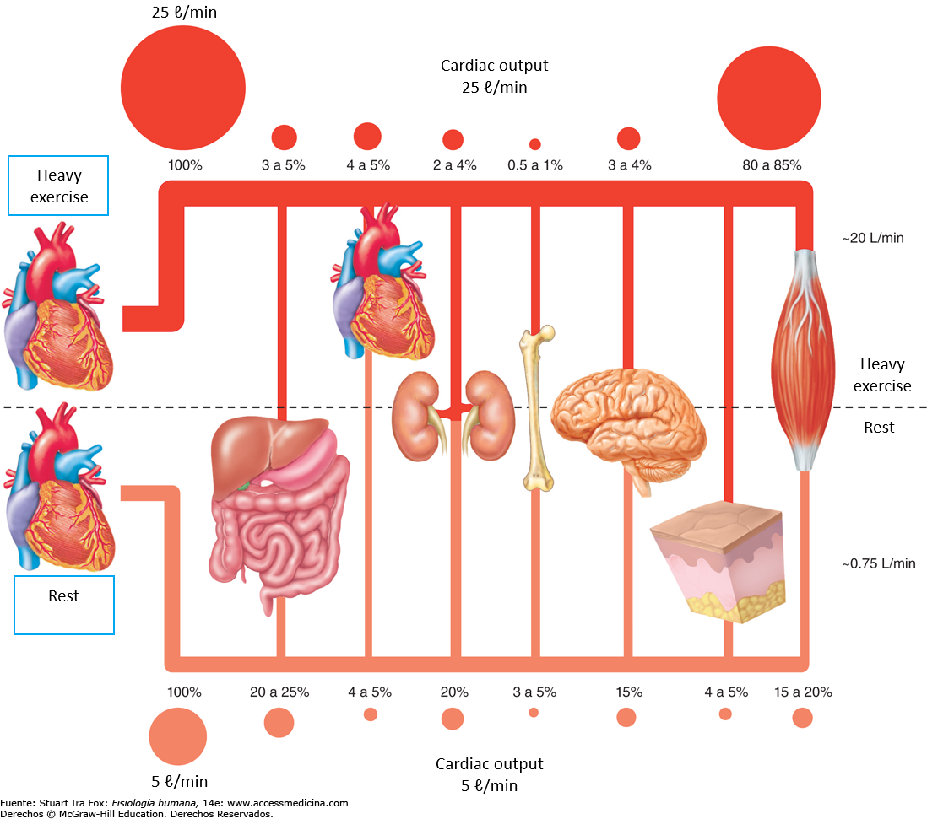
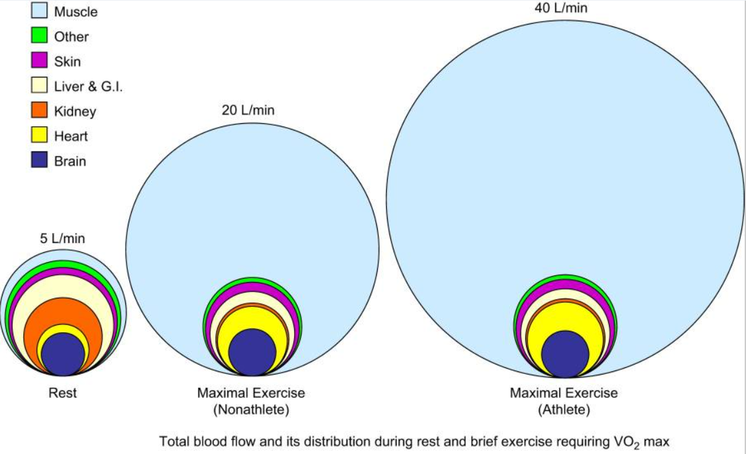
2g) Blood distribution
Notes:
https://www.ncbi.nlm.nih.gov/pmc/articles/PMC4551211/
https://physoc.onlinelibrary.wiley.com/doi/10.1113/JP270593

Slide 19
3a) Cardiovascular system and exercise
TERMS:
Heart rate (HR)
  RHR = resting heart rate
  HRmax
Blood pressure (BP)
  RBP = resting blood pressure
Stroke volume (SV) = volume
of blood pumped per contraction
Cardiac output (Q) is the total volume of blood pumped by the ventricles per minute
  Q=HRxSV
VO₂ max
Extraction of oxygen a-vO₂ difference
  Difference between the oxygen content in arterial and mixed-venous blood
  a-vO2 diff = Ca – Cv

Slide 20
3a) Cardiovascular system and exercise
Stroke volume (SV)
  50-100 ml on average
  End-Diastolic Volume (EDV)
  – blood volume in a ventricle before contraction
  End-Systolic Volume (ESV)
  – blood volume in a ventricle after contraction
  SV = EDV – ESV

Slide 21
3b) Cardiovascular system and exercise
a) Response vs
Acute (short-term)
Physiology
Function
b) Adaptation
Chronic (long-term)
Anatomy
Structure

Slide 22
3b) Cardiovascular Response to Acute Exercise
Anticipation of exercise:
Heart rate increases
Adrenalin is released

Slide 23
3b) Cardiovascular Response to Acute Exercise
During exercise:
Heart rate (HR) increases as exercise intensity increases up to maximal heart rate
Stroke volume (SV) increases up to 40% to 60% VO₂max in untrained individuals and up to maximal levels in trained individuals.
Increases in HR and SV during exercise cause cardiac output (Q) to increase
Blood flow and SBP (systolic blood pressure) increase
All result in allowing the body to efficiently meet the increased demands placed on it
Redirection of blood flow – vasoconstriction and vasodilation

Slide 24
3b) Cardiovascular Adaptations to Training
Left ventricle size and wall thickness increase
Resting, submaximal, and maximal stroke volume increases
Maximal heart rate stays the same or decreases
Resting heart rate decreases
Cardiac output is better distributed to active muscles and maximal cardiac output increases
Blood volume increases, as does red cell volume but to a lesser extent
Resting blood pressure does not change or decreases slightly, while blood pressure during submaximal exercise decreases

Slide 25


3c) Resting and Maximum Heart Rate
RHR
Averages 60 to 80 beats/min; can range from 28 to above
100 beats/min
Tends to decrease with age
and with increased cardiovascular fitness
Is affected by environmental conditions such as altitude
and temperature
HRmax
The highest heart rate value one can achieve in an all-out effort
to the point of exhaustion
Remains constant day to day
and changes slightly from year
to year
Can be estimated:
  HRmax = 220 – age in years or
  HRmax = 208 – (0.7 x age)
Notes:
https://www.mayoclinic.org/healthy-lifestyle/fitness/in-depth/exercise-intensity/art-20046887#:~:text=Subtract%20your%20age%20from%20220,minute%20for%20the%20average%20adult.

Slide 26
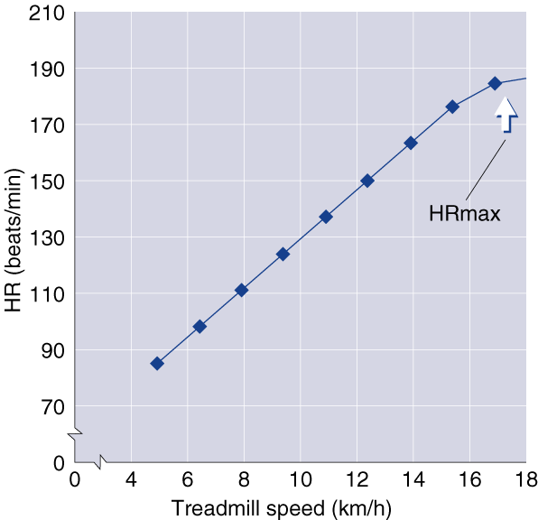
3c) Heart Rate and Intensity
Notes:
https://www.mayoclinic.org/healthy-lifestyle/fitness/in-depth/exercise-intensity/art-20046887#:~:text=Subtract%20your%20age%20from%20220,minute%20for%20the%20average%20adult.

Slide 27
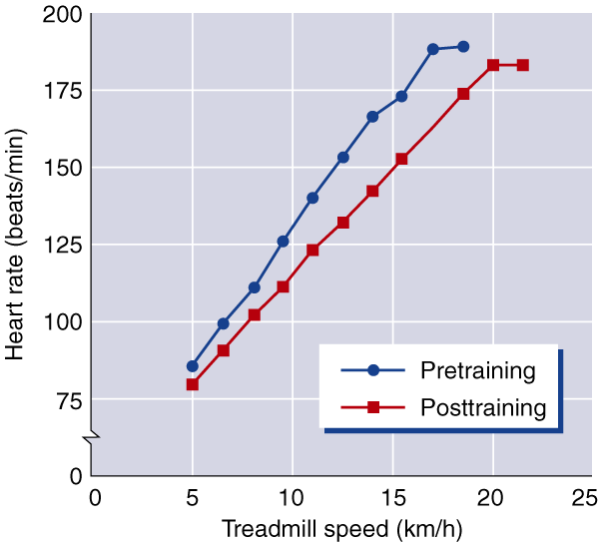
3c) Heart Rate and Training
Notes:
https://www.mayoclinic.org/healthy-lifestyle/fitness/in-depth/exercise-intensity/art-20046887#:~:text=Subtract%20your%20age%20from%20220,minute%20for%20the%20average%20adult.

Slide 28
3c) Resting Heart Rate
Decreases with endurance training likely due to more blood returning to heart and changes in autonomic control
Sedentary individuals can decrease RHR by 1 beat/min per week during initial training, but several recent studies have shown small changes of less than 3 beats/min with up to 20 wk of training
Highly trained endurance athletes may have resting heart rates of 30 to 40 beats/min
Notes:
https://www.mayoclinic.org/healthy-lifestyle/fitness/in-depth/exercise-intensity/art-20046887#:~:text=Subtract%20your%20age%20from%20220,minute%20for%20the%20average%20adult.

Slide 29
3c) Heart Rate During Exercise
SUBMAXIMAL
  Decreases proportionately with the amount of training completed
  May decrease by 10 to 30 beats/min after 6 months
  of moderate training at any given rate of work, with the decrease being greater at higher rates of work
MAXIMAL
  Remains unchanged or decreases slightly
  A decrease might allow for optimal stroke volume to maximize cardiac output
Notes:
https://www.mayoclinic.org/healthy-lifestyle/fitness/in-depth/exercise-intensity/art-20046887#:~:text=Subtract%20your%20age%20from%20220,minute%20for%20the%20average%20adult.

Slide 30
3c) Heart Rate Recovery Period
The time after exercise that it takes your heart to return to its resting rate
With training, heart rate returns to resting level more quickly after exercise
Has been used as an index of cardiorespiratory fitness
Conditions such as altitude or heat can affect it
Should not be used to compare individuals to one another

Slide 31
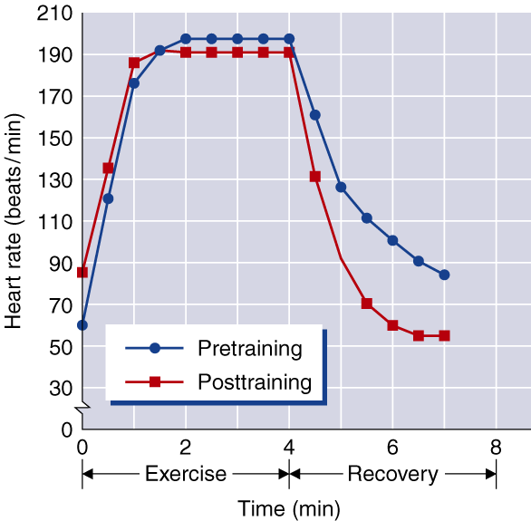
3c) Heart Rate Recovery Period and Training

Slide 32
3c) Stroke Volume
Determinant of cardiorespiratory endurance capacity at maximal rates of work
Increases with increasing rates of work up to intensities of 40%
to 60% of max or higher
May continue to increase up through maximal exercise intensity, generally in highly trained athletes
Magnitude of changes in SV depends on position of body during exercise

Slide 33
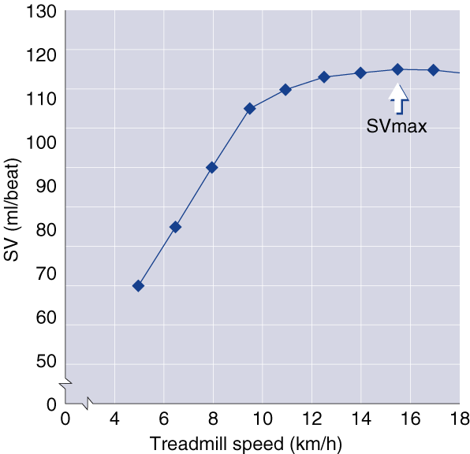
3c) Stroke Volume and Intensity

Slide 34
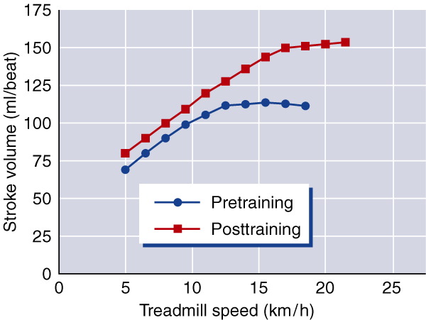
3c) Stroke Volume and Training
Stroke Volumes (SV) for Different States of Training
Subjects SVrest (ml) SVmax (ml)
Untrained 50-70 80-110
Trained 70-90 110-150
Highly trained 90-110 150-220

Slide 35
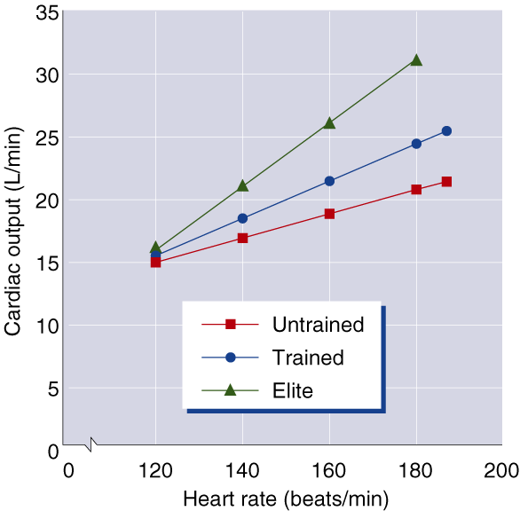
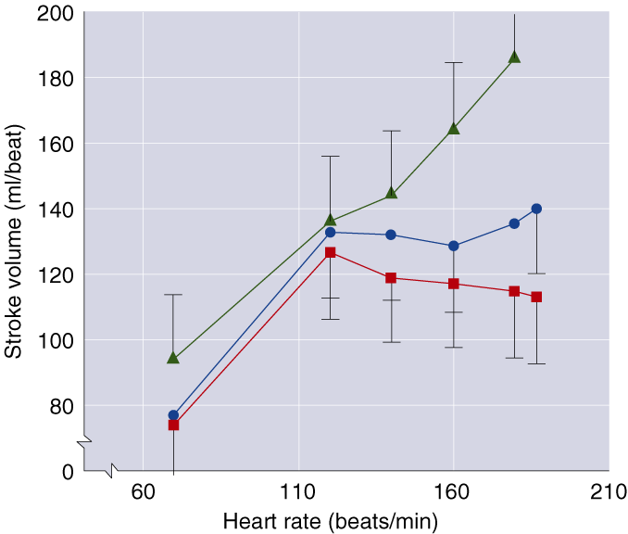
3c) Changes in Q and SV with Increasing
Rates of Work

Slide 36
3c) Cardiac Output
Resting value is approximately 5.0 L/min.
Increases directly with increasing exercise intensity
to maximal values of between 20 to 40 L/min.
The magnitude of increase varies with body size
and endurance conditioning.
When exercise intensity exceeds 40% to 60%, further increases in Q are more a result of increases in HR than SV since SV tends to plateau at higher work rates.

Slide 37
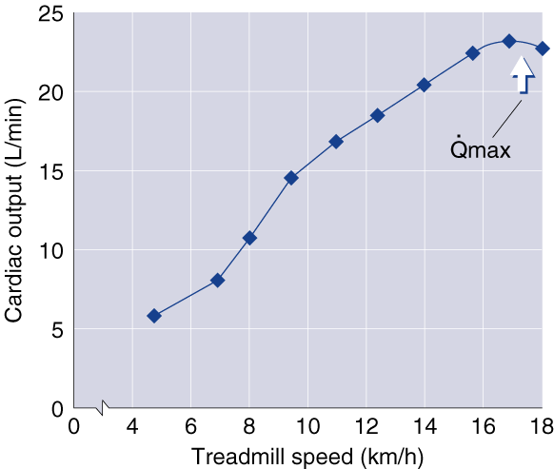
3c) Cardiac Output and Intensity

Slide 38
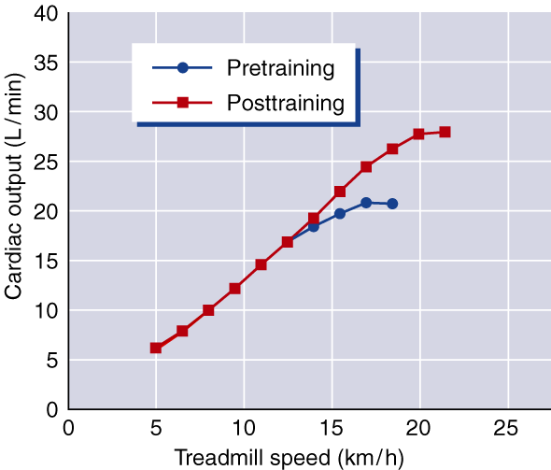
3c) Cardiac Output and Training

Slide 39
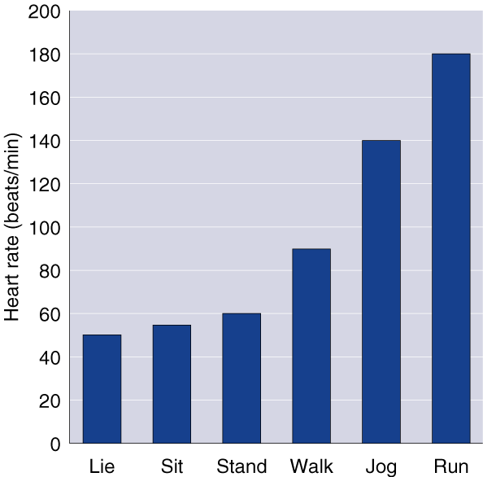
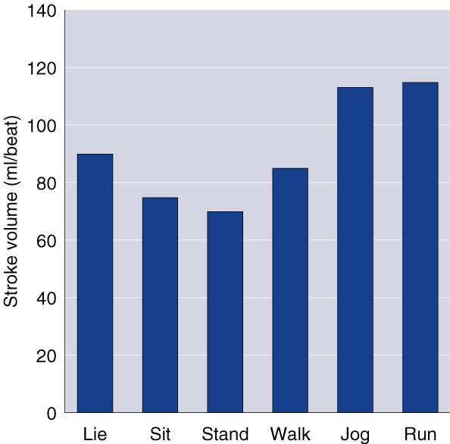
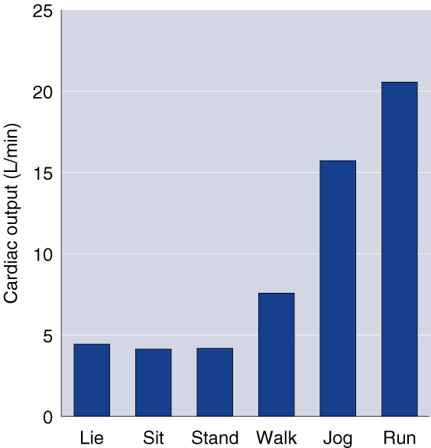
3c) Changes in HR, SV, and Q with Changes in Position and Exercise Intensity

Slide 40
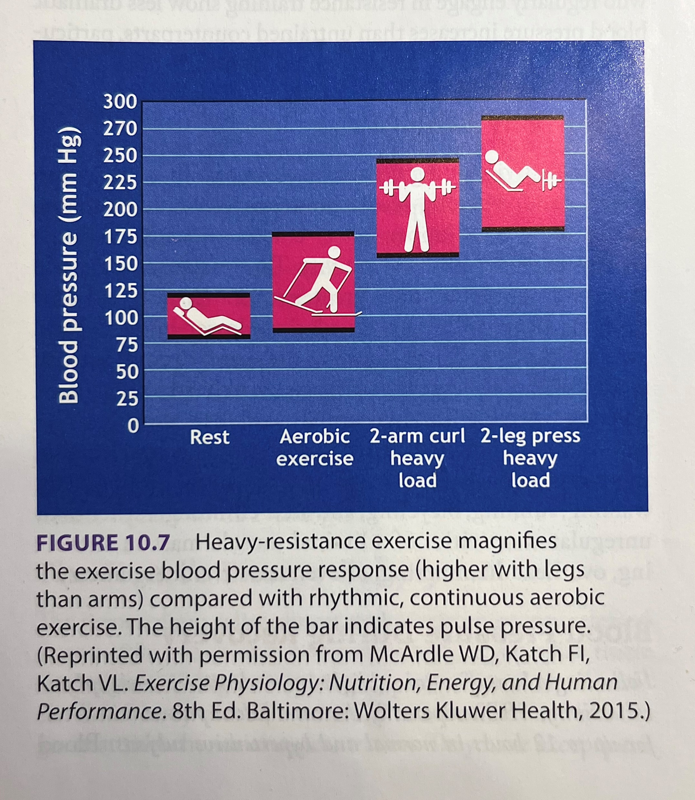
3c) Blood Pressure
Cardiovascular Endurance Exercise
  Systolic BP increases in direct proportion
  to increased exercise intensity
  Diastolic BP changes little if any during endurance exercise, regardless of intensity
Resistance Exercise
  Exaggerates BP responses to as high
  as 480/350 mmHg

Slide 41
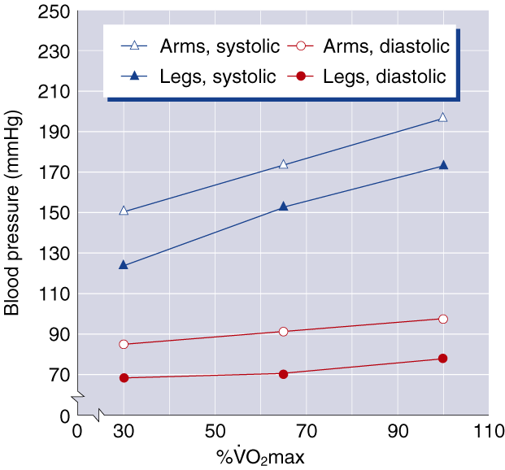
3c) Blood Pressure Responses

Slide 42

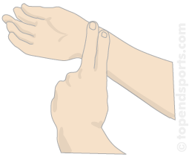
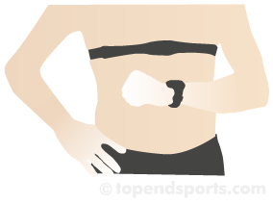
Heart rate measurements

Slide 43
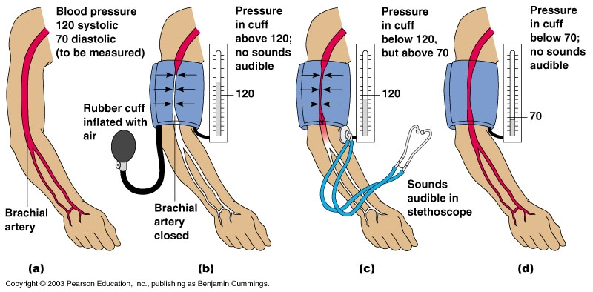
Blood pressure measurements

Slide 44
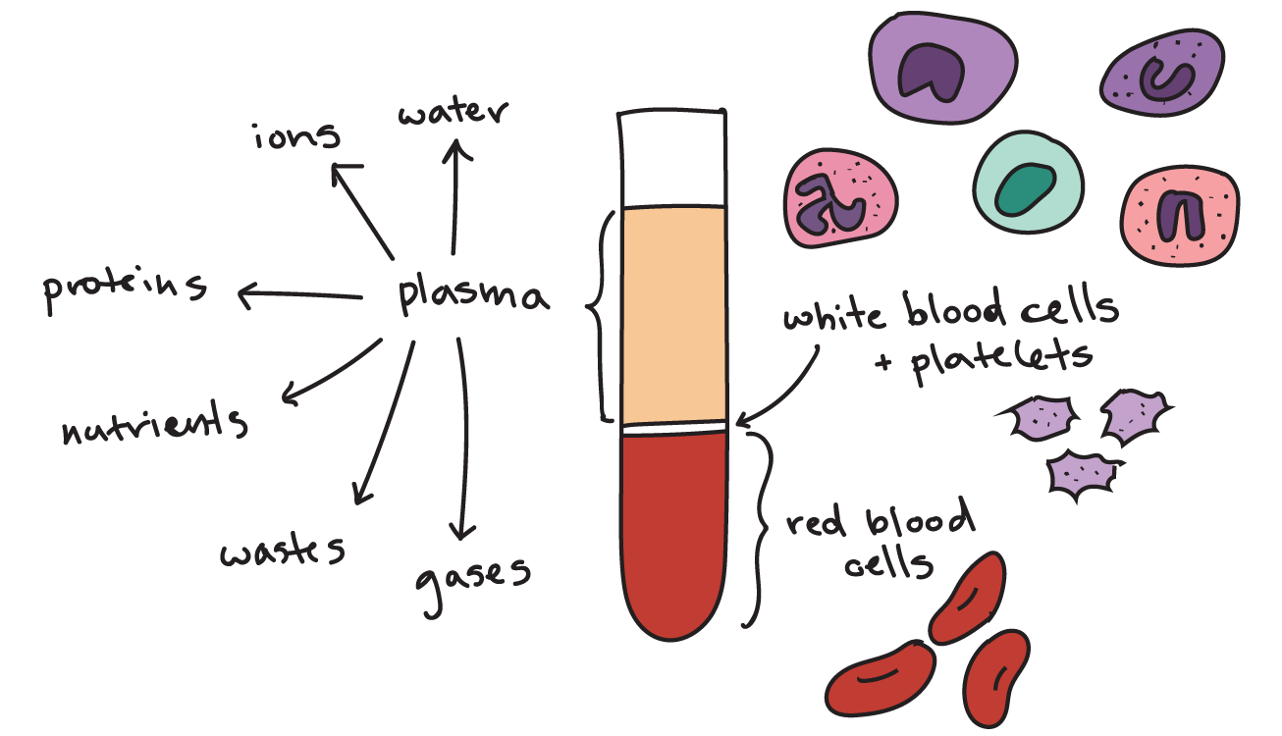

4. Blood
Connective tissue (the only fluid
tissue in the body)
Accounts for approx. 7% of body weight
An adult individual has approx. 5liters of blood
Blood composition
  Plasma (55%)
    91% water
    8% proteins – albumin, globulin (transportation)
    1% other molecules
  Formed elements (45%)
    99% red blood cells (erythrocytes) – carry oxygen
    <1% white blood cells (leukocytes) – protect from pathogens
  Platelets (<1%)
Blood placed in a centrifuge
* Erythrocytes and platelets do not possess all the typical organelles and they can not divide – they are replaced by stem cells in the bone marrow
Notes:
https://www.khanacademy.org/science/biology/human-biology/circulatory-pulmonary/a/components-of-the-blood
https://www.youtube.com/watch?v=yj7bfZKlIp8&t=182s&ab_channel=ProfessorDaveExplains

Slide 45
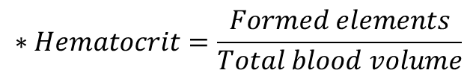
4a) Blood hematocrit, viscosity
$$∗Hematocrit=\frac{Formed elements}{Total blood volume}$$
Blood viscosity = thickness of the blood
The more viscous, the more resistant to flow
Higher hematocrits result in higher blood viscosity
Notes:
https://www.khanacademy.org/science/biology/human-biology/circulatory-pulmonary/a/components-of-the-blood

Slide 46
4b) Blood functions
Delivers oxygen to tissues
Delivers nutrients such glucose, amino acids or fatty acids
– dissolved in blood or attached to carrier proteins
Transports waste products – CO2, Urea, Lactic acid
Transports hormones
Protects from pathogens (Immunological functions) – white blood cells, Antibodies
Regulates temperature
Buffers and balances acid base homeostasis
Coagulation (to stop bleeding)

Slide 47
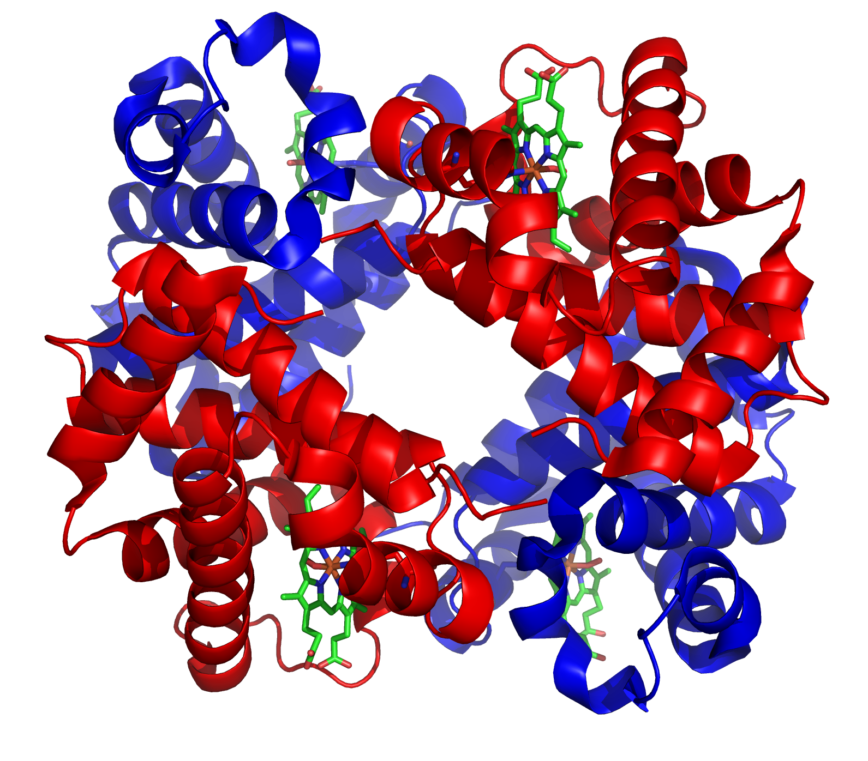
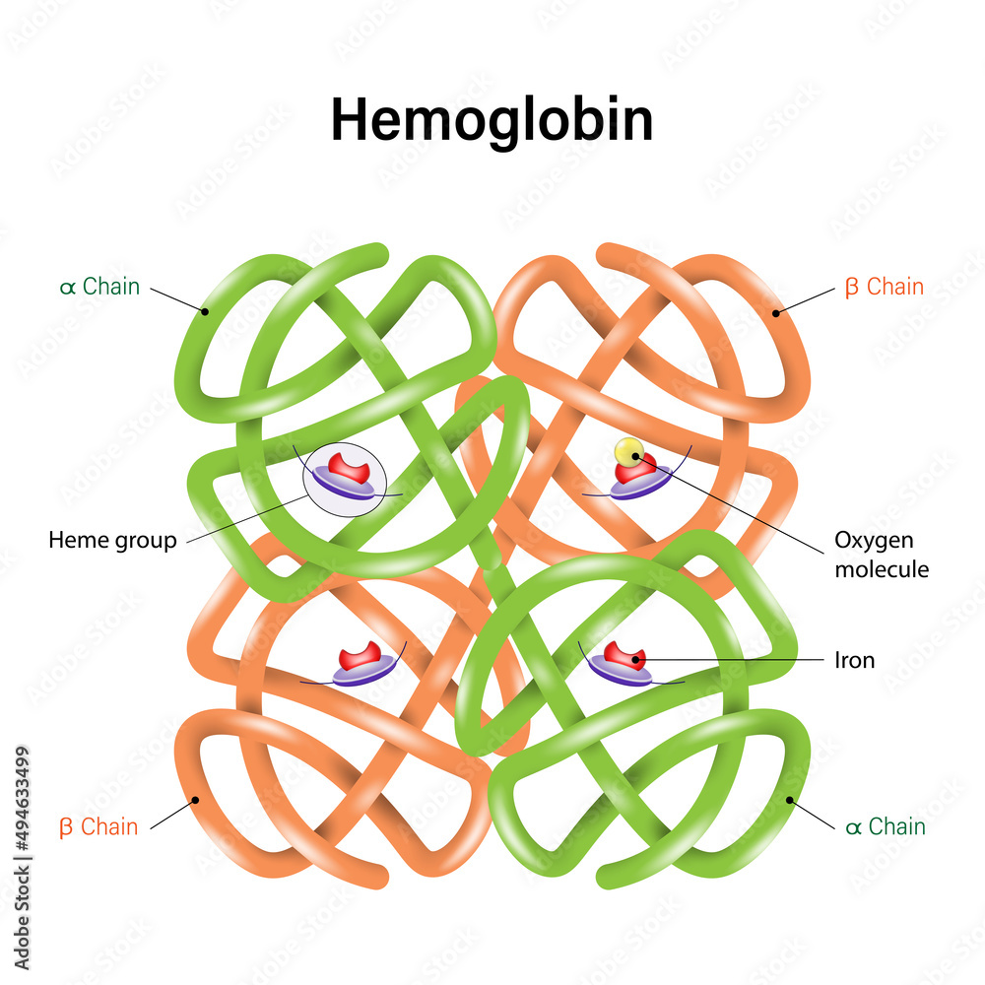
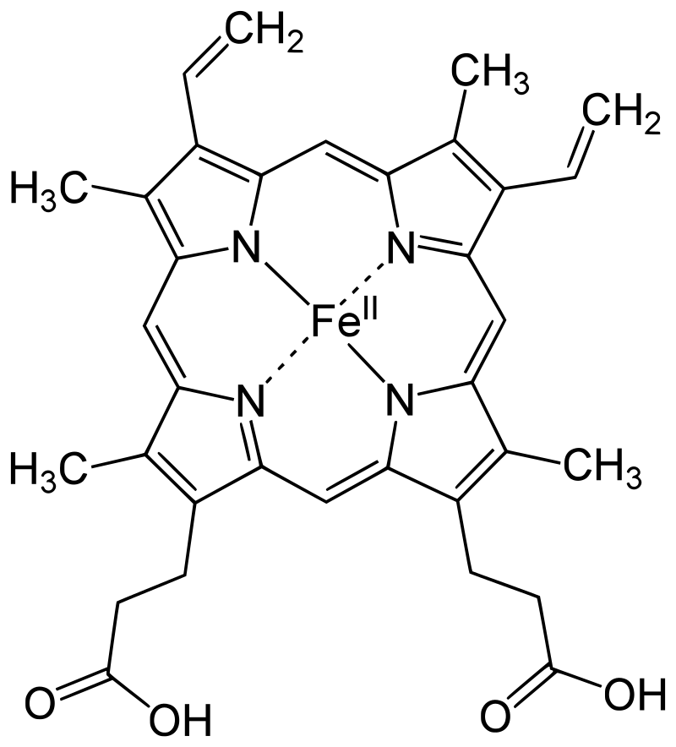
4c) Hemoglobin (Hb)
Hb comprises 4 globin subunits
– two α and two β units
Each globin is attached to a heme
b group with an iron atom at the center
Each heme b group can carry one oxygen molecule attached
to the iron atom
Hb is present in two forms (influenced
by partial pressures and pH)
  Relaxed (R)
  Tense (T)
  Different absorption spectra - used
  for oxygen levels measurements
Heme b group
Notes:
Various factors such as low pH, high CO₂ and high 2,3 BPG at the level of the tissues favor the taut form, which has low oxygen affinity and releases oxygen in the tissues. Conversely, a high pH, low CO₂, or low 2,3 BPG favors the relaxed form, which can better bind oxygen.^{[54]} The partial pressure of the system also affects O₂ affinity where, at high partial pressures of oxygen (such as those present in the alveoli), the relaxed (high affinity, R) state is favoured. Inversely, at low partial pressures (such as those present in respiring tissues), the (low affinity, T) tense state is favoured.^{[55]} Additionally, the binding of oxygen to the iron(II) heme pulls the iron into the plane of the porphyrin ring, causing a slight conformational shift. The shift encourages oxygen to bind to the three remaining heme units within hemoglobin (thus, oxygen binding is cooperative).

Slide 48
4c) Hemoglobin (Hb)
Approx. 250 million Hemoglobin
molecules per one red blood cell!
100 ml of blood contains
~14-18 g of Hb in men and ~12-14 in women (1 g of Hb combines with 1.34 ml of oxygen)
There are ~20.1 ml of O₂ per 100 ml of arterial blood (15 g of Hb x 1.34 ml of O₂/g of Hb) in men and ~17.4 ml of O₂ per 100 ml of arterial blood (13 g x 1.34) in women
Low iron leads to iron-deficiency anemia, reducing the body’s capacity to transport oxygen—this is more of a problem in women than men
Heme b group
Notes:
Various factors such as low pH, high CO₂ and high 2,3 BPG at the level of the tissues favor the taut form, which has low oxygen affinity and releases oxygen in the tissues. Conversely, a high pH, low CO₂, or low 2,3 BPG favors the relaxed form, which can better bind oxygen.^{[54]} The partial pressure of the system also affects O₂ affinity where, at high partial pressures of oxygen (such as those present in the alveoli), the relaxed (high affinity, R) state is favoured. Inversely, at low partial pressures (such as those present in respiring tissues), the (low affinity, T) tense state is favoured.^{[55]} Additionally, the binding of oxygen to the iron(II) heme pulls the iron into the plane of the porphyrin ring, causing a slight conformational shift. The shift encourages oxygen to bind to the three remaining heme units within hemoglobin (thus, oxygen binding is cooperative).

Slide 49
Blood KEY POINTS
Blood and lymph transport materials to and from body tissues
Blood is about 55% to 60% plasma and 40% to 45% formed elements (white and red blood cells and blood platelets)
Oxygen travels through the body by binding to hemoglobin
in red blood cells
An increase in blood viscosity results in resistance to flow

Slide 50
KEY POINTS – Cardiovascular system
The pacemaker of the heart is the SA node; it establishes heart rate and coordinates conduction
The autonomic nervous system or the endocrine system can alter heart rate and contraction strength
An ECG records the heart's electrical function and can be used to detect cardiac disorders

Slide 51
Vascular system
Arteries
Arterioles
Capillaries
Venules
Veins
Carry blood away from the heart
Carry blood back to the heart
Pulmonary VEINS carry oxygenated blood from the lungs to the heart
Pulmonary ARTERIES carry blood with lower oxygen levels to the lungs

Slide 52
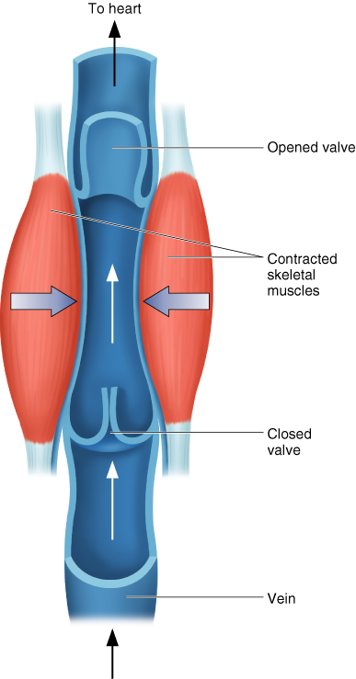
Vascular system
Arteries
Arterioles
Capillaries
Venules
Veins

Slide 53
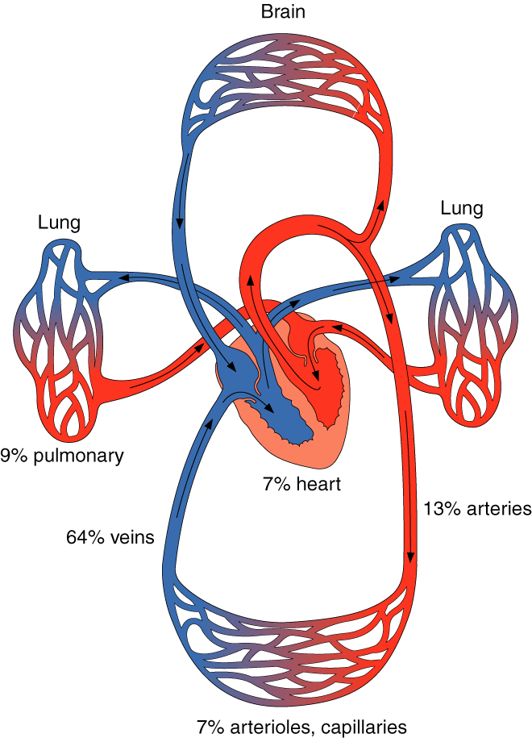
Blood distribution
Matched to overall metabolic demands
Autoregulation—arterioles within organs or tissues dilate or constrict in response to the local chemical environment
Extrinsic neural control—sympathetic nerves within walls of vessels are stimulated causing vessels to constrict
Determined by the balance between mean arterial pressure and total peripheral resistance

Slide 54
Blood Flow Increases with Training
Increased capillarization
  of trained muscles (higher capillary-to-fiber ratio)
  and in the lungs
Greater opening of existing capillaries
in trained muscles
More effective blood redistribution—blood goes where it is needed – vasoconstriction and vasodilation
Blood volume increases

Slide 55
Blood Volume and Training
Endurance training, especially intense training, increases blood volume
Blood volume increases due primarily to an increase in plasma volume (increases in ADH, aldosterone, and plasma proteins cause more fluid
to be retained in the blood)
Red blood cell volume increases, but increase in plasma volume is higher; thus, hematocrit decreases
Blood viscosity decreases, thus improving circulation and enhancing oxygen delivery
Changes in plasma volume are highly correlated with changes
in SV and VO₂max

Slide 56
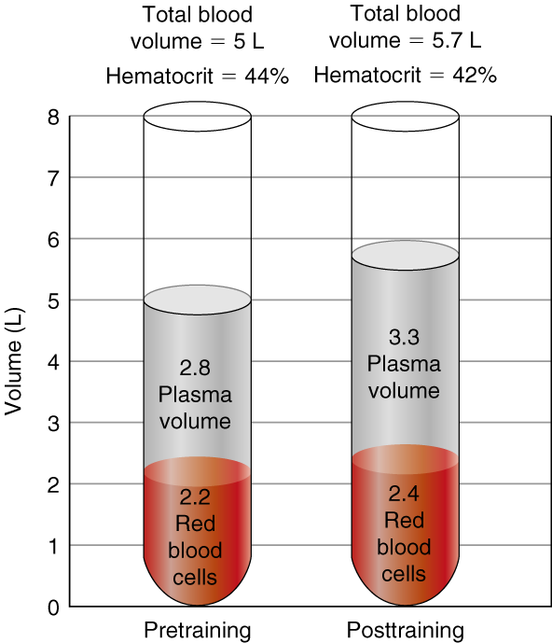
Blood and Plasma Volume and Training

Slide 57
Let’s try this:
Name a parameter we talked about and answer the following:
  Describe chosen parameter in one sentence
  What is the abbreviation used for this parameter
  What happens with this parameter with training
Example: Resting heart rate
  Number of heart beats per minute
  BPM (beats per minute)
  It decreases

Slide 58
  Resting heart rate
  Maximal heart rate
  Heart size
  Stroke Volume
  Cardiac output
  Blood flow
  Systolic blood pressure
  Diastolic blood pressure
  Blood volume
  Hematocrit
  Plasma volume

Slide 59
Thank you!

