Slide 1
Factor Analysis
Martin Sebera
Magdeburg 15. 12. 2023

Slide 2
Martin Sebera
Faculty of Sports Studies, Masaryk University Brno Czech Republic
Interests: mathematics, statistics, programming, artificial intelligence, esports
https://www.muni.cz/en/people/55084-martin-sebera
Email: sebera@fsps.muni.cz

Slide 4
Lecture schedule – Factor Analysis
What is it used for
Requirements
Procedure
Weaknesses
Conclusion
Example - Decathlon
- sw TIBCO Statistica 14
- sw IBM SPSS 28

Slide 5
When was it created and who discovered it?
Factor analysis originated in the field of psychology.
Its founder is considered to be Charles Spearman
in 1904 in an article on the nature of intelligence proposed the hypothesis of the existence of a common factor of "general intellectual ability", causing correlations between the results of various intelligence tests

Slide 6
What is it used for
To identify groups of variables that are interrelated and can be represented by a smaller number of factors or latent variables.
Dimensionality reduction: Factor analysis allows data simplification by reducing many measured variables to a smaller number of factors.
Structure Identification: Helps identify hidden structure in a data set, which can for example reveal groups of variables that may represent a common concept or factor.
Data Exploration: It is useful for data exploration when researchers are looking for patterns or relationships in complex datasets.

Slide 7
Requirements
Sample size: at least 5-10 observations for each variable, but ideally the total sample should have at least 100 observations. Larger samples provide more robust and stable results.
Linear relationships: Factor analysis assumes linear relationships between variables.
Normal distribution of data: Although factor analysis can be performed on data that is not normally distributed, the normal distribution increases the reliability.
Homogeneity of the sample: The data should come from a homogeneous group or population so that the results of the factor analysis are relevant and interpretable for that population.
No or minimal missing values

Slide 8
Procedure 1/2
Data preparation:
sample size, linear relationships between variables, normal distribution, etc.
Data cleaning - including addressing missing values and removing outliers.
Method selection - Deciding whether to use exploratory factor analysis (EFA) or confirmatory factor analysis (CFA). EFA is used for discovering potential structures, while CFA for testing hypotheses about the structure.
Calculation of the correlation matrix - Creating a correlation matrix of variables. This matrix provides the basis for factor analysis.
Choosing an extraction method - principal axes (Principal Axis Factoring) or maximum likelihood

Slide 9
Procedure 2/2
Selection of the number of factors to be extracted, which can be done using the Kaiser criterion (eigenvalues > 1), the scree test, or based on theoretical considerations.
Factor rotation – better interpretation. Orthogonal rotation (e.g. Varimax) maintains factor independence.
Interpretation of factors - Each factor is interpreted on the basis of variables that have high loadings on it. Interpretation depends on the research context.
Assessment of model fit and reliability - In CFA, model fit is evaluated using various measures such as RMSEA (Root Mean Square Error of Approximation), CFI (Comparative Fit Index), and others.

Slide 10
Important terms again - 1/3
The principal component method gives uncorrelated factors, which are additionally ordered according to their variance, such that the first factor has the largest variance and the last the smallest.
Factor analysis can be considered as its extension.
While principal component analysis tries to reduce the number of variables so that the variance of the original variables is best clarified, factor analysis tries to clarify the correlations of the original variables as best as possible.

Slide 11
Important terms again - 2/3
Factor rotation
there are infinitely many factor solutions.
The factors are transformed so that we can interpret them as best as possible.
At the same time, practice has shown that factors whose factor loadings take on values close to either one or zero are best interpreted

Slide 12
Important terms again - 3/3
Interpretation of factors
We describe a factor as having something in common in content with those variables that have high factor loadings on that factor.
When interpreting the factors, one must be careful and think about whether the name of the factor is really behind its real existence.
If it does not have a logical explanation for the factor, we cannot use factor analysis

Slide 13
Weaknesses
Complexity and subjectivity: The interpretation of factors can often be subjective and depends on the researcher's decisions (e.g. choice of number of factors, rotation).
Assumptions about the data: linear relationships between variables and normal distribution, which do not always correspond to the actual data.
Dependence on sample size: A large enough sample is needed for reliable results.
Limitation to linear relationships: Factor analysis cannot effectively handle non-linear relationships between variables.
Unclear meaning of factors: Identified factors may not always have a clear or intuitive meaning and may require further research to be fully understood.

Slide 14
Conclusion
It is always important to remember that
no statistical technique is all-powerfull,
it is necessary to evaluate the appropriateness of the method in relation to the data and objectives of your research.
If you are unsure, it may also be helpful to consult an expert in statistics or research methodology about the issue.

Slide 15
Example - Decathlon results from the Athens Olympics 2004
sw TIBCO Statistica 14
sw IBM SPSS 28

Slide 16
Example - Decathlon results from the Athens Olympics 2004
1. Objective of the analysis - We are interested in whether it is possible to identify the factors on which the results in individual disciplines depend. And further which factors are most important for victory.
2. Data standardization - Not necessary. Factor analysis, as a method based on the correlation matrix, is not dependent on the scale of the input values.
3. Factor estimation methods - the method of principal components,

Slide 17
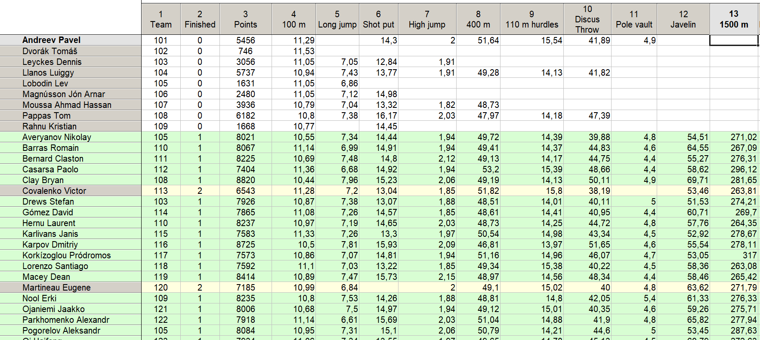

Slide 18
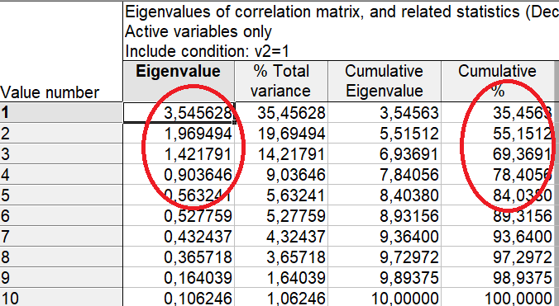
Example - Decathlon results from the Athens Olympics 2004
4. Eigennumbers & How many factors to create
There are three eigenvalues > 1 and the factors/components corresponding to them describe roughly 70% of the variability of the original variables. It is to be considered whether to use a fourth factor, which would increase the percentage of explained variance to 78%.

Slide 19
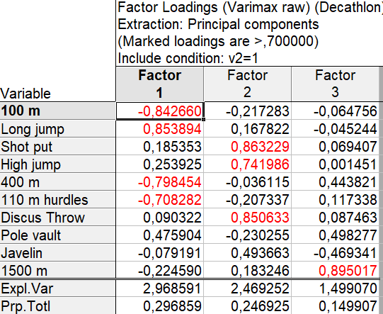
Example - Decathlon results from the Athens Olympics 2004
5. Factor loadings & Rotation and interpretation of factors
We try to achieve that each factor is correlated only with a certain group of variables and the correlations with the other variables are zero. The goal is to find meaningful factors.
We select using the Varimax method.

Slide 20
Example - Decathlon results from the Athens Olympics 2004
6. Interpretation. The first factor is clearly related to the results of short sprints and long jump - the better the result, the higher the value of the factor. F1 Speed factor. The strongest correlations of the second factor are with all "throwing" events and the high jump. F2 „Trunk“ strength (abdominal, back, core). The last third factor is clearly correlated with longer F3 distance running, which shows that this discipline is the most different from the others.

Slide 21
sw IBM SPSS 28

Slide 22
Basic characteristics of observed variables
Descriptive Statistics
 | Mean | Std. Deviation | Analysis N
v100_m | 10,92 | 0,23 | 28
Long_jump | 7,27 | 0,34 | 28
Shot_put | 14,63 | 0,86 | 28
High_jump | 1,98 | 0,09 | 28
v400_m | 49,61 | 1,27 | 28
v110_m_hurdles | 14,55 | 0,44 | 28
Discus_Throw | 44,38 | 3,30 | 28
Pole_vault | 4,73 | 0,29 | 28
Javelin | 58,95 | 4,98 | 28
v1500_m | 277,54 | 11,32 | 28

Slide 23
Conditions of use of factor analysis
correlation coefficients are high
we see positive and negative correlations,
there is a conditional formatting tool for that in Excel

Slide 24
Conditions of use of factor analysis
The Kaiser-Meyer-Olkin measure takes on a value of 0.58, is high and indicates the appropriateness of using factor analysis

Slide 25
Conditions of use of factor analysis
Bartlett's test of sphericity:
Test criterion value = 112.179
Number of degrees of freedom = 45
Significance ( = observed significance level) < 0.001

Slide 26
Conditions of use of factor analysis
Bartlett's test of sphericity:
Test criterion value = 112.179
Number of degrees of freedom = 45
Significance ( = observed significance level) < 0.001
Significance level is < 0,001, we reject H0: The correlation matrix is unity (correlation coefficients off the diagonal are zero).
Thus, the basic assumption for the use of factor analysis is fulfilled.

Slide 27
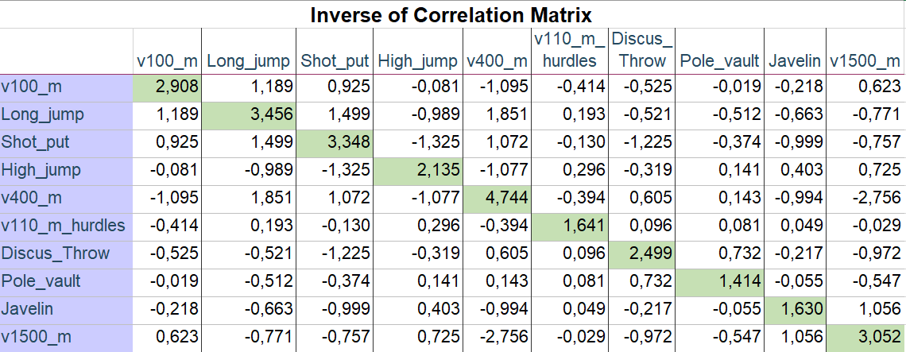
All KMO values for individual observed variables are satisfactory – greater than 0.5
Conditions of use of factor analysis

Slide 28
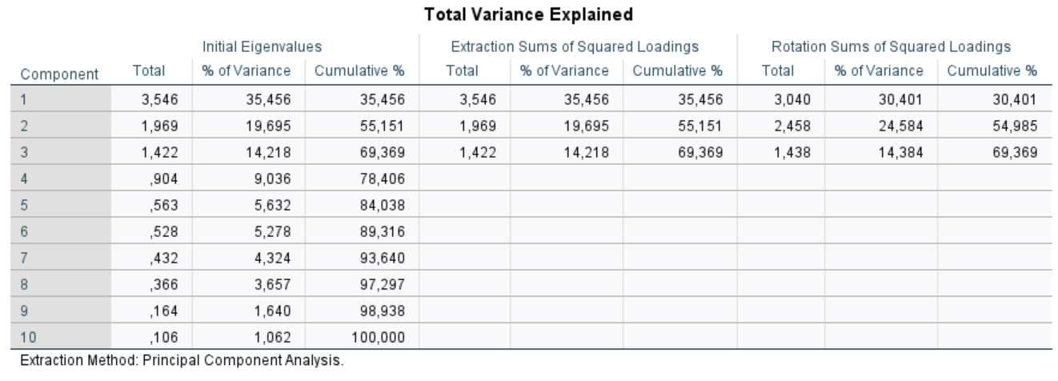
Factor extraction
Principal component method
Attention!
Unlike the tables of correlation coefficients and communalities, the rows of this table are not devoted to manifest variables, but to factors (components).

Slide 29
Factor extraction
Principal component method
The first section, entitled "Initial Eigenvalues" by SPSS, contains the results of the principal components method

Slide 30
Factor extraction
Principal component method
The eigenvalues are listed in the second column, which follows the column labeled factors (components).

Slide 31
Factor extraction
Principal component method
The eigenvalues of the correlation matrix indicate the variance exhausted by the factor. This variance, expressed as a percentage, is shown in the third column of the tables

Slide 32
Factor extraction
Principal component method
For a better idea of how much variance is already exhausted by the given number of factors, the fourth column with the cumulative percentage values of the exhausted variance is used.

Slide 33
Factor extraction
Principal component method
The second part of the table "Extraction Sums of Squared Loadings" gives the amount of variance extracted after factor extraction

Slide 34
Factor extraction
Principal component method
The second part of the table "Extraction Sums of Squared Loadings" gives the amount of variance extracted after factor extraction
absolute

Slide 35
Factor extraction
Principal component method
The second part of the table "Extraction Sums of Squared Loadings" gives the amount of variance extracted after factor extraction
percentage

Slide 36
Factor extraction
Principal component method
The second part of the table "Extraction Sums of Squared Loadings" gives the amount of variance extracted after factor extraction
in cumulative percentage form

Slide 37
Factor extraction
Principal component method
We see that it is limited to a given number
of factors, i.e. 3.

Slide 38
Factor extraction
Principal component method
For principal component factor extraction, it is of course identical to the first part of the table.

Slide 39
Factor extraction
Principal component method
In the third part of the table "Extraction Sums of Squared Loadings" the values of the exhausted variance after rotation are presented analogously.

Slide 40
Factor extraction
Principal component method
In the third part of the table "Extraction Sums of Squared Loadings" the values of the exhausted variance after rotation are presented analogously. We see that the first factor accounts for 30.4% of the variance

Slide 41
Factor extraction
Principal component method
In the third part of the table "Extraction Sums of Squared Loadings" the values of the exhausted variance after rotation are presented analogously. We see that the first factor consumes 30.4% of the variance, the second 24.58% and the third 14.38%.

Slide 42
Factor extraction
Principal component method
The method of principal components gives the factors that exhaust the highest percentage of variance of all the methods used. However, the main task of factor analysis is to clarify the original correlation matrix with the help of factors, not the variance.

Slide 43
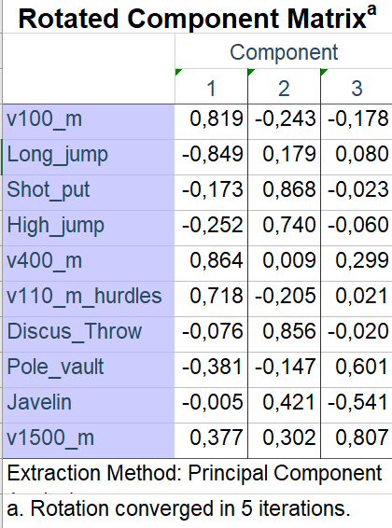
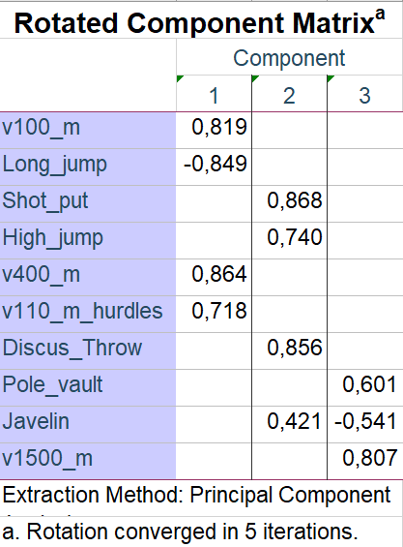
Rotated Component Matrix
Principal Component Analysis
Finally the result!
We can now try to interpret the factors
Loads less than ±0.4 are deleted

Slide 44
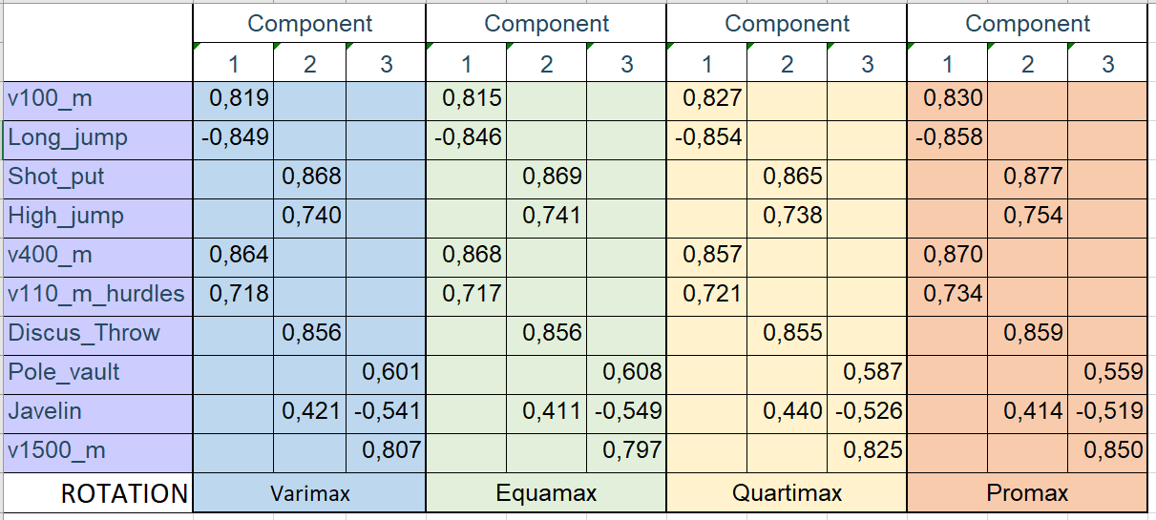
Compare 4 rotation methods

Slide 45
Transfer to sports training
What to train (it is not possible to train all 10 disciplines at the same time) to be the best decathlete?

Slide 46
Transfer to sports training
What to train (it is not possible to train all 10 disciplines at the same time) to be the best decathlete?
You can't always generalize, but it's a 400m run and a shot put spin!
Why? It said Mr. Váňa, the coach of the Czech decathletes Roman Šebrle (gold and silver from the Olympics) and Tomáš Dvořák (3x world champion, bronze from the Olympics). Váňa bet on the speed of execution of individual disciplines.

Slide 47
And what to do if we are looking for relationships and the conditions for classic tests known from statistics, such as linear regression, factor analysis, etc., are not met?

Slide 48
de Oliveira Abrahão, A. A., Marcos de Andrade Júnior, É., de França Ferraz, A., Kuang Hongyu, & Fett, C. A. (2022). Factor Analysis for detection of sports talent in football players. Saúde e Pesquisa, 15(1), 1–12. https://doi.org/10.17765/2176-9206.2022v15n1.e9766
Jinrui Zhang, Zhiwen Zhang, Shuo Peng, Veloo, A., Bailey, R. P., & Wee Hoe Tan. (2023). Psychometric properties of the Chinese version of Sport Anxiety Scale-2. Frontiers in Psychology, 1–10. https://doi.org/10.3389/fpsyg.2023.1260253
Lan Zhou, Sang-Ho Lee, & Youshen Cao. (2022). An empirical analysis of sport for mental health from the perspective of a factor analysis approach. Frontiers in Psychology, 13. https://doi.org/10.3389/fpsyg.2022.960255
Li, X., Chen, J., Zhan, J., & Liu, L. (2016). A Study on Sports Tourism Competitiveness Based on Factor Analysis Method. 2016 12th International Conference on Computational Intelligence and Security (CIS), Computational Intelligence and Security (CIS), 2016 12th International Conference on, CIS, 673–676. https://doi.org/10.1109/CIS.2016.0162
Putra, M. F. P. (2022). Construct validity test of spirituality in sports test (SIST) using confirmatory factor analysis (CFA) method. Ovidius University Annals, Series Physical Education and Sport/Science, Movement and Health, 22(2), 139.

Slide 49
Děkuji za pozornost
Thank you for your attention
Danke für Ihre Aufmerksamkeit

