Slide 1
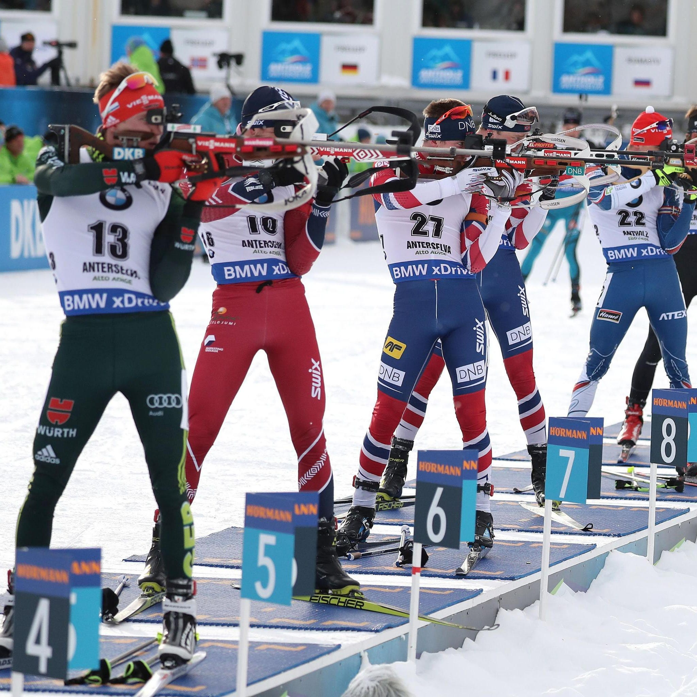
BIATHLON

Slide 2
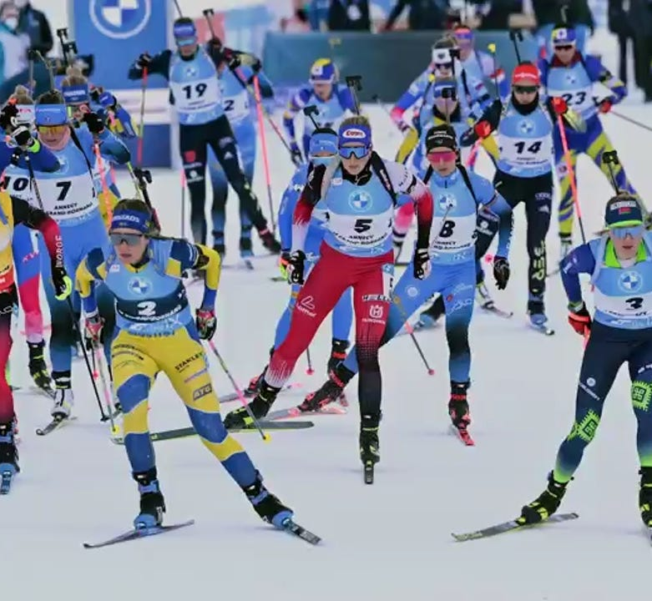
Complex overall performance
Skiing speed
Range time
Shooting time
Shooting performance
Laaksonen et al., 2018, in Frontiers in Physiology
Laaksonen et al., 2018, in Journal of Sport and Health Science

Slide 3
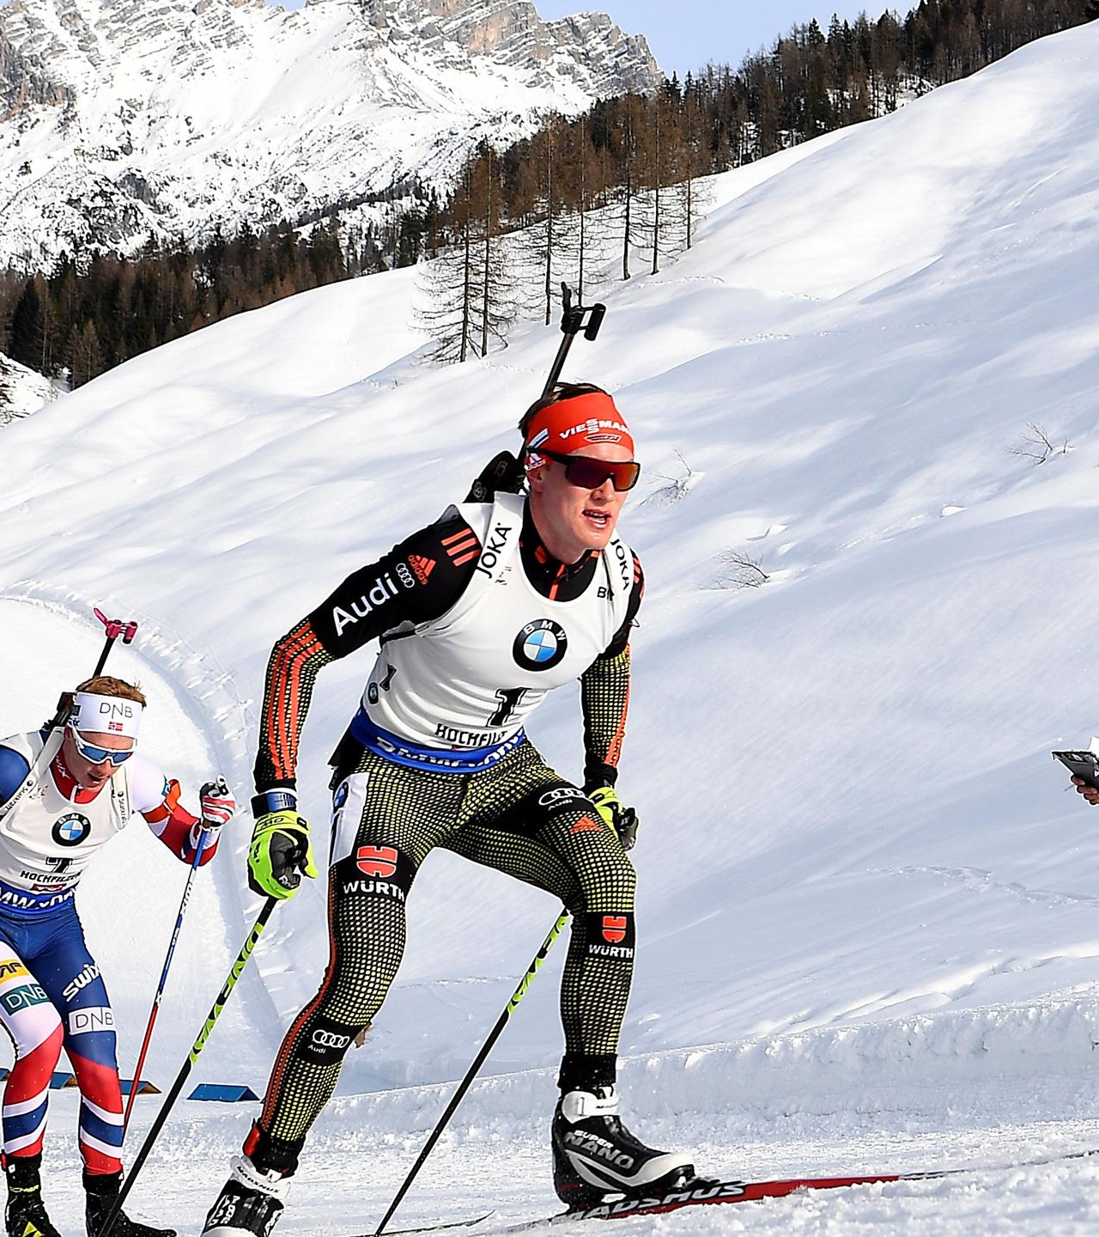
Skiing
Heart rate 90% of maximal HR
High VO2max, lactate treshold, gross efficiency (energy used and mechanical work) essential for successful performance
Flat, uphill, downhill → demands frequent change of techniques
Endurance athletes
Track profile, snow conditions, altitude, ski preparations
Laaksonen et al., 2018, in Frontiers in Physiology
Laaksonen et al., 2018, in Journal of Sport and Health Science

Slide 4
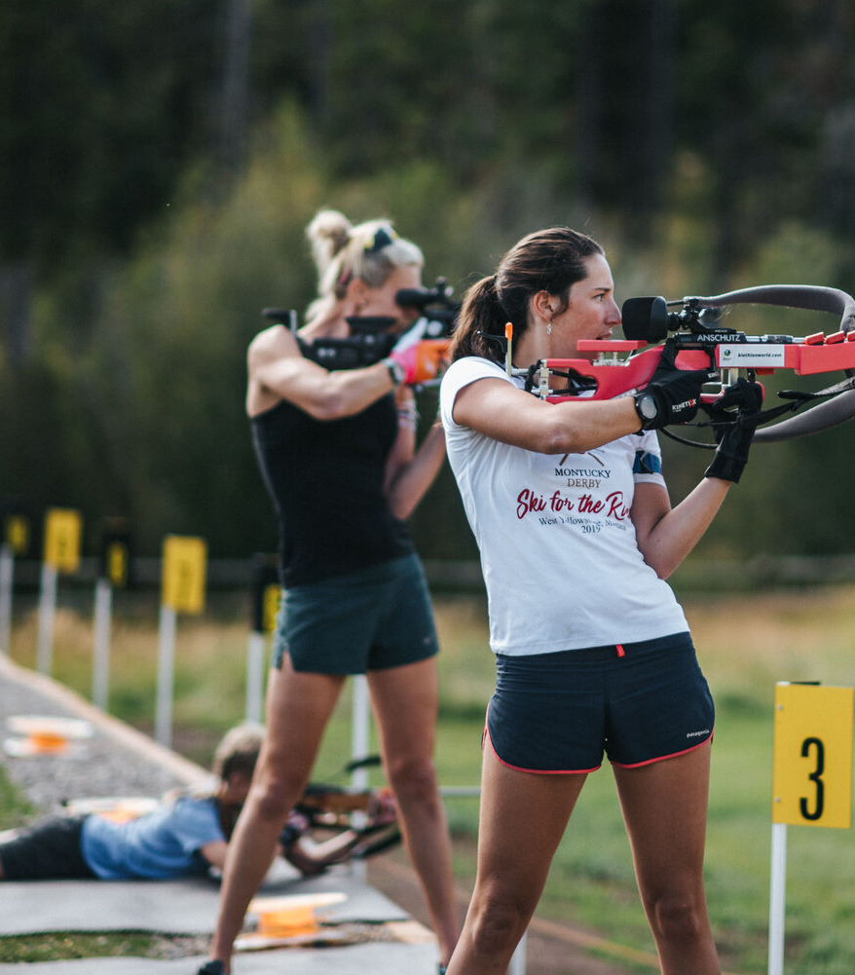
Shooting
Heart rate 60% of maximal HR
25-30s shooting range and shooting time
Shooting techniques demands extensive fine-motor control
Body sway: specific balance training
Weather conditions (especially wind)
Laaksonen et al., 2018, in Frontiers in Physiology
Laaksonen et al., 2018, in Journal of Sport and Health Science

Slide 5
Training
700-900 hours physical training a year
Endurance training
- 80% low intensity
- 4-5% moderate intensity
- 5-6% high intensity
10% strength and speed training
May-November 60-70%
December-April 30-40%
Laaksonen et al., 2018, in Frontiers in Physiology

Slide 7
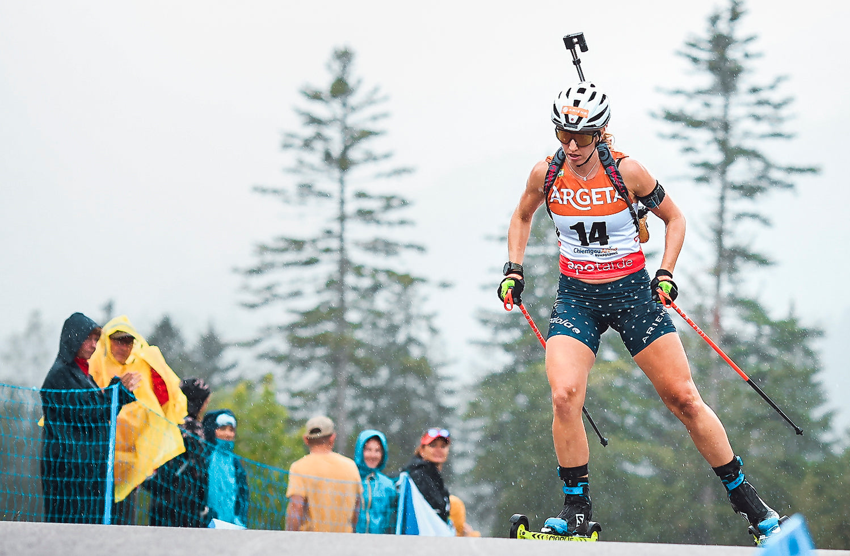
Speed and strength training
Speed: 10-20 sprints at maximal intensity with 2-3 min recovery
Strength: movement-specific training of maximal upper body strength improves skating techniques
Laaksonen et al., 2018, in Frontiers in Physiology
Wagner et al., 2024

Slide 8
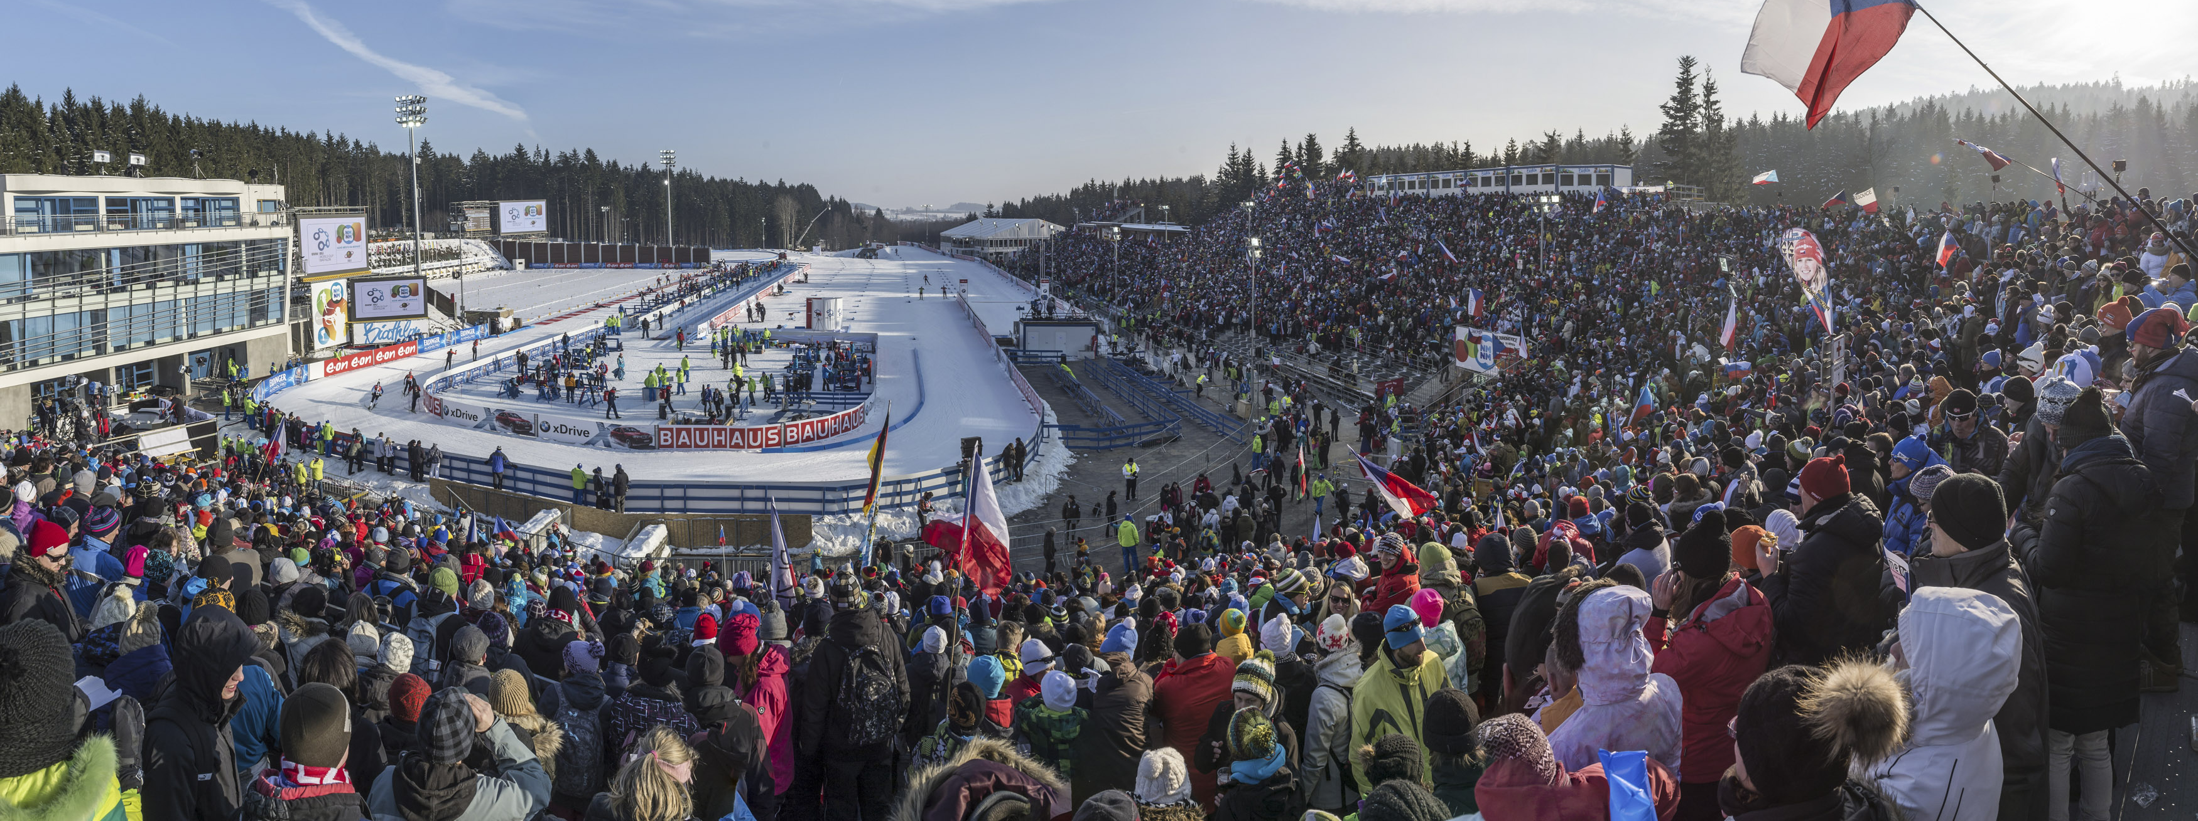
Training shooting
Ressembling competition conditions (ex. against each other, time pressure)
60% combined with endurance training
40% at rest (accuracy, speed)
Laaksonen et al., 2018, in Frontiers in Physiology

Slide 9
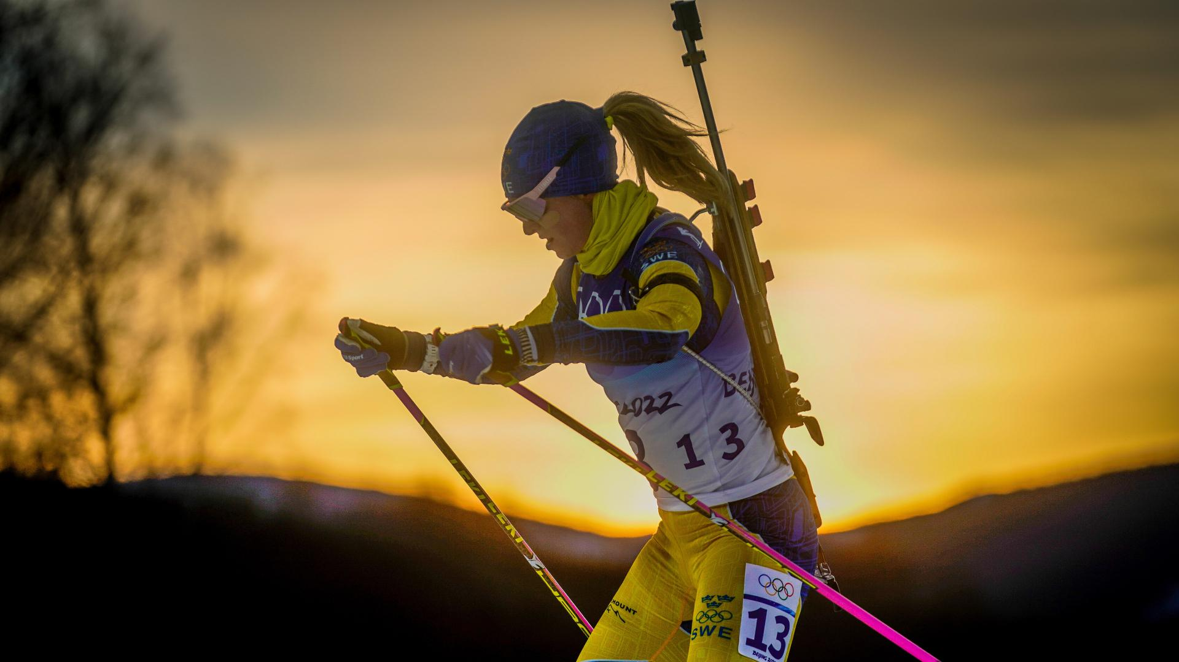
Injuries and illness
Little research
40.5% injury rate of slight to minimal severity
More injuries in female athletes:
- Lower back: rifle, static muscle contraction while shooting standing
- Knee: not from skiing, off-season, running
Blut et al., 2010

Slide 10
Sources
Blut, D., Santer, S., Carrabre, J. & Manfredini, F. (2010). Epidemiology of Musculoskeletal Injuries Among Elite Biathletes: A Preliminary Study. Clinical Journal of Sport Medicine, 20(4). https://www.researchgate.net/publication/45097483_Epidemiology_of_Musculoskeletal_Injuries_Among_Elite_Biathletes_A_Preliminary_Study
Laaksonen, M. S., Finkenzeller, T., Holmberg, H. & Sattlecker, G. (2018). The influence of physiobiomechanical parameters, technical aspects of shooting, and psychophysiological factors on biathlon performance: A review. Journal of Sport and Health Science, 7(4). https://www.sciencedirect.com/science/article/pii/S2095254618300760?via%3Dihub
Laaksonen, M. S., Jonsson, M. & Holmberg, H. (2018). The Olympic Biathlon – Recent Advances and Perspectives After Pyeongchang. Frontiers in Physiology, 9. https://www.frontiersin.org/journals/physiology/articles/10.3389/fphys.2018.00796/full
Wagner, C., Sandbakk, Ø., Röhrs, D., Schiemann, S., Schmidt, T. & Keiner, M. (2024). High-Volume Resistance Training Improves Double-Poling Peak Oxygen Uptake in Youth Elite Cross-Country Skiers and Biathletes: A Pilot Study. Applied sciences, 14(7). https://www.mdpi.com/2076-3417/14/7/2774

