Slide 1
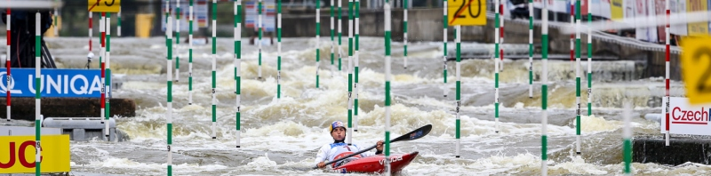
Canoe slalom

Slide 2
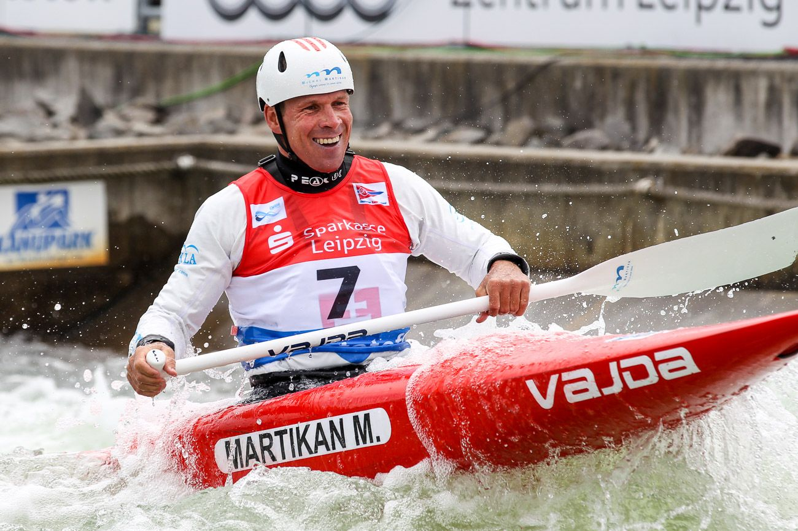
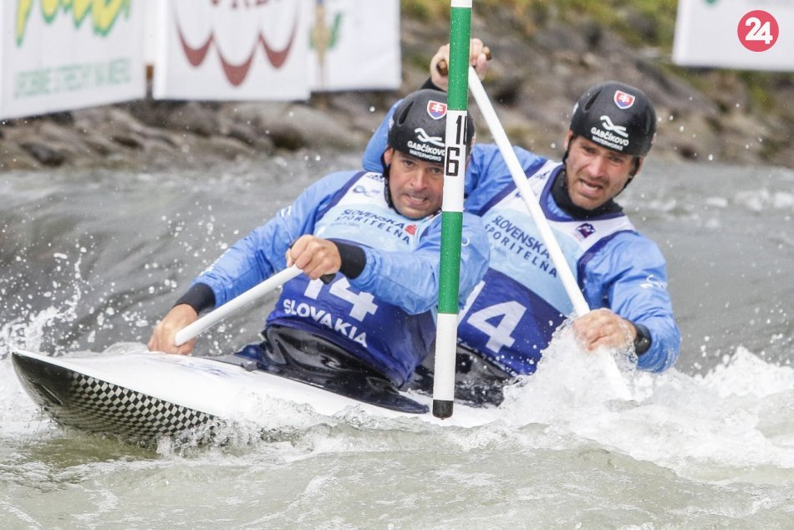
Slovak canoe slalom paddlers
Michal Martikán
Elena Kaliská
Peter Hochschorner
Pavol Hochschorner
Jana Dukátová
Alexander Slafkovský
Matej Beňuš

Slide 3

Sport held in natural and artificial rivers
Originated in Switzerland in 1933 as a summer alternative to slalom skiing
Summer Olympics Sport
First appearance at the Olympics in 1972

Slide 4
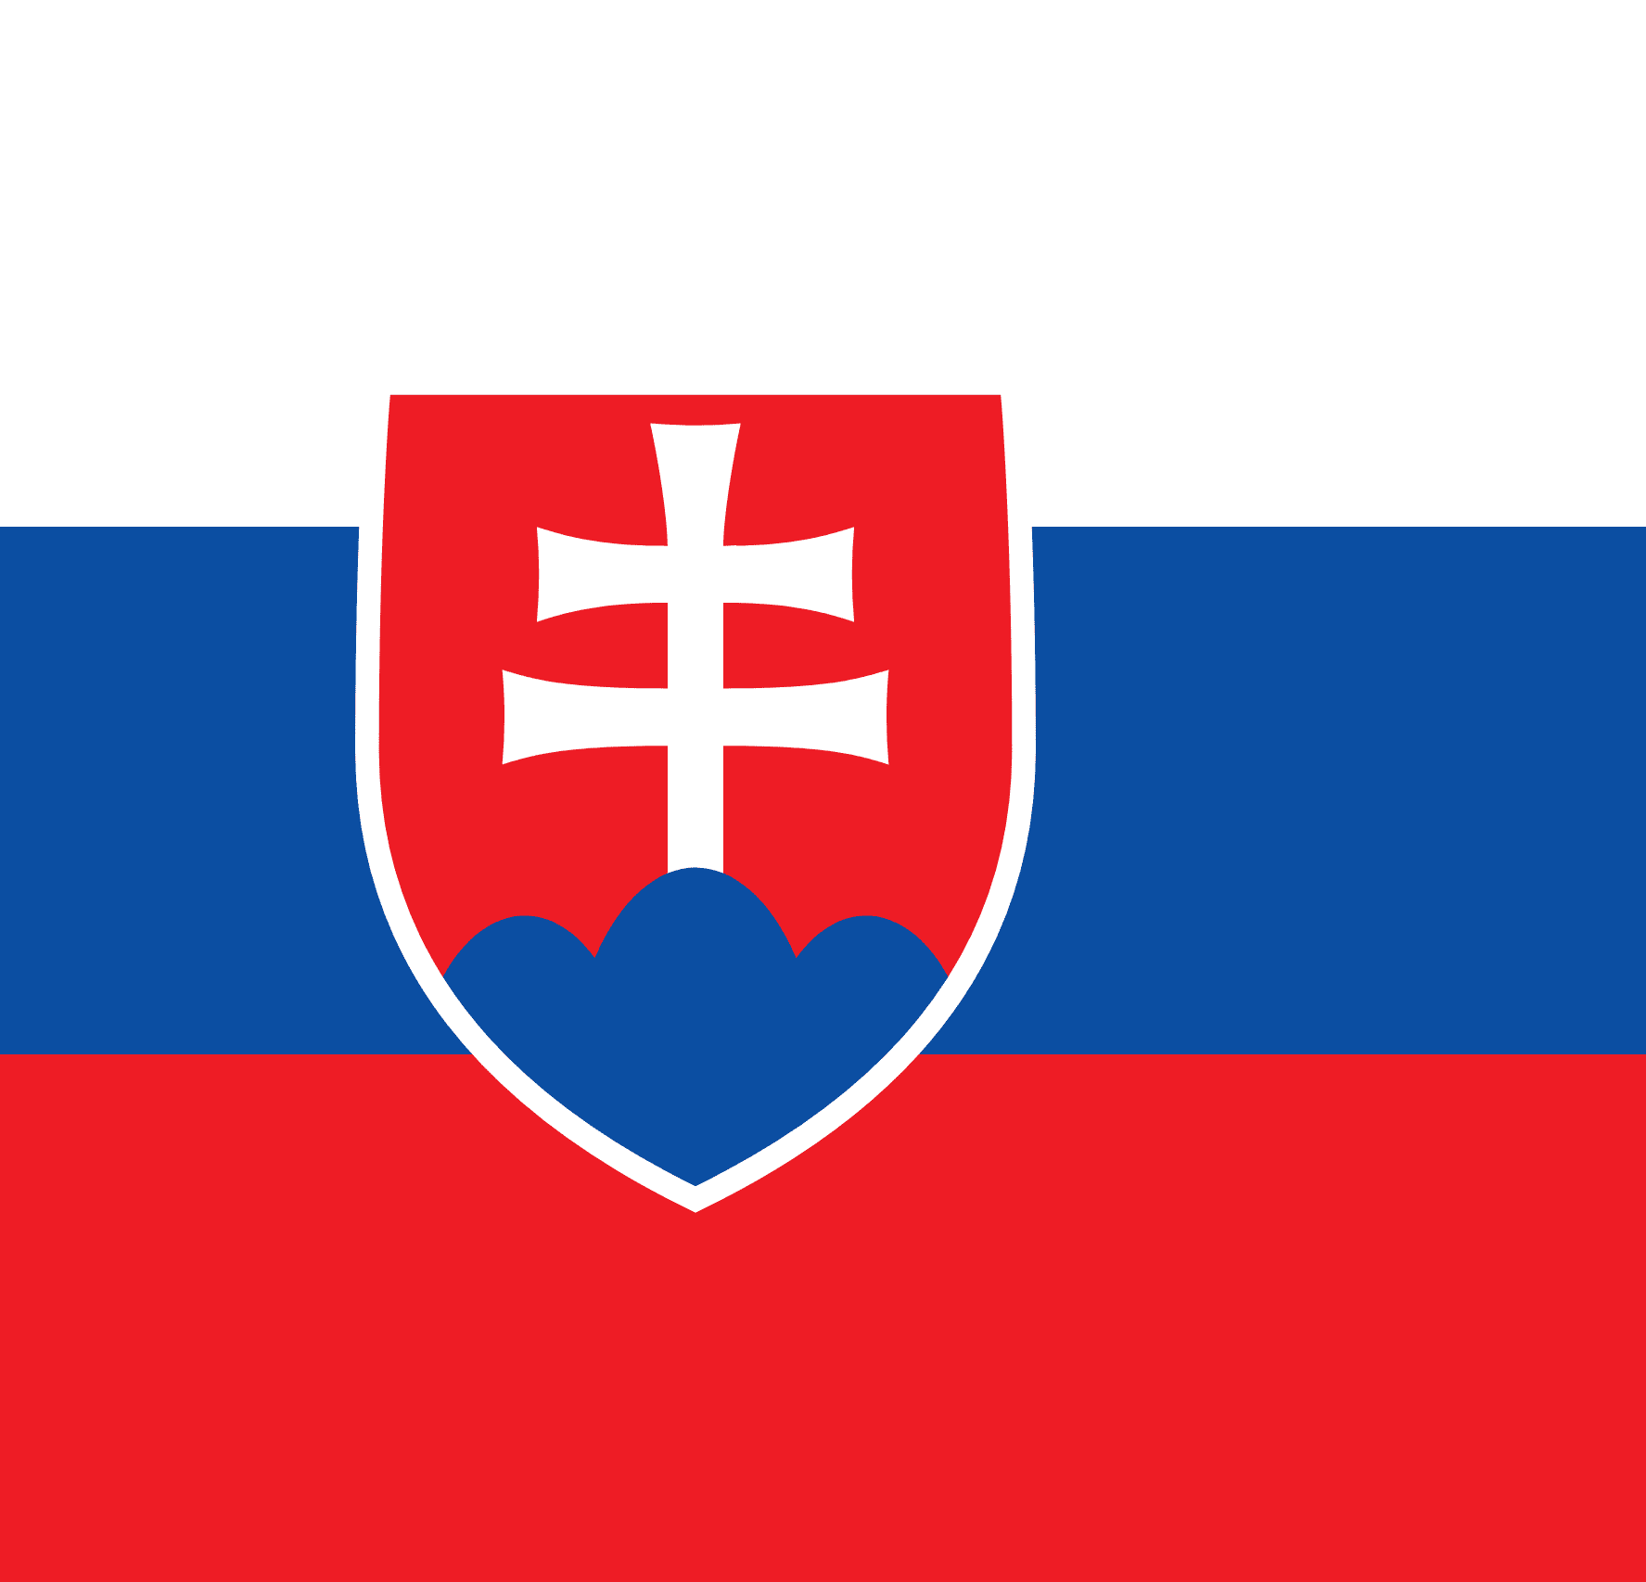
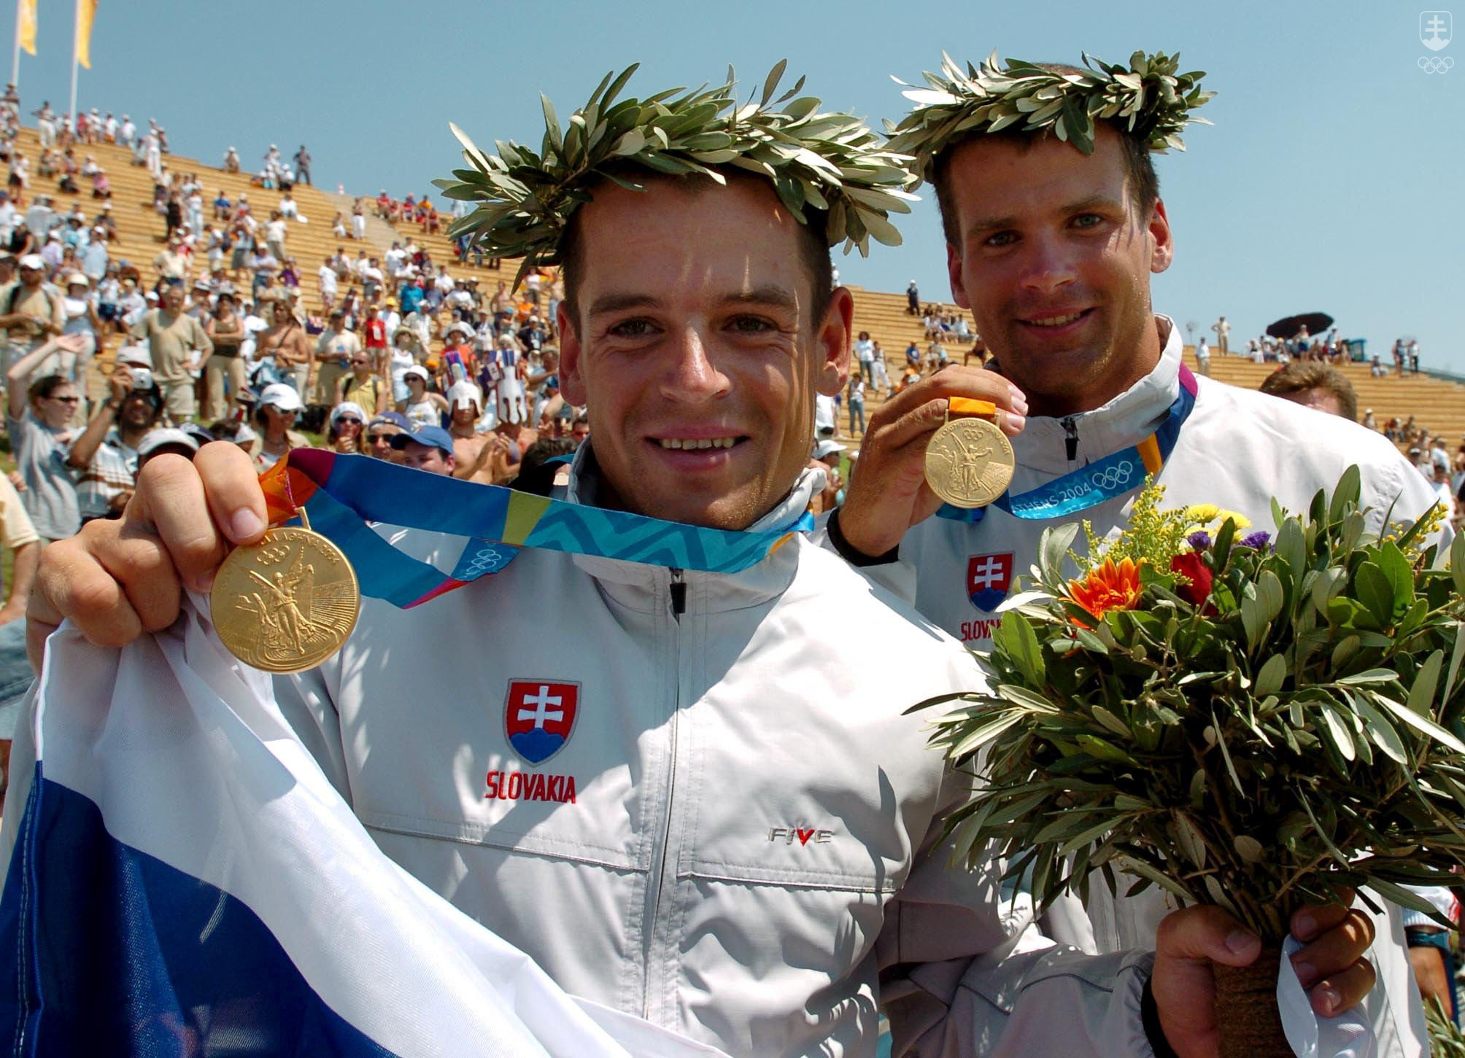
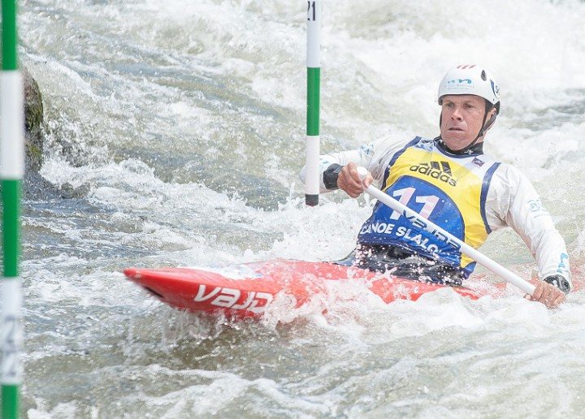
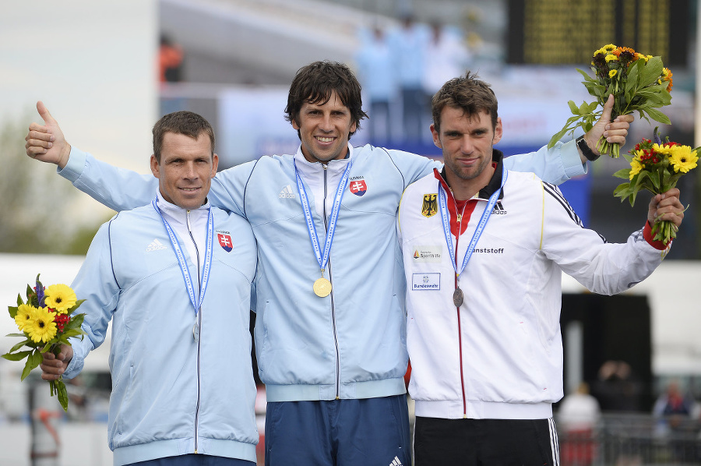
Slovakia hold the record for most gold medals in Canoe Slalom at the Olympic Games.
The only three people to claim more than three medals in the discipline at the Games are all Slovakian - Michal Martikán (two gold, two silver, one bronze) and twins Pavol and Peter Hochschorner (three gold and one bronze).
The Hochschorners finished on the podium in the MC2 at four consecutive Olympic Games - 2004, 2008, 2012 and 2016.

Slide 5
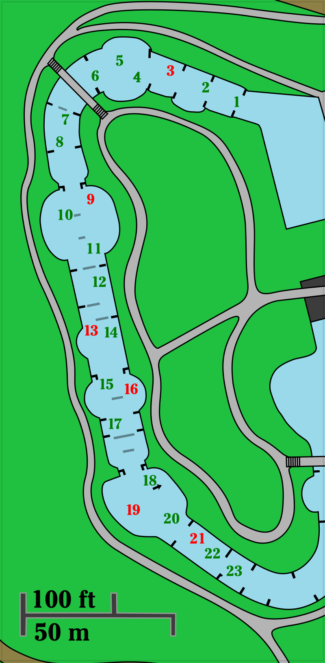
18-25 gates (6 or 8 must be upstream gates): green (downstream) or red (upstream)
80 to 120 seconds
300 m courses
Performance is determined by the time to complete the course plus penalties for touching or missing gates
Two types of boat: canoe (C): a single-blade paddle, athlete is strapped into the boat with their legs bent at the knees and tucked under their body kayak (K): double-bladed paddle, athlete is in a seated position in kayak.

Slide 6
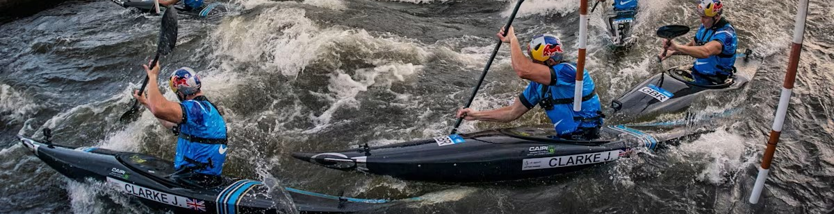
There are five events within canoe and kayak programme with both men and women contesting the kayak and canoe singles (WK1, MK1, WC1, MC1); there is also mixed canoe doubles (XC2).
Kayak Cross programme consists of women's kayak (WX1) and men's kayak cros (MX1).
The Olympic programme currently features four classes MK1, WK1, MC1 and WC1.
Kayak Cross will make its debut at the 2024 Olympic Games in Paris.

Slide 7
Physical demands
Muscular Strength and Power
  Upper limb muscles and trunk
  Muscular strength to paddle effectively
  Power for explosive movements during gate navigation and rapid acceleration
Endurance
  Length of races around 90 to 110 seconds: high-intensity effort
  Aerobic and anaerobic endurance for sustaining performance
Core Stability and Balance
  Dynamic water environment, changing water conditions
Agility and Coordination
  Navigating through gates - precise movements, quick adjustments
Anaerobic Capacity
  Short intervals of intense effort
  Acceleration between gates
Flexibility and ROM
  Paddling techniques, efficient strokes
Mental Toughness and Focus
  Slalom courses are challenging and unpredictable
  Mental resilience to handle pressure, make quick decisions, stay focused
Technical Skill
  Gate techniques - upstream & downstream
  Precision and timing

Slide 8
Year-long training program
Year-long canoe slalom training program is designed to develop the technical skills, confidence and fundamental habits necessary for long-term progression and enjoyment of the sport.
Training programs often include a mix of on-water practice and land-based training to build muscular strength and endurance specific to paddling.

Slide 9
Pre-Season
(November – February)
Spring
(March – May)
Strength and Conditioning: Intensive gym sessions to build power, strength, and endurance.
Technical Skills: Indoor pool sessions to refine stroke technique and roll efficiency.
Planning: Setting goals and outlining the competition calendar
Water Time: Transition to outdoor water as weather permits, focusing on technique and course navigation.
Conditioning: Maintaining strength while increasing on-water endurance.
Competitions: Start of the competitive season with national selection races.

Slide 10
Summer (June – August):
Autumn (September – October):
Peak Competition Phase: Participation in international competitions, aiming to peak for World Cups and Championships.
Tactical Training: Focus on race strategy and mental preparation.
Recovery: Implementation of active recovery protocols post-competitions.
Reflection: Analysis of performance from the competitive season.
Technique Tuning: Addressing any technical weaknesses identified during competitions.
Cross-Training: Performing other sports to maintain fitness and prevent burnout.

Slide 11
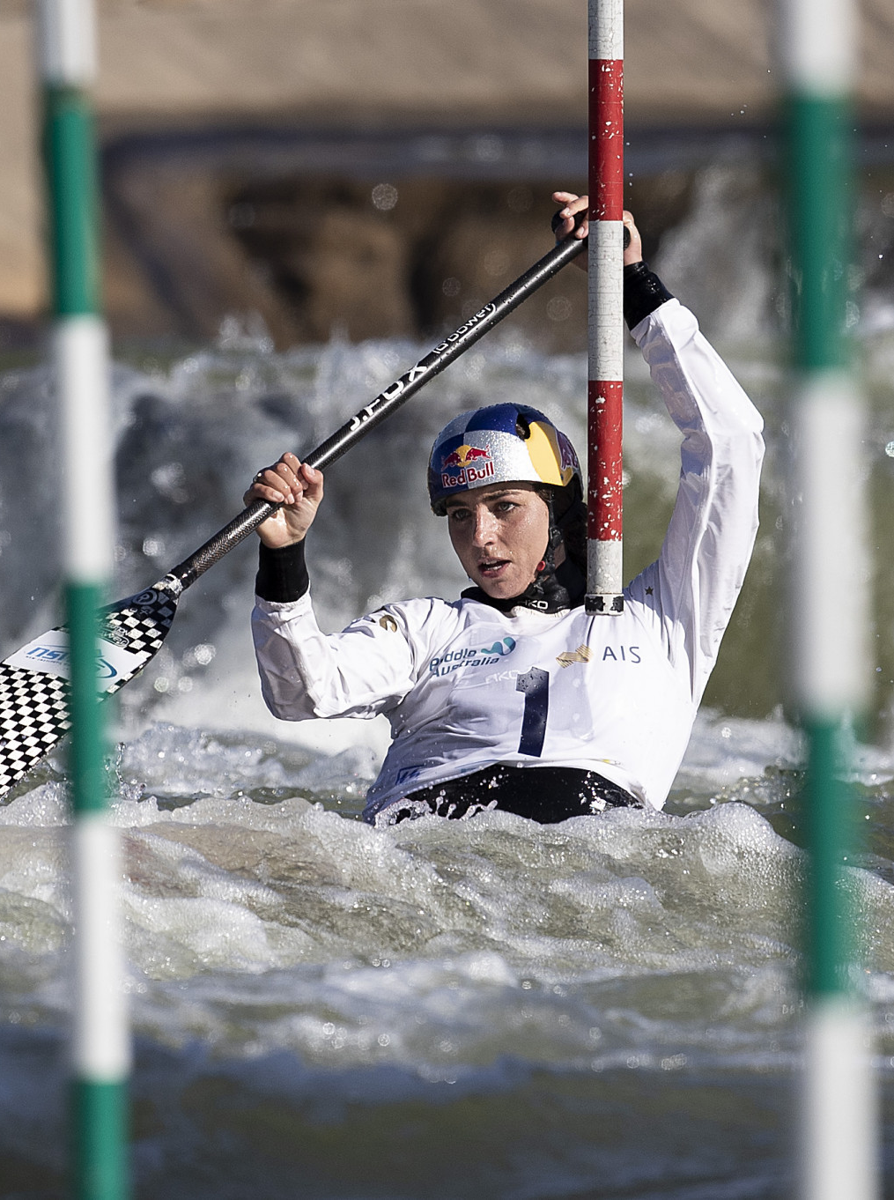
Off-Season (November – December):
Rest and Recovery: Take time off from intense training to allow the body to recover.
Cross-Training: Stay active with low-impact activities like cycling or swimming.
Mental Preparation: Work with sports psychologists to prepare mentally for the upcoming season.

Slide 12
Throughout the year, elite athletes also focus on:
Nutrition: Tailoring their diet to training demands to optimize performance and recovery.
Equipment: Regularly testing and adjusting equipment for optimal comfort and performance.
Video Analysis: Using video footage to analyze technique and identify areas for improvement.

Slide 13
Strength Training and Conditioning
Pre-competition season
Upper body - shoulders, arms, trunk, back
Direct Improvement → helping the muscles generate more force while kayaking
Indirect Improvement → providing better resiliency to injury during kayaking

Slide 14
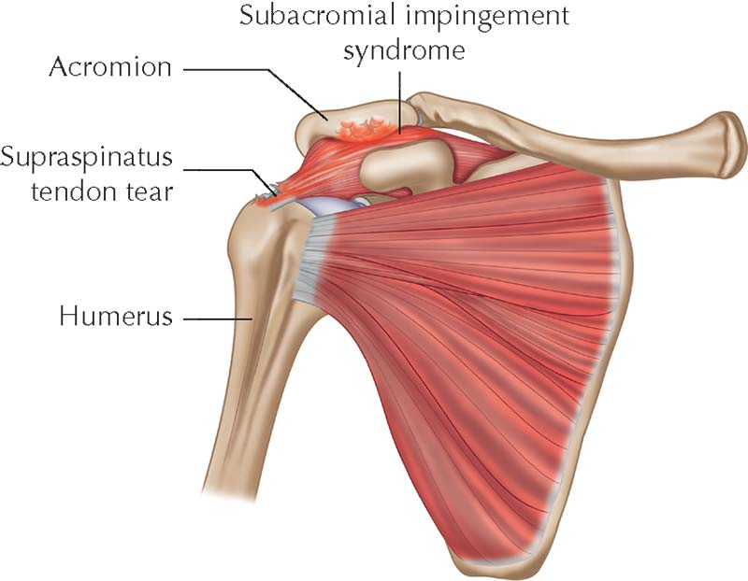
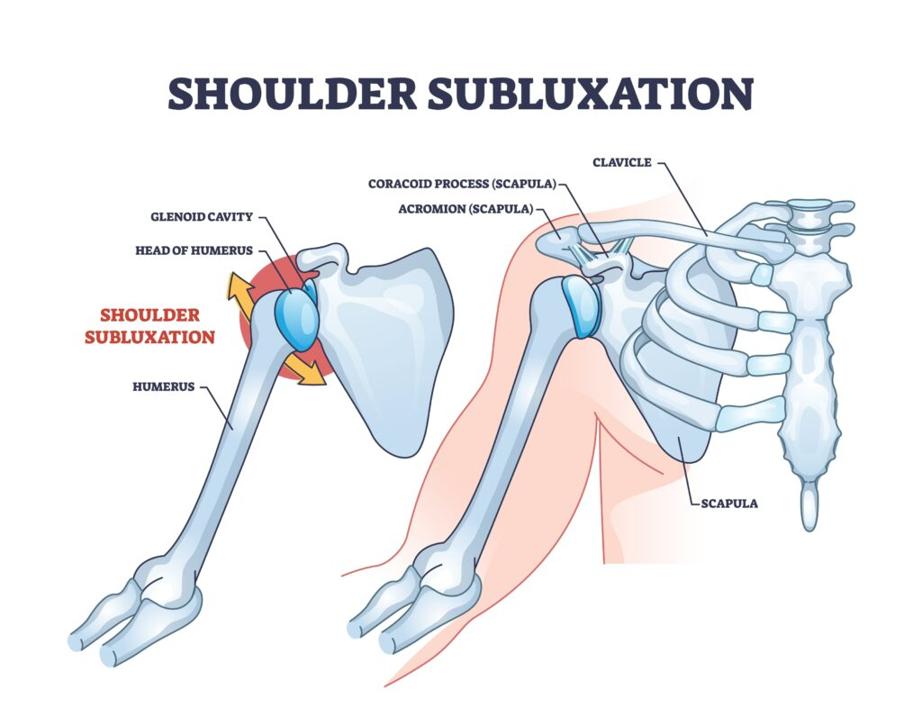
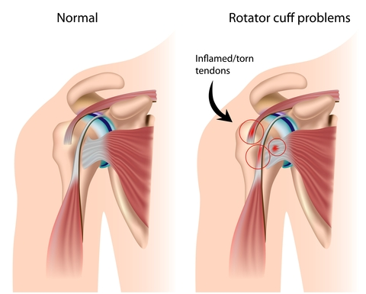
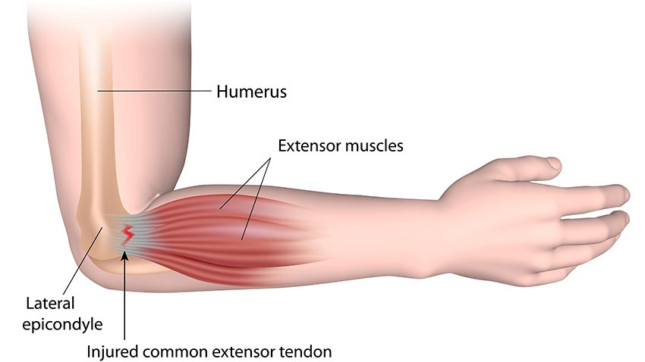
Injury and prevention
Shoulder
  Subacromial Impingement
  Rotator Cuff Tendinopathy
  Humeral Subluxation
Elbow
  Lateral Epicondylitis (Tennis Elbow)
  Insertional Tendinopathies
Forearm and Wrist
  Tenosynovitis
  Distal Triceps and Biceps Injuries
Back problems
Acute Trauma

Slide 15
References
Canoe Slalom - ICF Slalom Canoe and Kayak (canoeicf.com)
Coufalová, Klára & Busta, Jan & Cochrane, Darryl & Bílý, Milan. (2021). Morphological Characteristics of European Slalom Canoe and Kayak Paddlers. International Journal of Morphology. 39. 896-901. 10.4067/S0717-95022021000300896
Busta, Jan & Tufano, James & Suchy, Jiri & Bílý, Milan. (2019). Anthropometric, physiological and performance profiles of elite and sub-elite Canoe slalom athletes..
Holland, P., Torrance, E., & Funk, L. (2018). Shoulder Injuries in Canoeing and Kayaking. Clinical journal of sport medicine : official journal of the Canadian Academy of Sport Medicine, 28(6), 524–529. https://doi.org/10.1097/JSM.0000000000000472
Leonardo Henrique Dalcheco Messias, Ivan Gustavo Masselli dos Reis, Homero Gustavo Ferrari & Fúlvia de Barros Manchado-Gobatto (2014) Physiological, psychological and biomechanical parameters applied in canoe slalom training: a review, International Journal of Performance Analysis in Sport, 14:1, 24-41, DOI: 10.1080/24748668.2014.11868700
Slalom Technical Progression Guide: A Video Resource Tool | Access or download here (britishcanoeingawarding.org.uk)

Slide 16
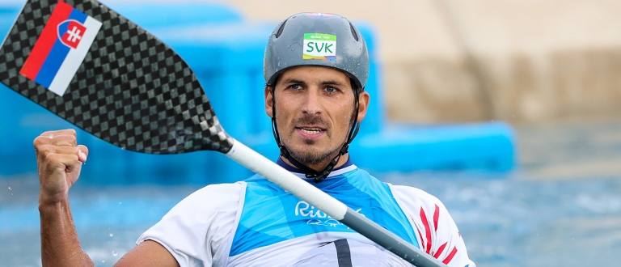
Thank you

