Slide 1
floorball
Course: Streng and conditioning
Merijn Smit

Slide 2
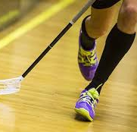

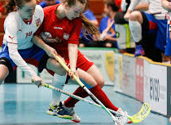
Characteristics of floorball
IFF
season
Game
Ball and stick
Body check
High intensity
Notes:
The International Floorball Federation has more than 50 member countries and is a full member of the International Olympic Committee (IOC). A floorball year consists of preseason (May-August), game season (September-March), and playoffs (April). The game time is 3 periods, 20 minutes each, with two 10-minute intermissions. Floorball is played with 5 players and 1 goalkeeper per team, with substitutions allowed during the game. The players use graphite compound sticks and a light ball made of hollow plastic. The rules of floorball state that it is a non-contact sport, but in the games that usually isn’t the case because of the high intensity and competition. Floorball is played at a very fast pace because of the bowl and stick design. The field is 20 x 40 meters and because of the fast pace of the ball you are always moving and most of the time sprinting.

Slide 3
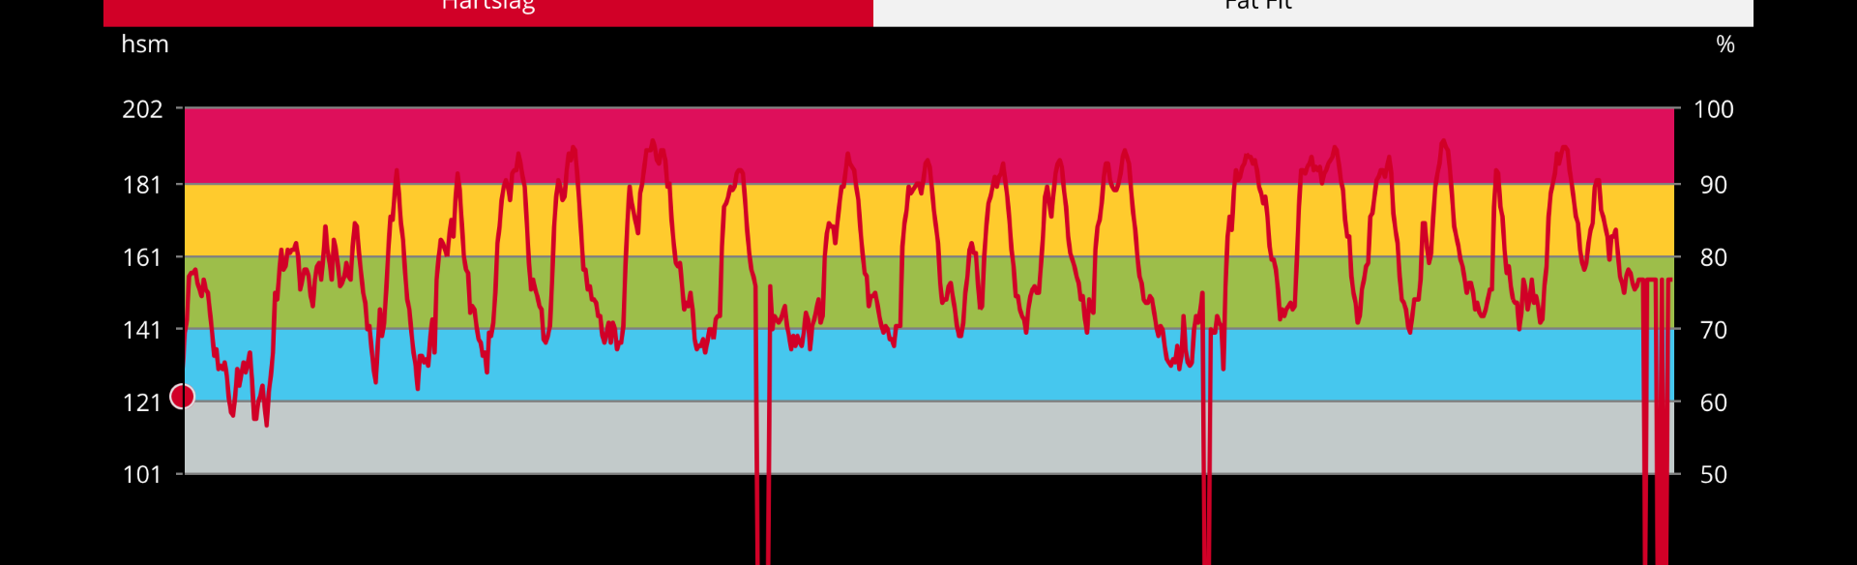
Physical demands
High intensity, lots of sprints
Explosive strengt
Cardio-vascular system
Coördination in whole body
Mobility and stability
Technique of the stick
Notes:
Like I said Floorball is played at a very high intensity. Here on the right you can see a screenshot of a Floorball match wich i have recorded, this is my heart-rate. You can see that there is a lot of variation when i am in het game and when I sit on the bench. In this game my max heart-rate was 192BPM. My BPM is so high because of all the sprinting, for all this sprinting you need explosive strengt and a good cardio-vascular system.
Because the game field is 20 x 40 meters and the ball goes so fast there is a lot of direction changes you have to do during the game, there fore you need good coordination in you feet, legs and actually your whole body. To do the fast direction changes you also need good moblily and stability in your whole body to transfer all the muscle power to the ground.
A last important physical demand is technique over the stick, for that you also need muscle strengt, mobility and stability in you shoulders and arms.

Slide 4
Preporation in off- and pre-season
Sport specific and athleate specific
Strive for optimum not perfection
Off season:
  sronger and more risilient
  Focus on weaknesses
  Restore optimal body functioning
Pre-season:
  More specific Floorball trainings
  Wich energy systems are already filled
Notes:
First of it is important to note not just for Floorball but for any sport, that it is important to train sport specific and atheate specific. What do i mean by that? I mean with sport specific that you need to train the thing that you need to be the best at your sport. For axample if you will run a marathon it is not optimal to train you cardio-vascular system by cycling. By athleate specific i mean that you need to look at the athleate and see in what part he is the worst. You are alway limited by the weakest link in the system. So train the weakest link and not what everybody else does to be the best in the sport.
In the preporation face of the off season it is normal that the athleates have no specific floorball training, therefor they can focus on getting stronger and more resilient. They should first focus more on the weaknesses that developed during the game season, the goal during the off season is to resore optimal body functioning.
During the pre-season there are more floorball specific trainings than in the off-season. During these floorball trainings, the athleate problably needs to sprint a lot and there for maintains or even develop the cardio-vascular system more. For that reason there is no point to do extra cardio-vascular trainings, this can even develop an overtraining syndrom. The athleate should consider wich energy systems are already filled by the specific floorball trainings. And in strengt training should focus on other things.

Slide 5
Competition face
Maintenance and peak performance training
2 trainigs sessions per week at maximum
Floorball specific or strengt trainings
Notes:
During the competition face the athleate should already have a good base of strengt, it is more about maintenance and peak performance training. this is because the stress from the games will already be higher, therfore, it is not wise to train too much strengt and neglect physical and mental recovery.
So during the competition face the athleate should do 2 trainings maximum per week. This can be floorball specific trainings or strengt trainings.

Slide 6
Frequent injuries
ScienceDirect.com | Science, Health and Medical Journals, Full Text Articles and Books., n.d.)
(Tranæus et al., 2016)
Overtraining
Eye
knee
ankle
Notes:
Overtraining is like in every other sport a This may be due to the structural damage and weakness because of inadequate recovery time and excessive stress impacting tissue remodeling.
Also common injuries are about the eye. Because the ball moves so fast it is hard to react in time to avoid contact with the ball. A study shows that floorball caused more eye injuries then all other sports combined.
Knee injuries are also common in floorball. If you compare knee injury to other locations of injuries then the knee injuries stand out by far. In one study there where in total about 700 injuries reported, and 400 where about a knee injury. Knee injuries occur mostly during the pre-season.
The ankle is the most common injury during the game season. Its also the most traumatic injury the athletes can sustain.
(ScienceDirect.com | Science, Health and Medical Journals, Full Text Articles and Books., n.d.)

Slide 7
Prevention of frequent injuries (literature based)
(ScienceDirect.com | Science, Health and Medical Journals, Full Text Articles and Books., n.d.)
(Tranæus et al., 2016)
(Tranæus et al., 2014)
Pre-season preporations
Sleep, diet and stress
Psychological training
Knee control
Notes:
First off want to start by saying that this page is literature based and the next page will be about injury prevention during exercise.
A result from one study found that a ot of injuries van be prevented by having good preporations before the game season.
They also found that if the athleate has their sleep, diet and stress level on point, the risk of injuries becomes much less.
(ScienceDirect.com | Science, Health and Medical Journals, Full Text Articles and Books., n.d.)
Another study found that by doing psychological trainings, the athleate will sustain less injuries. Unfortunately I cant find what they did during these trainings but yeah, aparanlty it helps.
(Tranæus et al., 2014)
Knee control. Another study did an experiement where they had three groups of floorball athletes. Every group had a complience group wich where, non, low and high. The method whas a knee control session, the group with low had 1-2 sessions per week and the group with high complience had more than 2 sessions per week. They found that the group with a high complience had a 35% lower prevalence of injuries overall and 60% lower prevelance of injuries overall compared to the low session group. So also recular control of different parts of the body can be included in a prevention method.

Slide 8
Prevention of frequent injuries through excercise
FMS tests
knee excercises
  Squat
  Lunge
  Step upp
Ankel excercises
  Calf raises
  Balance board
Notes:
Then we will start with my theory. The best method is to do some FMS tests on the athlete focussed on the lower body because there are the most injuries. When you have found something you can work on, you will focuss on that part. For axample if my client has a low score in the deep squad because his knees are not in line with his feet or track inside. Then I will find some excersise to overcome this problem.
So the first thing you do is the FMS tests. If you cant find flaw in those test you can do some excersises to strengten your lower body. Why focus on the lower body? Because most of the injuries are lower body related.
So what are the excersises you can do?
For the knee you can do a squat, lunge or step upp
And for the ankle you can do a calf raise or use the balance board.
Ofcourse do these excersises with the right technique and use some extra weight if neccesary to make the excercise harder.

Slide 9
Literature
ScienceDirect.com | Science, health and medical journals, full text articles and books. (n.d.). https://pdf.sciencedirectassets.com/272404/1-s2.0-S1466853X22X00060/1-s2.0-S1466853X22001638/main.pdf?X-Amz-Security-Token=IQoJb3JpZ2luX2VjEBsaCXVzLWVhc3QtMSJHMEUCIQDUCdqnVccpn%2BaVI2VyIS%2F3PIyA20dKOB1cAWKuaGePqwIgeEdeZ7gyEq2XgVa7BNj%2F9PUH4CxgalWN3GuKQlyuxs8qswUIZBAFGgwwNTkwMDM1NDY4NjUiDBqsNPHPZevekXtf5yqQBS6KF2MlYtf68w8nIhpMccxMu1nt8EsqPUQdy4b5Q%2B1sOQMy%2BD05DVPxgDUHz5RRC%2FXqL%2FH3WWrdQj3COJ9RHFNIgQoFxJ08isxypdI%2FWXSQl26WIHUTEjISRxm3Bg55yAtHOaKlLV3zalRZXmEbbyPFyUrQS%2FlsYUd3KgHU7UGpLygtvUjGhXE0X8zOCPULOcqxPL%2BlEStPgEth4x7vYIQZlpXg1ZZQx3cGvwTMLmjZSAXvjG1j0alkUd2oV%2FxcQUK81u2OZMAET%2FUPsBNm8bcEdG68knvQAv%2FPFIuKh3ZhphBaW%2FzzexCo%2BqDeisSmU55QRR8cDJRyyznXkEVq4brC5gWGCqYNylVg4JjvcqBiTbEzPeSFtqt5tswlUuDtxnOnZKDuv8sVtneOTIYFqvNHrtKGTUAzezQqIS4601dOUvUhb%2B%2Bv7WH04ug3gemFi1RheU5ZDv39CmxBW96K6%2BESoriLZEc5y5nw2Fg2e0VormWdaKl5ONOfkmCHrZR1a5ysd0QoslQXXAgtpzFDi1eIMhoeqYBMpLBKrKojQjTQ4qj2Gzgs0dlcX%2FG115eZUH5%2BF9MbZz7XISkneAb3ehuQQRueTf6FssLYT7KY%2B%2BoY0mzpD8F2Zvxyp2ieCr3IxqDd3ILEMTih%2BOFqq8rLnQnEsD6%2B6J1Uj
Tranæus, U., Johnson, U., Ivarsson, A., Engström, B., Skillgate, E., & Werner, S. (2014). Sports injury prevention in Swedish elite floorball players: evaluation of two consecutive floorball seasons. Knee Surgery, Sports Traumatology, Arthroscopy, 23(3), 899–905. https://doi.org/10.1007/s00167-014-3411-9
Tranæus, U., Götesson, E., & Werner, S. (2016b). Injury profile in Swedish elite floorball. Sports Health, 8(3), 224–229. https://doi.org/10.1177/1941738116628472
Perera, N. K. P., Åkerlund, I., & Hägglund, M. (2019). Motivation for sports participation, injury prevention expectations, injury risk perceptions and health problems in youth floorball players. Knee Surgery, Sports Traumatology, Arthroscopy, 27(11), 3722–3732. https://doi.org/10.1007/s00167-019-05501-7
Bro, T., & Ghosh, F. (2016). Floorball-related eye injuries: The impact of protective eyewear. Scandinavian Journal of Medicine & Science in Sports, 27(4), 430–434. https://doi.org/10.1111/sms.12653
Tranæus, U., Götesson, E., & Werner, S. (2016). Injury profile in Swedish elite floorball. Sports Health, 8(3), 224–229. https://doi.org/10.1177/1941738116628472
Bro, T., & Ghosh, F. (2016). Floorball-related eye injuries: The impact of protective eyewear. Scandinavian Journal of Medicine & Science in Sports, 27(4), 430–434. https://doi.org/10.1111/sms.12653
Bandyforbund, N. (2023) Injury prevention & strength training guide. https://bandyforbundet.no/innebandy/wp-content/uploads/sites/3/2023/03/Styrketreningsguide.pdf
Notes:
Bandyforbund, N. (2023) injury prevention & strengt training guide. https://bandyforbundet.no/innebandy/wp-content/uploads/sites/3/2023/03/Styrketreningsguide.pdf

