Slide 1
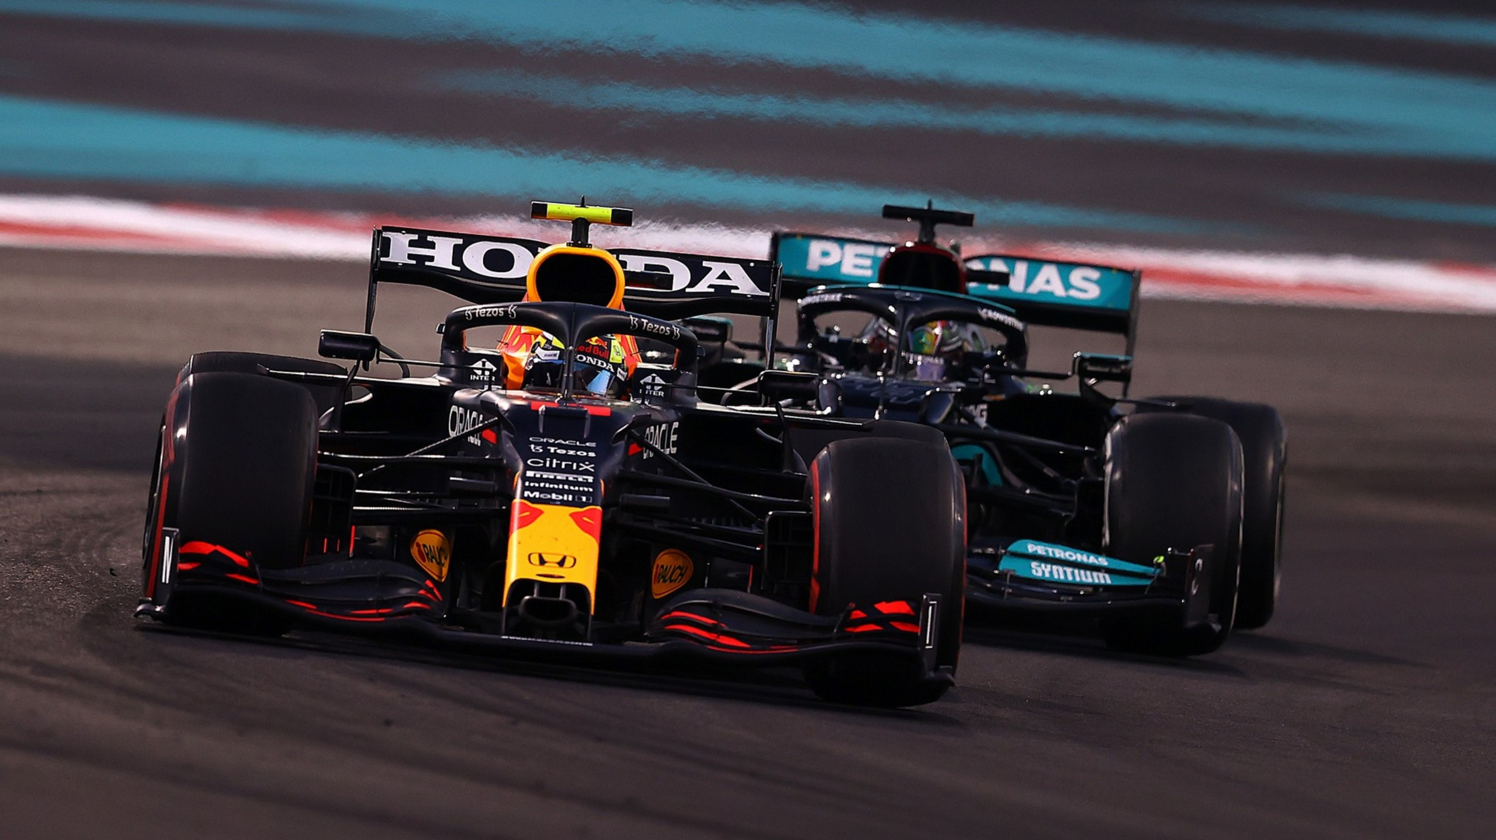
Formula 1
Jelle Groen

Slide 2
Physical Demands of Formula 1
High G-forces experienced during acceleration, braking, and cornering
Endurance required for races lasting up to two hours
Weight loss during the race (2-3 kg)
Mental focus and reaction time under extreme pressure
Explained: Why do F1 drivers get weighted after a race. (2024, March 29). RacingNews365.
https://racingnews365.com/why-do-f1-drivers-get-weighed-after-a-race#:~:text=Do%20F1%20drivers%20lose%20weight,due%20to%20the%20extreme%20heat.

Slide 3
Off-Season Preparation
Specific strength training programs to build muscle endurance and core strength
Cardiovascular conditioning for improved stamina
Keith, P. (2024, April 18). F1 drivers spill their fitness secrets. Red Bull.
https://www.redbull.com/int-en/formula-one-drivers-fitness-plans#3-how-do-drivers-get-in-shape-for-the-f1-season

Slide 4
Competition
Specific training regimes during the racing season
Different circuits -> different trainings
Strength, endurance, reaction time drills to improve overall performance
Balancing physical workouts with travel and race schedules
Importance of recovery between races
Mental training techniques to maintain focus and concentration
Keith, P. (2024, April 18). F1 drivers spill their fitness secrets. Red Bull.
https://www.redbull.com/int-en/formula-one-drivers-fitness-plans#3-how-do-drivers-get-in-shape-for-the-f1-season
Notes:
Intense focus on maintaining peak physical and mental condition throughout the racing season. - Specific workouts to address specific demands of each circuit, considering factors like track layout, climate conditions, and race duration. - Incorporation of strength, endurance, and reaction time drills to enhance overall performance on the track.
Balancing workouts and traveling:
Maintains peak performance.
Prevents injuries.
Optimizes recovery.
Supports mental well-being.
Promotes consistency and adaptability.

Slide 5
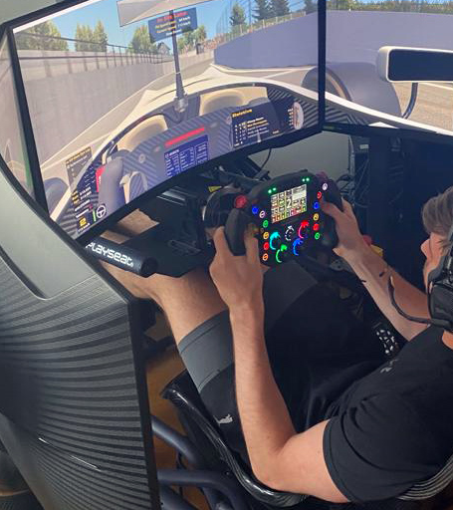
Special Sport Specific Exercises
Sim Racing
Simulate race conditions and maintain sharpness
Why?
Getting to know the track
Prepare different scenarios
Leporati, G. (2024, January 8). Formula 1 drivers spend hours in a simulator before each race. It can make or break race day. Business Insider.
https://www.businessinsider.com/formula-1-simulator-racing-team-alex-albon-williams-2023-11#:~:text=The%20simulator%20is%20particularly%20important,familiarity%20with%20the%20track's%20layout.

Slide 6
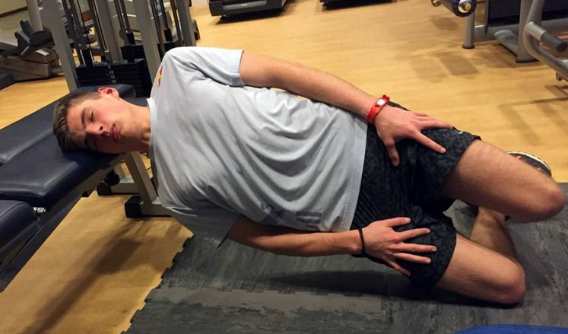
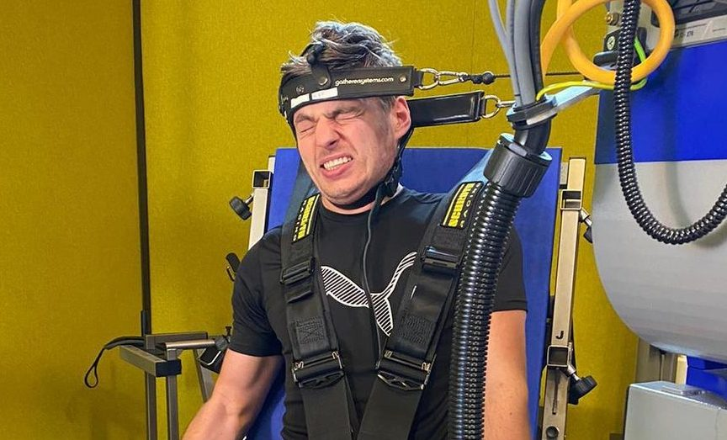
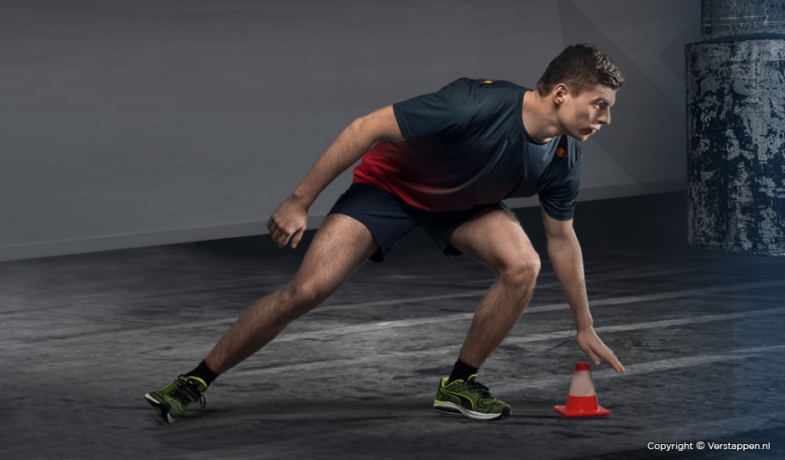
Injury Prevention Through Exercise
Neck strengthening exercises to withstand G-forces
Core stabilization exercises for improved balance and posture
Flexibility and mobility drills to prevent muscle strains
Plyometric training to enhance reactive strength and agility
Explosive movents, fast twitch muscle activation, better coordination and agility
Lum, D. et al. (2016). Effects of intermittent sprint and plyometric training on endurance running performance.
PubMed. https://www.ncbi.nlm.nih.gov/pmc/articles/PMC6742614/
Notes:
Plyometric training for reactive strength and agility in Formula 1 involves:
1. Explosive Movements: Quick stretching and contracting of muscles to generate maximum force quickly.
2. Fast-Twitch Muscle Activation: Activation of fast-twitch muscle fibers (type 2) for explosive power and rapid force production.
3. Better Coordination: Improving communication between nerves and muscles for precise and efficient movements.
4. Enhanced Agility: Training the body to change direction quickly and move explosively in various planes of motion.

Slide 7
References
Explained: Why do F1 drivers get weighted after a race. (2024, March 29). RacingNews365.
https://racingnews365.com/why-do-f1-drivers-get-weighed-after-a-race#:~:text=Do%20F1%20drivers%20lose%20weight,due%20to%20the%20extreme%20heat.
Keith, P. (2024, April 18). F1 drivers spill their fitness secrets. Red Bull.
https://www.redbull.com/int-en/formula-one-drivers-fitness-plans#3-how-do-drivers-get-in-shape-for-the-f1-season
Leporati, G. (2024, January 8). Formula 1 drivers spend hours in a simulator before each race. It can make or break race day. Business Insider.
https://www.businessinsider.com/formula-1-simulator-racing-team-alex-albon-williams-2023-11#:~:text=The%20simulator%20is%20particularly%20important,familiarity%20with%20the%20track's%20layout.

