Slide 1



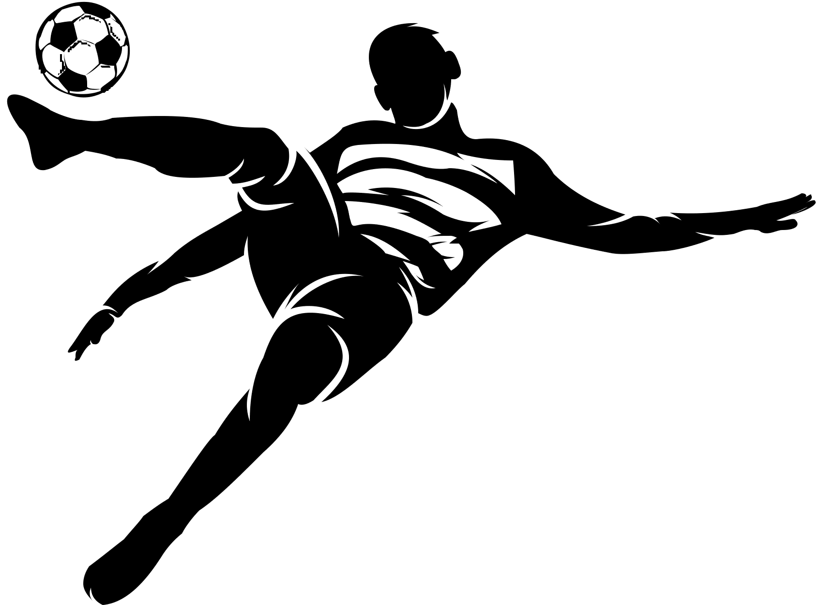

IGNACIO PÉREZ NIEVES
SOCCER

Slide 2



INDEX
01. Introduction
02. Physical Demands
03. Preparation in the off-season
04. Competition Period
05. Frequent injuries
06. Prevention
07. References

Slide 3


INTRODUCTION
Objective:
Teams aim to beat each other by scoring goals. The team with more goals at the end of the match wins.
Rules and Field:
Players use any part of their bodies except their hands and arms. Only the goalkeeper can handle the ball within the penalty area. Soccer is played on a rectangular field with goalposts at each end. Lines and markings define boundaries, the center circle, and the areas.
Duration:
Matches typically last 90 minutes, divided into two halves. Extra time or penalty shootouts may occur if the score is tied.
Global Popularity:
Over 1.3 billion people worldwide are interested in soccer. The FIFA World Cup attracts billions of viewers.

Slide 4

PHYSICAL DEMANDS
Players need strength to shield the ball, win aerial duels, and hold off opponents.
Balance is essential for dribbling, changing direction, and maintaining stability during tackles
Stretching and maintaining flexibility help prevent injuries and allow players to execute dynamic movements.
Full range of motion is essential for kicking, jumping, and diving (for goalkeepers).
Accelerate quickly to chase down opponents or reach the ball. Agility is crucial for evading defenders
COORDINATION AND BALL CONTROL
ENDURANCE
SPEED AND AGILITY
Players need exceptional cardiovascular endurance to maintain performance throughout the game.
Running long distances, sprinting, and changing direction repeatedly require stamina
STRENGTH AND BALANCE
Precise ball control demands excellent coordination. Players use their feet, thighs, chest, and head to manipulate the ball.
Passing, shooting, and dribbling can be influence by coordination
FLEXIBILITY AND RANGE OF MOTION

Slide 5


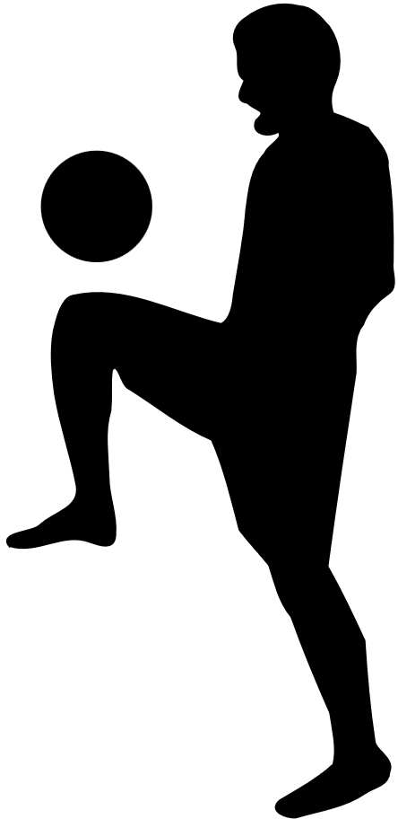
PREPARATION OFF-SEASON
Strength Training: Players focus on building strength through weightlifting, resistance exercises, and functional movements. This helps prevent injuries and enhances performance.
Cardiovascular Conditioning: Endurance training, such as running, cycling, or swimming, maintains cardiovascular fitness.
Skill Development: Players refine technical skills like passing, shooting, dribbling, and ball control.
Nutrition and Rest: Proper nutrition and adequate rest are essential for recovery and overall health.
Individualized Programs: Coaches tailor training programs to each player’s needs.

Slide 6



COMPETITION PERIOD
Training Load Management:
  Intensity and Volume: Balance high-intensity and recovery sessions to keep players fresh and avoid overtraining, using a periodized approach.
Tactical and Technical Training:
  Match Preparation: Focus on tailored tactical strategies and set pieces.
  Skill Maintenance: Regularly practice technical skills like passing, shooting, dribbling, and defending.
Recovery Protocols:
  Ensure adequate rest and quality sleep.
  Active Recovery: Use light activities like jogging, swimming, or cycling.
  Hydrotherapy and Massage: Utilize ice baths, hydrotherapy, and sports massages.
Injury Prevention:
  Strength and Conditioning: Maintain strength training, avoiding heavy lifting near match days.
  Flexibility and Mobility: Perform regular stretching and mobility exercises.
  Monitoring: Track physical conditions using GPS and heart rate monitoring.

Slide 7
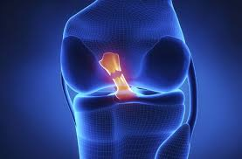
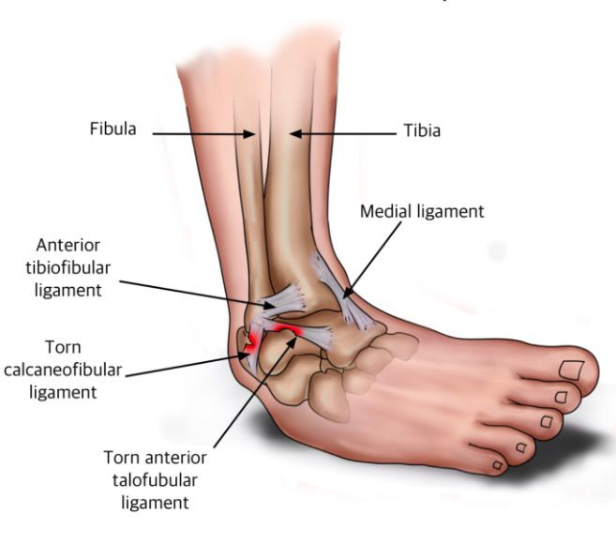
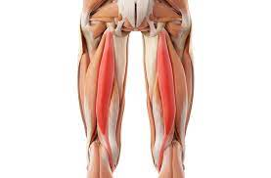
INJURIES
Knee injuries
Ankle sprains
Hamstring Strains
-Anterior Cruciate Ligament (ACL) Tears: These occur due to sudden stops, pivots, or changes in direction. The ACL, a ligament in the knee, can tear or sprain.
-Meniscus Tears: The meniscus, a C-shaped cartilage in the knee, can tear from twisting, pivoting, or impact.
Occur when the ligaments that support the ankle stretch or tear. This often happens due to sudden changes in direction, collisions with other players, or uneven playing surfaces. Lateral ligaments most affected vs medial
Hamstring strains involve injury to the muscles at the back of the thigh. These injuries typically result from explosive movements such as sprinting, sudden acceleration, or deceleration, and overstretching during kicking

Slide 8


PREVENTION
01
Proper Warm-Up and Cool-Down
Warm-Up: A proper warm-up increases blood flow to muscles, enhances flexibility, and prepares the body for intense physical activity. This typically includes dynamic stretching, jogging, and sport-specific drills.
Cool-Down: Cooling down helps to gradually lower the heart rate and relax the muscles, reducing the likelihood of stiffness and soreness. This involves light jogging or walking followed by static stretching.
02
Strength and Conditioning Training
Strength Training: Building strength provides better support and stability for joints, reducing the risk of sprains and strains. Exercises like squats, lunges, and core stabilization drills are essential.
Conditioning: Cardiovascular and muscular endurance are crucial to handle the demands of soccer without excessive fatigue. Conditioning drills such as interval training and agility exercises enhance overall fitness and performance.

Slide 9

Correct Technique and Form
Adequate Rest and Recovery
Proper technique in movements like running, jumping, landing, and changing direction minimizes undue stress on the body. Training should emphasize safe tackling techniques and proper ways to absorb contact to prevent collision injuries.
Coaches should focus on teaching these techniques consistently, using drills that replicate game situations to reinforce good habits.

Slide 10
REFERENCES
Nery, C., Raduan, F., & Baumfeld, D. (2016). Foot and Ankle Injuries in Professional Soccer Players: Diagnosis, Treatment, and Expectations. Foot and Ankle Clinics, 21(2), 391-403
Bangsbo, J., Mohr, M., & Krustrup, P. (2006). Physical and metabolic demands of training and match-play in the elite football player. International Journal of Sports Physiology and Performance, 2(2), 111-1271
Brumitt, J., Mattocks, A., Engilis, A., Sikkema, J., & Loew, J. (2020). Off-Season Training Habits and BMI, Not Preseason Jump Measures, Are Associated with Time-Loss Injury in Female Collegiate Soccer Players. Sports, 8(3), 36
Djaoui, L., Haddad, M., Chamari, K., & Dellal, A. (2017). Monitoring training load and fatigue in soccer players with physiological markers. Physiology & Behavior, 181, 86-94

Slide 11

THANKS FOR ATTENTION

