Slide 1
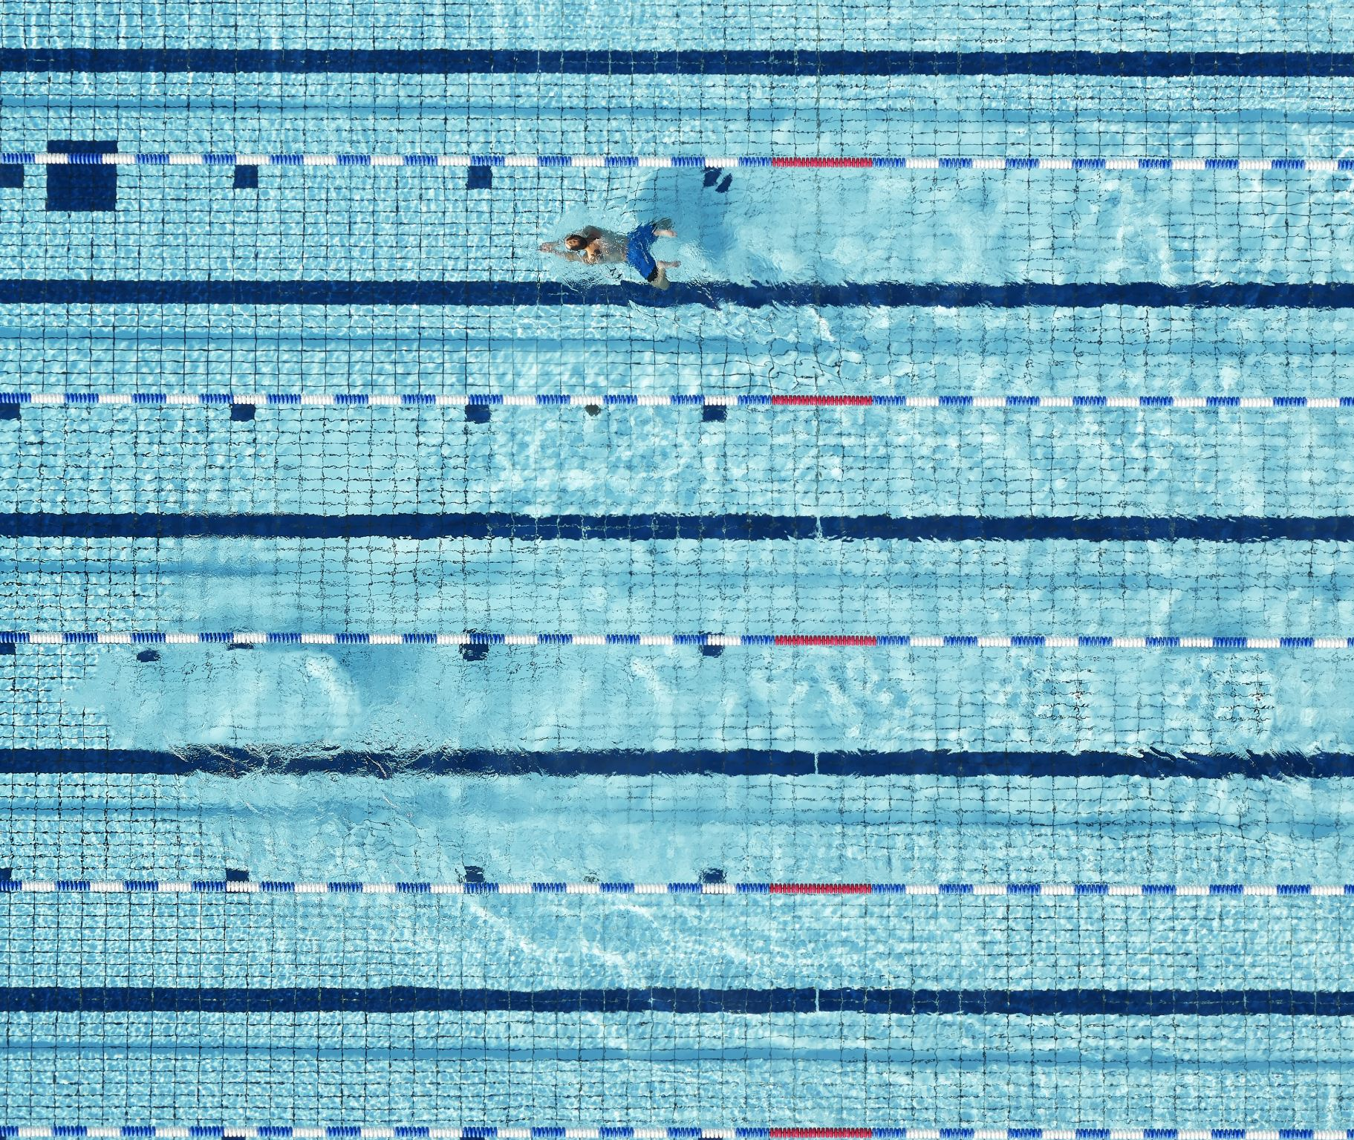
Swimming
Veronika Popelková
Strenght training and conditioning

Slide 2
physical demands
Swimmers are often tall , big upper body, hands, low number of fat
swimming athletes require elements of power, speed, and endurance to reach their performance potential
It is a full-body sport and requires coordinated activation of muscles in legs, the core, and the upper body with virtually every stroke that is taken
Swimming is a non-weight-bearing sport

Slide 3
season
We divide the annual training cycle into four periods
preparation period – rest is followed by a return to preparation. The number of kilometers covered slowly starts to rise, elements of technique repair and training are included, and strenght training based on the principle of endurance and strength development (for example, running, circuit training, gym), compensatory exercises is included
pre-race period – we start to move from volumes to medium distances, in strenght training we move more to the development of strength and speed
racing season - in terms of training, we switch between sprints and starts, turns and exits, the same applies to strenght training, where we include lifting the maximum weight, or running sprints and losses on command.
after the end of the racing season comes the off season
The weekly training cycle consists of approximately 6 training sessions per week (two-phase three times a week and one-phase training twice a week. We include conditioning training approximately 3 times a week plus compensatory exercises

Slide 4
Preparationin the off-season
After the peak of the season comes a rest for most swimmers. The peak of the season can be in the winter (around Christmas 2 weeks) after the Czech championship or in the summer after the championship (3-4 weeks)
Aktiv – running, walking in the mountains, cycling, skating
Pasiv - lying by the sea

Slide 5
Injuries
The most common injury swimmers shoulder's and breaststroker's knee
torn muscles
As prevention against injury, we can include dynamic warm-up before training, static stretching after training, compensatory exercises (at least once a week), massages and other regenerative elements.
Strength training can address strength and flexibility imbalances and reduce the risk of injury.

Slide 6
zdroje
ijerph-19-05369.pdf
PyneandSharp2014.Physicalandenergyrequirementsofcompetitiveswimmingevents.pdf
Physical-and-Energy-Requirements-of-Competitive-Swimming-Events.pdf (researchgate.net)

