Slide 1
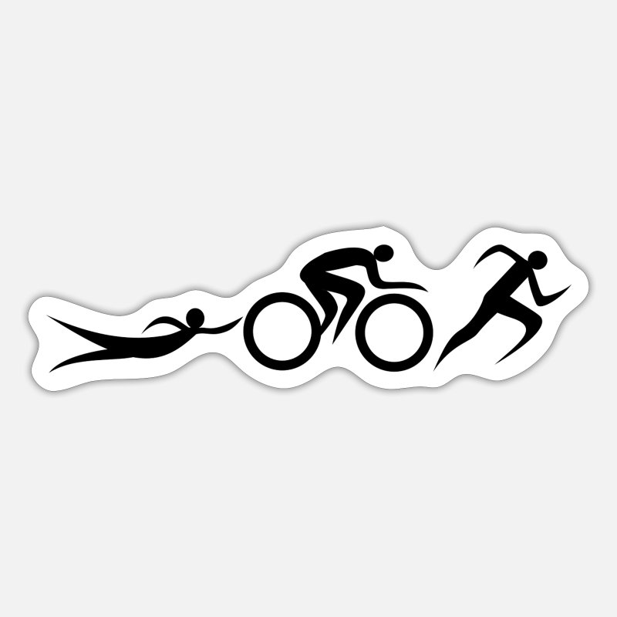
Strength training and conditioning in triathlon
Physical demands
Preparation
Frequent injuries and prevention
Figure 1: Illustration of the three disciplines in triathlon. Obtained from https://www.spreadshirt.ie/shop/design/triathlon+logo+bike+run+swim+triathlete+sticker-D5f3aa5995fd3e41a951e1475?sellable=XyVARyx1nQu17ZNwb11y-1459-215

Slide 2
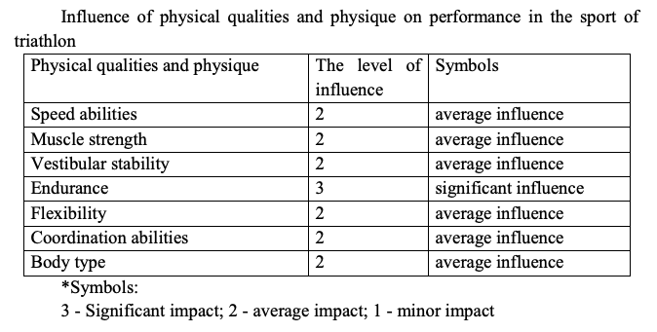
Physical demands
(Sleivert & Rowlands, 2012; Niyazova & Raximova, 2021)
Perform in three different disciplines
Develop characteristics that are a blend of the characteristics in endurance swimming, cycling and running
High VO2 max levels
Perform good → these abilities, especially endurance
Figure 2: Table over the influence of physical qualities and physique on performance in triathlon. Obtained from https://cyberleninka.ru/article/n/analysis-of-physical-fitness-of-triathletes-at-the-stage-of-improving-sports-skills/viewer

Slide 3
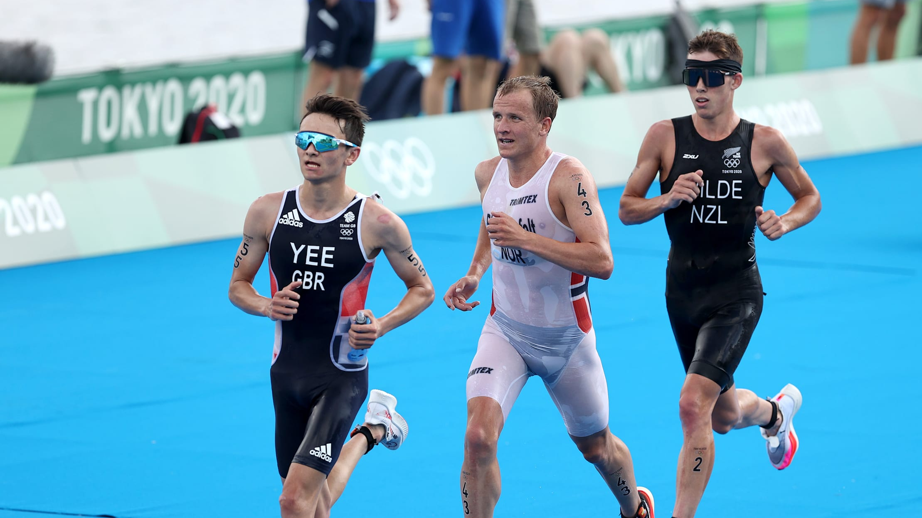
Training
(Etxebarria et al., 2019)
Well-organized and periodized training program
Peak performance alligned with the competitions
Most use the traditional periodization as basic guidelines → preparatory, competitive and transition periods
  Preparatory → lower intensity, higher volume for aerobic endurance and technique. Strength training
  Competitive → specific race preparation, increased intensity, interval training and speed work
  Transition → bridge between two faces. Rest phase, recovering while maintaining a level of fitness, lower intensity and lower volume
Figure 3: Triathlon competition. Obtained from https://olympics.com/en/news/world-triathlon-championship-series-cagliari-preview

Slide 4
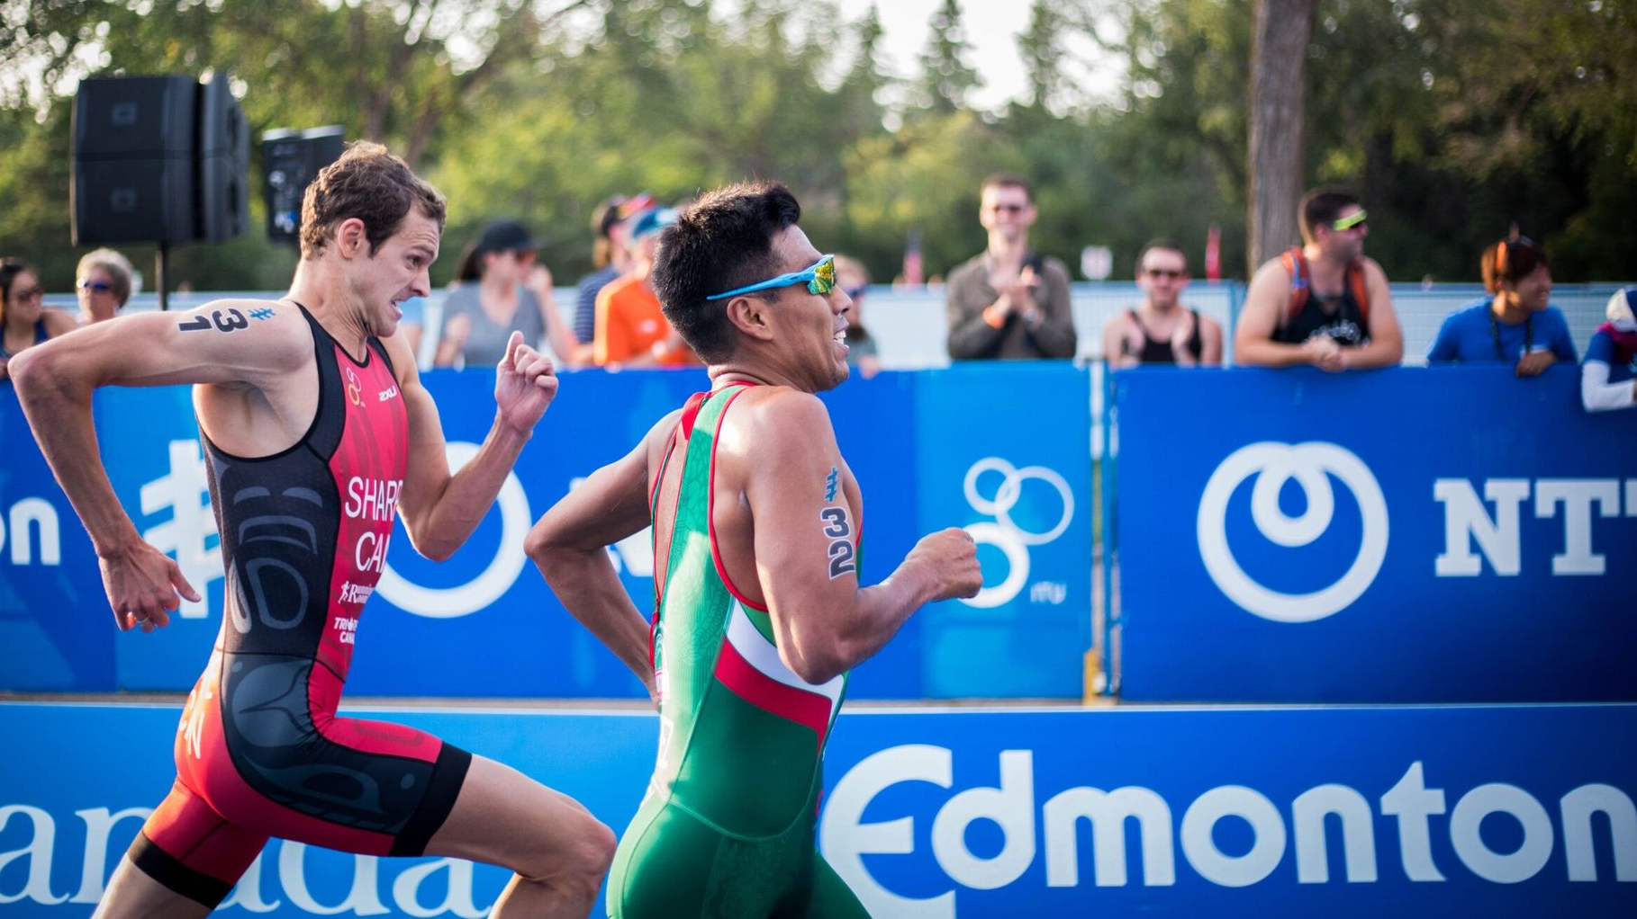
Preparation/off-season
(Cejuela & Sellés-Perez, 2022)
Study from 2022 that followed a male elite triathlete towards the Olympics in Tokyo 2020
Preparation for 43 weeks
General preparation period from week 1-14 → increasing in volume progressively, most of the trainings in low to moderate intensity
Specific preparatory period from week 15-30 → two altitude camps
  Develop higher training zones, closer to race intensity
Figure 4: Triathlon competition. Obtained from https://circledna.com/blog/do-you-have-what-it-takes-to-participate-in-a-triathlon/

Slide 5
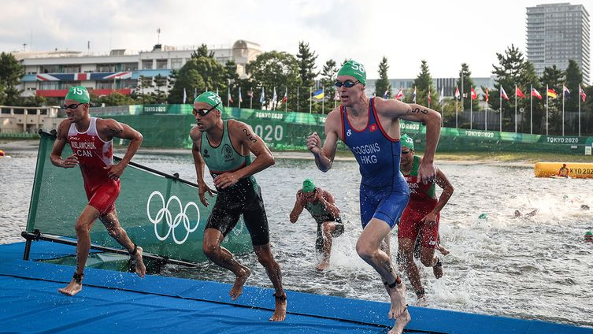
Competition period
(Cejuela & Sellés-Perez, 2022)
First competition period lasted 5 weeks, from week 31-35
Performed two olympic distance competitions
Tapering period during these weeks → reduce load to achieve supercompensation and improve recovery
Decreased volume, maintained high intensity training
5-week training block from week 36-40 → specific preparations for Tokyo, increased the load again
2-week tapering period in week 41-42 → supercompensation
Figure 5: Triathlon competition. Obtained from https://www.mapquest.com/travel/outdoor-activities/triathlons/triathlon-distances.htm

Slide 6
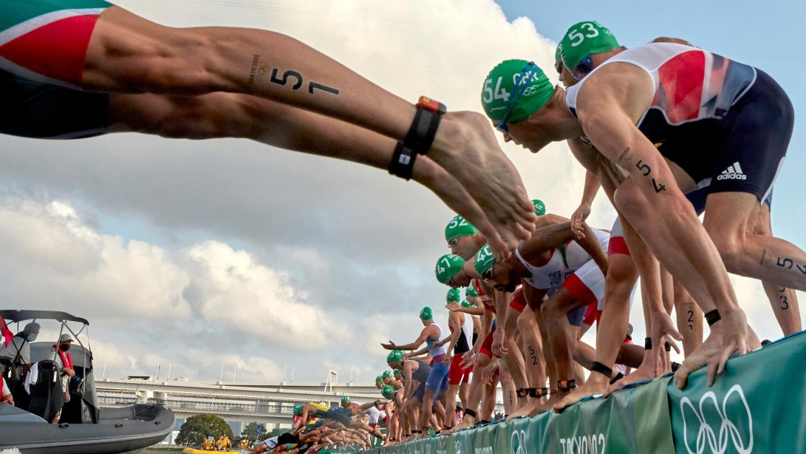
Strength training
(Cejuela & Sellés-Perez, 2022)
Two weekly strength sessions during the most part of the season
Multi-joint exercises for upper and lower body
  Movements over several joints and muscle groups.
  Squats, deadlifts, bench press, pull-ups.
Loads from 55-75% of 1RM
2-4 sets per exercise
4-8 reps per set
Complementary exercises 3-4 days per week → hip, ankle and shoulder mobility, core training
Achilles tendon prevention
Figure 6: Triathlon competition. Obtained from https://edition.cnn.com/2021/07/26/sport/men-triathlon-tokyo-2020-false-start-scli-intl-spt/index.html

Slide 7
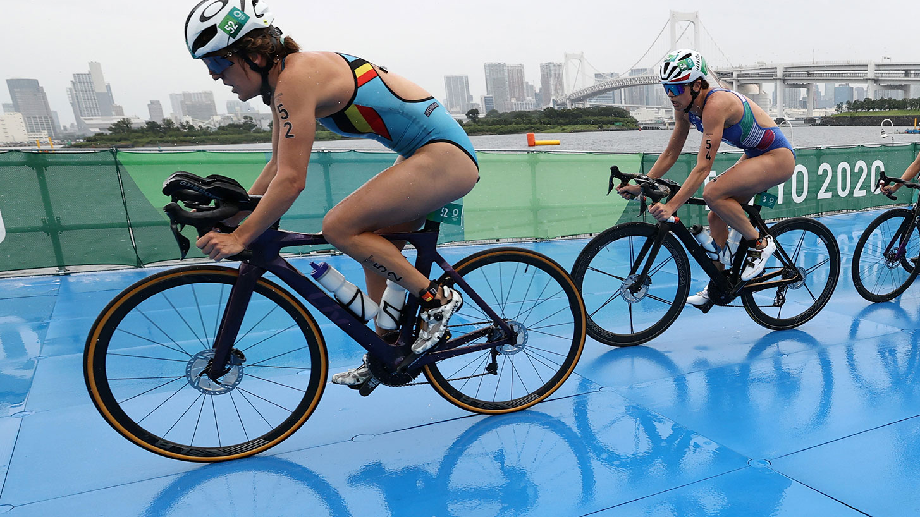
Injuries and prevention
(Andersen et al, 2013; Rhind et al., 2022; Kienstra et al., 2017; Etxebarria et al., 2019)
Overuse injuries
Knee, lower leg, lower back, shoulder
3 disciplines at the same time will result in high total load → training load, appropriate changes in volume and adequate recovery
Strength training effective to prevent injuries
The athlete performed multi-joint strength exercises for muscle endurance and joint stability
Mobility exercises
Specific injury prevention exercises
Be careful with compensating by increasing volume another discipline
Figure 7: Triathlon competition. Obtained from https://mgoblue.com/news/2021/7/30/olympics-michigan-olympic-updates-womens-triathlon

Slide 8
References
Andersen, C. A., Clarsen, B., Johansen, T.V. & Engebretsen, L. (2013). High prevalence of overuse injury among iron-distance triathletes. British Journal of Sports Medicine, 47, 857-861. https://bjsm.bmj.com/content/bjsports/47/13/857.full.pdf
Cejuela, R. & Sellés-Perez, S. (2022). Road to Tokyo 2020 Olympic Games: Training Characteristics of a World Class Male Triathlete. Frontiers, article 835705. https://doi.org/10.3389/fphys.2022.835705
Etxebarria, N., Mujika, I. & Pyne, D. B. (2019). Training and Competition Readiness in Triathlon. Sports, 7(5), 101. https://doi.org/10.3390/sports7050101
Kienstra, C. M., Asken, T. R., Garcia, J. D., Lara V. & Best, T. M. (2017). Triathlon Injuries: Transitioning from Prevalence to Prediction and Prevention. Current Sports Medicine Reports, 16(6), 397-403. 10.1249/JSR.0000000000000417

Slide 9
References
Niyazova R.R. & Raximova Z.D. (2021). Analysis of physical fitness of triathletes at the stage of improving sports skills. Central Asian Research Journal for Interdisciplinary Studies, 1 (3), 148-154. https://cyberleninka.ru/article/n/analysis-of-physical-fitness-of-triathletes-at-the-stage-of-improving-sports-skills/viewer
Sleivert, G.G & Rowlands, D.S. (2012). Physical and Physiological Factors factors associated with success in the triathlon. Sports Medicine, 22, 8-18. https://doi.org/10.2165/00007256-199622010-00002
Rhind, J.-H., Debashis, D., Barnett, A. & Carmont, M. (2022). A Systematic Review of Long-Distance Triathlon Musculosceletal Injuries. Journal of Human Kinetics, 10:81, 123-134. https://doi.org/10.2478/hukin-2022-0011

