Slide 1
Strength training for cross-country skiing
For performance and prevention of injuries

Slide 2
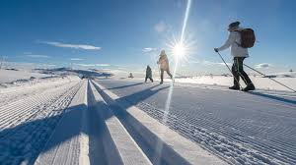
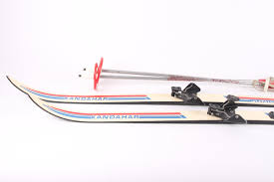
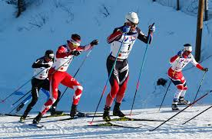
what is cross-country skiing
winter sport.
equipment
For everyone

Slide 3
Strength, why and principles
Increase the strength
Increase energy usage
Reduce the time for energy generation
4 principles.
Muscles specification.
Muscle length
the speed curve
plyometric muscle power

Slide 4
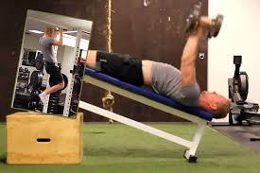
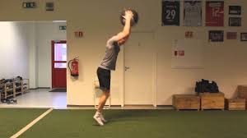
Exercises recommendation for improved performance
Standing medical Ball throw
Pull-over on elevated bench
Chin ups
Staking with cable.

Slide 5
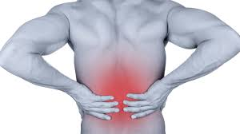
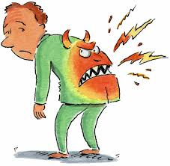
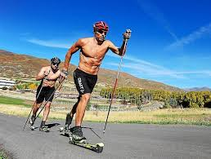
Prevention of damage
not many injuries,
Difference between pro and amateurs.
Full body work out all year.

Slide 6
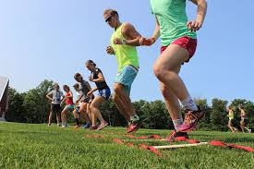
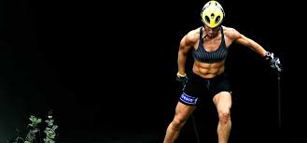
Full work out plan
For athletes focus on upper body for strength
For everyone else full body strength.

Slide 7
Sources
Rolf Bryhn (29. november 2019) langrenn. https://kildekompasset.no/en/references/journal-article-with-1-author/
Simen Aaland (08.12.2015) Styrketrening for langrennsløpere: Del 1 – Hvilke effekter. https://www.langrenn.com/external/styrketrening-for-langrennslopere-del-1-hvilke-effekter/
Simen Aaland (08.12.2015) Beste styrkeøvelser for å bli bedre langrennsløper https://www.langrenn.com/external/beste-styrkeovelser-for-a-bli-bedre-langrennsloper/
Luna Elisabeth Søgaard (last sen 14.05.2024) Hvordan forebygge langrennsrelaterte skader https://birkebeiner.no/no/nyheter/hvordan-forebygge-langrennsrelaterte-skader

