Slide 1
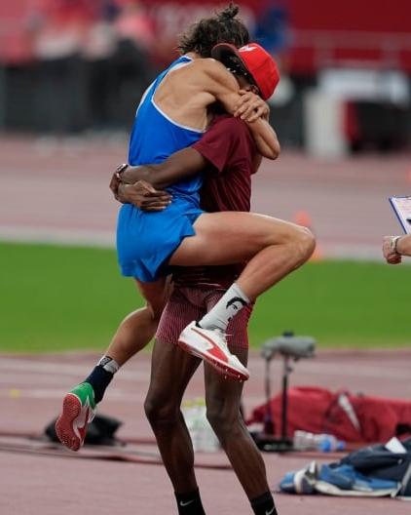
Strength Training and Conditioning: High Jump
546043 Hua Chiehchi

Slide 2

Phases of high jump
Approach: Begins as a straight line sprint that eventually turns into a curve. It increases the athlete's horizontal velocity, which will eventually be used for the plant.
Plant/Take off: The horizontal velocity that has been developed during the approach run is used to develop the vertical velocity that will be required to jump high.
Flight: Success in the flight phase is dependent by the athlete's ability to exert force against the ground during the plant/takeoff.
Landing
Approach
Landing
Flight
Plant/Take off
2

Slide 3
Physical demands
Power
Strength
Horizontal application of force
Single-leg strength and power
Ability to maintain posture
3

Slide 4
Strength training
Qualities | Exercises
Strength | Squats (back, front, split, overhead), Deadlifts, Romanian deadlifts, Good mornings, Presses (bench, incline, decline, military), Rows (bent-over, seated, one-arm), Pull-ups/pull-downs
Power | Cleans (power, squat, split), Snatches (power, squat, split), Jerks (push, power, split), Pulls
Horizontal application of force | Horizontal jumps (standing long jump, triple jump, hurdle hops, etc.), Sled pushing/pulling, Bounds, Resisted sprints
Single-leg strength and power | Split squats, Lunges, Step-ups, Split cleans/snatches/Jerks, One-legged cleans/snatches/Jerks
Ability to maintain posture | Squats (back, front, split, overhead), Deadlifts, Romanian deadlifts, Good mornings Squats, deadlifts, Romanian deadlifts, good mornings with a pause Squats, deadlifts, Romanian deadlifts, good mornings with an exaggerated eccentric phase
4

Slide 5
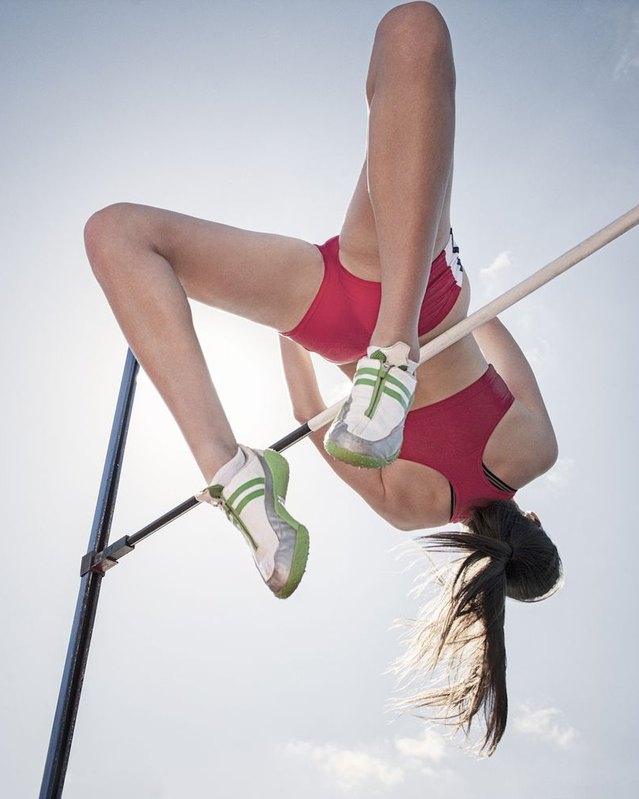
Specific training
Sprinting training: to improve the athlete's ability to perform the run-up.
Drills with few strides: focus on the plant/takeoff.
Back flexibility: to increase the arch of the jump.
Vertical and horizontal plyometrics: to enhance jump performance.
5

Slide 6

Potential injuries
01
02
Hamstring injury in sprinting
Ankle joint injury in change of directions
The biceps femoris is especially susceptible to strains when the leg is being swung forward or during foot strike, as these are times when the muscle is lengthened.
In take-off stage, it moves in a rotation with a range more than normal and may sometimes lead to injury.
6

Slide 7
Potential injuries prevention
01
02
Hamstring injury in sprinting
Ankle joint injury in change of directions
Strengthen the hamstring muscles eccentrically.
e.g. Romanian deadlifts, Good mornings (standing, seated), Glute-ham raises, Reverse hyperextensions, Nordic leg curl
Improve and strengthen the weak muscles, tendons, and ligaments surrounding the ankle joint.
7

Slide 8
References
Bora, P. (2012). Direct competition preparation in elite high jumping. New Studies in Athletics, 3, 23-28.
Cissik, J. (2019). The High Jumper–Strength and Conditioning.
Khaleel, F. S. (2023). The effect of physical exercises to improve muscle strength to reduce recurrent injuries of the ankle joint in men's high jump. SPORT TK-Revista EuroAmericana de Ciencias del Deporte, 25-25.
Ritzdorf, W. (1986). THE PRACTICE OF STRENGTH TRAINING IN WOMEN S HIGH JUMP. International Association of Athletics Federations-IAAF, 2, 81-9.
Schiffer, J. (2012). Plyometric training and the high jump. New Studies in Athletics, 27(3), 9-21.
王季瑜, & 涂瑞洪. (2009). 背向式跳高的生物力學原理概述. 屏東教大體育, (12), 303-309.
張維綱, 劉金鎗, & 許弘恩. (2008). 田徑運動跳高項目運動傷害之探討. 嘉大體育健康休閒期刊, 7(3), 167-173.
8

