Slide 1
Hacking the stress system: the stress response as an adaptive trait that can work for or against you
I - Introduction to the course and the evolutionary basics of stress

Slide 2
Course: Performing under Pressure
Faculty of Sports Studies
Schedule
Every Tuesday at 9:00
Lecturer
David William Mac Gillavry
404280@in.muni.cz
Office hours – upon request

Slide 3
Who am I?
Religious studies (UvA / MUNI)
Cognitive science of religion
Western esotericism
Secrecy dynamics
Military Management (UNOB)
Stress & PTSD
Leadership
Nutrition
Social conformity & in-group dynamics

Slide 4
My current research University of Defence
Stress resilience under extreme conditions
Leadership & combat leadership
In-group dynamics & moral behaviour under extreme conditions
Preparation for high-stress experiences

Slide 5
Course specifics
The course aims to provide students with a comprehensive understanding of the evolution and function of the stress response, as well as practical methods to optimise this response for better performance. Students will learn that the stress response is a double edged sword that can be incredibly harmful to both short-term performance and long-term health, or a tool with which to tackle complex problems under time pressure. After successful completion of the course students will have a both a theoretical basis and a set of practically applicable techniques, with which the stress response can be optimised for performance in both oneself and others.

Slide 6
Syllabus
Lecture | Topic | Seminar
1 | Introduction to the course and the evolutionary basics of stress | Your stress in a wider context
2 | Social stress, reproduction and hierarchy
3 | On the genetics and epigenetics of stress resilience / sensitivity
4 | On the intersection between culture and stress
5 | Why stress makes you stupid, most of the time | What stresses you and why?
6 | Depression, PTSD and anxiety
7 | On the psychology of lying, deceit, and how stress makes it all much worse
8 | Lifestyle and stress I: Nutrition & Sleep | How can you optimise resilience?
9 | Lifestyle and stress II: Sport & Social connections
10 | Optimising the stress response for greater performance | Practical solutions for stress management

Slide 7
Course requirements
Be here, be active & be prepared
A term paper
Min 5 pages (2.0 spacing)
Proper bibliography and referencing (preferably APA)
Subject of your choosing as long as it relates to stress and peak performance

Slide 8
Stress in an evolutionary context
Stress evolved to protect the organism from (often life-) threatening stimuli.
Other species (who wish to eat you)
Infections (bacterial and viral)
Parasites
Injury
Out-group members (struggle over recourses)
In-group members (struggle over position)

Slide 9
Specific solution for a specific problem
Evolution usually endows us with specific solutions for specific problems.
The stress response, however is a single solution to a host of different unpleasant stimuli.

Slide 10
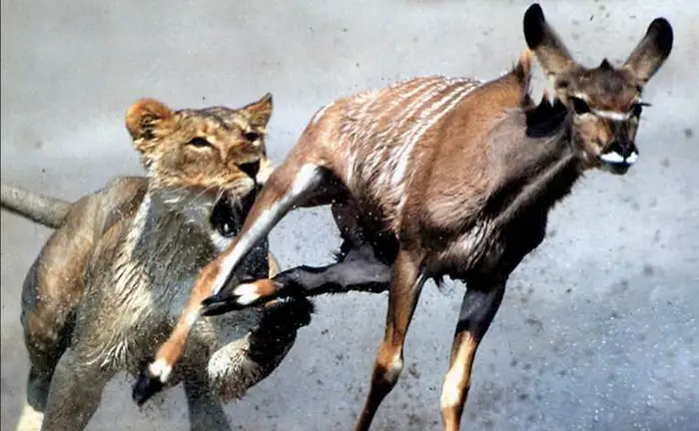

Slide 11
Nature selects for speed
Speed over accuracy
It matter less where you run than that you run as quickly as possible
Limited time frame (5 min)
Most negatives effects of stress are the result of turning on the system for way longer than the approximately 5 minutes it usually takes.
Sapolsky, R. M. (2004). Why zebras don’t get ulcers: A guide to stress, stress related diseases, and coping. In Natural History. https://doi.org/10.1002/cir.3880060119
Heitz, R. P. (2014). The speed-accuracy tradeoff: History, physiology, methodology, and behavior. Frontiers in Neuroscience, 8(8 JUN), 1–19. https://doi.org/10.3389/fnins.2014.00150

Slide 12
Both the lion and the gazelle need the same acute processes to survive
Energy (fuel + oxygen)
Hyper cognitive focus on the task at hand
Down-regulation of non-essential processes
Upregulation of the immune system

Slide 13
One major issue to address
The point of this course is NOT [sic!] to reduce or eliminate stress! If you are in a situation that requires a functional, focused and quick response, you had better get stressed like any other mammal!
Stress management
(Genetic) disorders that impair the stress response
Psychopathy
Addison’s disease

Slide 14
An easy conceptualisation of the different neurotransmitters involved
Noradrenaline (movement)
Blood pressure / heart-rate
Respiration rate
Task related focus and memory
Cortisol (energy)
Release glucose (fuel) from glycogen stores
Suppress inflammation
Blood pressure
Dopamine (direction)
Schultz, W. (2002). Getting formal with dopamine and reward. Neuron, 36(2), 241–263. https://doi.org/10.1016/S0896-6273(02)00967-4
Ross, J. A., & Van Bockstaele, E. J. (2021). The Locus Coeruleus- Norepinephrine System in Stress and Arousal: Unraveling Historical, Current, and Future Perspectives. Frontiers in Psychiatry, 11(January), 1–23. https://doi.org/10.3389/fpsyt.2020.601519

Slide 15
Stress as a promotor of peak performance
Without stress you’d get bored! Nothing would get done, and you would probably die off as a species.
Stress facilitates / supports
Movement
Progress
Community
Human excellence against all odds

