Slide 1
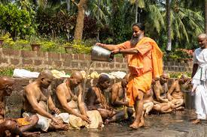
Hacking the stress system: the stress response as an adaptive trait that can work for or against you
IV - On the intersection between culture and stress

Slide 2
Life-threatening and social stress
Acute life threatening stress
Fight or flight response
Social stress
Social standing and position in the hierarchy
Challenges to reproductive success

Slide 3
How our stress differs from most other mammals I: Anticipation
If you can turn on the stress system before a stressor arrives, you are even quicker.
Hyperactive Agency Detection
Its better to get scared a 100 times for nothing, than not have a stress response when you really need it.
Theory of mind
The anticipation of intention
5th degree
Lisdorf, A. (2004). What’s HIDD’n in the HADD?–A cognitive conjuring trick? Birot.Hu, (January 2006), 5–7. https://doi.org/http://dx.doi.org/10.1163/156853707X208549
Bering, J. M. (2002). The existential theory of mind. Review of General Psychology, 6(1), 3–24. https://doi.org/10.1037//1089-2680.6.1.3

Slide 4
How our stress differs from most other mammals II: perception
We have a strong tendency to stress over perceived inadequacies rather than real ones
Beauty ideals
Happiness & success
Social media
Frank, R. H. (2016). Success and luck: good fortune and the myth of meritocracy. Princeton, Oxford: Princeton University Press.
Lin, R., & Utz, S. (2015). The emotional responses of browsing Facebook: Happiness, envy, and the role of tie strength. Computers in Human Behavior, 52, 29–38. https://doi.org/10.1016/j.chb.2015.04.064
de Lima Bastos, P. A., & Pessoa, R. R. (2019). A discussion on english language students’ body image: Beauty standards and fatness. Profile: Issues in Teachers’ Professional Development, 21(1), 13–26. https://doi.org/10.15446/profile.v21n1.69603

Slide 5
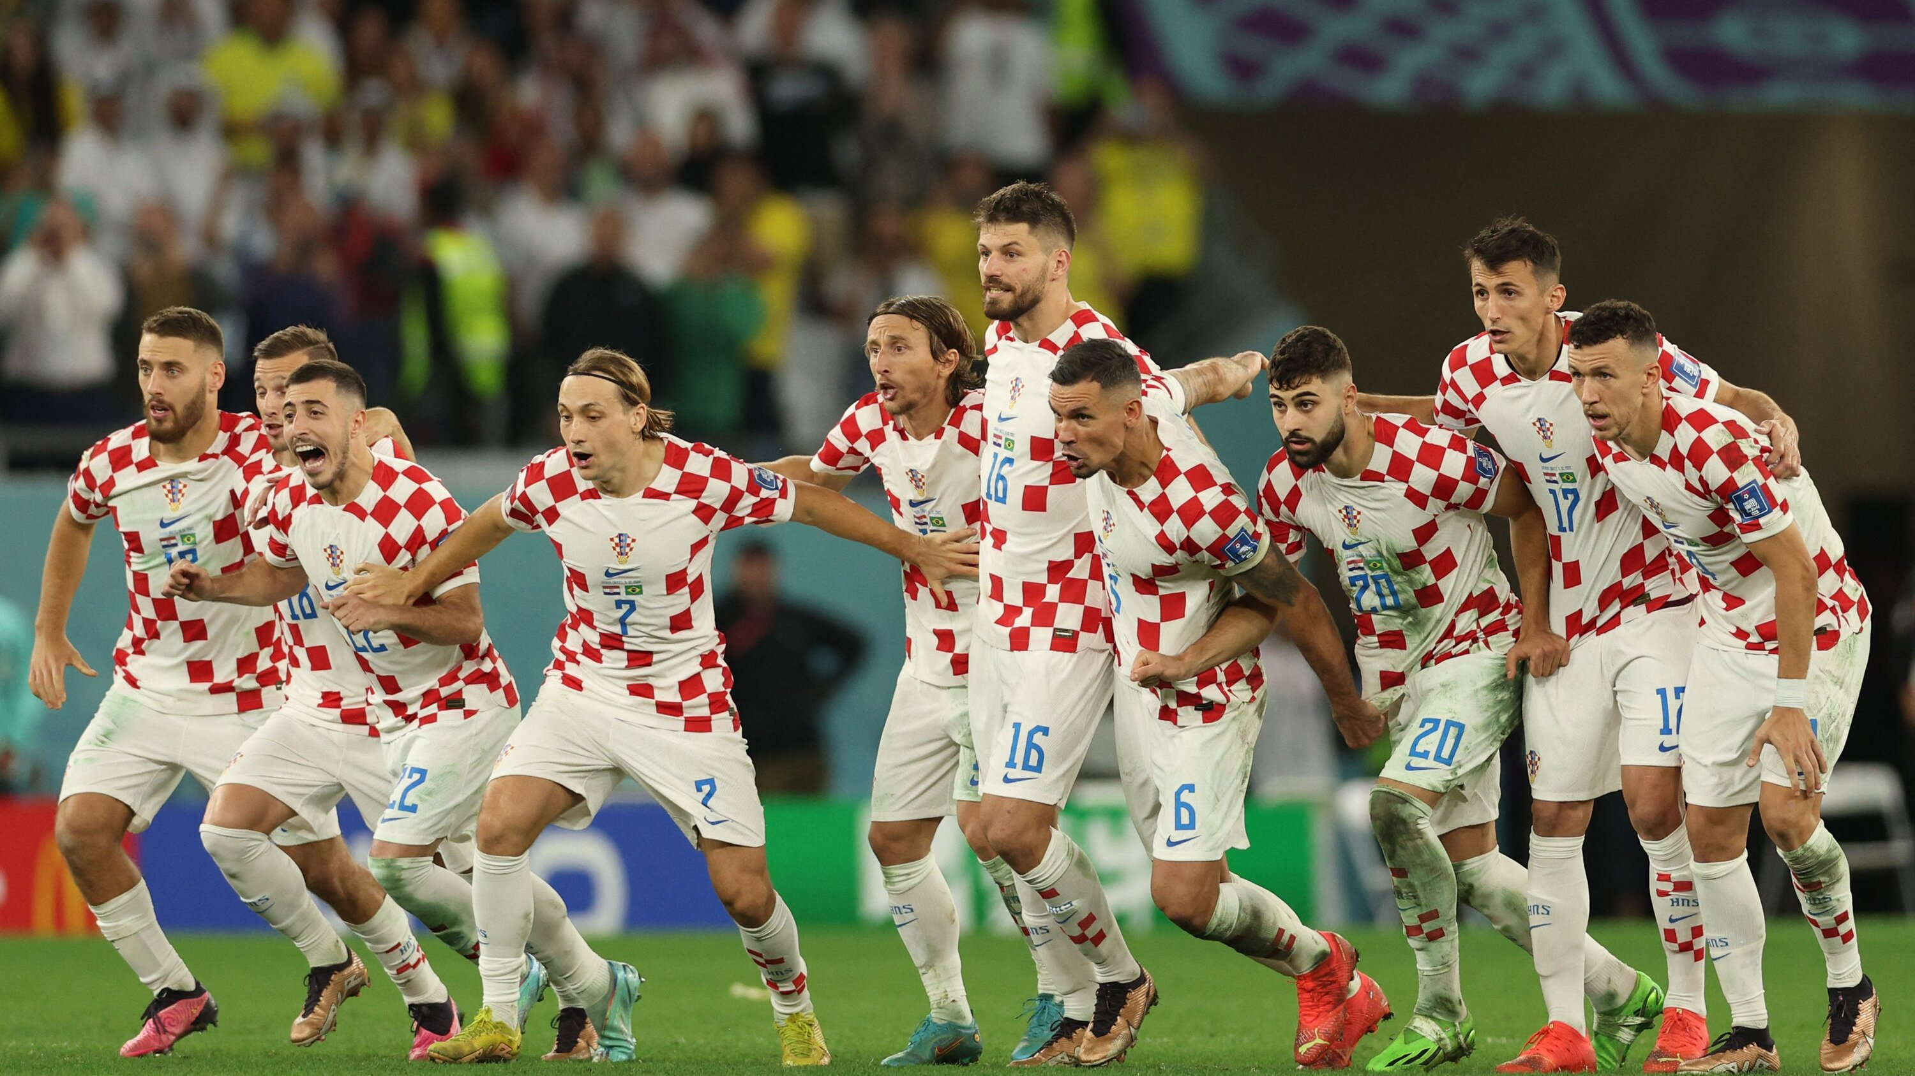
Retrospective stress appraisal: did we win?

Slide 6
How our stress differs from most other mammals III: Duration
We turn on the stress system for much longer than any other animal
Many of the stress related problems we know derive from this ability to be stressed for much longer than any other animal

Slide 7
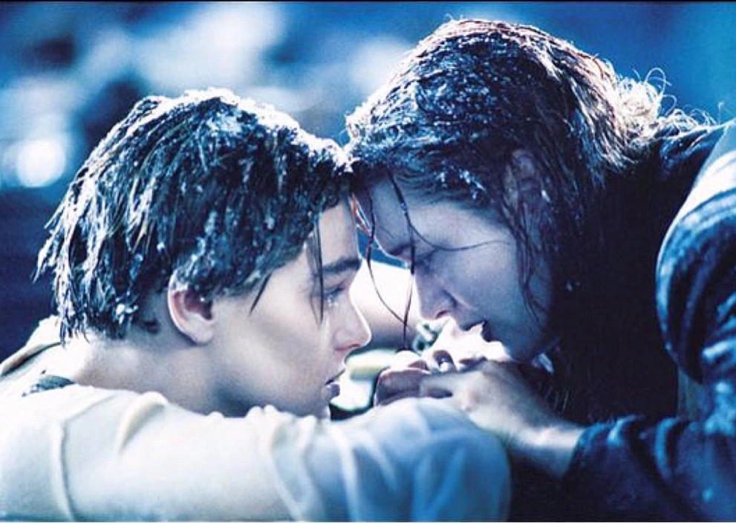
How our stress differs from most other mammals IV: Projection
We have the unique ability to project our stress on other beings
Other people, even those we do not know
Animals
Fictional characters

Slide 8
Agriculture, population growth and specialisation
You need a food surplus for some to specialise in other fields than food production.
Political class
Religious class
Warrior class
Problems with population growth and available land
Who inherits?
What do you do with the rest?

Slide 9
Culture as an emergent property of circumstance
What we eat
Where our culture develops

Slide 10
The cortex & in-group function.
Dunbar’s number (+/- 150)
Larger groups require
Formal leadership
Codified barter
Dunbar, R. (2010). How Many Friends Does One Person Need? Cambricge: Harvard University Press.

Slide 11
Culture and social support
Growth, support and initiation
How much time does mom invest in you in your first days
How strong are the social bonds in your group
Pourmand, V., Lawley, K. A., & Lehman, B. J. (2021). Cultural differences in stress and affection following social support receipt. PLoS ONE, 16(9 September), 1–17. https://doi.org/10.1371/journal.pone.0256859
Francis, D. D., & Meaney, M. J. (1999). Maternal care and the development of stress responses. Current Opinion in Neurobiology, 9(1), 128–134. https://doi.org/10.1016/S0959-4388(99)80016-6

