Slide 1
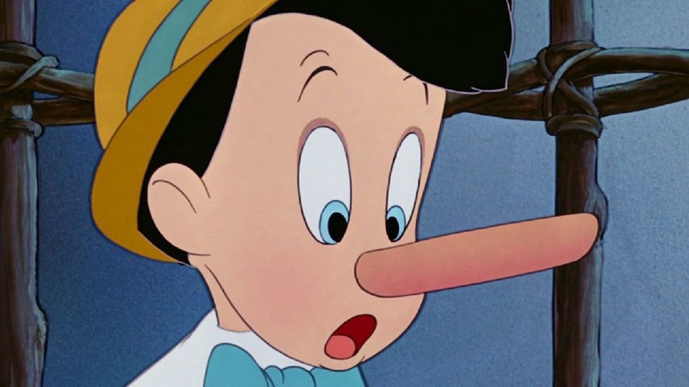
Hacking the stress system: the stress response as an adaptive trait that can work for or against you
VII - On the psychology of lying, deceit, and how stress makes it all much worse

Slide 2
What does it mean to be human?
Are people naturally good, but situationally bad?
  Soul
  Rooted in traditional religious perceptions of human nature
Are people naturally geared towards their perceived optimisation of returns on investment? This may mean:
  Selfishness, dishonesty and betrayal
  But it may just as well mean in-group loyalty, friendship, altruism and kindness
  Moreover, sometimes lies serve the in-group, ethics and humanity

Slide 3
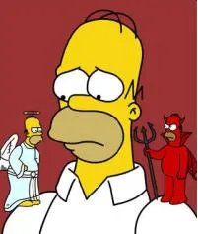
What does it mean to be human?
I: The traditional view
People are naturally good, but situationally bad?
  Mind – body division
    Soul, higher self, etc.
  Rooted in traditional religious perceptions of human nature

Slide 4
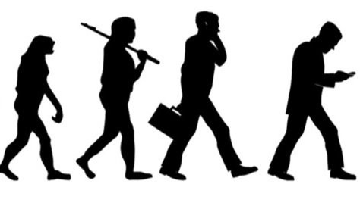
What does it mean to be human?
II: The evolutionary perspective
A behaviour, regardless of value judgements on its morality, must advance, or in the very least not hamper, the proliferation of the organisms genes in the next generation.
  Promoting survival
  Promoting reproduction
  Promoting the survival of offspring
Lying, and other forms of questionable behaviour, can thus be highly adaptive, if it furthers these evolutionary aims.
Ekman. (2009). Telling lies. New York, London: W W - Norton & Company.

Slide 5
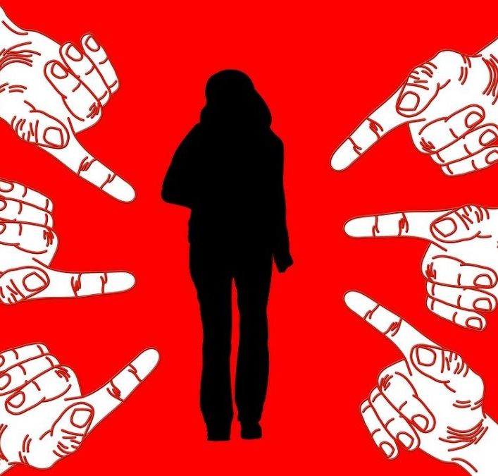
So, why would we lie?
To conceal unpleasant information about ourselves
  Misbehaviour
  Stigmatisation
    Dyadic cooperation
    Parasite avoidance
    Coalitional exploitation
For material or social benefit
To avoid discomfort in others (white lies)
Piazza, J., & Bering, J. M. (2010). The Coevolution of Secrecy and Stigmatization. Human Nature, 21(3), 290–308. https://doi.org/10.1007/s12110-010-9090-4
Mac Gillavry, D. W. (2018). Rethinking Secrecy in Religion: Cognition and the Intimacy of Secrecy. Method & Theory in the Study of Religion, 30(4–5), 301–320. https://doi.org/10.1163/15700682-12341430

Slide 6
Types of deceit
Fabrication
Omitting information (not providing crucial information)
Secrecy (concealing information while not concealing its existence)
Self-concealment (concealing both the information and its existence)
Ekman. (2009). Telling lies. New York, London: W W - Norton & Company.
Mac Gillavry, D. W. (2018). Rethinking secrecy in religion cognition and the intimacy of secrecy. Method and Theory in the Study of Religion, Vol. 30, pp. 301–320. https://doi.org/10.1163/15700682-12341430

Slide 7

Two competing theories
Truth Default Theory
  We speak the truth because it is harder to lie.
Information Manipulation Theory 2
  It is only easier to be truthful under neutral circumstances.
  Once you enter in a stressor, deceit may be the easier option
McCornack, S. A., Morrison, K., Paik, J. E., Wisner, A. M., & Zhu, X. (2014). Information Manipulation Theory 2: A Propositional Theory of Deceptive Discourse Production. Journal of Language and Social Psychology, 33(4), 348–377. https://doi.org/10.1177/0261927X14534656
Levine, T. R. (2014). Truth-Default Theory (TDT): A Theory of Human Deception and Deception Detection. Journal of Language and Social Psychology, 33(4), 378–392. https://doi.org/10.1177/0261927X14535916

Slide 8
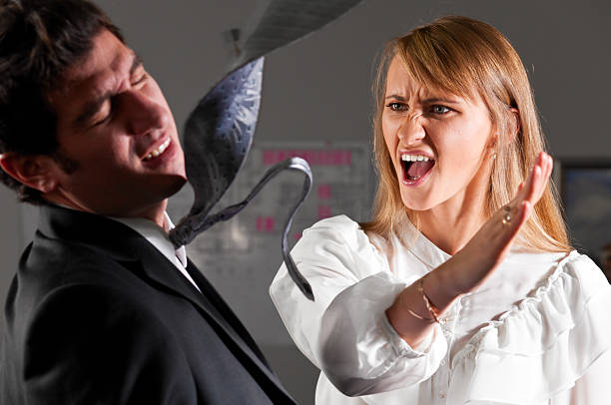
What happened here?

Slide 9
It is all about perception! The ad hoc decision on the better choice. When stressed, tired, hungry, etc. we are more likely to opt for solutions which provide immediate relief.
Speed over accuracy!

Slide 10
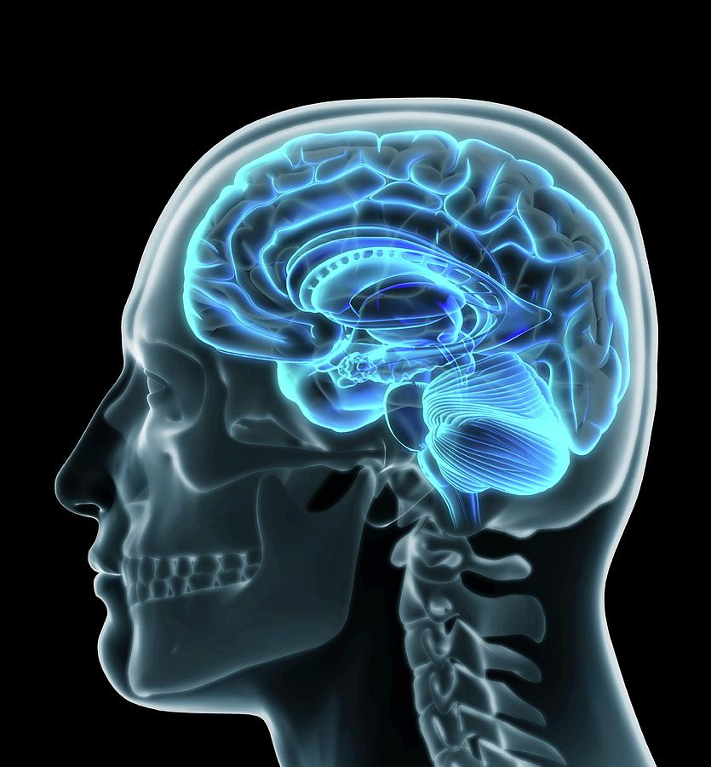
Processing stress stimuli: the hardware
A stimulus is detected by one of our senses
The amygdala relays signals if the stimulus is threatening
  Locus coeruleus (Norepinephrine)
  Hypothalamic adrenal axis (Cortisol)
  Ventral tegmental area (Dopamine)
  Medial prefrontal cortex

Slide 11
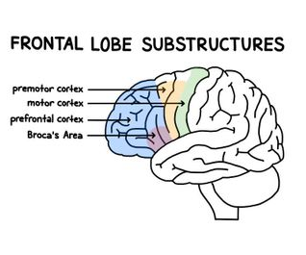
The frontal cortex and lying
Stress makes people lie (avoid confrontation / focus at personal needs)
Your frontal cortex keeps you from doing so, but when you do, it will make sure you will do so well.

Slide 12
However, if lying does take effort (even if it may seem less than facing up to the truth) …
There should be observable physical and psychological signs of deceit
  Stress related indicators
    Increased heart-rate
    Increased skin conductivity
    Calming behaviours (signifiers)
  Masking behaviours
    Micro-expressions
    Freudian slips
Ekman. (2009). Telling lies. New York, London: W W - Norton & Company.

Slide 13
Careful though: Many tells are stress related and, consequently, they may indicate deceit. They may however also be indicative of the stressful stimuli (being interrogated, being disbelieved, etc.)

