Slide 1
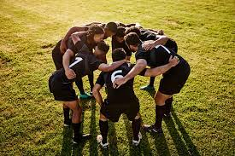
Hacking the stress system: the stress response as an adaptive trait that can work for or against you
IX - Lifestyle and stress II: Sport & Social connections

Slide 2
How exercise affects the stress response
Exercise enhances
Mood
Energy
Memory
Attention
A single workout can raise dopamine, noradrenaline and serotonin for at about 2 hours
Repeated exercise
neuroplasticity
Hippocampus (memory)
Frontal cortex (attention)
Brain health
Suzuki, W. (2017). The brain-changing benefits of exercise.
Basso, J. C., Shang, A., Elman, M., Karmouta, R., & Suzuki, W. A. (2015). Acute Exercise Improves Prefrontal Cortex but not Hippocampal Function in Healthy Adults. 791–801. https://doi.org/10.1017/S135561771500106X
Basso, J. C., & Suzuki, W. A. (2017). The Effects of Acute Exercise on Mood , Cognition , Neurophysiology , and Neurochemical Pathways : A Review. 2, 127–152. https://doi.org/10.3233/BPL-160040

Slide 3
Hippocampal neurogenesis
Brain Derived Neurotropic Factor (BDNF)
2 pathways through which exercise stimulates BDNF
Myokine (muscle released protein); exercise increases levels and permutation of the blood brain barrier
Beta-hydroxybutyrate (a ketone released by the liver during exercise
Suzuki, W. (2017). The brain-changing benefits of exercise.
Basso, J. C., Shang, A., Elman, M., Karmouta, R., & Suzuki, W. A. (2015). Acute Exercise Improves Prefrontal Cortex but not Hippocampal Function in Healthy Adults. 791–801. https://doi.org/10.1017/S135561771500106X
Basso, J. C., & Suzuki, W. A. (2017). The Effects of Acute Exercise on Mood , Cognition , Neurophysiology , and Neurochemical Pathways : A Review. 2, 127–152. https://doi.org/10.3233/BPL-160040

Slide 4
Completion between individuals vs completion between groups

Slide 5
Competition between individuals
Internal struggle between individuals within the group
Struggle over excess to mates, recourses and position in the social hierarchy
In its core, egocentristic
Testosterone (its not aggression!!)

Slide 6
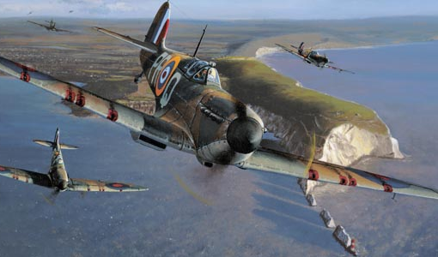
Intra-group conflict as a backdrop for inter-group competition
Inter-group competition can, and often does, involve efforts to outdo one another in the extend to which victories are gained against otherwise anonymous members of targeted outgroups.

Slide 7
Intra-group competition
In-group coordination
Teamwork
Cooperation
Leadership
Group-identity

Slide 8
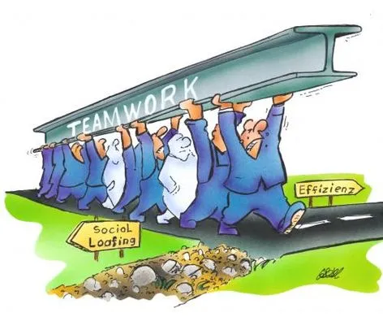
Costly signalling and the free rider problem
Humans are extremely vulnerable alone but united, we dominate almost any environment we enter.
Teamwork serves the group
But abstaining from cooperation, while reaping the benefits of the team effort serves the individual most
Groups need to control for free riding
Costly signalling
Hard to fake
Sosis, R., & Bressler, E. R. (2003). Signaling Theory of Religion. CrossCultural Research, 37(2), 211–239. https://doi.org/10.1177/1069397103251426
Dunbar, R., Barrett, L., & Lycett, J. (2007). Evolutionary Psychology.
Sun, S., Johanis, M., & Rychtář, J. (2020). Costly signalling theory and dishonest signalling. Theoretical Ecology, 13(1), 85–92. https://doi.org/10.1007/s12080-019-0429-0

Slide 9
Leadership, the great undefinable !
A minimum of 66 different theories on leadership in the expert literature
Massive methodological issues in the field
The main problem
Philosophical reflection upon phenomenological observations of behaviour in search of universal tendencies
Ethics?
Transformation?
Service?
Alvesson, M., & Kärreman, D. (2016). Intellectual Failure and Ideological Success in Organization Studies: The Case of Transformational Leadership. Journal of Management Inquiry, 25(2), 139–152. https://doi.org/10.1177/1056492615589974
Atwater, L. E., Mumford, M. D., Schriesheim, C. A., & Yammarino, F. J. (2014). Retraction of leadership articles: Causes and prevention. Leadership Quarterly, 25(6), 1174–1180. https://doi.org/10.1016/j.leaqua.2014.10.006

Slide 10
Leadership: an evolved behavioural solution to a specific problem
Coordinated action
Leadership can only exist, where there is a problem to be solved, i.e. a stressor.
Leadership effectively modulates stress reactions
The range of human crises, which require communal action, is so large, that it is not feasible that one behavioural action can produce effective leadership in all cases.
Observable behavioural and physiological changes in followers
Context related behavioural and physiological changes in leaders

