Slide 1
The Theory of Sport Training
Lesson 6
Speed and Strength

Slide 2
Strength
It is the strength ability …
The tasks of strength training:
- general bodybuilding, stabilize the muscle apparatus for well-being, health, fitness
- injury prevention and rehabilitation
- cosmetic training – visage, appearance
- development of performance for competitive sport

Slide 3
Strength
Precondition of good strength ability
- coordination of working muscles
- coordination of working and opponent muscles
- size of the muscles cross-sectional area
- the number of fibres recruited to the work
- energy system
- quality of neural system and neuromuscular system

Slide 4
Strength
Biomechanical preconditions:
- affectivity of muscular work
- place of the muscle tendon attachment (fixing) to the bone
- difference between short and long muscles for resistance activity

Slide 5
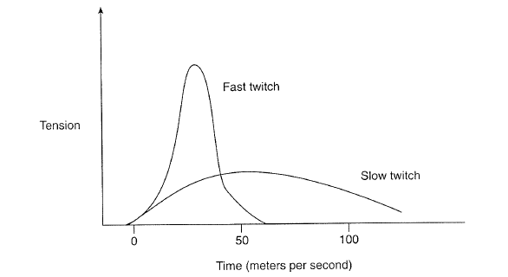

Slide 6
Type of contraction
Concentric – shortening of the muscle
Eccentric – lengthening of the muscle
Static or isometric – the change of the force without the change of muscle length
Isokinetic – constant velocity movement, the change of force size

Slide 7
Strength development
General strength – basic anatomical adaptation, preparation for specific training
Specific strength – typical for every sport, games, the development of specific muscles groups important for given sport, games , specific dynamic characteristic and time of load

Slide 8
Type of strength
Along the size of weight, speed of motion and time (number of repetition) of physical activity
Maximal strength
Dynamic, explosive strength
Speed strength
Strength – endurance
Relative strength

Slide 9
Strength training and muscular adaptation
Anatomical adaptation
- increase the oxidative capacity of ST
- strengthen tendons, ligaments and joints
- increase the bone mineral content
- proliferation of connective tissue that surrounds the individual muscle fibres.
The aim: progressive adaptation of the athlete body for demanding training

Slide 10
Strength training and muscular adaptation
Hypertrophy
- increase of cross-sectional area of muscles
- increase storage capacity for high-energy substrates and enzymes
- hypertrophy – fast and slow fibres

Slide 11
Strength training and muscular adaptation
Maximal, submaximal strength:
- depend on the diameter of cross-sectional area
- capacity recruit fast twitch fibres
- ability to synchronize or simultaneously call into action all primarily involved muscles in right moment

Slide 12
Strength training and muscular adaptation
Conversion (transfer)
-depend on sport – type of muscular work, level of resistance
- must include movement pattern, force
production, velocity consideration
- conversion to the power

Slide 13
Principles of strength training
Train movements, not muscles
Train core strength before extremity strength
Build strength from the bottom up
Incorporate movements, that enhance linkage among the all joints
Sensibly vary the mode and the load
The systematic, intensive and regularly strength training can start after maturity

Slide 14
SPEED
It is the speed ability….
Very hereditary determined
Factors which determined speed:
- genotyp , somatotyp, composition of the muscle, ability to use the energetic source, neuromuscular work,

Slide 15
Speed
Factor which affects the results of speed during performance:
- frequency
- strength
- technique (coordination)

Slide 16
Biology base of preconditions
CNS
- the quality of neural system, primarily – irritation, the velocity of irritation conduction, velocity of information transfer and control of neural-muscular activity
- intramuscular coordination

Slide 17
Biology base of preconditions
Muscle system:
the length of muscle tissue and fascias, number of sarcomas , and the angle of the muscle tissue under which are fasten to the bone
high rate of FG and the ability of very quickly change of tension and release (70-80%)
FOG are important for speed endurance
Optimal rate of flexibility for realization of the technique in full range of demanding movement

Slide 18
Biology base of preconditions
Energy system
High store of CP for resynthesis ATP and partly the store of carbohydrates
Psychological preconditions:
Image about right movement – idea about the course of movement
High ability of concentration
High emotional stability

Slide 19
Characteristics of fast – twitch tissue
Fast to fatigue
They are innervate from large nerve cell- and can innervate from 300 to more than 500 muscle fibres
Develops short, forceful contractions
Recruited only during high – intensity work

Slide 20
Type of speed
Speed of reaction and speed realization of the movement
Cyclic or acyclic
Linear or nonlinear (multidimensional)

Slide 21
Reaction
Type of reaction
- simple
- selective
50-60% of hereditary conditioned
Training can improve reaction time by about 30 %
The kind of stimuli:
- visual – reaction time of athletes 0,15 – 0,3 s
- auditory -0,07 – 0,15 s
- kinaesthetic – 0,1 – 0,15 s

Slide 22
Linear speed
Sports?
Concept of training- from point of speed
- start - reaction, absol. and explosive strength
- acceleration – dynamic strength, power
- max. speed
- speed maintenance

Slide 23
Multidimensional speed
Sports?
Agility, quickness
Factors – perception, decision, dynamic strength, speed, coordination, ability to change direction and speed- connected with balance
Concept of training:
- coordination, technique, reaction,
- max. speed
- quick change of direction, change of speed, high
variability of movement
- dynamic strength, max. strength

