Slide 1
The Theory of Sport Training
Basic Principles
LESSON 2
The Aim of the ST
Structure of Sport Performance

Slide 2
The kinds of sports
Racing, competitive sport (children, youth, adults, recreational, second level performance sport, top sport…)
Sport for health
Sport of disable people

Slide 3
The aim of the ST
Two ways of ST process:
- ST for keeping or improving the health state
- ST as a training process for competitors, for
improvement of performance

Slide 4
The aim of the racing ST
The aim of racing, competitive sport
To reach the individual highest performance in chosen sport or discipline with the help of universal development of athlete
The task of ST
- to learn technique skills and ability to use these
skills during competition
- the development of motor abilities during fitness
preparation
- the development of mental side of athlete

Slide 5
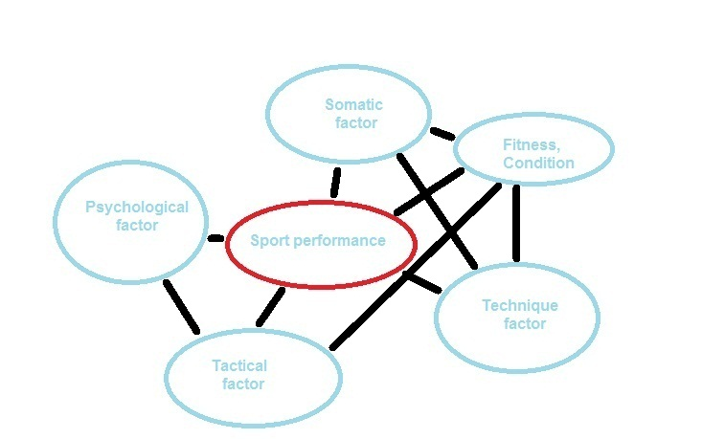
Structure of Sport Performance

Slide 6
Somatic factor
Building of body
– external appearance of athlete (somatotyp),
anthropometric dimension – H, W, Length of
extremities
- composition of body – internal environment
Factor of technique
The ability to learn new movement structure and use its during competition

Slide 7
Fitness, condition factor
Precondition to realize movement, motor abilities
Tactical factor
The ability to use the experience and knowledge to gain advantage over opponent
Psychological factor
The development of individuality, social abilities etc.

Slide 8
Classification of the SP
Speed – strength performance
Aesthetic – technical performance
Endurance performance
Games
Combat sports
The sport performance connected with the handling of some apparatus, animal or sport equipment
Sensorymotor performance

Slide 9
Speed – strength performance
Sports ?
The aim: get over the distance as fast as possible, take the highest, longest jump, lift the most weigth barbell
Motor abilities – strength, speed, co-ordination
Motor skills – simple structure, locomotion, (cyclic, acyclic, combined), the number of skills- small, variability ???
Physiology – great energy cost during short time, nBM – 10 – 30000%
Psychology – big concentration of volitional effort in short time

Slide 10
Aesthetic – technical performance
Sports ?
The aim: solution of difficult movement task
Motor ability: co-ordination, flexibility, strength, speed,
Motor skills: great number of skills with difficult structure, variability ???
Physiology: not very high energy cost, aer-anaer. metabolism, load – middle, nBM – 2 – 5000%
Psych. –creativity,

Slide 11
Endurance performance
Sports?
The aim: get over the given distance in shortest time
Motor ability: endurance, strength
Motor skills: small number, structure simple , variability ???
Physiology: middle energy cost per minute, but total cost during the whole time of race is enormous
2-5000% nBM, aer. metabolism,
Psych: long term volitional effort and concentration, get over fatigue, persistence of effort

Slide 12
Games, collective sport performance
Games??
The aim: get over active opponent
Motor ability: all
Motor skills: high number, structure – very complicated, variability high
Physiology: load middle and changing, aer-anaer.metab., 1 – 2000% nBM
Psych: creative tactical thinking, team motivation (team spirit), anticipation, accept the social rule of team

Slide 13
Combat sports, individual sports
Sports ?
The aim: get over active opponent
Motor ability: all
Motor skills: great number, structure – very complicated, variability ???
Physiology: small to high energy cost, 400-1500%nBM, aer- anaer. metabolism
volitional activity, the ability get over pain, control of aggression, decision under deficit of time, anticipation

Slide 14
The sport performance connected with the handling of some apparatus, animal or sport equipment
Sports ?
The aim: get over distance, optional exercise in shortest time
Motor ability: all
Motor skills: from low to very high number, structure – very various, variability ?
Physiology: energy cost 500-1000% nBM, most aer. than anaer. met.
Psych: decision under time deficit, get over the fear, scare, courage, risk, danger, solve the unexpected problems

Slide 15
Sensorymotor performance
Sports ?
The aim: the most accurate hit of the target
Motor ability: co-ordination
Moto skills: small number, structure simple, variability???
Physiology: energy cost low, 400-700% nBM,
Psych: high level of concentration,

