Slide 1
Cognitive Hiking and Cycling
ep901 Physical Education
Sylva Hřebíčková
hrebickova@fsps.muni.cz
+420 777 079 582 (SMS)

Slide 2
Autumn 2011
Hiking
3 one-day trips
Outdoor clothing and boots (5-15°C) something to eat, money
starting time and location will be confirmed by mail
What you learn:
  prepare a tourism event
  explore 3 folders of tourism
  navigate in unfamiliar terrain using maps and GPS
  evaluate tourist event
date
  28.9. Veveri castle
  7.10. Punkva caves
  14.10. Lednice + Valtice (UNESCO)
Next info
By e-mail, Educational Materials (in IS)
http://www.jizni-morava.cz/

Slide 3
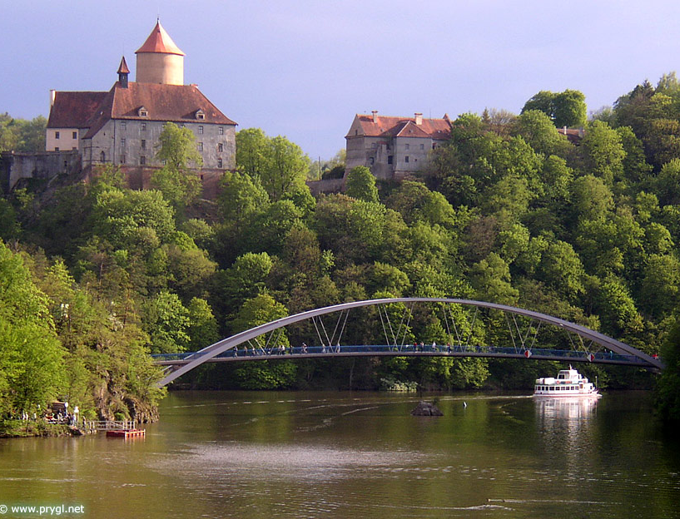
Trip 1 – Castle Veveri
28.9.2011
Start at 9:00
(dock Brno Dam)
20km walk
price: individual max 200,-
http://www.veveri.cz/
http://www.prygl.net/

Slide 4
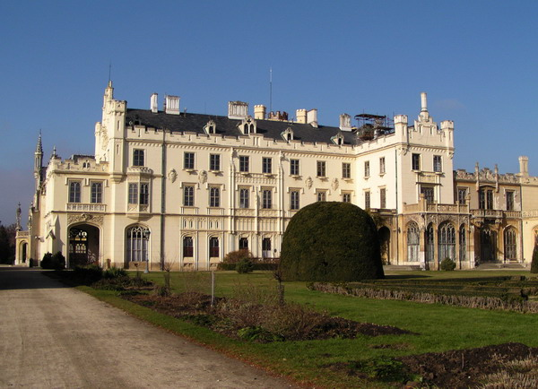

Trip 2 – Lednice and Valtice area
14.10.2011
Start: central railway station
Time (? Specification by e-mail)
Tour - castle 60min.
price: 200,- Kč
UNESCO
http://www.lednicko-valticky-areal.cz/

Slide 5
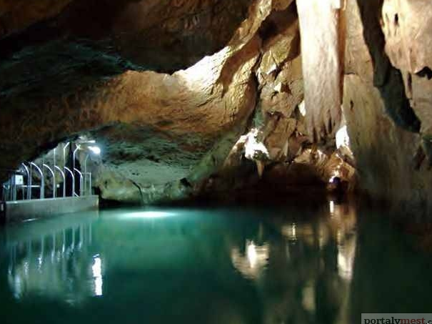
Trip 3 – Punkva cave
21.10.2011
Start: central railway station
Time (? Specification by e-mail)
Tour 1250m 60min.
price: 200,- Kč
warm clothing !!
http://www.punkevni-jeskyne.cz/

Slide 6
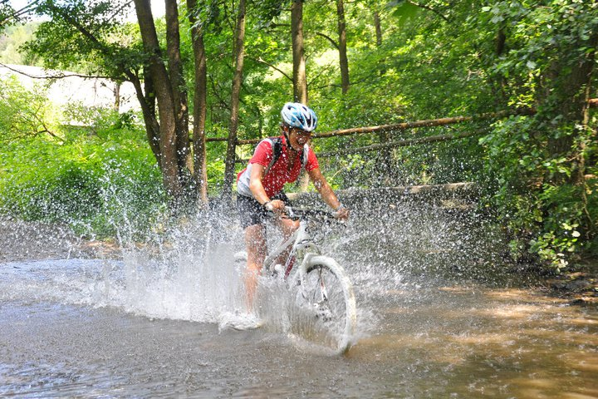
Spring 2012
3 trips by bike neighborhood Brno
Mountainbike
Terrain
Info by e-mail

