Slide 1

Theory of Martial Arts
(and Combat Sports)
UNIWERSYTET RZESZOWSKI
Dr hab. Wojciech J. Cynarski
Prof. of the University of Rzeszów, Rzeszów (Poland)
Visiting Professor at the Masaryk University in Brno (Czech Rep.)
e-mail: ela_cyn@w.pl

Slide 2
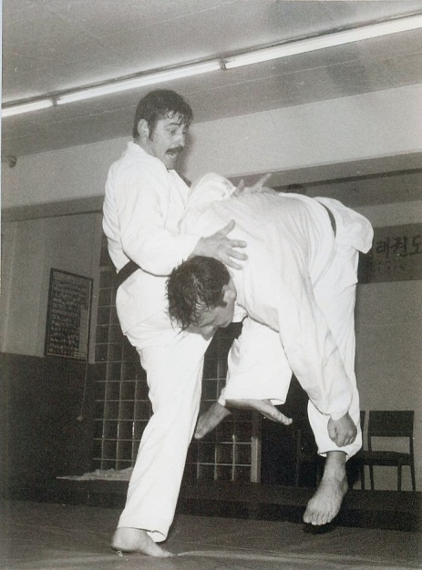
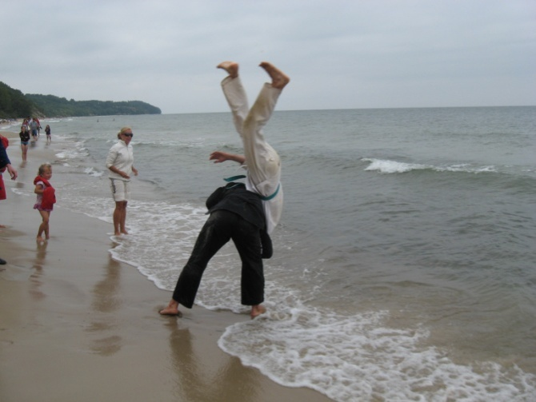
Introduction
a state of knowledge in MA & CS
lecture in 7 thematic parts
key words: martial arts, combat sports, fighting arts, theory, terminology, connections

Slide 3
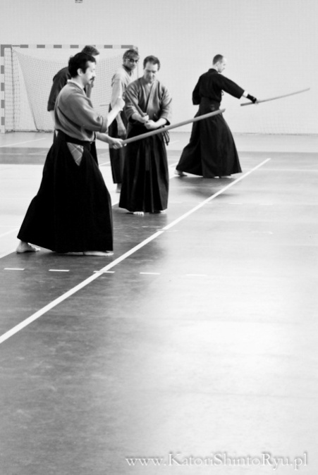
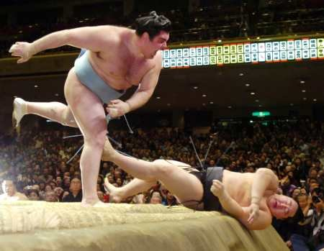
I. Theories and proposals for terminology
Hoplology – D.F. Draeger et al.
Theory of Combat Sports - Roman M. Kalina [2000]
American anthropology of martial arts - David E. Jones [2002] et al.
Martial arts as performance art [Klens-Bigman 2002]
The human motricity concept / application – Abel A. Figueiredo [2009]
The logic of fighting / combatology – Keith R. Kernspecht [2011; Brizin, Kernspecht 2014]

Slide 4
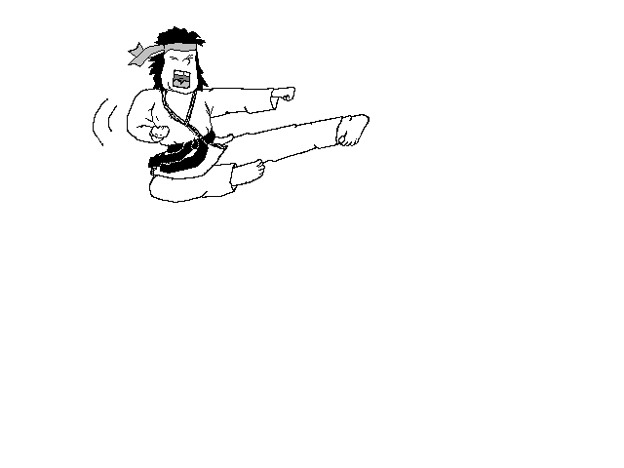
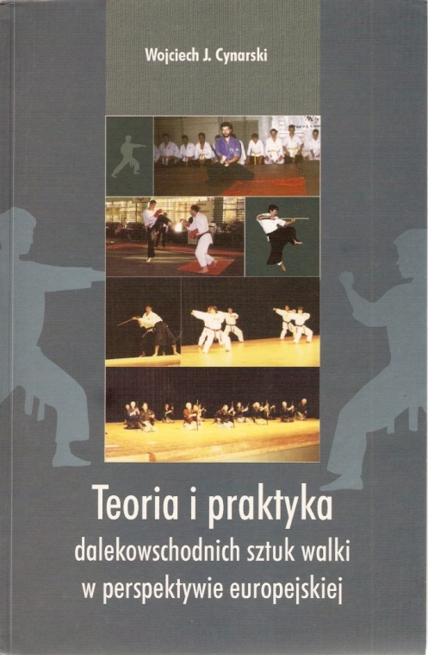
I.1.Towards a General Theory
Humanistic Theory of Martial Arts [Cynarski 2004]
The holistic anthropology of martial arts, as a general theory [Cynarski 2012]
A General Theory of Fighting Arts [Cynarski, Sieber 2012] or a General Theory of Combat [Brizin, Kernspecht 2014] ?
Problem with general names / terminology
”combative disciplines“ [Lee-Barron 2011]
”combatives“ [Reguli 2009]
”oriental sports“ [Raimondo 2007] (putting martial arts, combat sports or e.g. yoga and qigong to one section)

Slide 5
Definitions
martial arts, are (according to the Humanistic Theory of Martial Arts) a historic category of flawless methods of unarmed combat fights and use of weapon combined with spiritual element (personal development, also in transcendent sphere) [Cynarski 2004]
The term “fighting arts” combines the skills, forms or fighting behaviour, which are mistakenly called martial arts by anthropologists and hoplologists. The term describes also self-defence and other combat sports, training programmes within this scope etc.
Ways of martial arts are included in these two term ranges – psychophysical training systems and fighting arts. The ways as educational systems, however, move beyond the field of sports and fighting understood as a direct confrontation of power. Their numerous properties that are not only technical or physical should also be considered.
Area for the general theory of fighting arts
Apart from anthropology aspects (humanistic and cultural) it undoubtedly should refer to fighting skills. We shall differentiate, as in case of art of war, the grand theatre. It should embrace the strategy of conducting war, tactics, the ability to win the battle and conquer the fortifications. The middle range, on the contrary, embraces the use of long range weapons – in the past, there used to be bows and crossbows. And finally, a small theatre refers to the battle between groups or a fight of one against a group (various self-defence situations) as well as one-to-one fights.

Slide 6

UNIWERSYTET RZESZOWSKI Faculty of Physical Education, University of Rzeszów
Tab. 1. What makes difference between martial arts and combat sports?
Criterion | Martial Art | Combat Sport
Goal of practicing/training | Widely understood perfectionism, self-realization | Winning in competition, sport result
Sense of fight | As above or victory in self-defence | As above: fighting the opponent
Sense of mastery | Master-level skills, knowledge and moral maturity; state of harmony of body, mind and spirit, formally confirmed high levels. | Winning the title of e.g. world champion, master sport class, medals in the Olympic Games, high level of skills in a particular sport discipline
Means and Methods of training | Traditional and modern methods and means, teaching real technical and tactical skills and moral education | Modern training oriented towards sport result
Source: authors own study [Cynarski 2011]

Slide 7
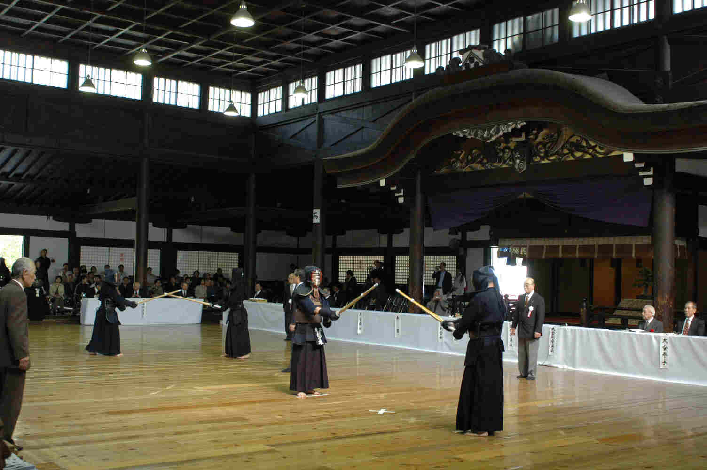
Skills of fighting
The warrior should be able to use: 1) cold steel of different lengths and construction, including staff weapon as well as flail and clubs; 2) weapon of longer range (throwing, hurling weapons, rope, chain weapon etc.); 3) short-range weapon (small weapons e.g. knuckleduster); 4) unarmed fighting – the use of one’s own body.
The art of self-defence (Jap. goshinjutsu) is a derivative of fighting arts. It has been changing throughout the years together with the modifications of threats in social life.
self-defence - “technical and tactical skills to avoid or fend off an attack and neutralize the attacker/s” [Cynarski, Skowron 2014]
A success in fight depends on preparation: technical and tactical, physical, mental, and knowledge, and experience.

Slide 8
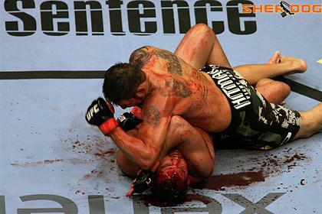
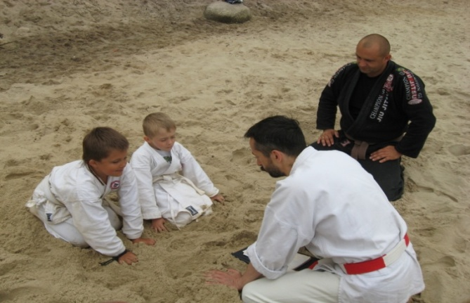
Combat sports are derivative of fighting skills of East and West and elements of sports competition.
MMA (mixed martial arts) training programmes and practicing these modern types of gladiatorship (MMA shows), which do not fit martial arts category and describing them as sports arouses serious doubts, also can be defined as a neutral “type of combat”.
Genuine martial arts (Jap. bujutsu ryūha, koryū, kobudō, sōbudō) teach more skills than fighting. These are schools of character, whole educational systems. They involve teaching a particular knowledge, including practical medicine.

Slide 9
In combat sports of Asian origin we also have a problem with training. That progress can be found on five subsequent stages of training, analysed in long-term perspective:
1.General development and free time activity,
2.Basic training (about 3 years),
3.Aufbau – (building special skills) – 3 years,
4.Anschluss-Training (combining skills) – 3–4 years,
5.Professional training – about 10 years.
6.Period after training – the time of lowering fitness activity [Renninghoff, Witte 1998: 31]
The general theory of fighting arts should also embrace the methodology of movement activities, methods of training (traditional and modern ones), forms of physical activities organisation etc. Teacher training in Germany (DDBV) involves a subject called Stilkunde which includes basic information about theory of training and methodology of teaching.
Kinds of tactical preparation
Tactics in self-defence and in fighting differs from tactics in combat sports, which is adapted to particular sports regulations. There are, however, suggestions common for different fighting arts. These include: 1) purposefulness and rationality of activities, economical and planned way of conducting fights; 2) assessment of situation – who is an opponent, his strong and weak sides and conditions of confrontation; 3) self-assessment of one’s own abilities (predispositions and skills) and adapting them to the situation.
Sports tactics, on the contrary, requires taking a person’s and opponent’s potential into consideration as well as the regulations of a given sports discipline and competition.

Slide 10
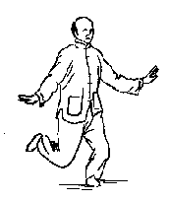
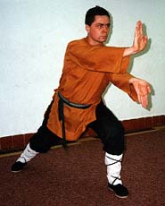
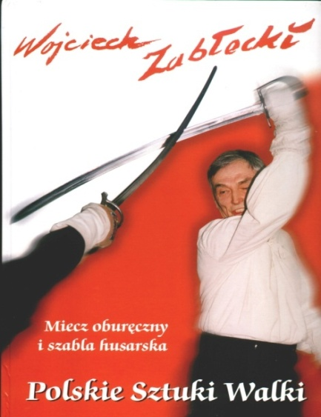
I.2. On real fighting
In real fight one should take into consideration the following factors: number of opponents, their weapons, terrain conditions (space, ground, lighting), the ability to use some objects for protection or calling help. There is a limited amount of time for reconnaissance and planning.
A well-trained warrior should be able to fight with a simple stick, an umbrella, a walking stick or any other object. For instance, an arm wrapped in a jacket or a coat can be used for protection and blocking knife stabbing.
If the opponent is unknown to us, ...
A more versatile warrior ...
Breathing, distance, rhythm and timing
Style of fighting

Slide 11
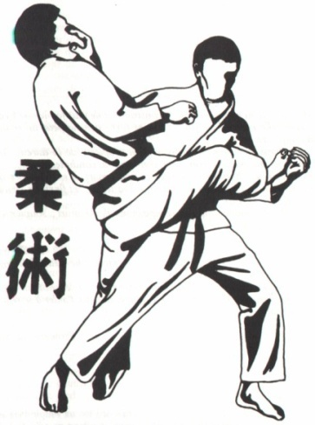
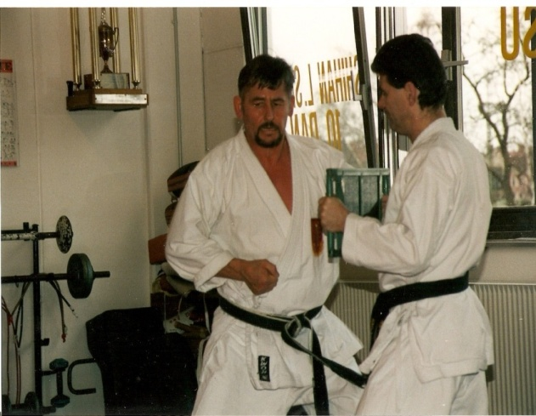
I.3. Definitions of other basic terms
The Highest Technical Degree (HTD) – the highest master degree, which requires passing a practical exam.
The specific ontogeny of a martial arts’ adept, towards a mastery
Ontogenetic way of budō – it is – the process of the psycho-physical practice, which is practising budō. “’Ontogeny of budō’ is the specific ‘sports biography’ of a man of martial arts. It is more a way of growth of skills and knowledge, moral progress and spiritual improvement than physical, personal development throughout its life cycle, taking into account biological and environmental conditions” [Cynarski, Skowron 2014].
E.g. uchi-deshi (internal student) with the traditional teaching and knowledge transfer 'from heart to heart' – ishin-den shin.
The menkyō kaiden license confirms that the student mastered the entire programme of teaching.

Slide 12
I.4. Particular theories or philosophies
“Budō, the martial ways of Japan, have their origins in the tradition of bushido – the way of the warrior. Budō is a time-honoured form of physical culture comprising of jūdō, kendō, kyūdō, sumō, karatedō, aikidō, shōrinji kenpō, naginata and jūkendō. Practitioners study the skills while striving to unify mind, technique and body, develop his or her character; enhance their sense of morality; and to cultivate a respectful and courteous demeanour. Practised steadfastly, these admirable traits become intrinsic to the character of the practitioner. The Budō arts serve as a path to self-perfection. This elevation of the human spirit will contribute to social prosperity and harmony, and ultimately, benefit the people of the world”. [Matsunaga et al. 2009: 16]
Ontology explains some of the basic common entities and concepts that exist here. From an anthropological perspective the human being, personal, physical and psychological is interesting. The body here is not undervalued but bodily practice is related to the path of spiritual development. The pursuit of perfection affects both the skills of hand-to-hand fighting and of wielding weapons, as well as the morality and the pursuit of full humanity.
General reflections about this philosophy are realized from various points of view [cf. Kauz 1977; Kim, Back 2000; Shishida, Flynn 2013]. Grand Masters of martial arts schools introduce philosophical elements from various philosophical and religious traditions.
There is also a philosophy of idō (‘perpetual movement’, ‘endless road’, or ‘infinite way’), initiated by Dr Wally Strauss [Cynarski 2009] and adopted by a group of today's warriors of the pathway. This philosophy unites new Budo with European chivalric ethos, ethics of brotherhood and personal self-realization.

Slide 13
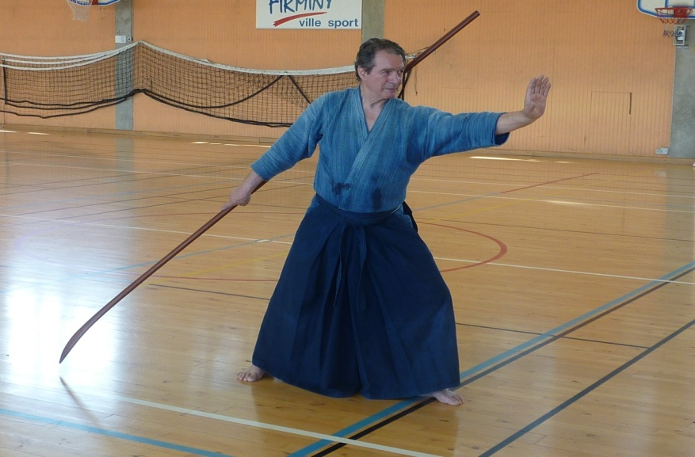
II. Stages of development – last hundred years in the West
II.1. Stage 1. Establishment of martial arts schools
In cultures of warriors (cultura militum, cultura militaris), this practical knowledge and skills gained special recognition, because they determined the life and death of a warrior.
Tenshinshoden katorishinto-ryu is the first school of classical bujutsu (15th century) - Japanese martial arts, which actually operates until today.

Slide 14
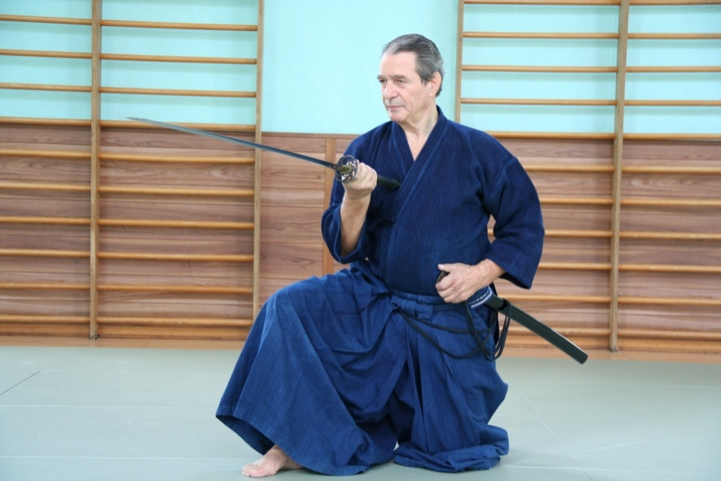
II.2. Stage 2. From the early martial arts into educational systems
From fighting skills, along with the development of warriors’ culture, martial arts matured into an educational systems.
"Big Three of Budo" (J. Kano – judo, G. Funakoshi – karatedo, M. Ueshiba – aikido) and kendo masters
higher goals and values ​​of the 'Warrior’s Pathway'
changes in combat sports
II.3. A and B
Stage 3A. Imported message - incomplete knowledge - filling in missing parts
New eclectic schools and their masters (self-proclaimed)

Slide 15
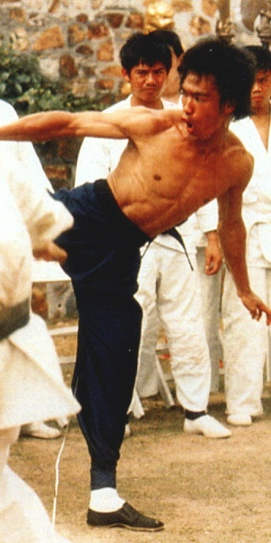
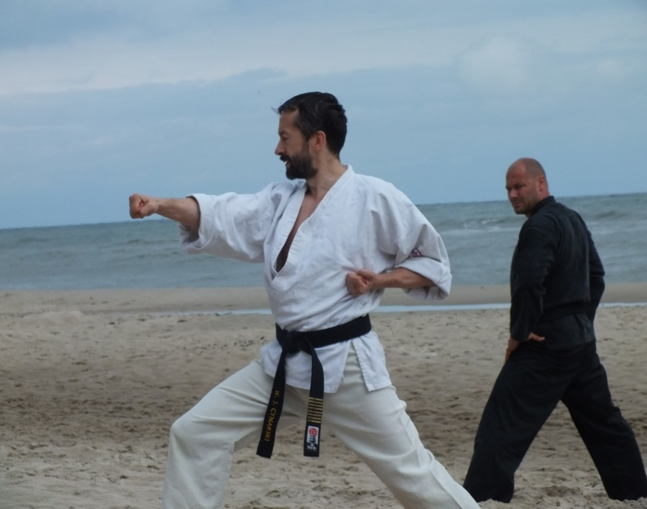
Stage 3B. Other changes and their causes
Combat systems had an eclectic form from the beginning.
Bruce Lee and his revolution
Modification, modernization, westernization - not always extorted incomplete knowledge.

Slide 16
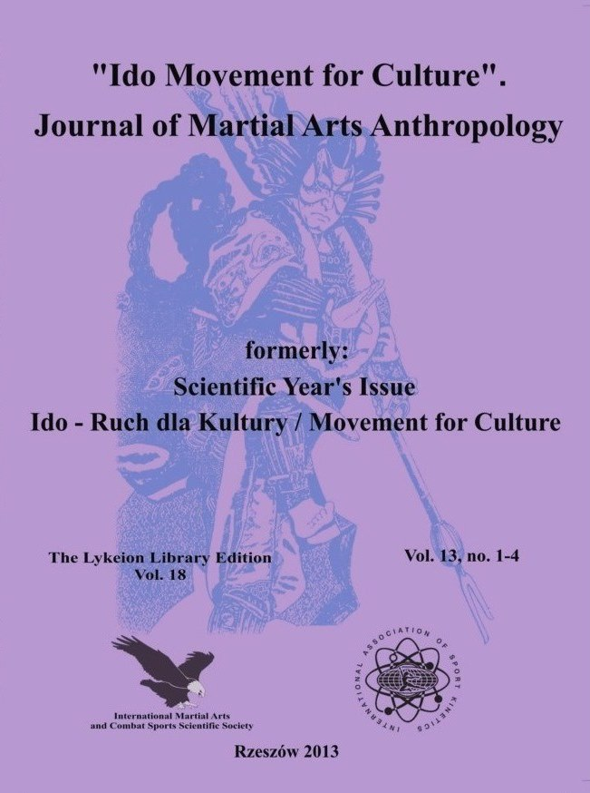
III. Martial arts and theatre, dance and film
connections between theater and martial arts in West Sumatra [Pauka 1998]
on general connections of martial arts with cinema and dance [Anderson 2001]
A way of an actor vs. a way of a warrior – a scientific session organized in Łódź (Poland), 4-5 of April, 2003.
Similarly to the theatre, Far-Eastern martial arts originate from (or they reflect strong connection with) magic and religious rituals.
It is possible to formulate here the chain of connections: magic – ritual – dance – theatre, and, further – the cinema and film.
Tokarski wrote also about the myth of Bruce Lee – “a kung-fu poet” who underwent a metamorphosis from a punk to a monk; from a strong fist lover to a seeker after the eastern way of ascetism [Tokarski 1989].
Archetypical heroes in the martial arts film
Actor of the ancient Japanese ‘no’ theatre is shown on the cover of “Ido Movement for Culture”.

Slide 17
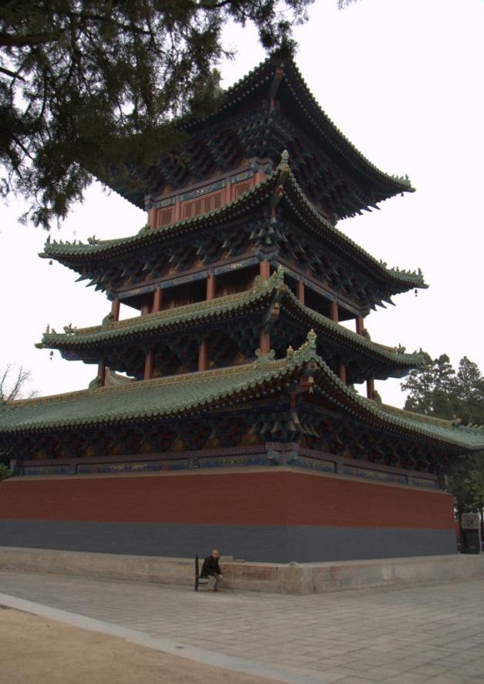
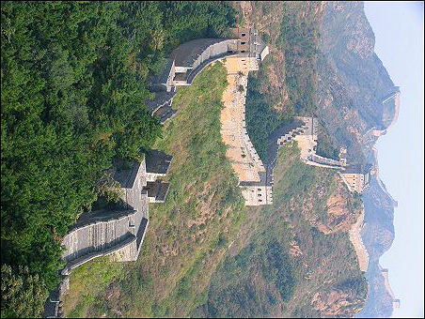
IV. Martial arts and religions or ideologies
Martial arts and religions (not only Buddhism in origin)
Shaolin temple, Taoistic and Shinto shrines, other
Budo and Japanese chauvinistic ideology (II world war)
Ideologisation today: ekologism [Brown, Jennings, Sparkes 2014], amorphous, eclectic New Age movement [Dole, Langone, Eichel 1990; Hanegraaf 1996; Heelas 1996; Jennings, Brown, Sparkes 2010], etc. …

Slide 18
V.Psychological, cultural-sociological, and educational aspects
The pedagogy of martial arts is an application of their philosophy or theory.
Dr Jigorō Kanō was one of the first, …
Taekwondo im Westen. Interviews und Beiträge zum kulturellen Schlagabtausch [Hartl, Faber, Bögle 1989]
USA – J. Donohue; M. Kennedy; B.P. Skott
Holandia – Ragna Zeiss – Sociology of Martial Arts
The sociology of martial arts as a separate sociological subdiscipline [Cynarski 2012a; Sanchez-Garcia, Spencer 2013].
Research from psychological perspective ... [Mercer 2011; Strayhorn, Strayhorn 2011; Vit, Reguli 2011]
VI.Symbolic dimension of Japanese budō and similar martial cultures
In the theoretical reflection we reach for selected concepts of symbolic culture and art, theory of archetypes and symbols, symbolism of Chinese and Japanese cultures.
VI.1. Symbolic culture and art; archetypes and symbols
‘symbolic language’ [Cassirer 1977]; ‘esthetic experience’ [Guiroud 1974]; ‘inner experience’ [Fromm 1977; Maliszewski 1996]; symbolic language of Fromm and Jung; …

Slide 19
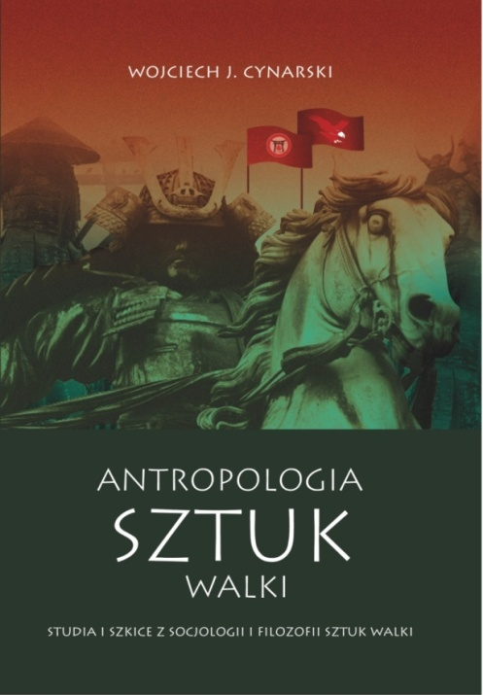
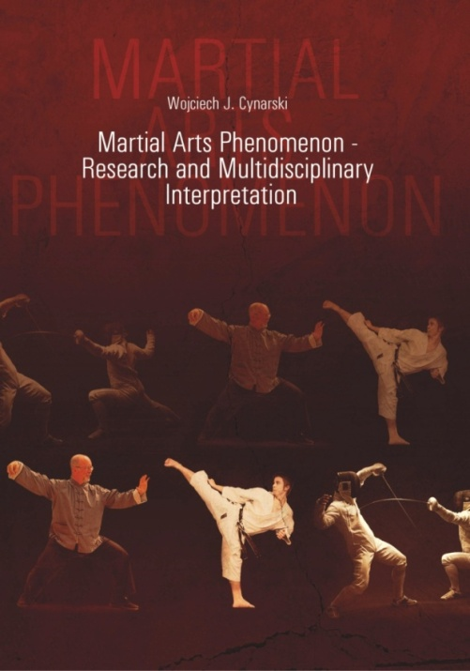
VI.2. Symbolic culture in budō
Old Chinese symbols (Tao, Yin-Yang, Fife Elements), the Sun and the Moon – the image of In – Yō powers, dragons
Symbols of bushi culture (chrysanthemum - kiku, sakura, sword, torii, tiger)
Other – mandala; tactics of a willow (yōshin-ryū) and elasticity (jūjutsu); dōjō

Slide 20
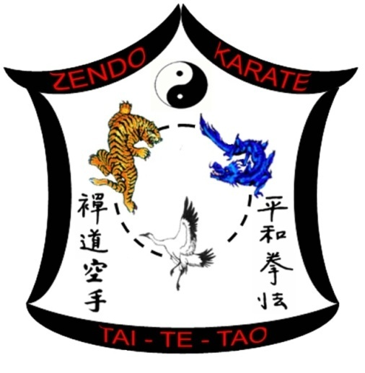
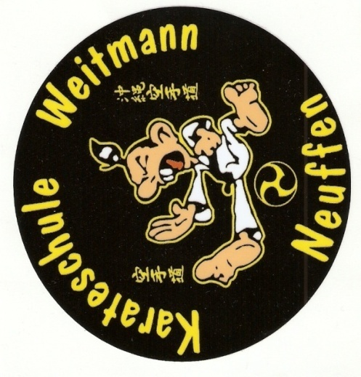
VI.3. Symbolism of classical schools of martial arts
tatsushi level with the features of a tiger (toranomaki); kyōshi and dragon (ryunomaki)
daitō-ryū school – four rhombuses or diamond (hardness) in an oval (softness, harmony);
takeda-ryū sobudō – Japanese national emblem ‘kiku’ with images of the sun and the moon (yin-yang elements)
VI.4. Symbolism of modern organizations of martial arts and combat sports
Old symbols of elitist knightly schools turn into labels of companies on the commercial market of service [Cynarski, Obodyński 2009].

Slide 21
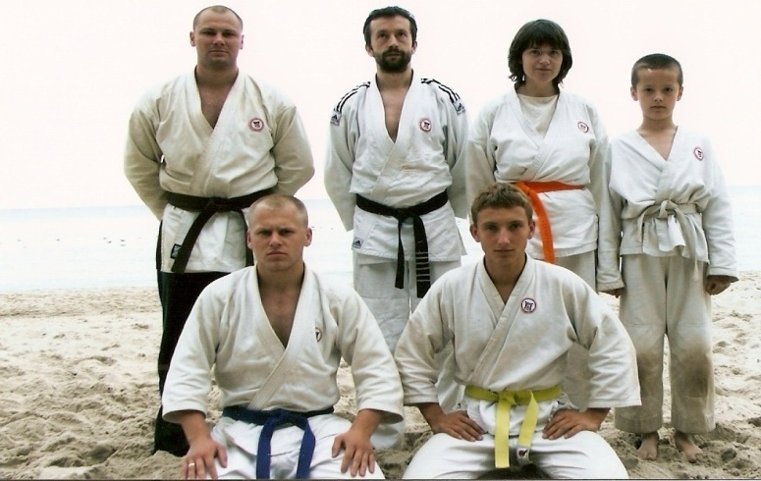
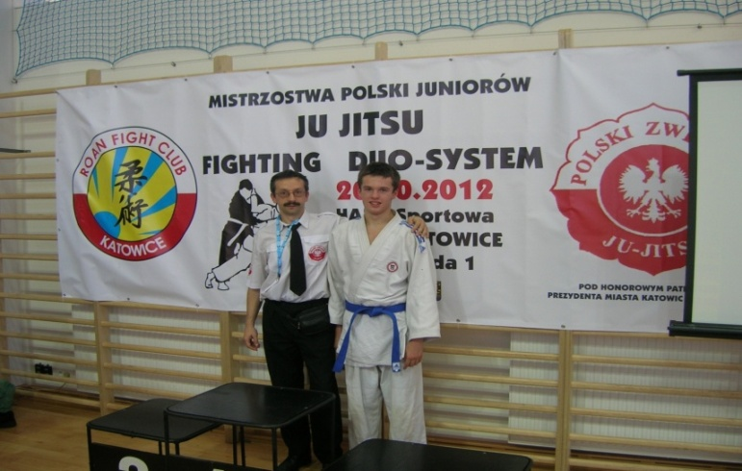
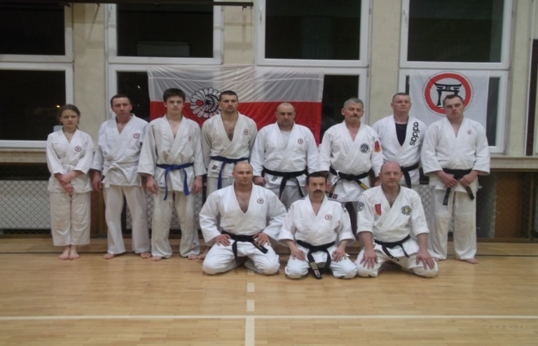
VII. Three special institutions
The Idōkan Poland Association (IPA) [www.idokan.pl]
Logo Idōkan Poland Ass. ®

Slide 22
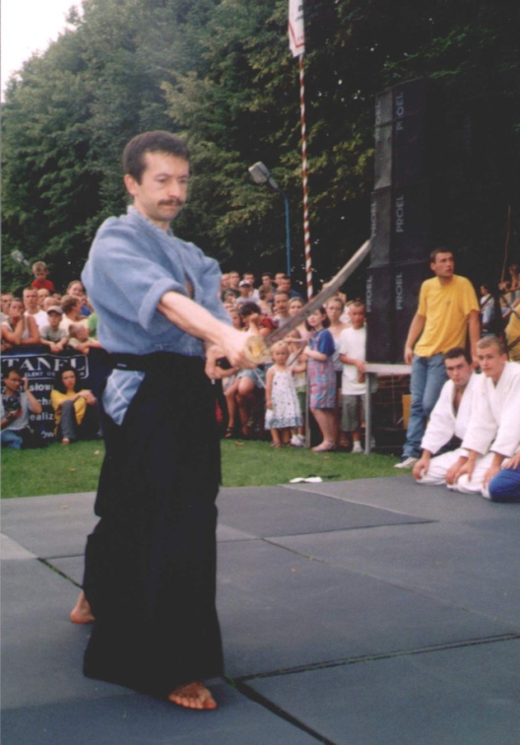
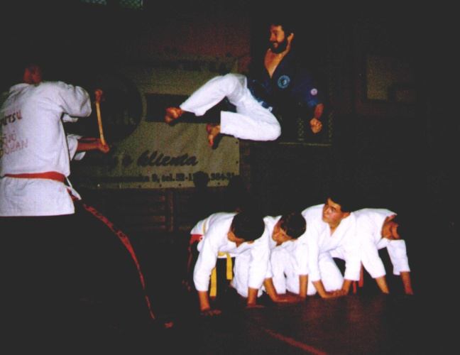
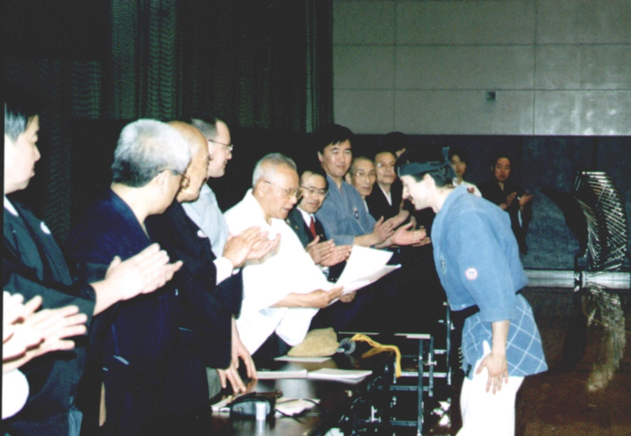
Yoko-tobi-geri. Jeden z licznych pokazów sztuk walki w Rzeszowie
II miejsce w karate i III m. w formach kobudo w MŚ IMAF, Tokio 2000
Pokaz iaido w Strzyżowie

Slide 23
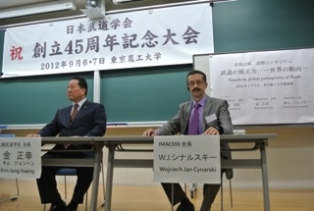
IMACSSS – the International Martial Arts and Combat Sports Scientific Society
[www.imacsss.com]

Slide 24
"Ido Movement for Culture. Journal of Martial Arts Anthropology"
under auspices of IMACSSS, International Association of Sport Kinetics, and with support of the University of Rzeszów, and Polish Ministry of Science
indexed e.g. in Elsevier Scopus. It has a global range [more: Cynarski, Reguli 2014].
See: www.idokan.pl

Slide 25
References
Abe I., Kiyohara K., Nakajima K. (1992), Fascism, sport and society in Japan, ”The International Journal of the History of Sport”, vol. 9, no. 1, pp. 1-28.
Acevedo W., Gutiérrez C, Mei Cheung (2010), Breve Historia del Kung-Fu, Nowtilus, Madrid [in Spanish].
Anderson A.D. (2001), Asian martial arts cinema, dance, and the cultural languages of gender, “Asian Journal of Communication, vol. 11, no. 2, pp. 58-78.
Brakel J.J. (1987), Thesaurus of Martial Arts, “International Bulletin of Sports Information”, vol. 8, no. 3-4, pp. 2–27.
Brizin D., Kernspecht K.R. (2014), Introduction to Combat Logic – A General Theory, "Ido Movement for Culture. Journal of Martial Arts Anthropology", vol. 14, no. 4.
Brown D.H.K., Jennings G., Molle A. (2009), Exploring Relationships between Asian Martial Arts and Religion, “Stadion”, no. 35, pp. 47–66.
Brown D.H.K., Jennings G., Sparkes A.C. (2014), Taijiquan the “Taiji World” Way: Towards a Cosmopolitan Vision of Ecology, “Societies”, vol. 4, no. 3, 380-398; doi: 10.3390/soc4030380
Campbell C. (2007), The Easternization of the West: A Thematic Account of Cultural Change in the Modern Era, Paradigm, Boulder, CO.
Cassirer E. (1977), Essay on Man, Czytelnik, Warsaw [in Polish].
Christofer C. (2006), Budo Belts and Ranks: The Forgotten Symbolism, „Fighting Arts”, www.fightingarts.com
Clausewitz C. v. (1999) [1832], W. von Seidlitz [ed.], Vom Kriege [On war. In German], Mundus, Essen.
Cynarski W.J. (2002), Mastery in Far-Eastern martial arts, „Sport Wyczynowy”, no. 1-2, pp. 96-106.
Cynarski W.J. (2004a), Theory and practice of Far-Eastern martial arts in European perspective [in Polish], Rzeszów University Press, Rzeszów.
Cynarski W.J. (2004b), Relationships of Far-Eastern martial arts with theatre, „Ido – Ruch dla Kultury / Movement for Culture”, vol. 4, pp. 256-261.
Cynarski W.J. (2006), Reception and internalization the ethos of martial arts by practicing persons, Rzeszów University Press, Rzeszów [in Polish].
Cynarski W.J. (2009), Martial Arts – Idō & Idōkan, IPA, Rzeszów.
Cynarski W.J. (2011), Teaching of fighting arts in pedagogical and sociological perspective, “Studia Sportiva”, vol. 5, no. 3, pp. 275-284.
Cynarski W.J. (2012a), Anthropology of Martial Arts. Studies and Essays of the Sociology and Philosophy of Martial Arts, Rzeszow University Press, Rzeszów. The Lykeion Library edition, vol. 16 [in Polish].
Cynarski W.J. (2012b), Martial Arts Phenomenon – Research and Multidisciplinary Interpretation, Rzeszow University Press, Rzeszów.
Cynarski W.J. (2013), General reflections about the philosophy of martial arts, “Ido Movement for Culture. Journal of Martial Arts Anthropology”, vol. 13, no. 3, pp. 1–6.
Cynarski W.J., Lee-Barron J. (2014), Philosophies of martial arts and their pedagogical consequences, “Ido Movement for Culture. Journal of Martial Arts Anthropology”, vol. 14, no. 1, pp. 11-19. doi: 10.14589/ido.14.1.2
Cynarski W.J., Litwiniuk A. (2004), A way of an actor vs. a way of a warrior, „Ido – Ruch dla Kultury / Movement for Culture”, vol. 4, pp. 436-439.
Cynarski W.J., Obodyński K. (2004), Ethos of martial arts in the movie at the beginning of the 21st century [in:] J. Kosiewicz, K. Obodyński [eds.], Sports involvement in changing Europe, PTNKF, Rzeszów, pp. 136-152.
Cynarski W.J., Obodyński K. (2009), The symbolic dimension of Japanese budō [in:] D.H. Jütting, B. Schulze, U. Müller [eds.], Local Sport in Europe, Waxmann, Münster-New York-München-Berlin, pp. 67-75.
Cynarski W.J., Obodyński K., Zeng H. (2012), Martial arts anthropology for sport pedagogy and physical education, "Romanian Journal for Multidimensional Education Lumen", vol. 4, no. 2, pp. 133-156.
Cynarski W.J., Reguli Z. (2014), Martial arts science institutionalisation: specialized scientific periodicals, “Ido Movement for Culture. Journal of Martial Arts Anthropology”, vol. 14, no. 1, pp. 54-62. doi: 10.14589/ido.14.1.5
Cynarski W.J., Sieber L. (2006), Training of martial arts – holistic concept, “Sport Wyczynowy”, no. 11–12, pp. 4–14.
Cynarski W.J., Skowron J. (2014), An analysis of the conceptual language used for the general theory of martial arts - Japanese, Polish and English terminology, "Ido Movement for Culture. Journal of Martial Arts Anthropology", vol. 14, no. 3, pp. 49-66. doi: 10.14589/ido.14.3.7
Dole A.A., Langone M.D., Eichel S.K.D. (1990), New Age Movement: Fad or Menace?, “Cultic Studies Journal”, vol. 7, no. 1, pp. 69–91.
Draeger D.F. (1973), The Martial Arts and Ways of Japan, vol. II: Classical Budo, Weatherhill, New York.

Slide 26
Dykhuizen J.C. (2000), Culture, training, and perception of the martial arts: Aikido example, “Journal of Asian Martial arts”, vol. 9, no. 3, pp. 9-31.
Eberhard W. (2001), Chinese symbols. Dictionary, Universitas, Kraków.
Eliade M. (1993), Treaty on History of Religion, Opus, Łódź [in Polish].
Figueiredo A.A. (2009), The object of study in martial arts and combat sports research – contributions to a complex whole [in:] W.J. Cynarski [ed.], Martial Arts and Combat Sports – Humanistic Outlook, Rzeszow University Press, Rzeszów, pp. 20-34.
Fromm E. (1977), Forgotten language, PIW, Warsaw [in Polish].
Goodger B.C., Goodger J.M. (1977), Judo in the light of theory and sociological research, “International review of Sport Sociology”, vol. 12, pp. 5-34.
Green T.A., Svinth J.R. [eds.] (2010), Martial Arts in the World: An Encyclopedia of History and Innovation, ABC-Clio, Santa Barbara (CA).
Grossman E. (1998), Towards a semiosis of the martial arts: Aikido as a symbolic form of communication, “Journal of Asian Martial Arts”, vol. 7, no. 2.
Grzegorz R., Walendowicz M. (2008), The History of Ju-Jitsu in Poland 1904-1939, International Modern Ju-Jitsu Federtion, Głogów.
Guiroud P. (1974), Semiology, Warsaw [in Polish].
Habersetzer R. (2005), „Code of the colors” and Mental Blockings, Communication no 3 of the Tengu Institute, http://perso.orange.fr/karate-crb/couleurs, s. 1-4.
Hanegraaf W.J. (1996), New Age Religion and Western Culture: Esotericism in the Mirror of Secular Thought, Brill, Leiden.
Harasymowicz J. (2011), Tradition of physical exercises and martial arts in actors' education, “Arch Budo”, vol. 7, no. 2, pp. 65-71.
Heelas P. (1996), The New Age Movement: The Celebration of the Self and the Sacralization of Modernity, Blackwell, Oxford.
Jennings G., Brown D.H.K., Sparkes A.C. (2010), It Can Be a Religion If You Want: Wing Chun Kung Fu as a Secular Religion, “Ethnography”, vol. 11, no. 4, pp. 533–557.
Jirásek I., Hopsicker M. (2010), Philosophical kinanthropology (philosophy of physical culture, philosophy of sport) in Slavonic countries: the culture, the writers, and the current directions, “Journal of the Philosophy of Sport”, no. 37, pp. 253-270.
Jones D.E. [ed.] (2002), Combat, Ritual, and Performance. Anthropology of the Martial Arts, Praeger, Westport, CT.
Jung C.G. (1976), Archetypes and symbols. Selected writings, Czytelnik, Warsaw [in Polish].
Kalina R.M. (2000), Theory of Combat Sports, COS, Warsaw [in Polish].
Kano J. (1932), The contribution of Jiudo to education, “Journal of Health and Physical Education, no. 3, pp. 37-40, 58.
Kauz H. (1977), The Martial Spirit: An Introduction to the Origin, Philosophy and Psychology of the Martial Arts, The Overlool Press, New York.
Kernspecht K.R. (1988), Vom Zweikampf. Strategie, Taktik, Physiologie, Psychologie und Geschichte der waffenlosen Selbstverteidigung, Burg-Fehmarn [in German].
Kernspecht K.R. (2011), Kampflogik, Vol. 3: Die Praxis des Treffens & Nicht-getroffen-Werdens, EWTO-Verlag [in German].
Kim D., Back A. (2000), The Way do Go: Philosophy in Martial Arts Practice, Nanam, Seoul.
Klens-Bigman D. (2002), Toward a theory of martial arts as performance art [in:] D.E. Jones [ed.], Combat, Ritual, and Performance. Antropology of the Martial Arts, Praeger, Wesport, Connecticut – London, Westport, Connecticut – London, pp. 1-10.
Kosiewicz J. (2007), Philosophy of physical culture in Poland, “Idō – Ruch dla Kultury / Movement for Culture”, vol. 7, pp. 11-37.
Lee-Barron J.R. (2011), The Complete Martial Arts Instructor. A Manual of Teaching Martial Arts Effectively and Safety, Lulu Publishing, Morrisvile, NC.
Levine D.E. (1991), Martial arts as a resource for liberal education: The case of Aikido [in:] M. Featherstone [ed.], The Body: Social Process and Cultural Theory, Sage, London, pp. 209-224.
Light R.L. (2014), Mushin and learning in and beyond budo, "Ido Movement for Culture. Journal of Martial Arts Anthropology", vol. 14, no. 3, pp. 42-48. doi: 10.14589/ido.14.3.6
Lind W. (1999), Lexikon der Kampfkünste, Sportverlag Berlin [in German].

Slide 27
Maliszewski M. (1996), Spiritual Dimensions of the Martial Arts, C.E. Tuttle Company, Rutland-Tokyo.
Maroteaux R.J., Cynarski W.J. (2002-2003), On philosophy of Japanese martial arts – questions and answers, „Ido – Ruch dla Kultury / Movement for Culture”, vol. 3, pp. 48-55.
Matsunaga H. et al. (2009), Budo: The Martial Way of Japan, Nippon Budokan, Tokyo.
McFarlane S. (1990), Mushin, morals, and martial arts – a discussion of Keenan’s Yogacara critique, “Japanese Journal of Religious Studies, vol. 17, no. 4, pp. 397-420.
Mercer J. (2011), Martial arts research: weak evidence, “Science”, no. 334 (6054), pp. 310-311.
Mintz M.D. (1978), The Martial Arts Film, A.S. Barnes and Company, South Brunswick and New York, Thomas Yoseloff Ltd., London.
Mol S. (2001), Classical Fighting Arts of Japan; A Complete Guide to Koryū Jūjutsu, Kodansha International.
Neumann U., Saldern M. von, Pöhler R., Wendt P.-U. (eds.) (2004), Der friedliche Krieger. Budo als Methode der Gewaltprävention, Schüren, Verlag Marburg [in German].
Newman W. (2005), Escrima,WuShu-Verlag Kernspecht, Burg/Fehmarn [in German].
Ohms C. [ed.] (1997), Frauen Kampfkunst, Orlanda Fraeunverlag, Berlin [in German].
Pauka K. (1998), Theater & Martial Arts in West Sumatra: Randai & Silek of the Minangkabau, Ohio University Press, USA.
Pérez-Gutiérrez M., Gutiérrez-García C., Escobar-Molina R. (2011), Terminological Recommendations for Improving the Visibility of Scientific Literature on Martial Arts and Combat Sports, “Archives of Budo”, vol. 7, no. 3, pp. 159–166.
Raimondo S. [ed.] (2007), Vibrazioni nella Forza. Storia critica delle discipline orientali, Persport, Edizioni la Meridiana, Molfetta [in Italian].
Reguli Z. (2009), Taxonomy of combatives as it is seen from Tyrš tradition in the Czech Republic, „Ido – Ruch dla Kultury / Movement for Culture”, vol. 9, pp. 38–43.
Renninghoff J., Witte F. (1998), Jujutsu – Training. Das Modell des Budosport-Trainings, Sport Verlag, Berlin [in German].
Sanchez-Garcia R., Spencer D.C. [eds.] (2013), Fighting Scholars : Habitus and Ethnographies of Martial Arts and Combat Sports, Anthem Press.
Shishida F., Flynn S.M. (2013), How does the philosophy of martial arts manifest itself? Insights from Japanese martial arts, “Ido Movement for Culture. Journal of martial Arts Anthropology”, vol. 13, no. 3, pp. 29-36.
Sieber L., Cynarski W.J., Litwiniuk A. (2007), Spheres of fight in martial arts, ”Archives of Budo”, vol. 3, no. 3, pp. 42-48.
Simpkins C., Simpkins A. (2007), Confucianism and the Asian Martial Traditions, “Revista de Artes Marciales Asiáticas”, vol. 2, no. 2, pp. 46–53.
Stanley C.I. (1999), The Science of Martial Arts Training, Multi-Media Books, Orange, CA.
Strayhorn J.M., Strayhorn J.C. (2011), Martial arts research: prudent skepticism, “Science”, no. 334 (6054), pp. 310-311.
Sun A. (2013), Confucianism as a World Religion: Contested Histories and Contemporary Realities, Princeton University Press, Princeton, NJ.
Szyszko-Bohusz A. (1989), The Holistic Pedagogy, Ossolineum, Wrocław [in Polish].
Szyszko-Bohusz A. (2003), Theory of Genetic Immortality in Relation to Holistic Pedagogy and Far-Eastern Martial Arts [in:] W.J. Cynarski, K. Obodyński [eds.], Humanistic Theory of Martial Arts and Combat Sports – Conceptions and Problems, Rzeszów University Press, Rzeszów, pp. 17-23.
Tokarski S. (1989), Martial arts. Movement forms of expression of the Eastern philosophy, Glob, Szczecin [in Polish].
Vit M., Reguli Z. (2011), Motivation and value orientation of combative systems trainers, "Ido Movement for Culture. Journal of Martial Arts Anthropology", vol. 11, no. 3, pp. 52-59.
Westbrook A., Ratti O. (1970), Aikido and the Dynamic Sphere: An Illustrated Introduction, C.E. Tuttle, Vermont.
Wolters J.M., Fuβmann A. [eds.] (2008), Budo – Pädagogik. Kampf-Kunst in Erziehung, Therapie und Coaching, Ziel – Praktische Erlebnispädagogik, Augsburg [in German].
Yi Duk-moo, Park Je-ga (2000), Muye Dobo Tongji. Comprehensive Illustrated Manual of Martial Arts. By order of King Jungjo, transl. by Sang H. Kim, Turtle Press, Hartford.
Zeng H.Z., Cynarski W.J., Lisheng Xie (2013), Martial Arts Anthropology, Participants’ Motivation and Behaviours. Martial Arts in Chanshu: Participants’ Motivation, Practice Times and Health Behaviours, Lambert Academic Publishing, Saarbrücken.
Znaniecki F. (1934), The Method of Sociology, New York.
Zygmunt S. (1998), From Bruce Lee to van Damme. Lexicon of films (CD-ROM, Ed. Wiedza i Życie), no 1.
And Internet sources:
www.idokan.pl
www.imacss.com

Slide 28
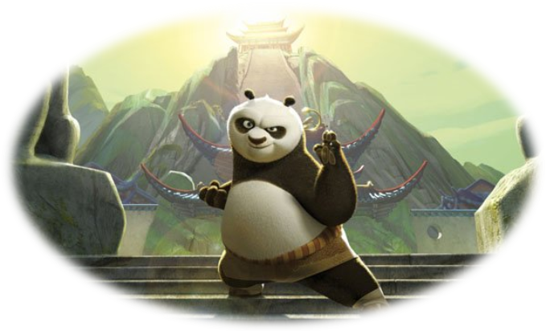
Thank you very much for your attention.
UNIWERSYTET RZESZOWSKI

