Slide 1
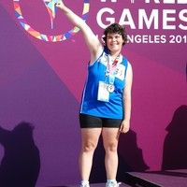
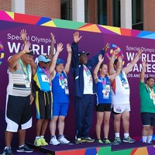

Slide 2


Philosophy of the Special Olympics in the Network of the Olympic Games

Slide 3
Olympic Games
World known phenomenon
In CZ: General population
- spectators, TV fans
- Incentive of olympic parks,
- Commerce,
- Etc, etc

Slide 4
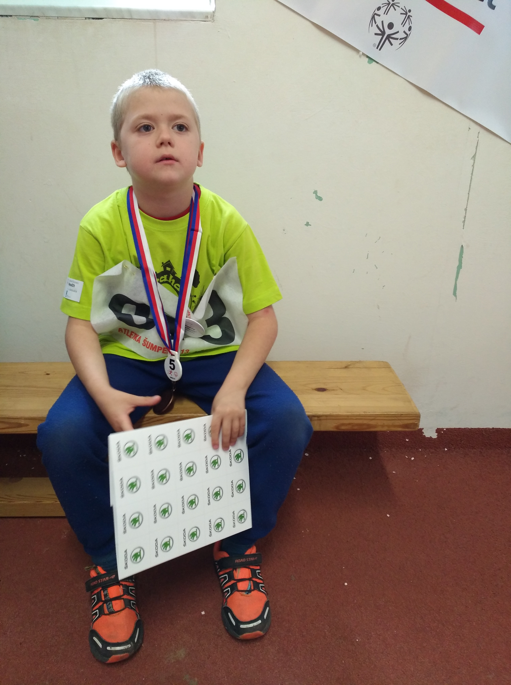
Pierre de Coubertin
WHAT IS OLYMPICS NETWORK ???

Slide 5



José Antonio Samaranch
Paralympics – PD – Sir Ludwig Guttmann
1960 // 1988
Deaflympics - HD - board 1924
Special Olympics - MD/ID - 1968
1988
Notes:
•

Slide 6
Network - according time

Slide 7
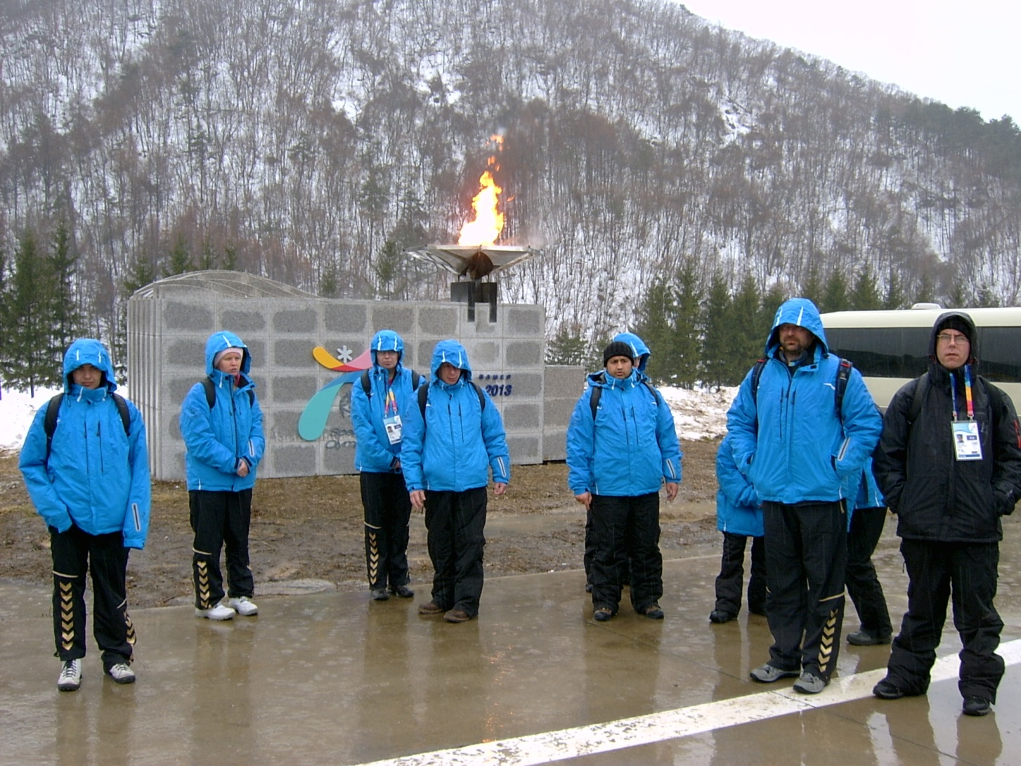

Slide 8
General principles
Participation on the basis of the minimum disability level rules;
- Fair play behavior and compliance with the Charter on Ethics in Sport;
- The four-year cycle for summer and winter games;
- Logo and branding, not identical to the OG ;
- Ceremonies: Olympic Torch, opening – closing – promises of the athlete's and referee‘s ;
- Awarding ceremonies based on the principle either normality or relativity;
- Accompanying cultural or educational programs.

Slide 9
PARTICIPATION
The principle of the minimal disability level
- PD - functional classification. The role of the classificators
- HD - minimum 55dcb loss on a "better“ ear
- VD - B1, B2, B3
- MD - (Inas II & SO) IQ lower than 75 p.
Long-term discussion
Ethical problem

Slide 10
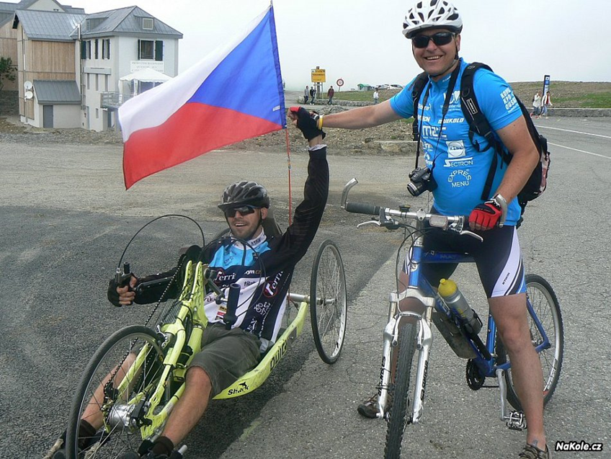
Principles:
NORMATIVE - relative
"normative" approach :
PARA - BLIND - DEAF - Inas II
limits,
exclusion,
winners (3),

Slide 11
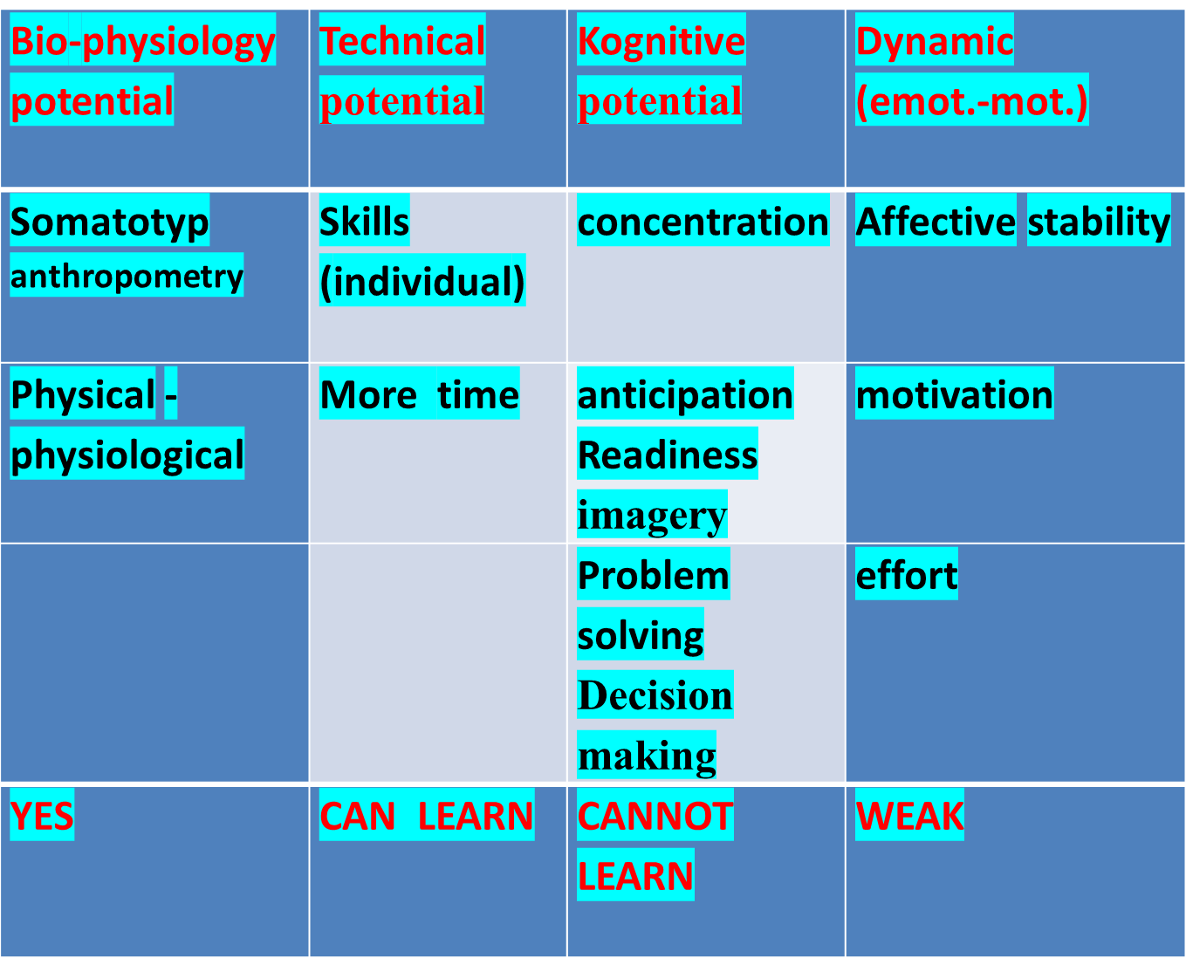

Slide 12
SO Philosophy
1. SO – for all participants of different diagnosis, intensity or origin of mental disability
2. Olympic sport or modifications, „divisioning” related to abilities
3. Awarding ceremony for everybody in final
4. Criteria for Athlete Advancement: previous competition and random draw
5. No fee, no material award
6. Athletes are not representatives of country but – SO national program
7. Obligation of SO: development of official complimentary programs

Slide 13
Principles: normative - RELATIVE
Special Olympics: the formation of the final groups based on the results from the qualification, which is one day or two before the final. There is no normative exclusion here, but everyone goes into the final with respect to gender, age and achievement (divisioning).
Discussion: MER principle of maximum effort rule

Slide 14
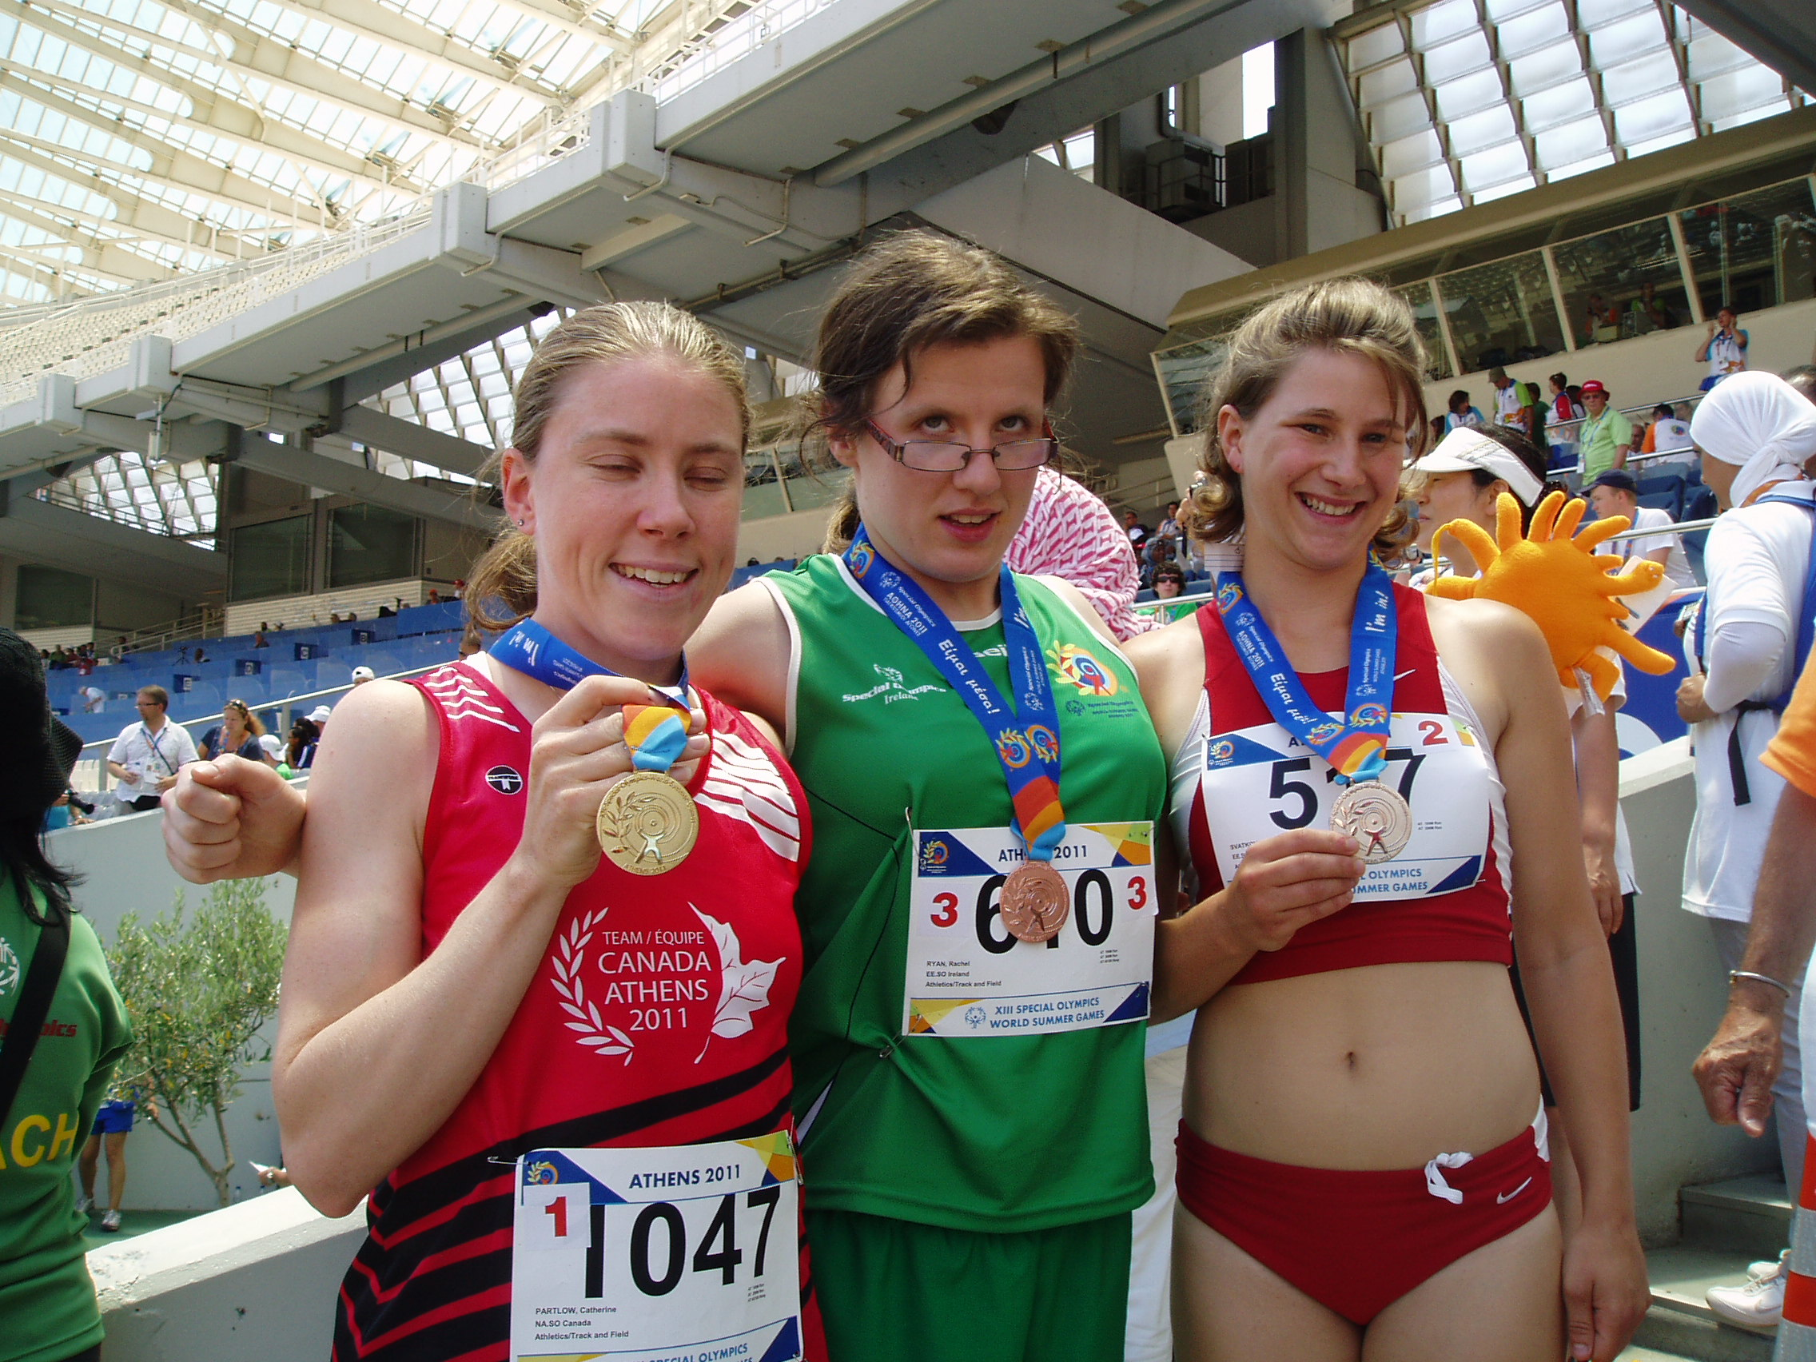
Olympic sports
Olympis sports – international rules

Slide 15
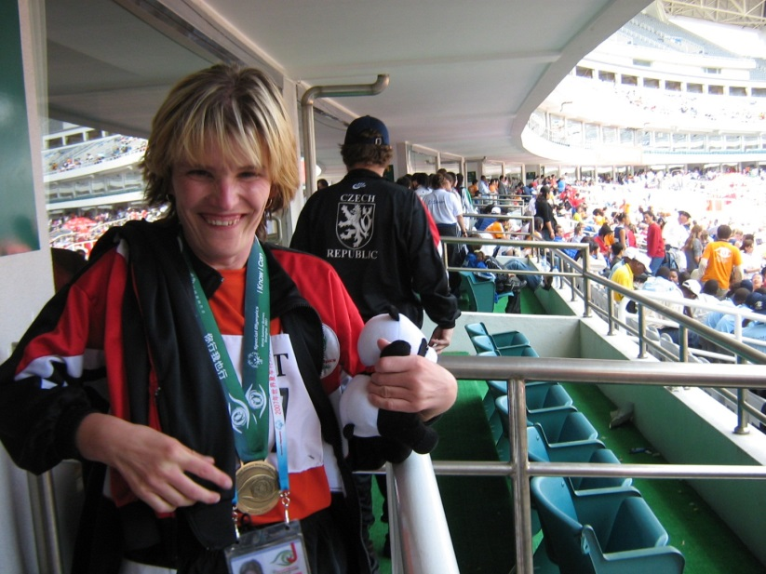
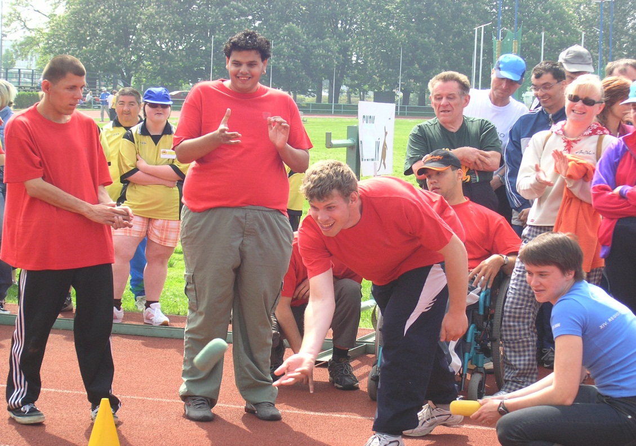
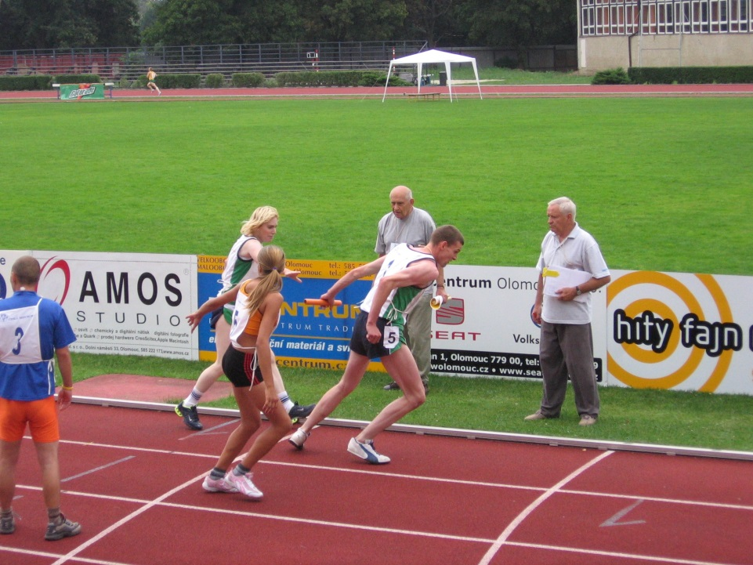

Slide 16
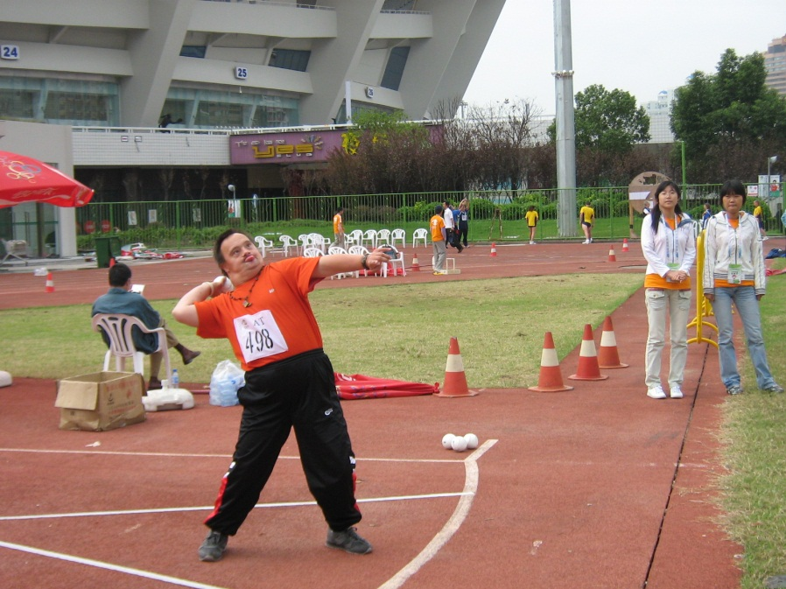
Olympics - modification
Olympic sport – events (50m walk, mini-javelin, softball throw, floorhockey, etc)

Slide 17
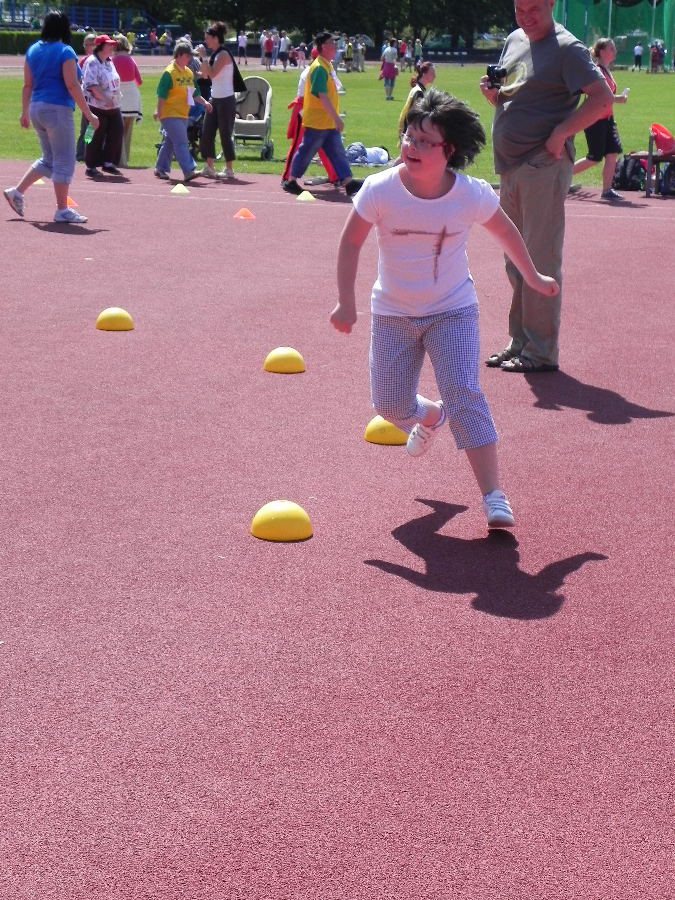
MODIFICATIONS 2
Adapted sports // events - based on simply motor tests, 2 tasks maximum

Slide 18
Unified sports
Athletes – partners
video

Slide 19
Restrictions
relating to competitions
No fees for participation
No connections with tobacco & alcohol producers
No smoking & drinking during competitions
No national flags
No commercial messages

Slide 20

50 years anniversary in 2018
CZ SO based on volunteering
- 9 summer – 4 winter sport (adapted – team)
- Coaches – volunteers education
- Connection with universities (6 in official agreement)
- Healthy Athlete programs
– Healthy Community

Slide 21
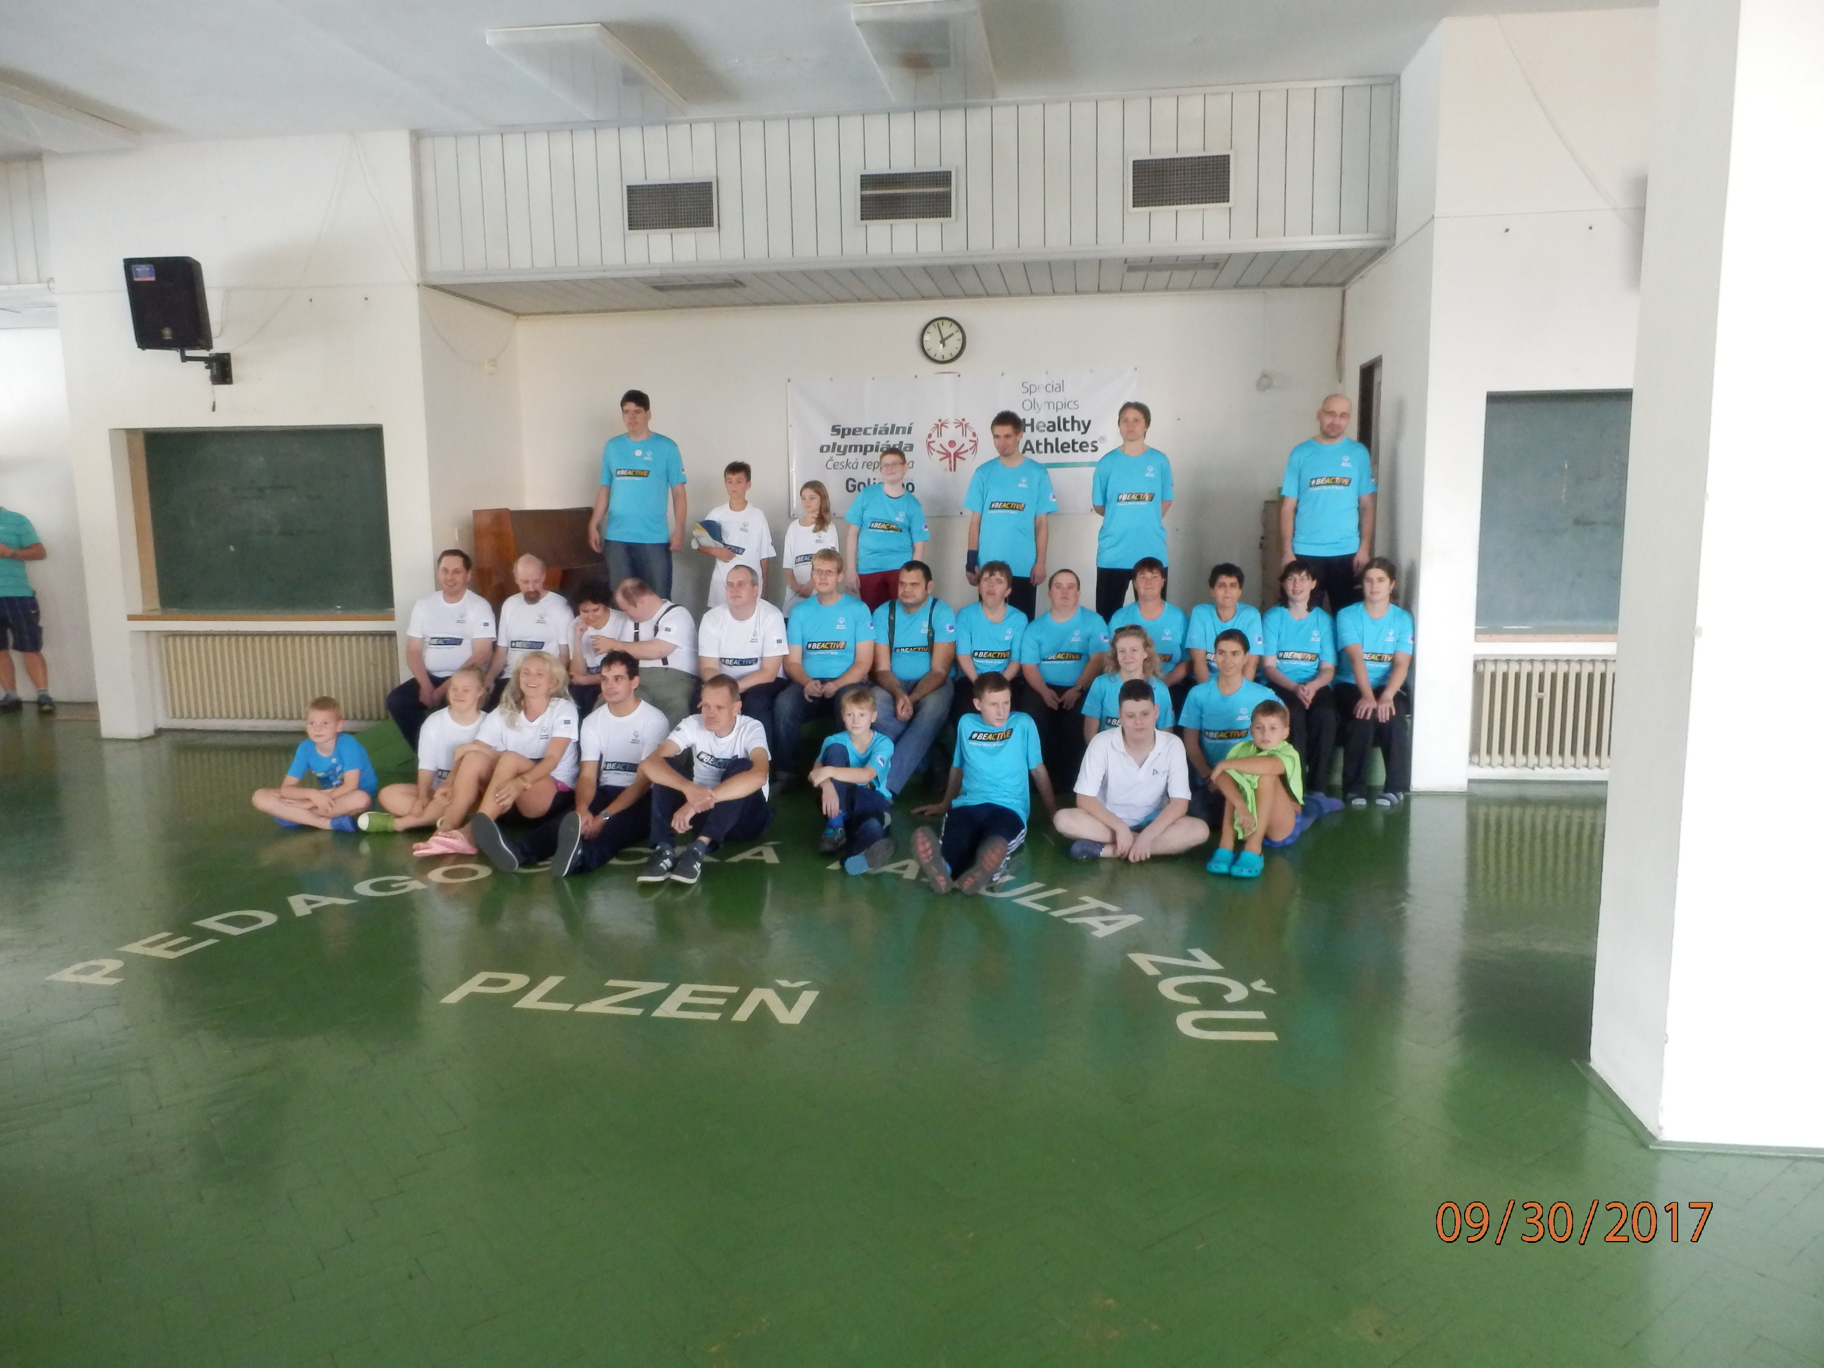

Slide 22
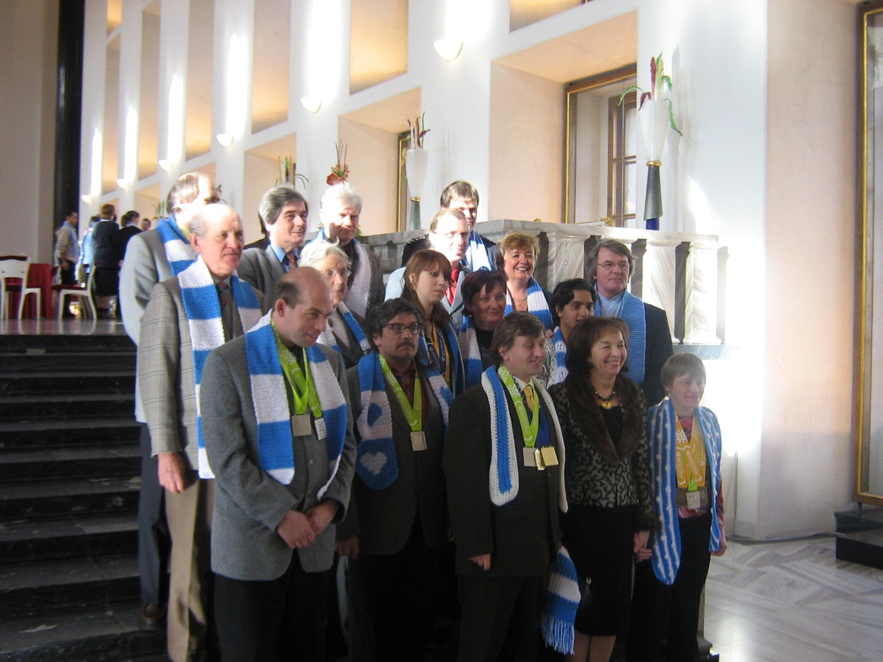
Thank you !
2003 Dublin - video

