Slide 1
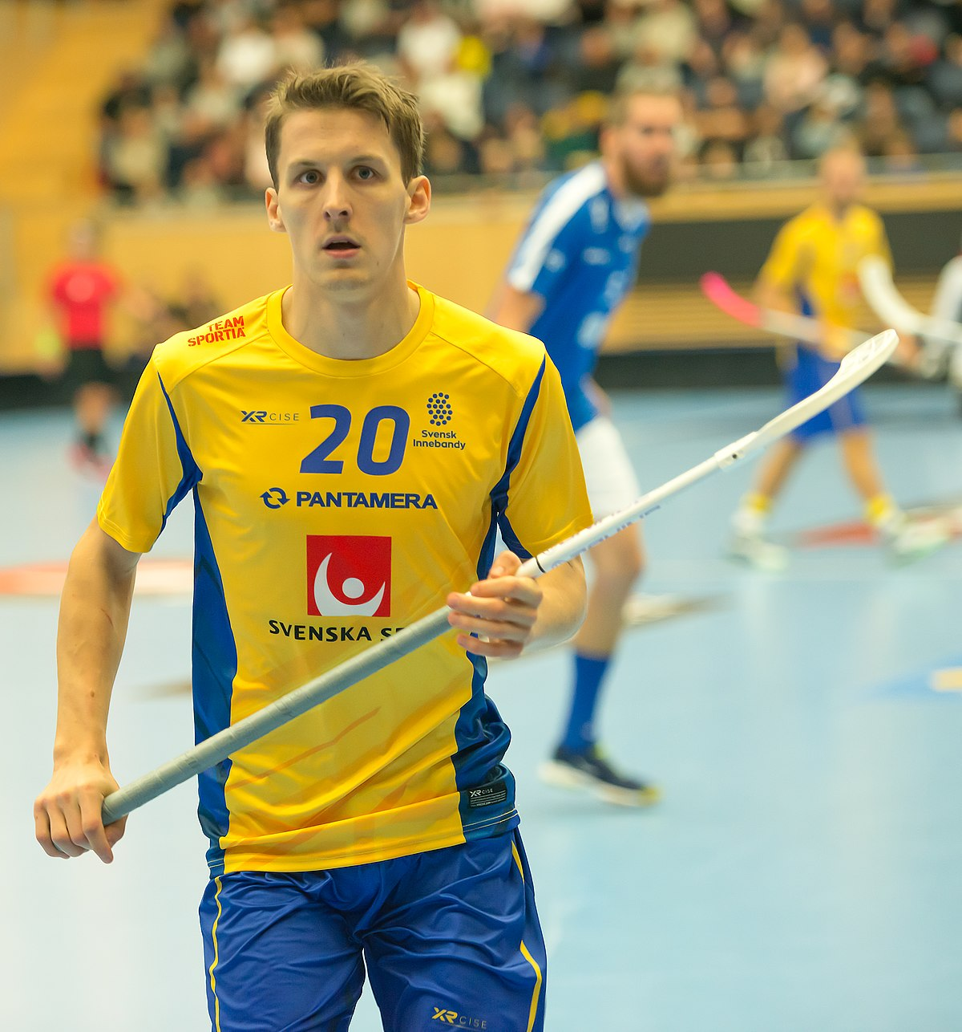

FLOORBALL
Bruna Branco UCO 506275
Joana Santos UCO 506290

Slide 2
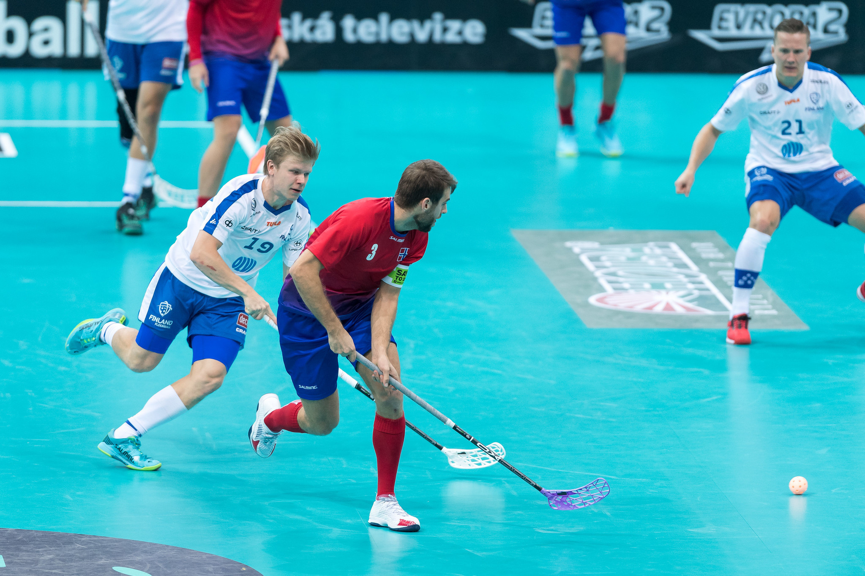
WORLDWIDE SPORT
Floorball is a fast and entertaining sport and the development has been amazingly quick. Since the first Floorball federation was founded in Sweden, the sport has spread all over the world and is now played in over 80 countries out of which close to 75 countries currently are members of the International Floorball Federation (IFF).
The largest number of players can be found in Northern Europe, Switzerland and Czech Republic, but the sport has already spread around the whole world. Floorball is played in Europe, Asia, Australia, North America, South Africa and Africa and is constantly spreading to new countries, who are eager to take up this fascinating sport.

Slide 3
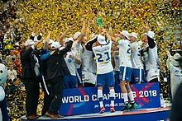
history
In various forms the game has been played since the early 20th Century in Canada as a recreational sport, especially in high school gymnasiums, as a playful variant of hockey, where the sticks got their form from the hockey game. Most Canadian males born in 1950s and before could attest to this. Similarly, durng the 1950s and 1960s many public school systems within Michigan incorporated floorball into their primary and secundary school gym classes. Later, Americans claimed to have invented it, and held interstate tournaments in the 1960s. The game was formally organized as na international and more organised sport in the late 1970s in Gothenburg, Sweden. The sport began as something that was played for fun as a pastime in schools. After a decade or so, floorball begn showing up in Nordic countries where the former schoolyard pastime was becoming a developed sport. Formal rules soon were developed, and clubs began to form. After some time, several countries developed national associations, and the IFF was founded in 1986.
The game of floorball i also known by many other names, such as salibandy (in Finland), innebandy (in Sweden and Norway), and unihockey (in Switzerland and Ireland).
Despite being red, Mars is actually a cold place full of iron oxide dust

Slide 4
BENEFITS OF FLOORBALL
Floorball is a sport which is easy to start playing. No big investment in the equipment is needed and it is possible to start playing with only shoes and a stick. No previous experience is required either, the players develop quickly and almost everyone can learn the basic skills of the sport and have fun while playing.
Floorball can be played by anyone. A great benefit is that the physical factors of the player do not decide how good the player is. The speed of the player is not everything, since the ball still moves faster, giving space also for analytical players. Another great benefit of Floorball is that it can be played almost everywhere and even in quite extreme surroundings such as the beach, snow, ice or even the swamp.

Slide 5
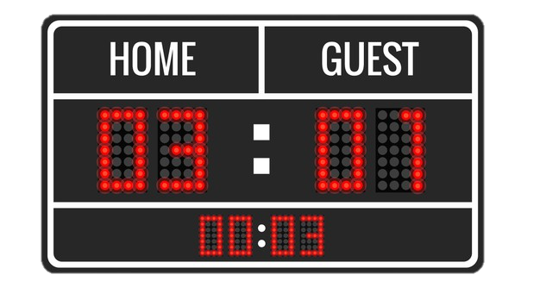
GAME TIME
The game time can vary depending on the age of players and the level of the match. In official matches the game time is 3 x 20 minutes effective time. During tournaments and in matches with young players other game times can be used, for example 2 x 15 minutes.
Despite being red, Mars is actually a cold place full of iron oxide dust

Slide 6

RULES
Floorball is a sport which everybody can take part in and the rules encourage quick and technical play. When offences are made, free hits are given for the opponents and if offences are bad enough penalties are given. Players can be sent off for two, five, or ten minutes or for the rest of the game, depending on the severity of the offence. A penalized player is not allowed to leave the penalty bench area, until their penalty time has finished.
It is not allowed to:
hit, block, lift or kick an opponent’s stick;
push, tackle or obstruct the opponent;
play the ball above the knee level with the stick;
raise the blade above waist level when hitting the ball;
jump up and stop the ball;
play the ball with your stick between the opponent’s legs.
Despite being red, Mars is actually a cold place full of iron oxide dust

Slide 7

FLOORBALL EQUIPMENT
The basic equipment of a field player includes a stick, shoes and clothes suitable for playing. The goalkeeper has a helmet, goalkeeper pants, a jersey and protective gear. Is also strongly recommends the use of protective eye wear and for the junior players (under 18) the use eye protection is mandatory.
Despite being red, Mars is actually a cold place full of iron oxide dust

Slide 8
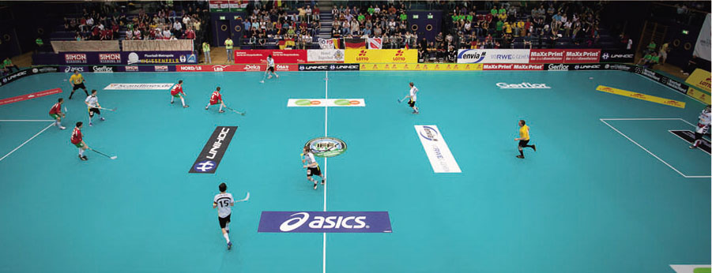
THE RINK AND THE GOAL
The rink is built from a series of connected boards, made of either wood or a plastic material. In many places floorball is also played three versus three without a goalkeeper in small rink using small goals. On the International competition level, the rink size has from the beginning been 40 x 20 m and the goal size is 160 x 115 cm. The rules allow all rink sizes between 36 x 18 m and 44 x 22 m, as long as the rink formula is length = 2 x width. A fully equipped rink includes also markings on the floor. Two goalkeeper areas, the center line, the center spot and the other six face-off dots shall be marked on the floor. Both goals are surrounded with the goal area of 4 x 5 meters and inside the goal area there is a smaller goalkeeper area of 1 x 2,5 meters, where only the goalkeeper can operate.

Slide 9
COMPETITIONS
In addition to the Floorball World Championships, there are other IFF Events for club teams such as the Champions Cup which is for the national competition winners from the Top-4 ranked nations, and the EuroFloorball Cup for the national competition winners from the 5th and lower ranked nations. There are also many international floorball club competitions.
Asia Pacific Floorball Championship
Canada Cup
Champions Cup
USA Cup
EuroFloorball Cup
NAFC - North American Floorball Championship
Czech Open

Slide 10
References
https://en.wikipedia.org/wiki/Floorball
https://www.floorballplanet.com/category/WHATIS_FB.html
http://www.floorball.org/Materiaalit/learn-start-play.pdf
Despite being red, Mars is actually a cold place full of iron oxide dust

Slide 11
Video links
https://www.youtube.com/watch?v=6Thy6-kPj3Q&ab_channel=IFFFloorball-Channel1
https://www.youtube.com/watch?v=TVVBDLo3QpI&ab_channel=NinhLy
https://www.youtube.com/watch?v=MpNV9aNTOxY&ab_channel=Falk%26Garnett

Slide 12


THANKS!

