Slide 1
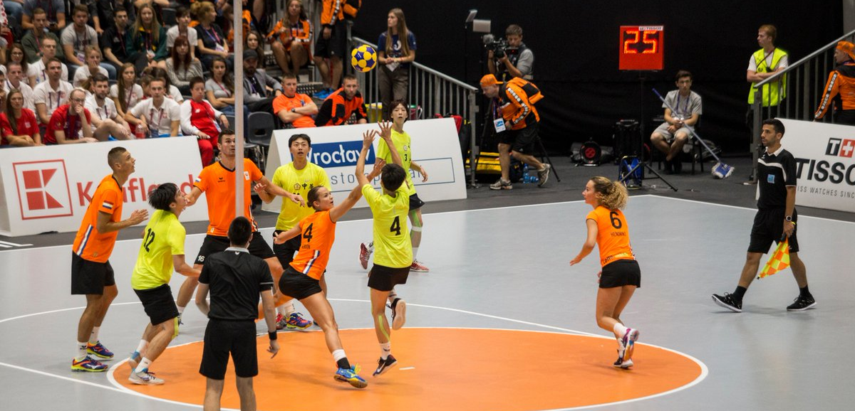
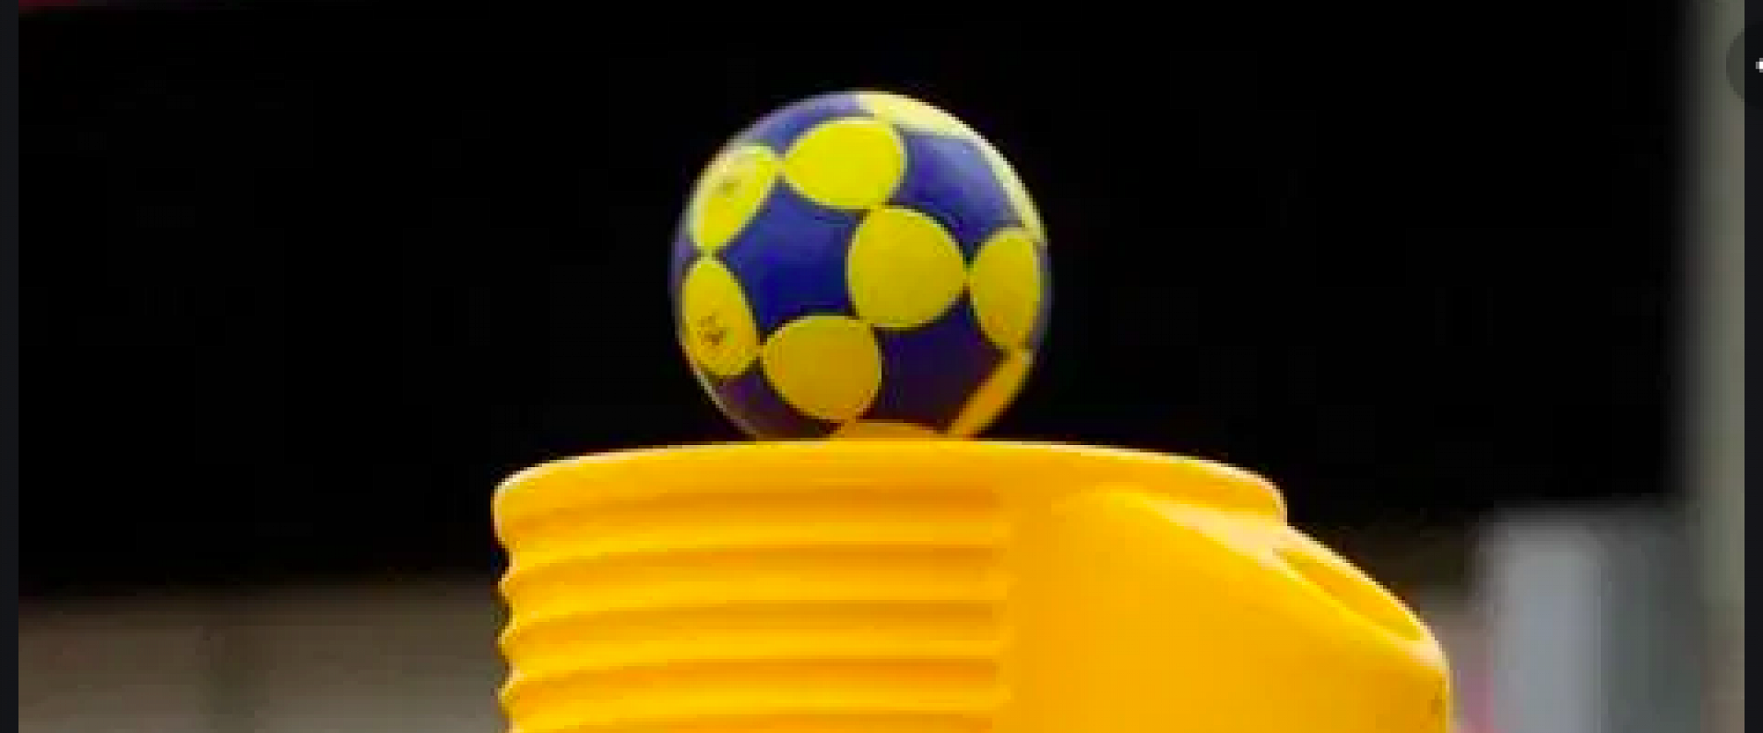

KORFBALL
Course: Nontraditional Games
Presentation by : Ivan Karuc
Davor Kuna

Slide 2
Content of presentation
What is korfball?
History
Basic rules and regulations of the game
Kinesiology of korfball
Movement structures
Popularity of korfball in the World
Fun facts
References

Slide 3
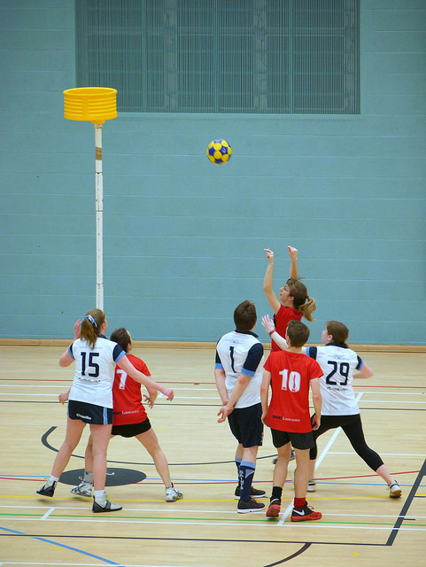
What is korfball?
Korfball (Dutch: korfbal) is a ball sport with similarities to netball and basketball. It is played by two teams of eight players with four female players and four male players in each team. The objective is to throw a ball into a netless basket that is mounted on a 3.5 m (11.5 feet) high pole.
https://www.youtube.com/watch?v=lnNSU4kbVvI

Slide 4
History of korfball
Korfball was invented by Dutch school teacher Nico Broekhuysen in 1902.
Nico Broekhuysen got inspired by ,,ringboll’’ when he was in Sweden. Ringboll is Swedish game in which one could score points by throwing the ball through a ring that was attached to a 3 m pole
When Nico came back to Netherlands, he replaced the ring with a basket ( Korf means basket in Dutch) and also replaced some rules from ringboll and after that korfball was born in Netherlands

Slide 5
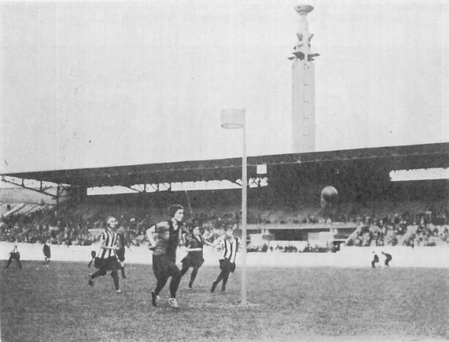
Korfball was criticized back in the days, because both sexes were included in the game
The oldest non-emerged club in history of korfball is H.K.C. ALO
H.K.C. ALO is Dutch club from Hague which was found in 1906.
The International Korfball Federation was
founded in 1933 in Antwerp, Belgium
Korfball match
(as a part of Olympic demonstration sports)
at the 1928 Summer Olympics in Amsterdam

Slide 6
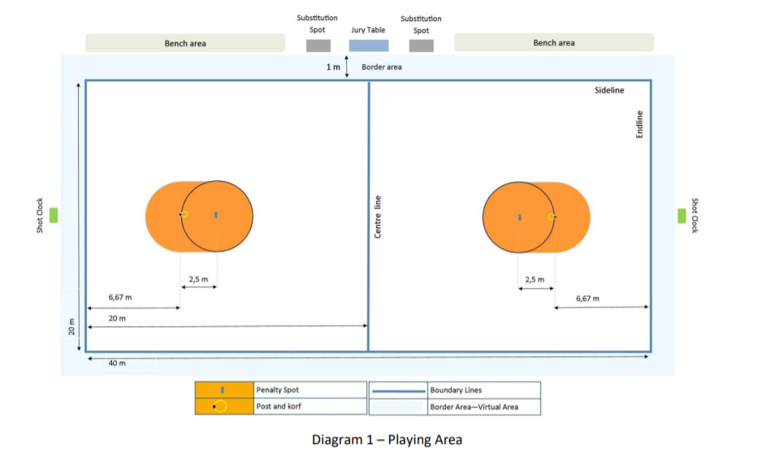
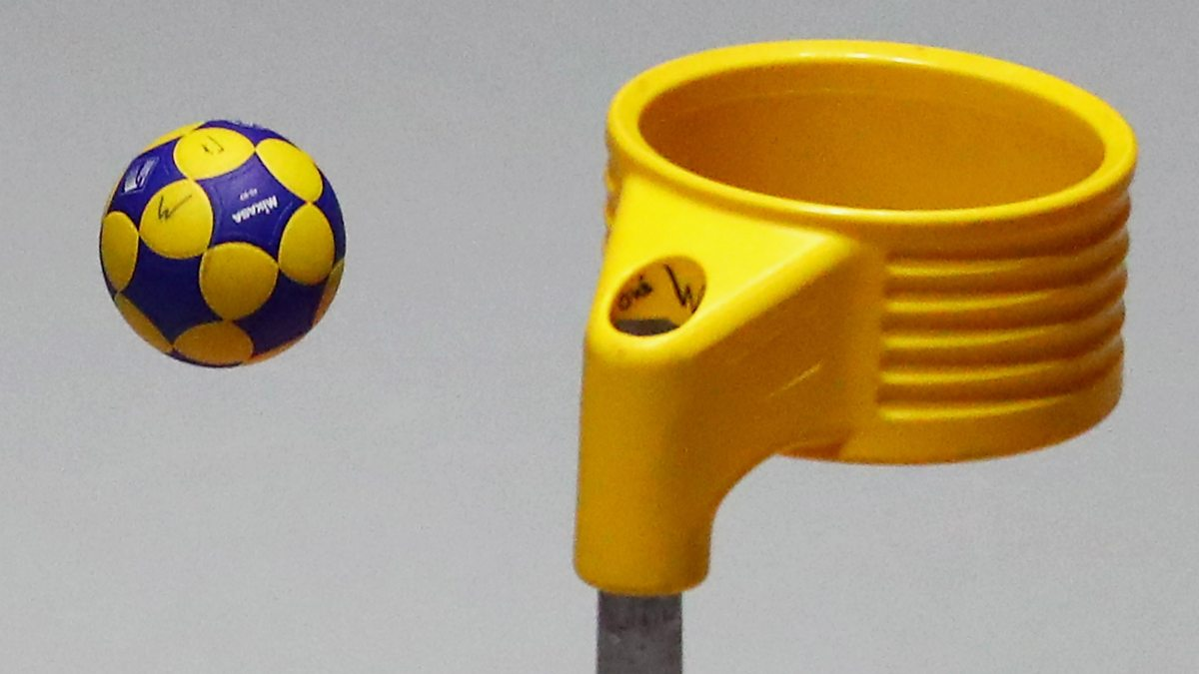
Basic rules and regulations of the game
The size of the court is 20m x 40m(it can be played indoor or outdoor)
The court is divided into two halfes which are called ,,zones’’
In each ,,zone’’ there is 3.5m pole with a basket at the top of it
Each ,,team’’ consists of 8 players: 4 male and 4 female players

Slide 7
Basic rules and regulations of the game
A match is played in two halves of 25 minutes of real playing time and each half is divided in two equal periods by a technical time-out of a one minute break.
Four players of each team are in one zone and the other four are in the other zone. Within each zone, a player may only defend a member of the opposite team of the same gender.
It is not allowed to dribble, kick or walk with ball
There is not much physical contact allowed (no tackling, blocking..)
The team with the most goals (points) at the end of the match is declared as a winner. If the score at the end is same, the game is declared as draw

Slide 8
Kinesiology of korfball
Korfball is sport with both aerobic and anaerobic energy systems involved, so it develops cardiovascular system and it increases anaerobic capacity
It has impact on developing motor abililites such as coordination, speed & agility
It is team sport, so it combines cognition with movement

Slide 9
Movement structures in korfball
The game consists of different movements structures which are done in offense (with or without ball) and in defense
Usually there are a lot of passes, different types of shots ( running in shot, standing shot, penalty shot..), changes of direction and defensive movements without ball
The game is dynamic, so ball movement and player movement is very important

Slide 10

Standing shot

Slide 11

Running in shot

Slide 12
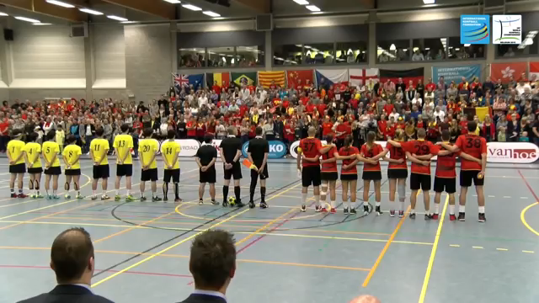
Example of real game

Slide 13
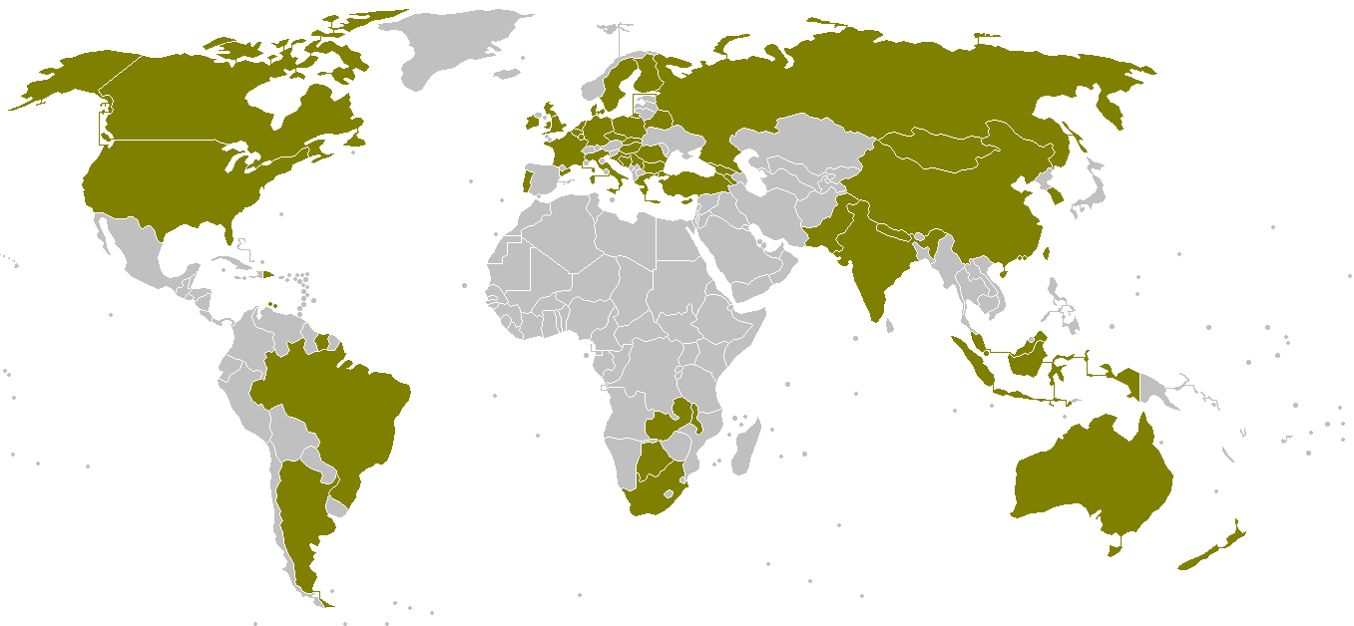
Popularity of korfball in the World
It is officially played in 69 countries (5 continents) including Czech Republic
It is most popular in Netherlands, Belgium, China, Taiwan..
In Netherlands there are more than 500 clubs and more than 90 000 people playing it
Countries-members of the International Korfball Federation

Slide 14
Fun facts
There is a korfball klub in Brno
Besides usual korfball, beach korfball is also played in some countries
Joy In Leeuwarden (We Are Ready) is the song by Half Man Half Biscuit which sings about korfball
In history, women which played korfball were criticized because of showing bare knees and ankles

Slide 15
References
https://korfball.sport/wp-content/uploads/2017/09/The-Rules-of-Korfball-2020.pdf (official rules of korfball 2020.)
https://www.rulesofsport.com/sports/korfball.html
https://en.wikipedia.org/wiki/Korfball
https://korfbalbrno.cz/korfbal/historie-korfbalu/

Slide 16
If you have any questions about korfball, don’t hesitate to ask as on:
karucivan1@gmail.com or davor.kuna97@gmail.com
THANKS FOR YOUR TIME AND DON’T FORGET TO
WATCH KORFBALL ONLINE :D

