Slide 1

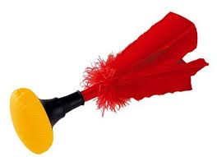
INDIACA
Karla Kožić & Eva Kočiš

Slide 2
What is indiaca?
Indiaca is a form of the Brazilian game ‘peteca’ popular in Europe.
This hybrid of Volleyball and Badminton is played with a giant shuttlecock (sort of a ball with feathers on it ) goes by many names.
indiaca can be played between two players facing eachother, or by small teams

Slide 3
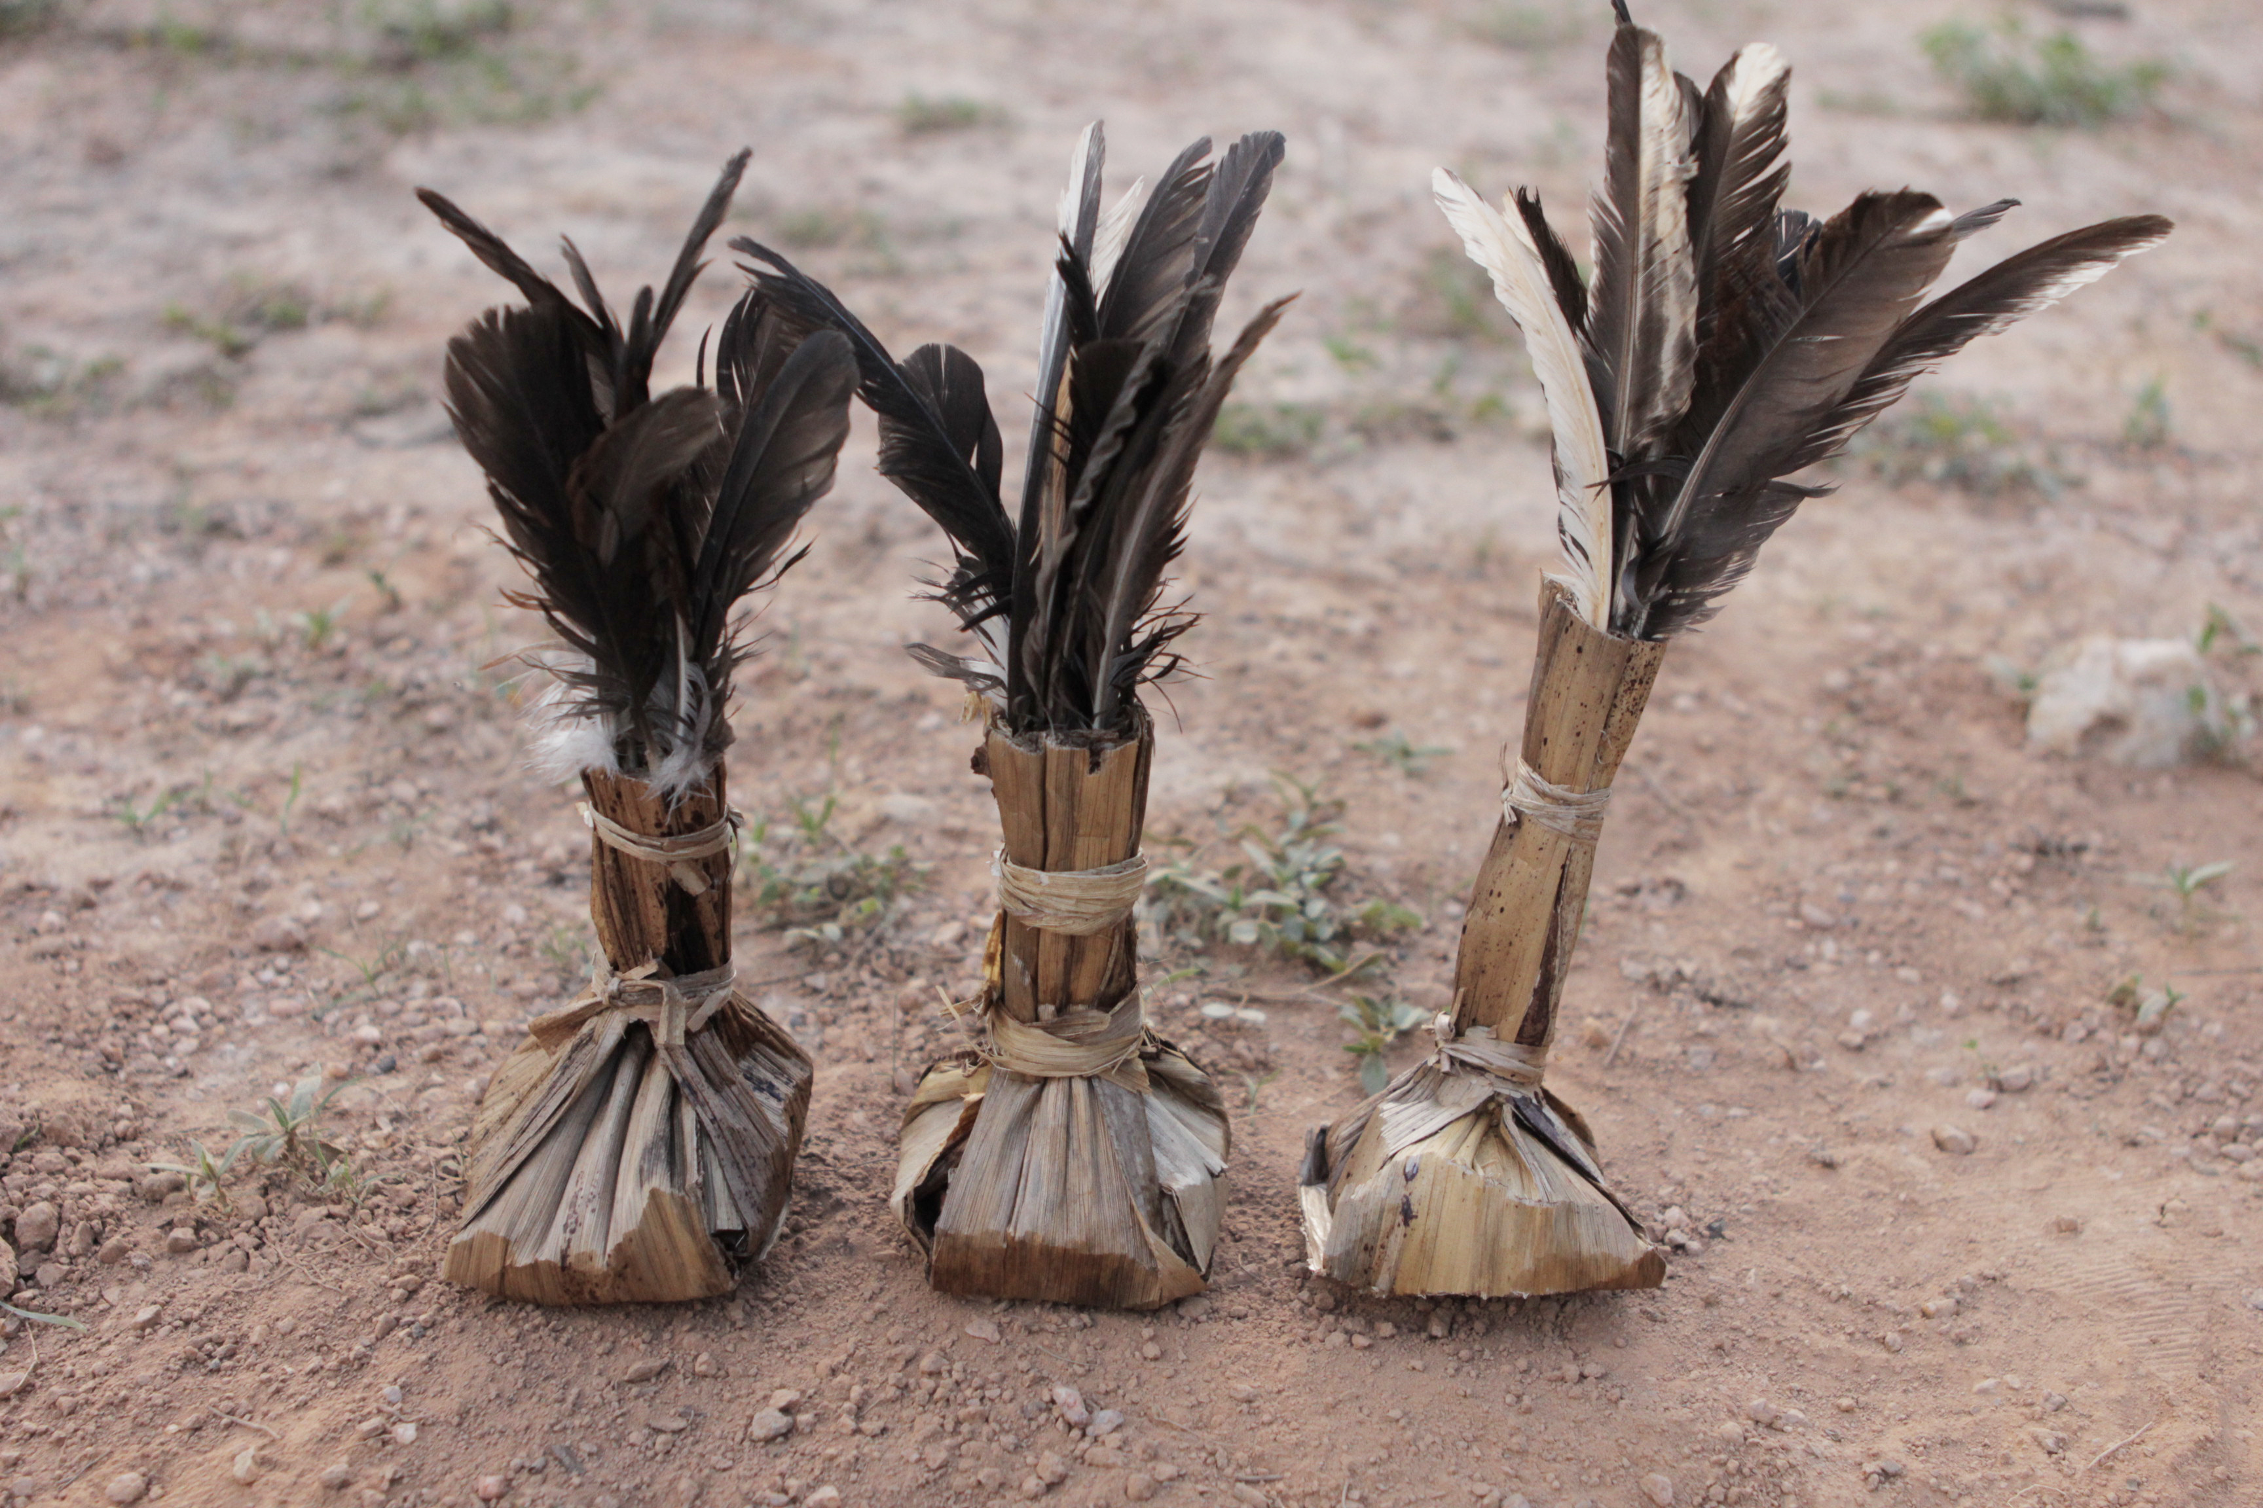
History
Records showed that in the past Indiaca was practiced by native Brazilian Indians as a recreation, even before the Portuguese arrived. This was passed successively through generations in Brazil.

Slide 4
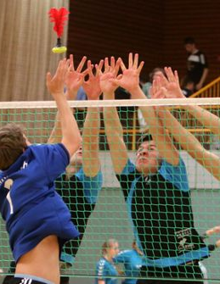
Rules
Indiaca is played on court across a net with similar rules to volleyball.
Instead of a ball, a large shuttlecock, sometimes also called an indiaca, or featherball is used; and it is controlled using the hands.

Slide 5
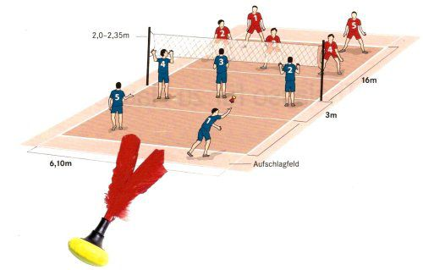

Slide 6
Playing area
The free playing space shall measure a minimum of 6 meters in height from the playing surface.
All lines must be of light color, clearly marked and different from the colorof the floor and from any other lines
The playing court is a rectangle measuring 16x 6,10 meters.

Slide 7
The net height in IIA competitions has to be:
Youth category
Men:215 cm
Women:205 cm
Mixed:210 cm2
Junior category
Men:225 cm
Women:215 cm
Mixed:220 cm
Open Category (no age limit)
Men:235 cm
Women:220 cm
Mixed:225 cm
Senior category (40+)
Men:225 cm
Women:210 cm
Mixed:215 cm
Height of the net
(some information that can be useful if you want to play with your friends or kids at school)

Slide 8
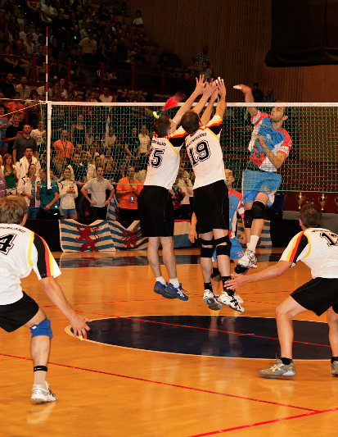
Teams
In competitions there must be 5 players on court at the moment of the service. Special Rules may authorize a team to play with only 4 players
In mixed category, teams must have at least 2 male and 2 female players on the court

Slide 9
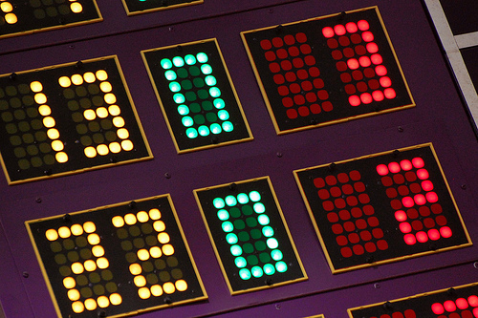
How to score a point?
A team scores a point:
1. by successfully grounding the ball on the opponent’s court.
when the opponent team commits a
fault.when the opponent receives a penalty
A match is won by the team that, according to rules ofthe concrete competition:
wins 2 sets in a best of three sets game.
wins 3 sets in a best of five games.

Slide 10
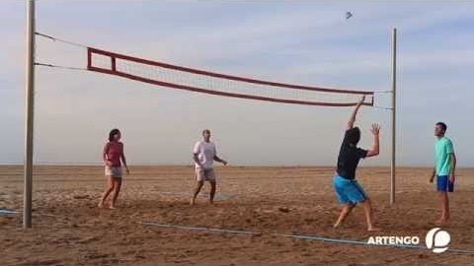
How to play?

Slide 11

And now you will learn how to play step by step

Slide 12

Lesson 1: service

Slide 13
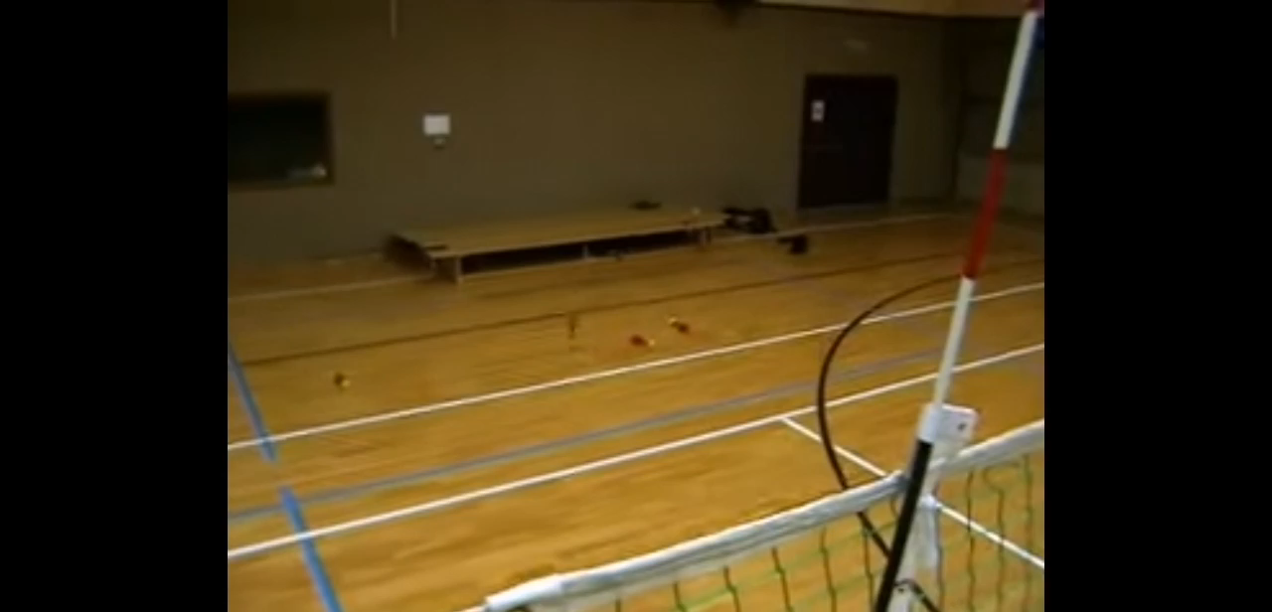
Lesson 2: pass

Slide 14
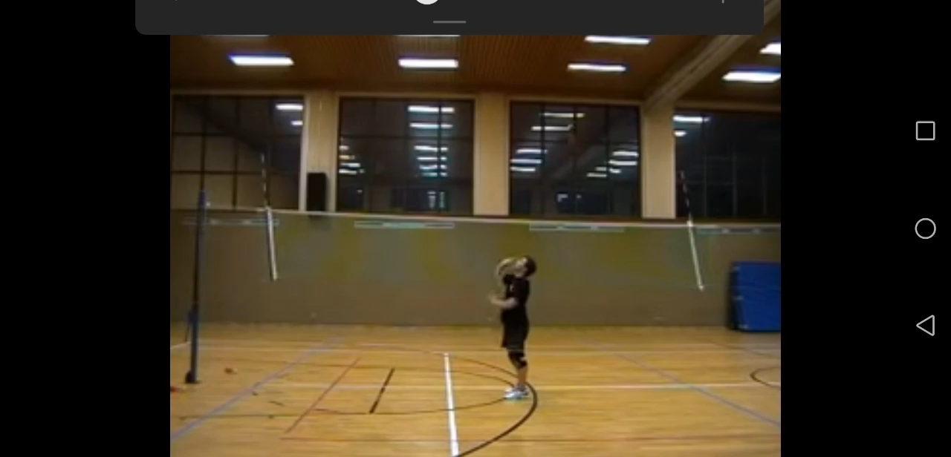
Lesson 3: attack

Slide 15
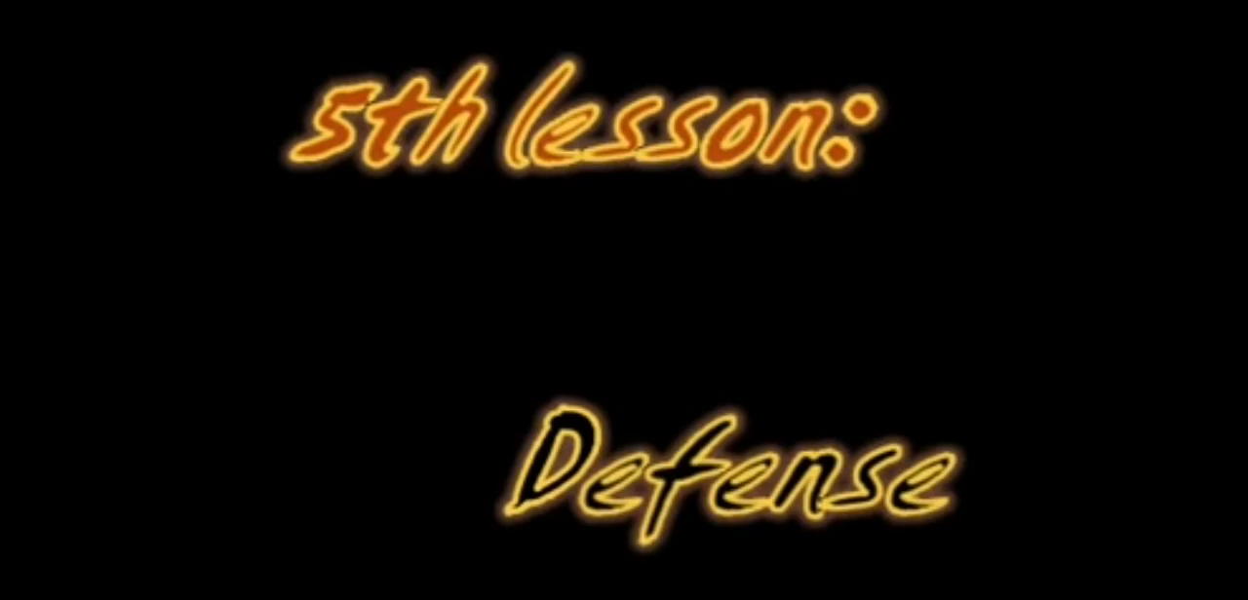
Lesson 4: defence

Slide 16
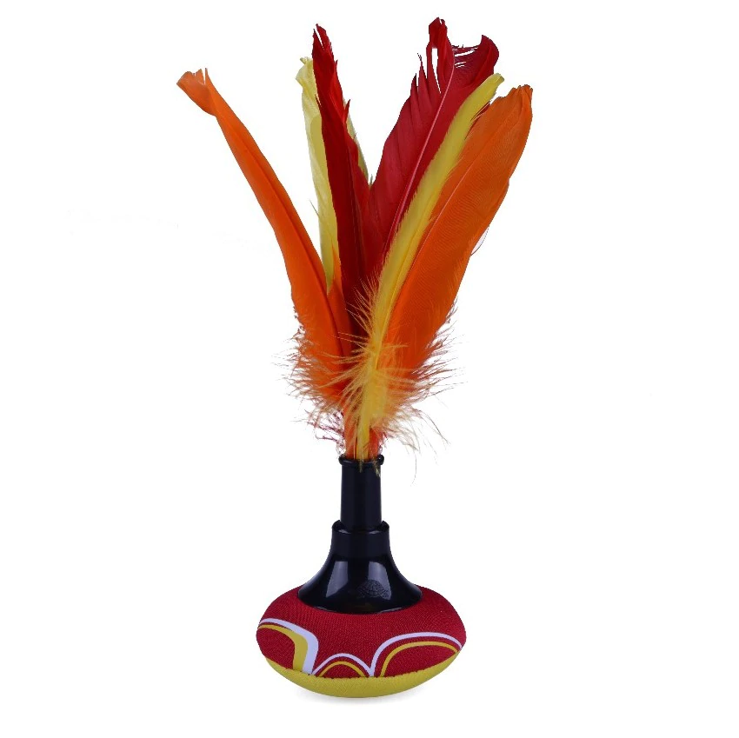
Dear colleauges, hope you learned something new and interesting and you will have fun playing indiaca.

Slide 17

Thanks for watching
Stay safe and happy

Slide 18
References
International indiaca association: http://www.indiaca-iia.com/technical-matters/indiaca-rules/
Wikipedia: https://en.wikipedia.org/wiki/Indiaca
Videos are from this link: https://youtu.be/34rJl5XzJjk

